Slide 1

Exploratory Data Analysis on Sample Superstore
By:-
Biswajit Kumar Singh
Data Science And Business Analytics Intern
#dec2020

Slide 2
Data Set Link:-
https://bit.ly/3i4rbWI
Tableau Link:-https://public.tableau.com/profile/biswajit.kumar.singh#!/vizhome/SampleSuperstores_16073428892620/Story1?publish=yes

Slide 3
Problem Statements:-
As a business manager, try to find out the weak areas where you can work to make more profit.
What all business problems you can derive by exploring the data?

Slide 4
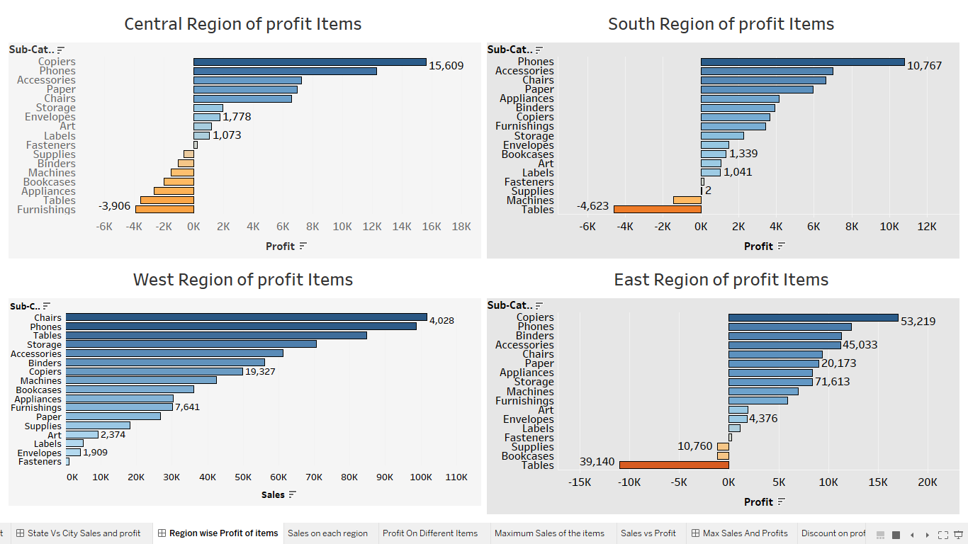

Slide 5
Some insight From last Image :-
As we see in the last image the Copier has more profit and Furnishings has negative profit in central regions of USA . So we have to improve on Furnishings profit in central reason more.
2. As we see in the last image the phones has more profit and Tables has negative profit in South regions of USA . So we have to improve on Tables profit in south reason more.
3.As we see in the last image the chairs has more profit and Fasteners has less profit in west regions of USA . So we have to improve on Fasteners profit in west reason more.
4.As we see in the last image the copiers has more profit and Tables has negative profit in east regions of USA . So we have to improve on Tables profit in east reason more.

Slide 6
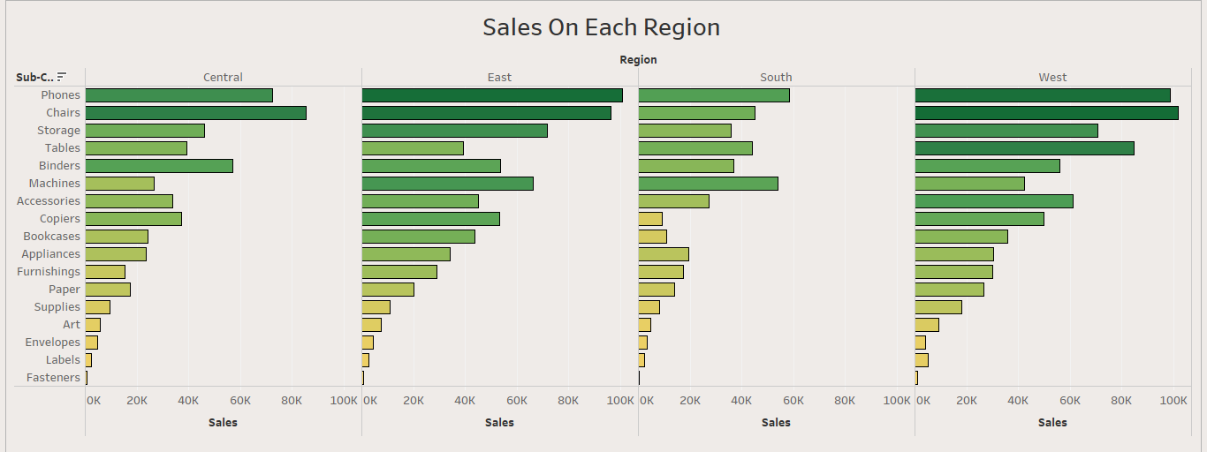

Slide 7
Some insights From Last Image :-
Darker The Color more the profit and lighter the color lesser the profit on that region
As we see in the last pic the central reason of USA chairs has more sales and Fasteners has less sales in that region. So we have to improve the sales of Fasteners on this region
As we see in the last pic the east reason of USA phones has more sales and Fasteners has less sales in that region. So we have to improve the sales of Fasteners on this region
As we see in the last pic the South reason of USA phones has more sales and Fasteners has less sales in that region. So we have to improve the sales of Fasteners on this region
As we see in the last pic the west reason of USA Chairs has more sales and Fasteners has less sales in that region. So we have to improve the sales of Fasteners on this region

Slide 8
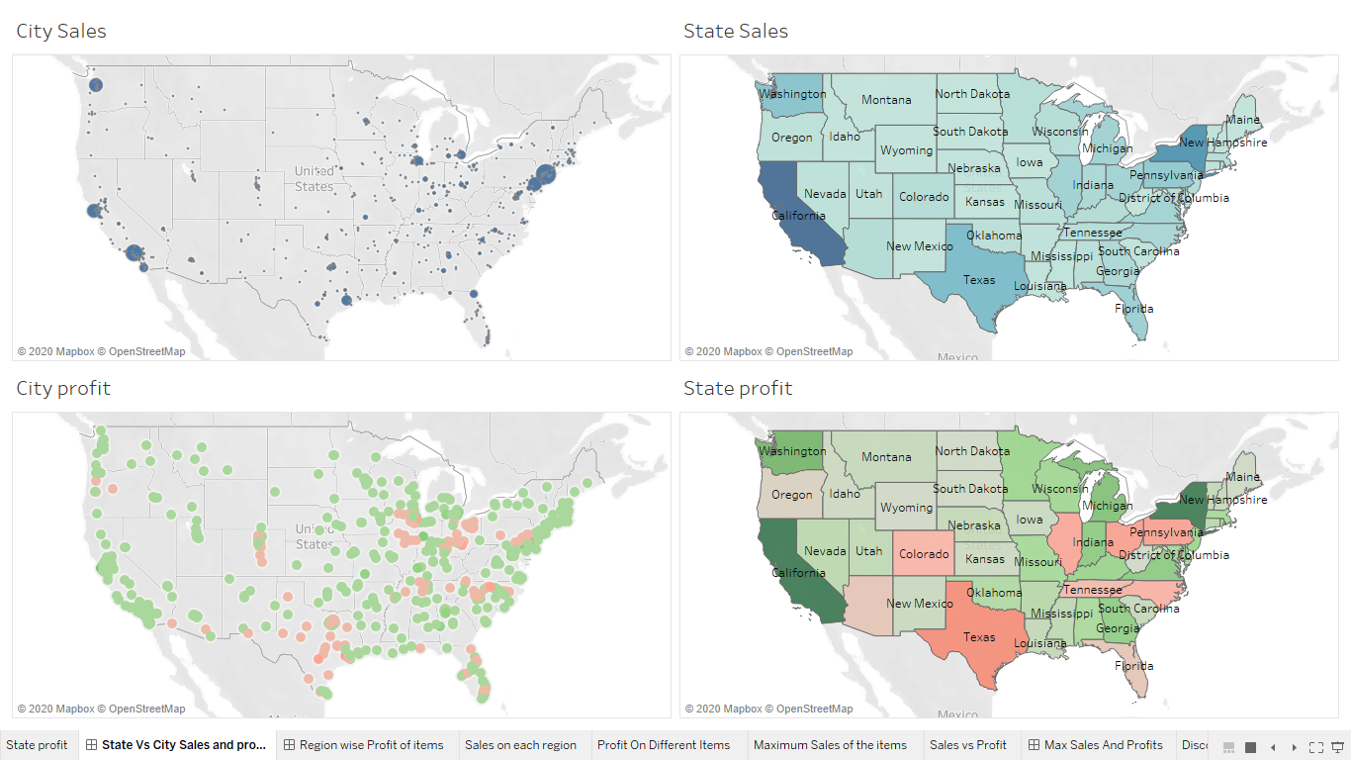

Slide 9
Some Insights from last image:-
As we see in the USA map, from the new York city we are getting maximum number of sales. So from looking the graph where there is less darker circle we are getting very less from that city.so we have to improve our sales in that city.
From the USA map we see that we are getting more profit from California city and in the Texas city we are getting negative profit. So we have to find the reason behind this and try to improve the profit in Texas city.

Slide 10
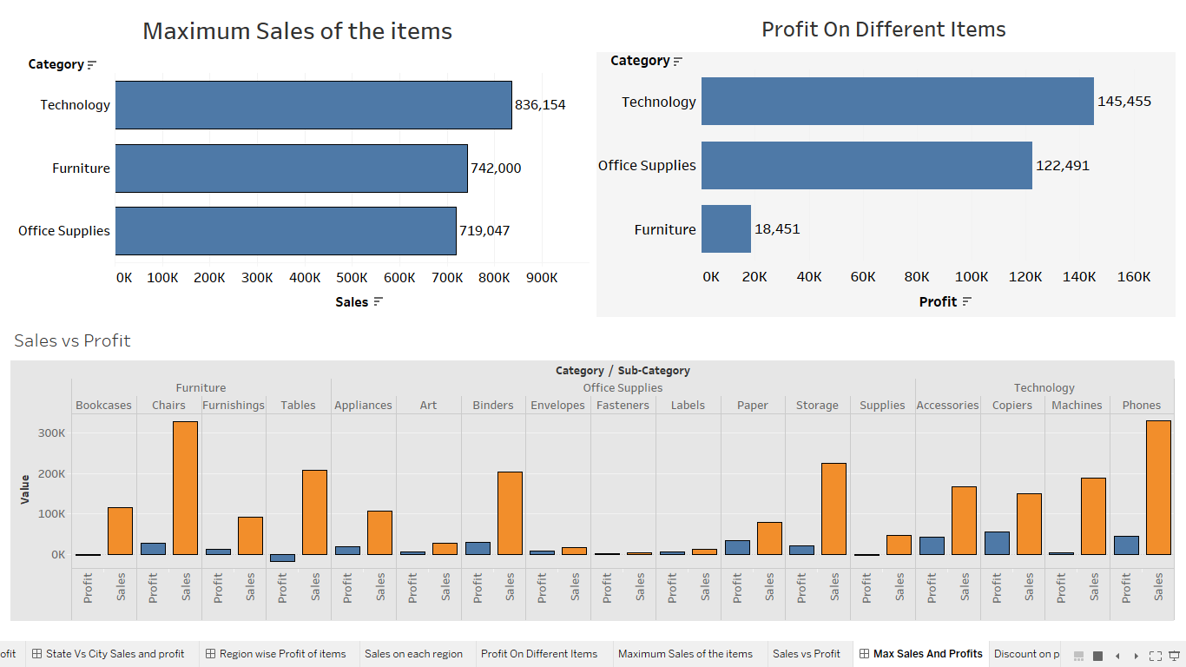

Slide 11
Some Insights from last image:-
From the last image we see that technology items has more sales and office supplies has less sales.so we have to try to improve the sales on office supplies.
As we see in the image technology items has more profit and furniture items has less profit. So we have try to improve the profits furniture items .
Despite of having good sales of furniture items we are getting negative profits. So we have to work on furniture items more so that despite of good sales we can improve our profit.

Slide 12
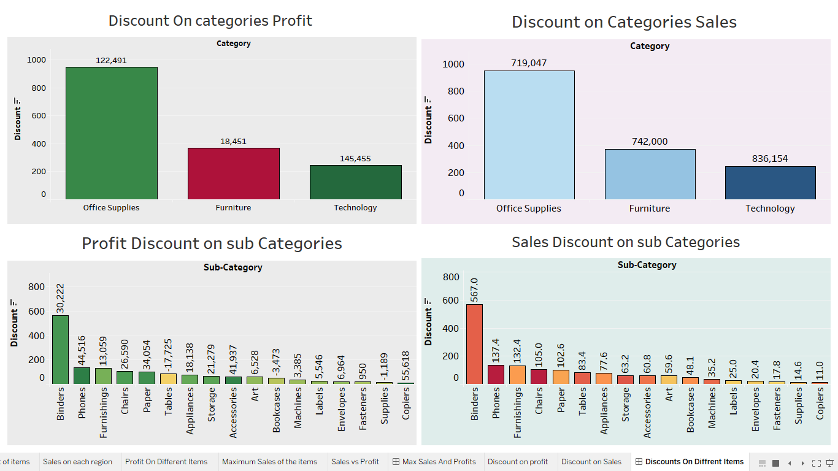

Slide 13
Some Insights From Last pic:-
After giving more discount on office supplies the profit is more and technology items has less profit because of less discount.so we have to give little more discount on the technology items to improve the profits.
After giving more discount on office supplies the Sales is more and technology items has less sales because of less discount. discount.so we have to give little more discount on the technology items to improve the sales.
Despite of giving less discount on phone items we are getting more sales as compared to others items and giving good discount on Fasteners but we are still getting very less sales. So we have to improve the discounts on Fasteners so we can increase our sales.
Despite of giving very less discount on copiers we are getting highest profit as compared to the other items. And as giving good amount of discount on tables we are still getting negative profit on that category. So we have to work on the tables category more so we can improve our profit.

Slide 14
THANK YOU

