Slide 1
AJ Ecom Pvt Ltd Data Visualization Decode 9.1 (Python Hackathon)
By:-
Biswajit Kumar Singh

Slide 2
INTRODUCTION
AJ Ecom Pvt Ltd is one of the leading business who have supermarkets across different regions
of India. They want to understand the performance of their supermarket in terms of customers,
products and its sale.
Come up with minimum 10 different problem statements which could give valuable insights for
AJ Pvt Ltd with the help of data analytics and science.

Slide 3
Dataset File 1: Customer.csv
Customer_id: Unique id for the customer
DOB: Date of birth of customer
Gender: Male or female sex of customer
City code: Unique code of city of customer
Dataset File 2: Prod_cat_info.csv
Prod_cat_id: id of product of a particular (main) category
Prod_cat: Unique type (Category of product)
Prod_sub_cat_code: Sub-category code of the product
Prod_sub_cat: Sub category description
Dataset File 3: Transaction.csv
Transact_id: Unique id of transaction done by customer
Cust_id: customer id
Transact_date: Date on which customer has made the transaction
Prod_subcat_code: sub category of the product
Prodcat_code: main category of the product
Qty: Quantity of item purchased (ignore the negative symbol)
Rate: Price to be paid ( Ignore the negative symbol)
Tax: GST as per rate
Total_amount: Amount paid by customer
Store_type: Different types of stores present in the market

Slide 4
Problem Statements:-
1.Which Gender is Contributing more to the sales of items?
2.Which Age Group of people who are buying the products ?
3.Which product items was brought by the customers more from the supermarket ?
4.Which Store type Contribute to the highest sales ?
5.Which Year Has more number of sales of the items from the super market ?
6.Which month has highest number of sales of the items ?
7.Which day of the week has maximum number of sales ?
8. Which sub_category related to product peoples are buying from supermarket ?
9.Which Store type Collecting maximum revenue ?
10. Which Store type Collecting more taxes on items ?

Slide 5
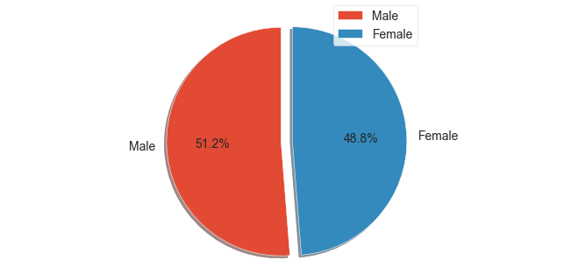
1.Which Gender is Contributing more to the sales of items?

Slide 6
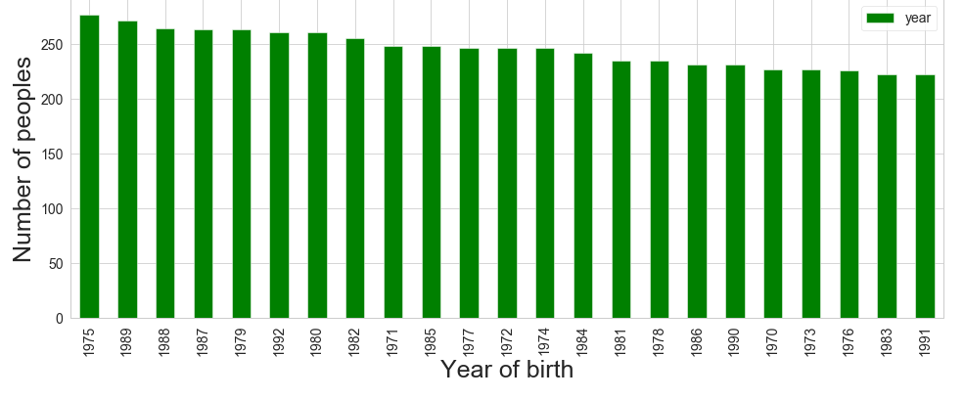
2.Age Group of people who are buying the products ?

Slide 7
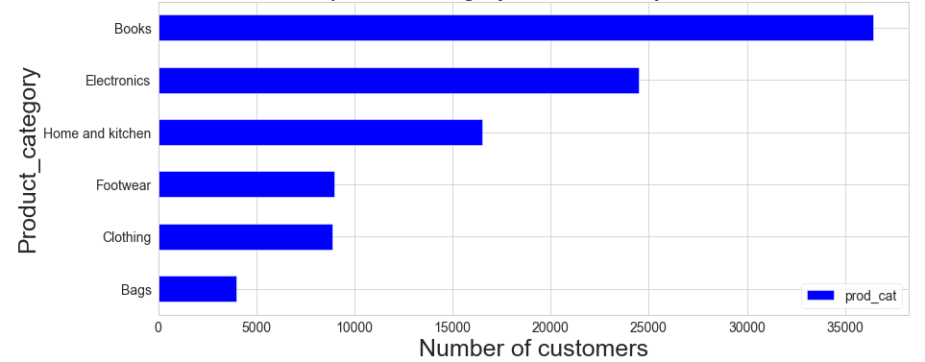
3.Which product items was brought by the customers from the supermarket ?

Slide 8
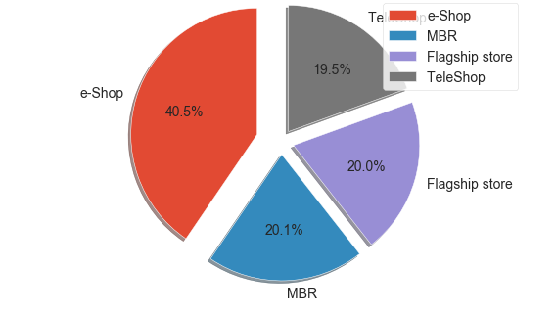
4.Which Store type Contribute to the highest sales ?

Slide 9
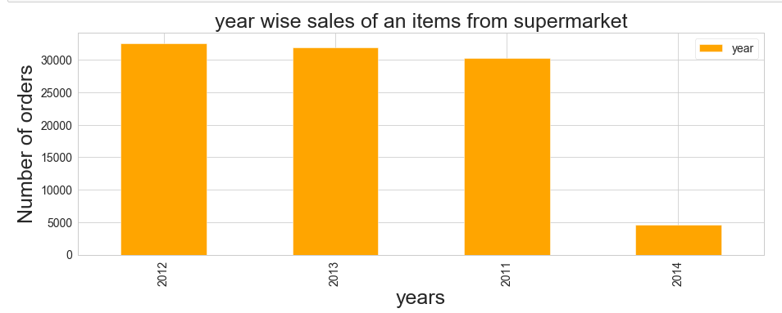
5.Which Year Has more number of sales of the items from the super market ?

Slide 10
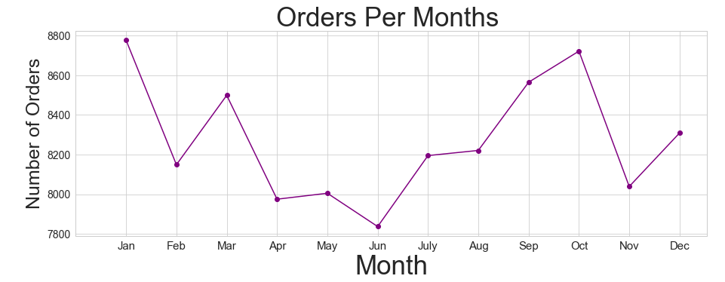
6.Which month has highest number of sales of the items ?

Slide 11
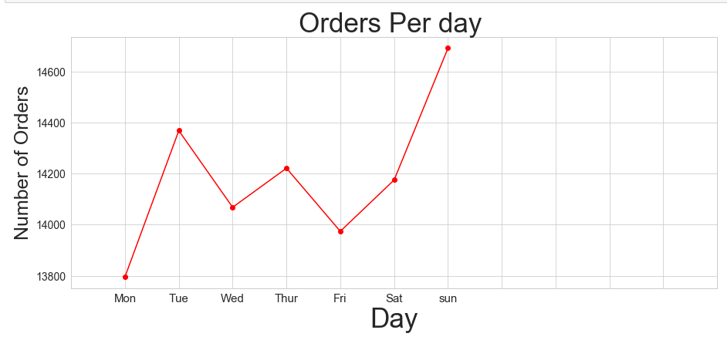
7.Which day of the week has maximum number of sales ?

Slide 12
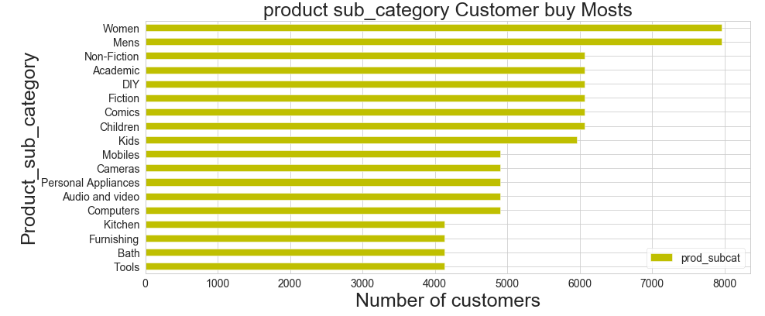
8. Which sub_category related to product peoples are buying from supermarket ?

Slide 13
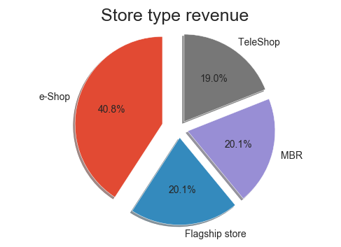
9.Which Store type Collecting maximum revenue ?

Slide 14
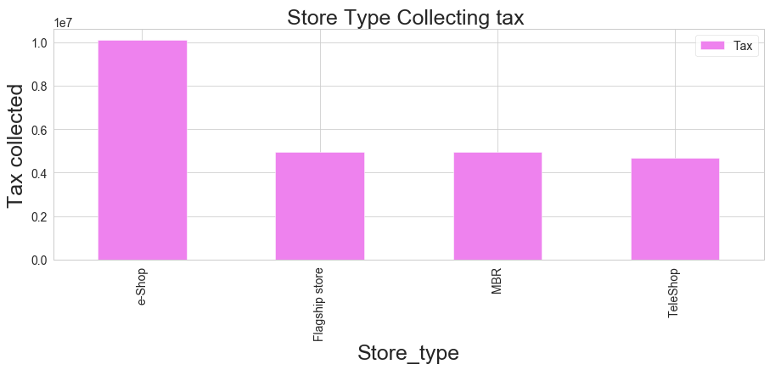
10.Which Store type Collecting more taxes on items ?

Slide 15
Insights
People from age group of 1975 has purchasing more number of items from super market stores
Male people are shopping more than female people from the supermarket
Peoples are interested to buy the books more from the supermarket
E-shop category was contributing more number of sales from store type
In 2012 more number of items was sales from the supermarket
The month of Jan the sales of items was high in a year.
The day of sun in every week the sales of the item was more from each week
Men's and women's related product are peoples are buying more from the supermarket.
E-shop store type has generated maximum revenue from the customers.
e-shop store type taking more number of taxes from people if they are buying some items from the superstore.

Slide 16
THANK YOU !

