Slide 1
IPL DATA VISUALIZATION
Decode8.2(TableauHackathon)
By:-
Biswajit Kumar Singh

Slide 2
INTRODUCTION
BCCI wants to understand the performance of cricket of every team. Design the dashboard
which clearly explains about cricket match, performance of players, outcome of match and every
single factor which is responsible for the match like venue, toss, captain’s performance,
individual’s performance etc. over the years.

Slide 3
Problem Statements
1. Does age matter in the performance of a game?
2. How many matches have been held from 2008 to 2017?
3. How many matches have been held in different venues? Which venue has hosted the highest
and least number of matches?
4. Which team has won the most number of matches?
5. Which team has won the most number of tosses?
6. What percent of types of batting are involved by players?
7. What are the different types of bowling adapted by bowlers?
8. What are the different countries from where players have come?
9. How were the extra runs given in the match?
10. How batsmen have got dismissed?
11. Is there any player who has been awarded man of the match multiple times?
12. How many international players are there in multiple teams?

Slide 4
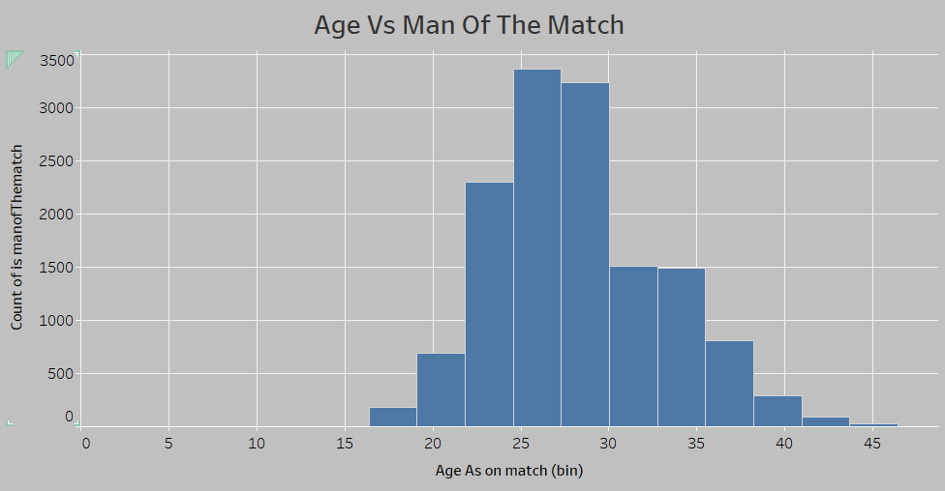
Does age matter in the performance of a game?

Slide 5
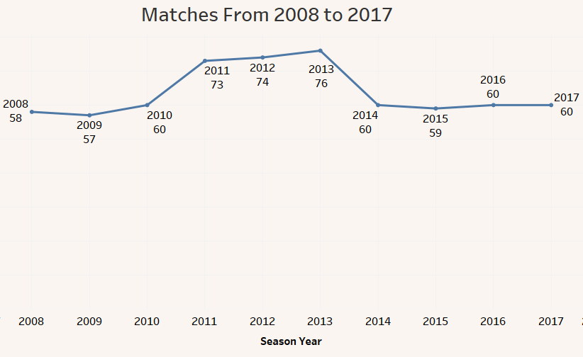
matches have been held from 2008 to 2017

Slide 6
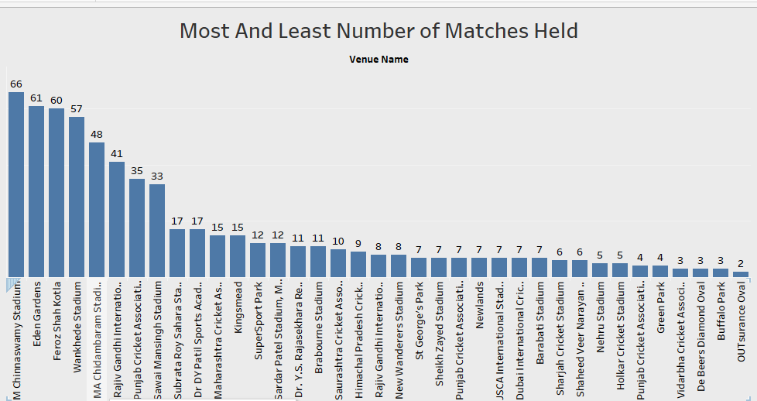
How many matches have been held in different venues? Which venue has hosted the highest
and least number of matches?

Slide 7
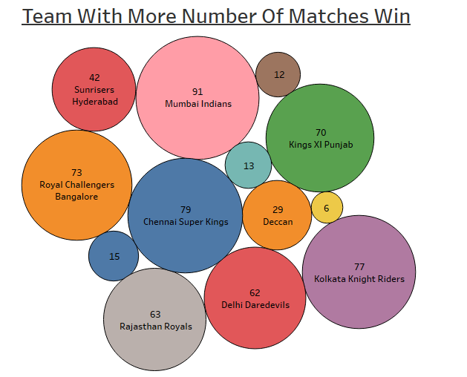
team has won the most number of matches?

Slide 8
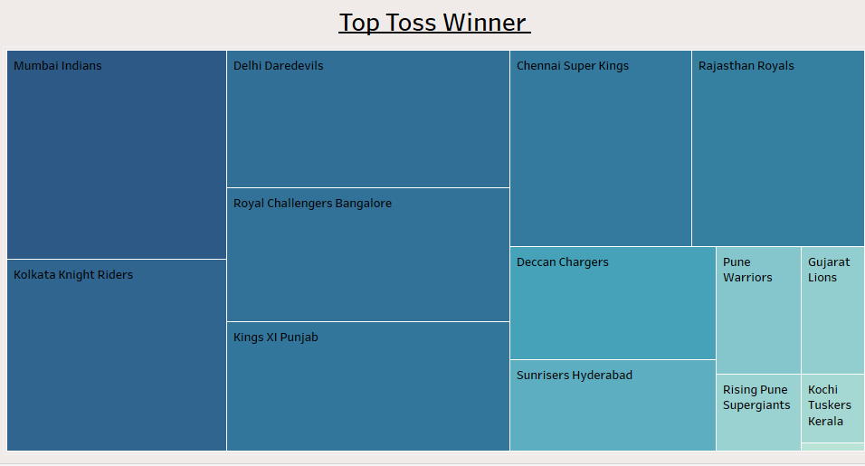
team has won the most number of tosses?

Slide 9
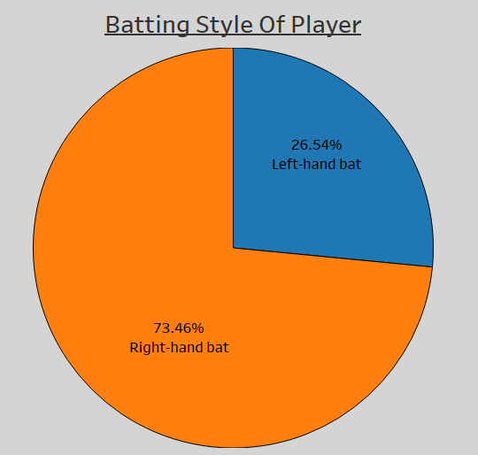
percent of types of batting are involved by players?

Slide 10
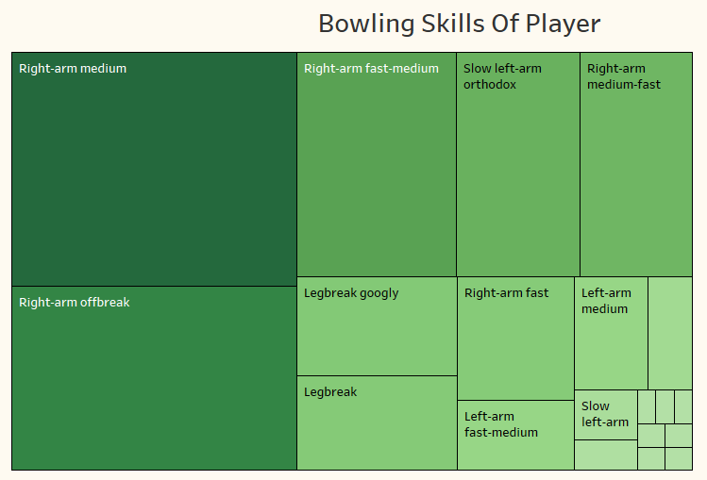
different types of bowling adapted by bowlers?

Slide 11
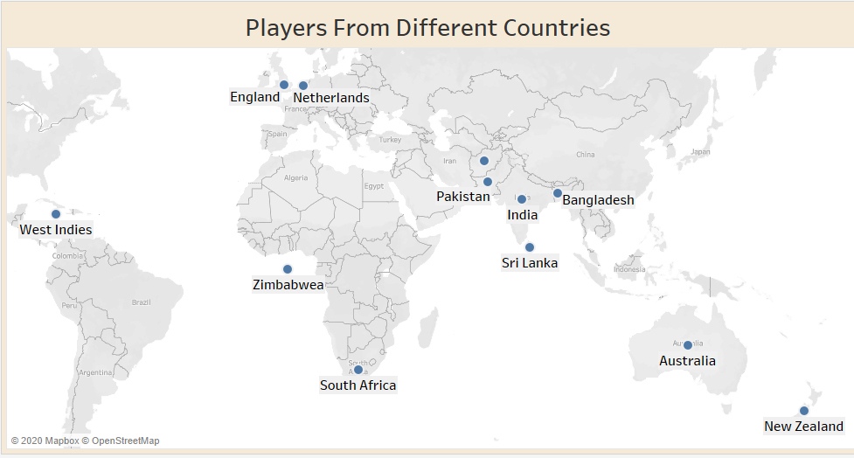
different countries from where players have come?

Slide 12
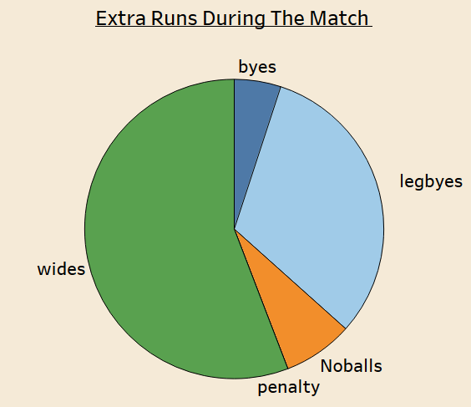
extra runs given in the match?

Slide 13
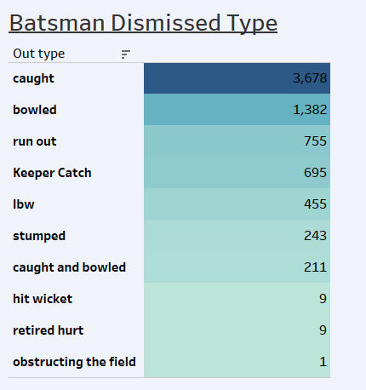
Batsmen have got dismissed?

Slide 14
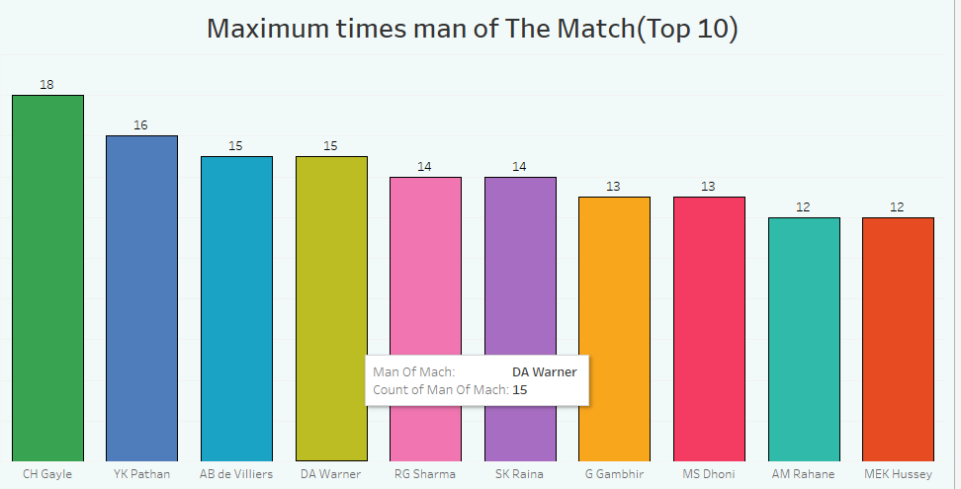
Awarded man of the match multiple times?

Slide 15
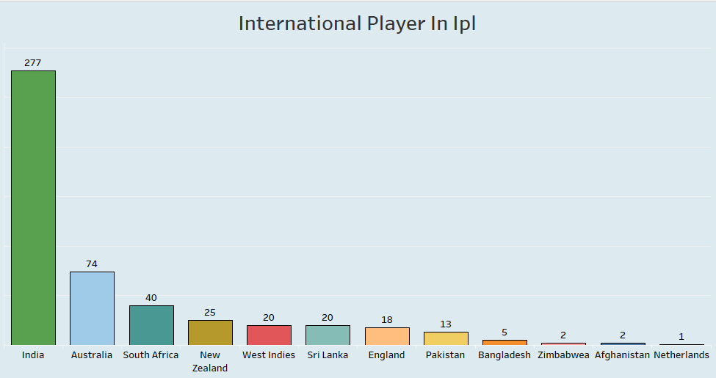
How many international players are there in multiple teams?

Slide 16
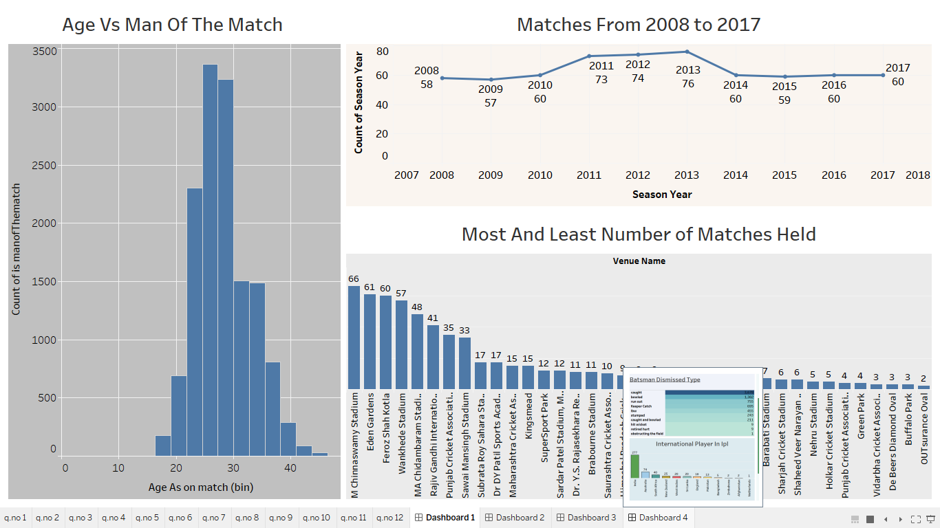
DASHBOARD 1

Slide 17
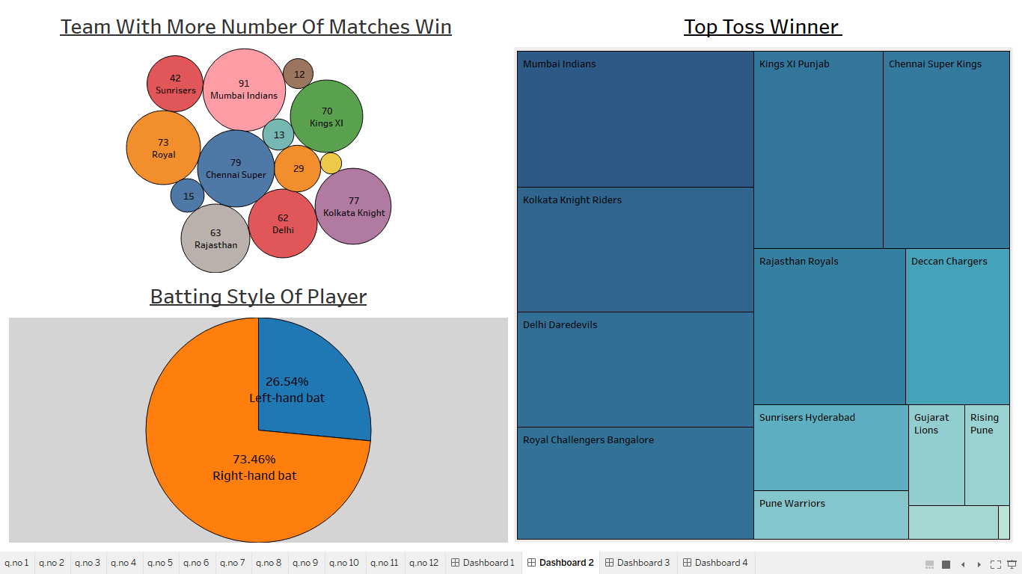
DASHBOARD 2

Slide 18
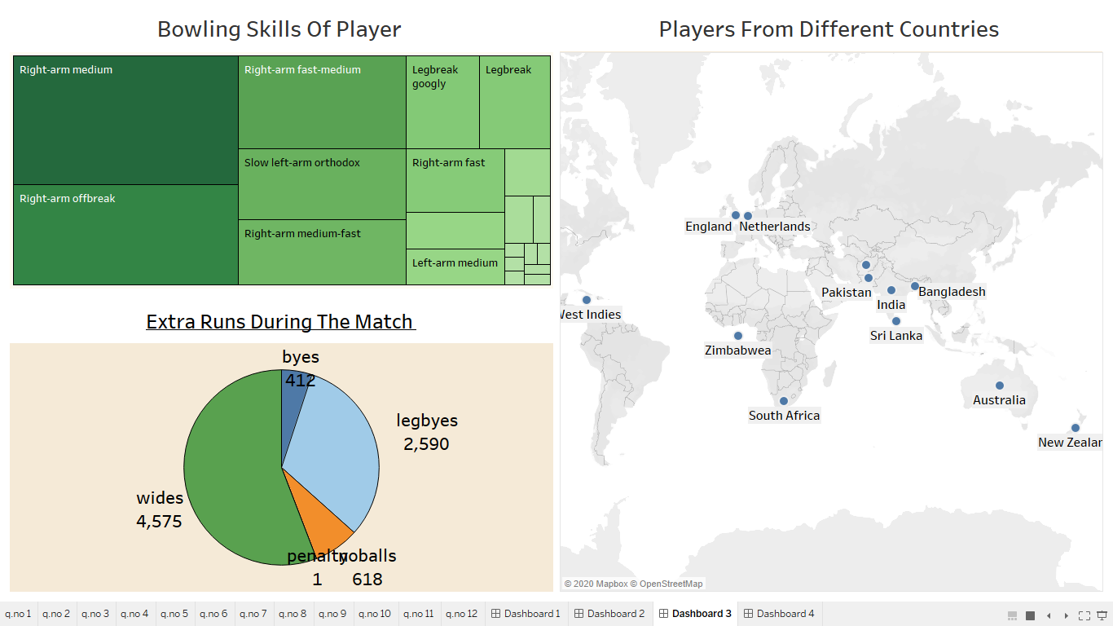
DASHBOARD 3

Slide 19
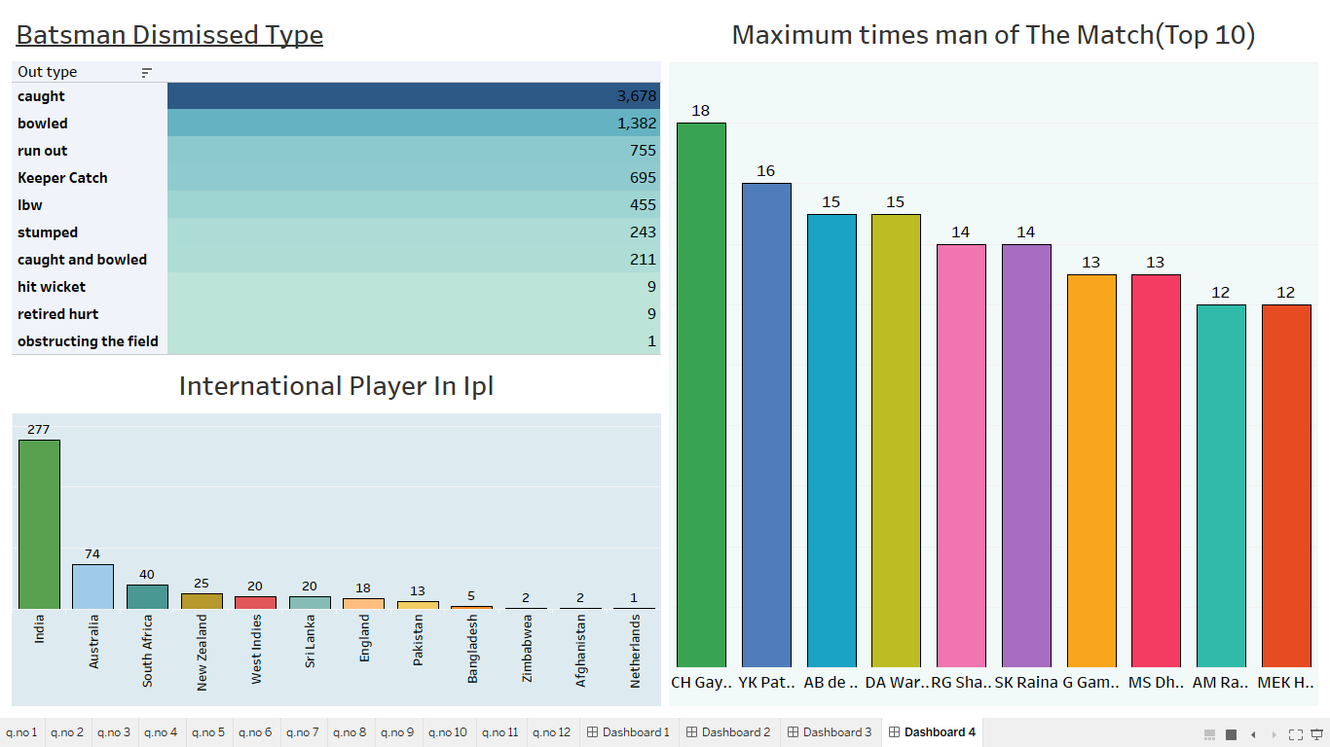
DASHBOARD 4

Slide 20
Important Insights
1.As it is indian preamer league, the maximum number of player is from India.
2.Mumbai India has won the maximum no of matches during the ipl matches from 2008-2017.
3.Maximum number of matches has been played in m chinnaswamy stadium.
4.Crish Gayle has won the maximum number of man of the match during the ipl matches from 2008-2017.
5.Age doesn't matter for winning the man of the match .

Slide 21
THANK YOU

