Slide 1
AIA response functions with different abundance datasets.
Chianti version: 11.02
AIA effective area version: 10 (applied /dn)
Abundance database:
  sun_photospheric_2021_Asplund.abund
  sun_coronal_2021_chianti.abund
  sun_coronal_1992_feldman_ext.abund
Also compare chianti responses with SSW calculated response: tresp=aia_get_response(/temperature,/dn, timedepend_date=‘1-May-2010’,/area):
  In SSW calculation empirical correction (chiantifix) is not applied.
  SSW calculations are based on Chianti version-9
  SSW calculations used Feldman coronal abundances
Biswajit Mondal
Oct.15.2026

Slide 2
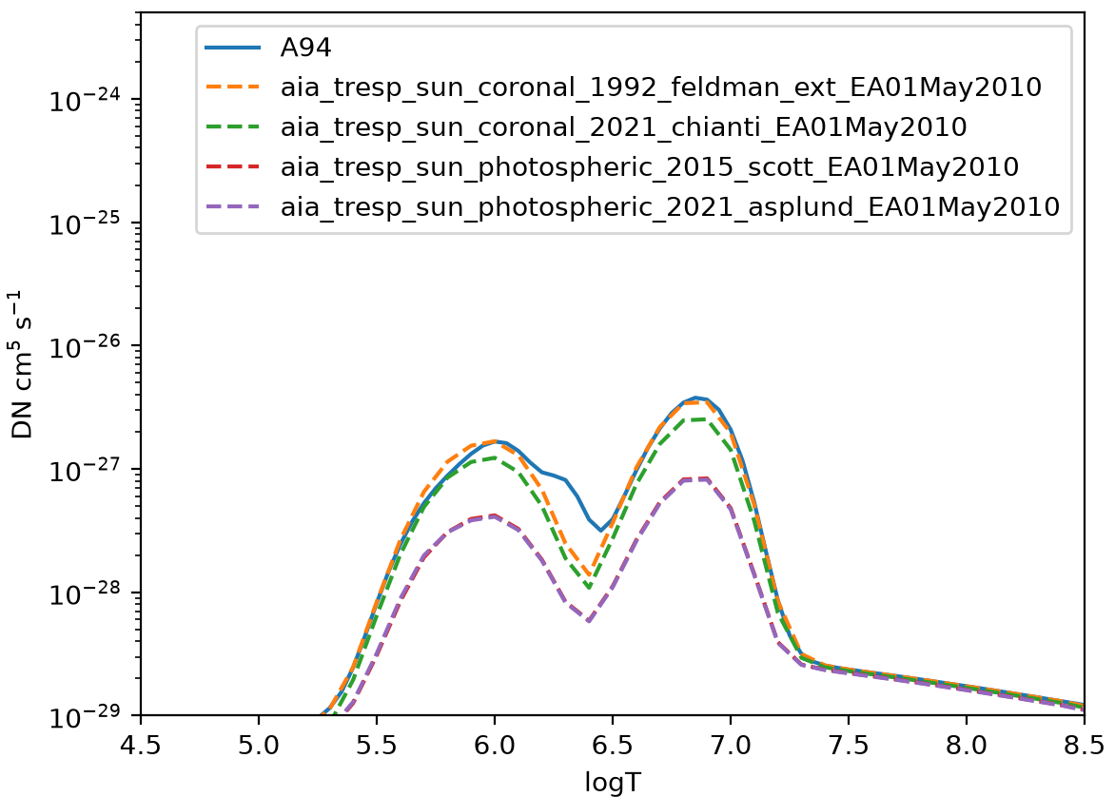
Comparison: AIA 94
Solid line: SSW calculated response
This passband show significant deviation in between 6.0< logT < 6.5 .
- Change of atomic data in new Chianti version ?

Slide 3
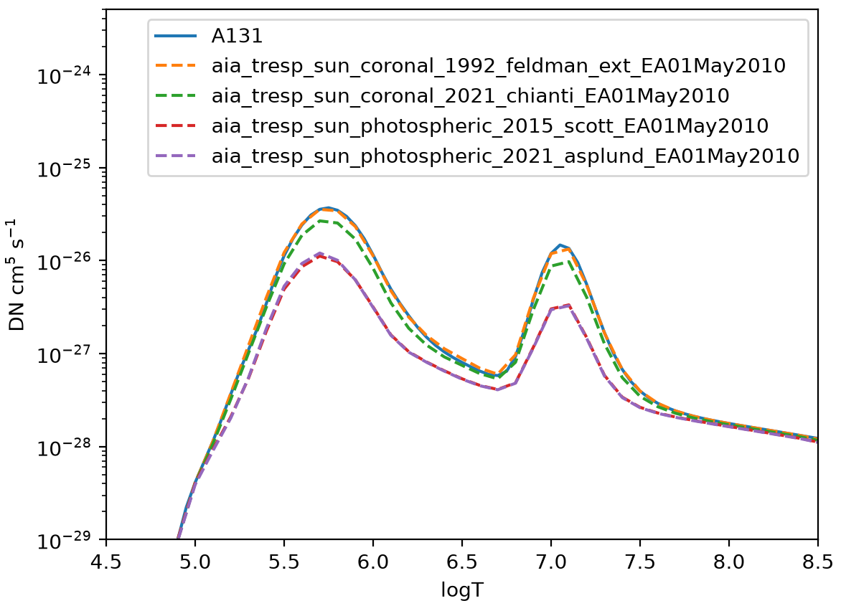
Comparison: AIA 131
Overall good agreement
Solid line: SSW calculated response

Slide 4
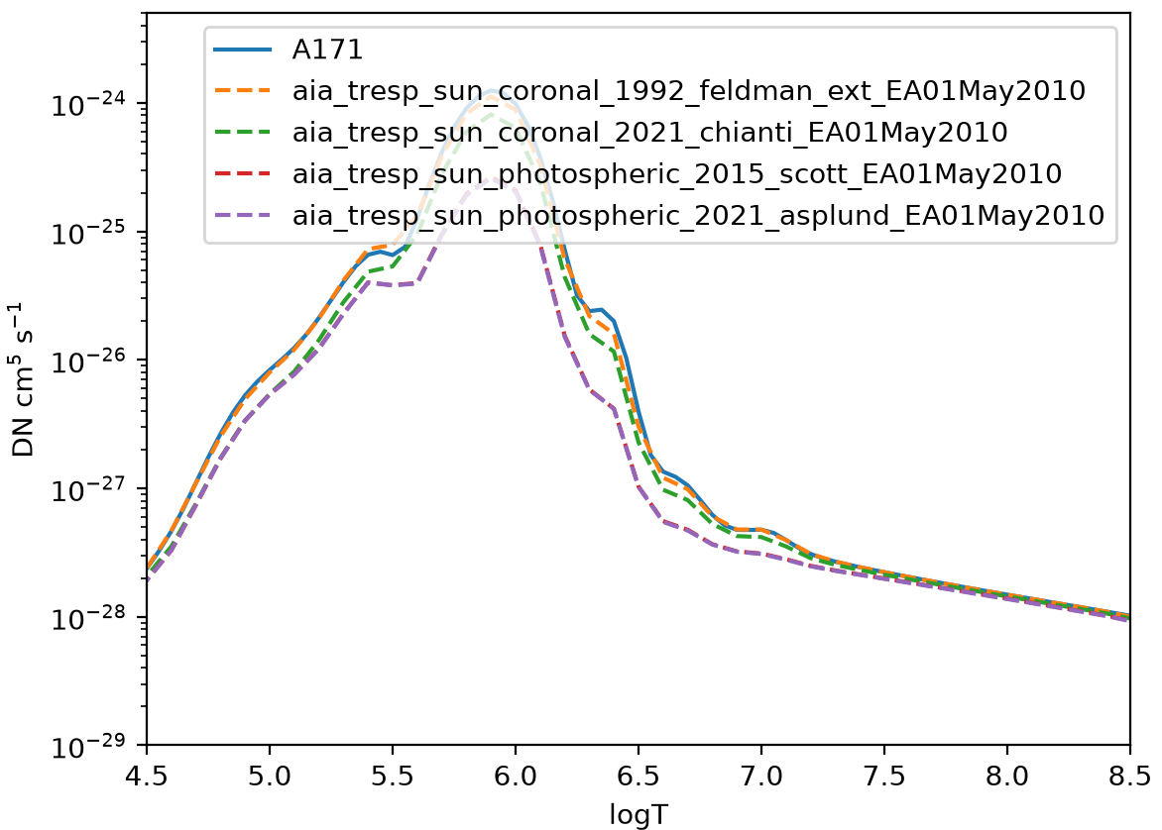
Comparison: AIA 171
Overall good agreement
Solid line: SSW calculated response

Slide 5
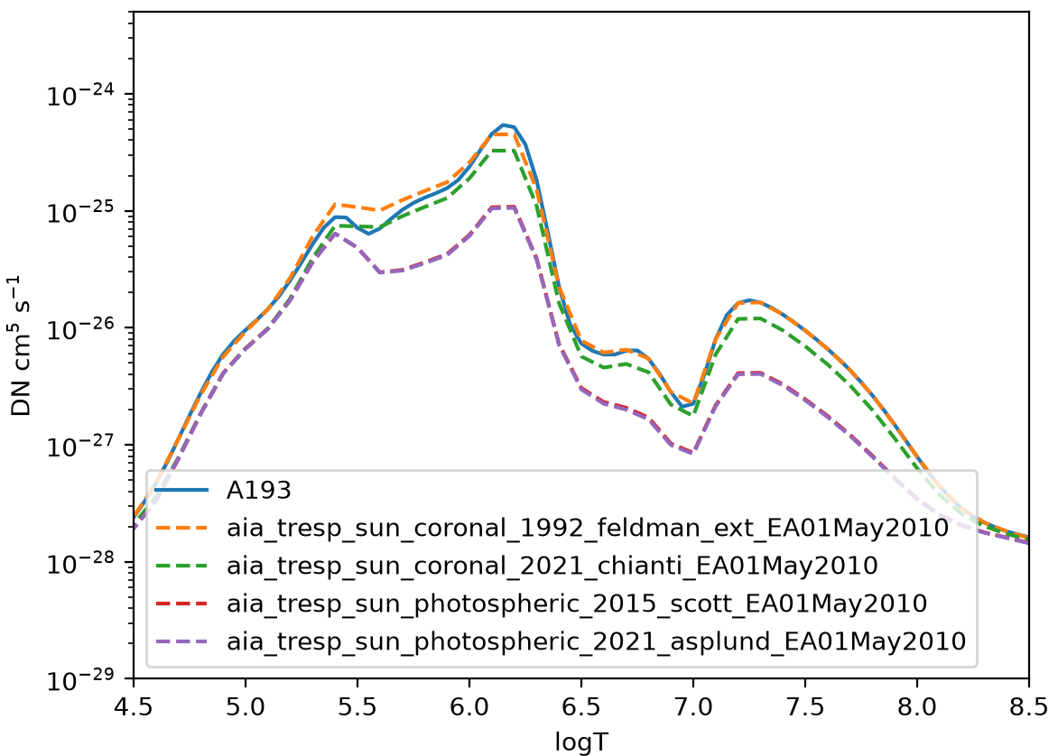
Comparison: AIA 193
Solid line: SSW calculated response
Overall good agreement

Slide 6
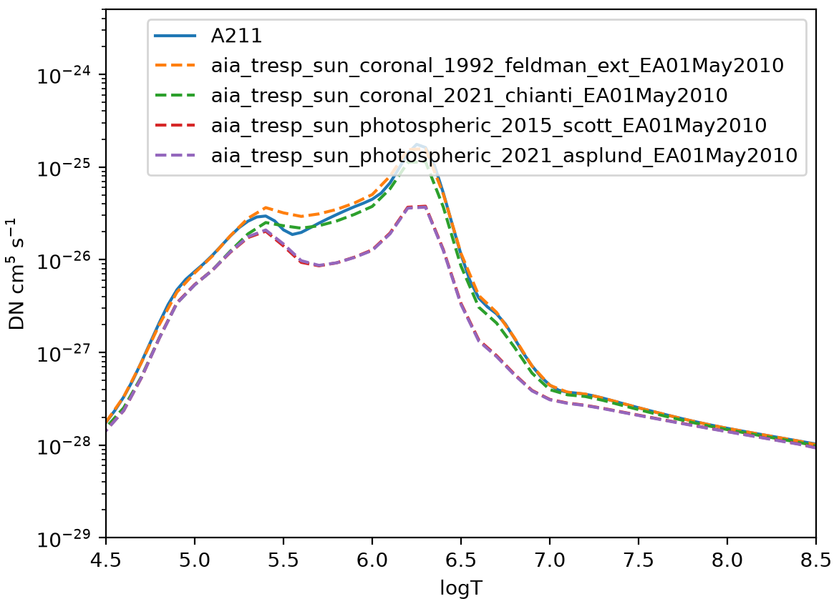
Comparison: AIA 211
Overall good agreement
Solid line: SSW calculated response

Slide 7
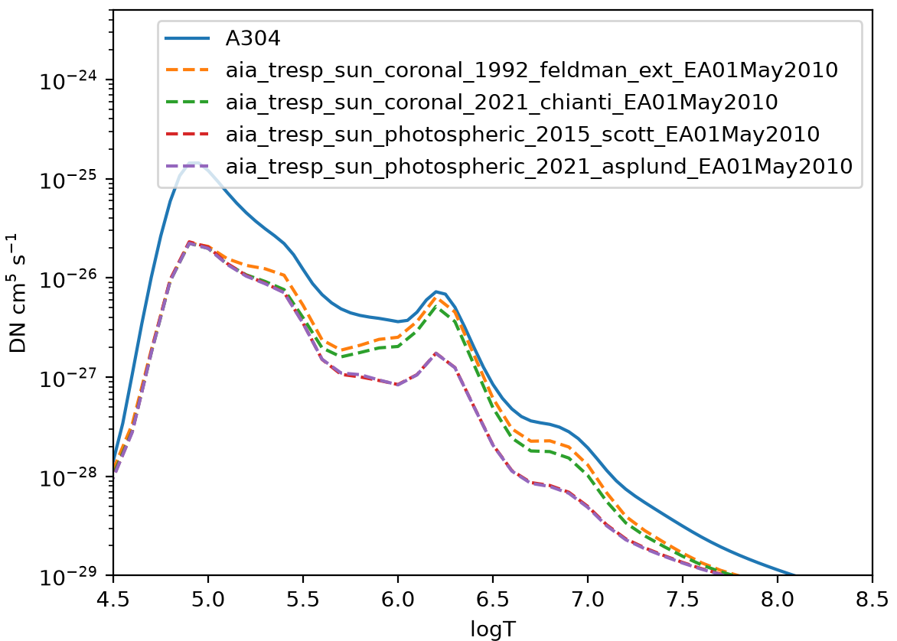
Comparison: AIA 304
This passband show significant deviation.
SSW uses some empirical factor to compensate optically thick He-II emission?
Solid line: SSW calculated response

Slide 8
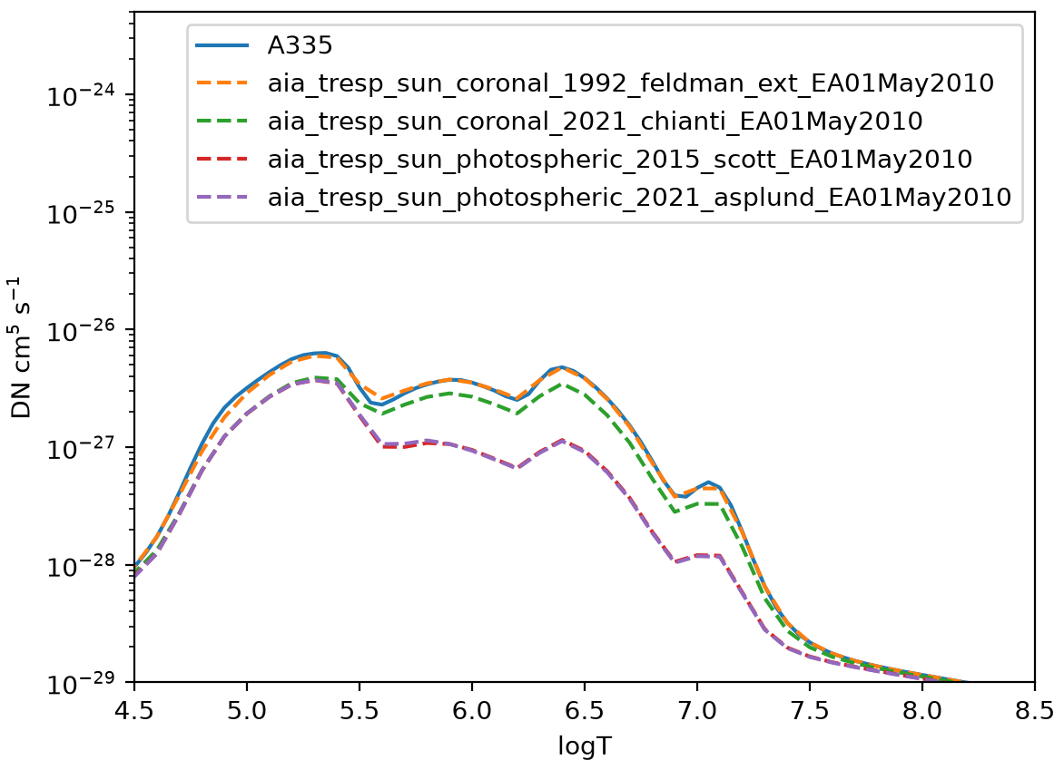
Comparison: AIA 335
Solid line: SSW calculated response
Overall good agreement

