Slide 1


SMART INDIA HACKATHON 2026
SIH26139
HYBRID QUANTUM MACHINE LEARNING PLATFORM FOR EARLY DISEASE DETECTION
Theme:
MedTech / BioTech / HealthTech
Category:
Software
Team ID:
Team Name:
Chai.EXE
Institution:
Barak Valley Engineering College
Members:
• Uddipan Kashyap — Team Leader
• Biki Kalita
• Biswajyoti Nath
• Bishwashree Chakraborty
• Doreen Baruah
• Subinoy Nath

Slide 2


HYBRID QML PLATFORM FOR EARLY DISEASE DETECTION
Evidence-Gated Classical + Quantum Learning for Biomedical Data
Chai.EXE
EVIDENCE-GATED PIPELINE ARCHITECTURE
Our Differentiator
QUANTUM IS EVALUATED, NOT ASSUMED.
Core Innovation:
The platform does not force a quantum pathway. It measures whether one is justified for the available data and tested evidence.
Evidence States Evaluated:
Classical Preferred
When classical baselines excel on standard data
Quantum Pathway Promising
When quantum mapping provides clear edge
Statistically Comparable
When both paths yield similar outcome
Inconclusive
When data limits confident evaluation
The Challenge
Biomedical datasets can be:
High-dimensional & complex
Noisy and heterogeneous
Difficult to represent on near-term quantum models
Current QML evaluation is also computationally expensive, making brute-force quantum execution unviable.
Our Approach
A hybrid platform that:
Intelligently preprocesses medical data
Evaluates both classical and quantum pathways
Compares predictive accuracy against runtimes
Recommends the pathway supported by empirical evidence
1. Biomedical Data & Ingestion
2. Preprocessing & Feature Engineering
3. Representation & Complexity Profile
4. Hybrid Learning Engine (Dual-Path Evaluation)
Classical Baselines
• Support Vector Machine
• Random Forest
• XGBoost
Quantum Enhanced
• Var. Quantum Circuit
• QSVM / Kernel
• QNN Architectures
5. Controlled Benchmark & Evaluation
6. Evidence-Gated Pathway Selection
Innovation Layer • Dynamic Routing

Slide 3
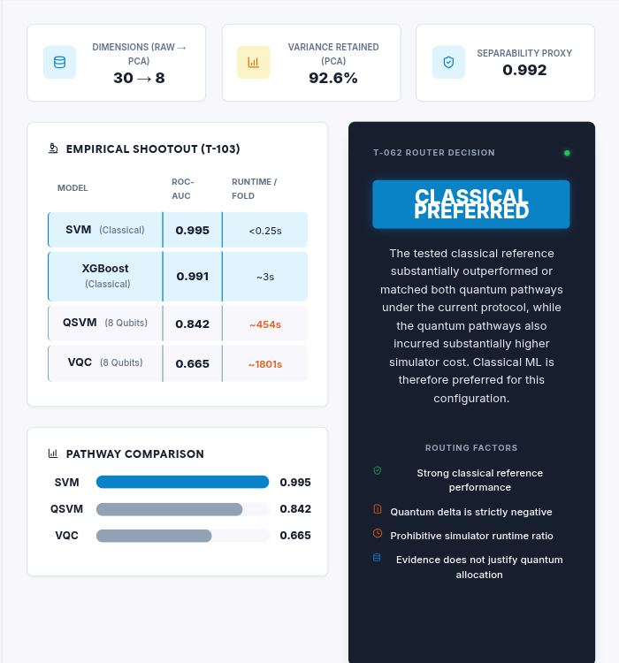
TECHNICAL APPROACH
Chai.EXE
TECHNICAL SYSTEM ARCHITECTURE
BIOMEDICAL DATA
↓
PREPROCESSING
Standardization + PCA
↓
REPRESENTATION PROFILE
Dimensions & Retained Variance
↓
HYBRID MODEL TRAINING
CLASSICAL
SVM • RF • XGBoost
QUANTUM
VQC • QSVM
↓
DISEASE PREDICTION
↓
PERFORMANCE + RUNTIME EVALUATION
↓
EVIDENCE-GATED ROUTING
↓
PATHWAY RECOMMENDATION
WORKING RESEARCH PROTOTYPE
Interactive evidence-gated evaluation dashboard
Quantum benchmark runs are executed offline; the dashboard interactively evaluates stored experimental evidence.
Python • React • TypeScript • FastAPI • scikit-learn • PennyLane

Slide 4
FEASIBILITY AND VIABILITY
Can this actually be built? Experimental evidence, current limitations, and mitigations.
Chai.EXE
DATASET | SVM | RF | XGBoost | QSVM | VQC
WDBC | 0.995 | 0.987 | 0.991 | 0.842 | 0.665
Parkinson's | 0.815 | 0.801 | 0.781 | 0.505 | 0.549
Current Evidence CLASSICAL CURRENTLY LEADS
"Under the tested protocol, classical baselines outperform the evaluated quantum configurations."
Quantum is not automatically justified.
Quantum simulation has substantial cost.
Pathway selection should be evidence-driven.
Key Challenges & Limitations
1. HIGH-DIMENSIONAL DATA: Qubit-limited representation.
2. SIMULATION COST: Circuit simulation becomes expensive.
3. LIMITED COVERAGE: Current evidence covers tested datasets/configurations.
ROC-AUC under the tested protocol
Simulator Runtime Comparison (per fold)
CLASSICAL<0.25 s – ~3 s
QSVM~454 s – ~576 s
VQC~1801 s – ~2064 s
Note: Offline simulation execution, not physical QPU performance.
RESPONSE STRATEGY: MATCHED EVALUATION • LEAKAGE-SAFE PREPROCESSING • RUNTIME-AWARE ROUTING • BROADER VALIDATION
* T-103B: Encoding ablation attempted but deferred after local simulator resource exhaustion (OOM).

Slide 5
IMPACT AND BENEFITS
Chai.EXE
HYBRID QML PLATFORM TARGETS
BIOMEDICAL ML RESEARCHERS
Controlled classical-vs-quantum evaluation on biomedical datasets.
QML RESEARCHERS
Compare quantum pathways against strong classical references.
HEALTHCARE AI TEAMS
Evaluate predictive and computational trade-offs before deployment.
EVIDENCE-DRIVEN MODEL SELECTION (Performance + Computational Cost + Representation Conditions)
RESEARCH
Systematic classical-vs-quantum benchmarking.
COMPUTATION
Avoid unnecessary quantum computation when current evidence does not justify it.
ENGINEERING
Modular platform that can incorporate new datasets and quantum pathways.
VALIDATION ROADMAP
CURRENT: WDBC + Parkinson's ➔ NEXT: More datasets + quantum pathways ➔ FUTURE: QPU evaluation + clinical validation

Slide 6



RESEARCH EVOLUTION & REFERENCES
SIH 26139: Hybrid Quantum Machine Learning Platform for Early Disease Detection
Chai.EXE
T-060: Synthetic Complexity
Investigated dataset-dependent quantum suitability through controlled experiments.
Research Foundation
Havlíček et al., 2019 | Nature
Quantum-enhanced feature spaces and kernel methods.
Schuld & Killoran, 2019 | Phys. Rev. Lett.
Quantum feature Hilbert spaces.
Cerezo et al., 2021 | Nature Reviews Physics
Variational quantum algorithms.
Gupta et al., 2025 | npj Digital Medicine
Quantum machine learning in digital health.
T-061: Biomedical Validation
Conducted evaluations using real disease-classification profiles on WDBC and Parkinson’s datasets.
T-103: Quantum Shootout (Key Evidence)
Demonstrated that quantum pathways did not justify the additional simulator costs under the current protocol.
Project Code
Scan to view full experimental artifacts and architecture.
Source Code
Experiments
Documentation
T-103B: Encoding Ablation (Deferred)
Reached hard system limits, triggering an "Out of Memory" (OOM) error in the simulator.
Dataset References
WDBC: UCI Wisconsin Diagnostic Breast Cancer (569 samples, 30 features)
Parkinson's: OpenML 42176 (756 samples, 753 features)
T-062: Evidence-Gated Routing (Prototype)
Developed an initial prototype that dynamically selects pathways based on computed metrics derived from current benchmark evidence.

