Slide 1
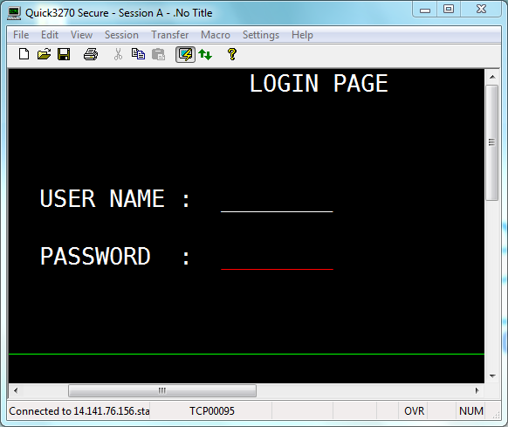
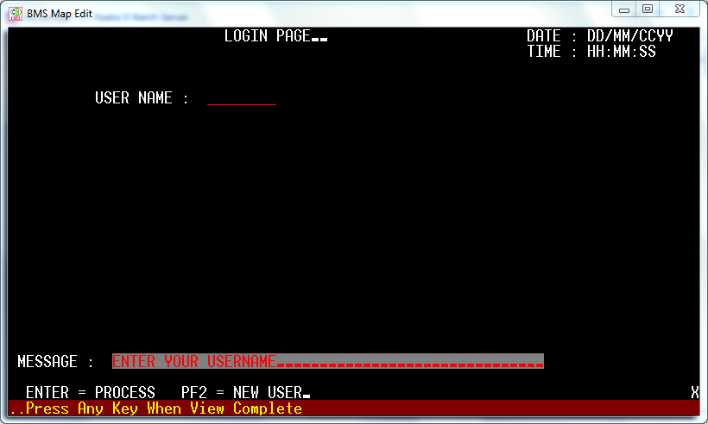
New broker
Notes:
Login page
here broker first enter the username then system check for username existence
then he get this map again by having username prot and password unprot.
at f2 we will navigated to the accout creation for broker.

Slide 2
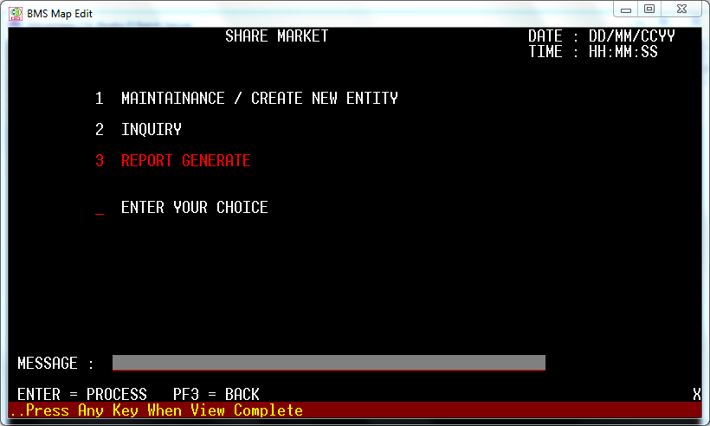

Slide 3
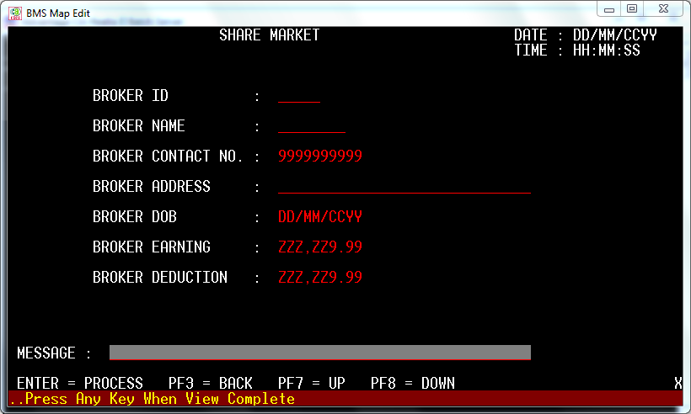
Notes:
On this page all the info of broker is displayed
Enter =display
F2=add broker
f3-=exit
F4=delete broker
F5=update

Slide 4
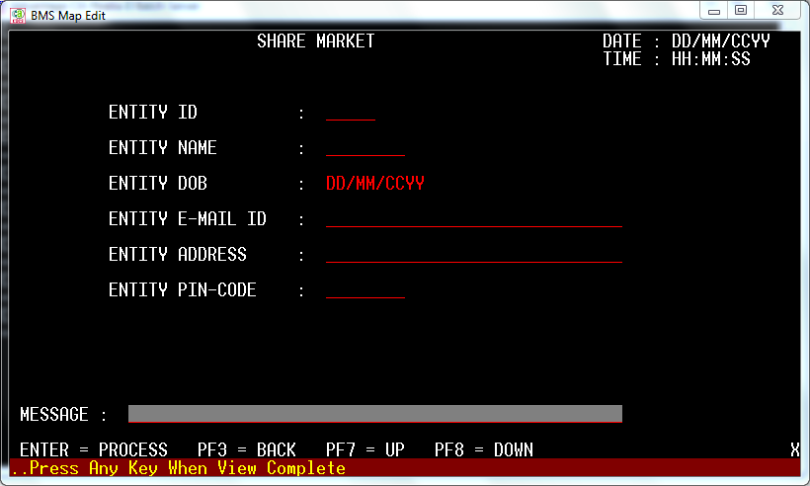

Slide 5
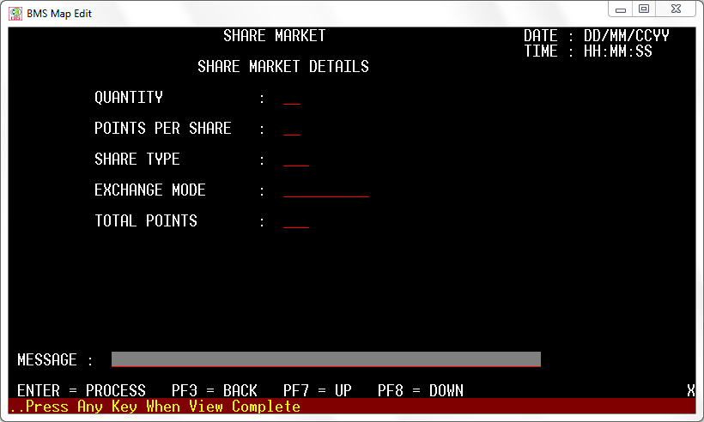

Slide 6
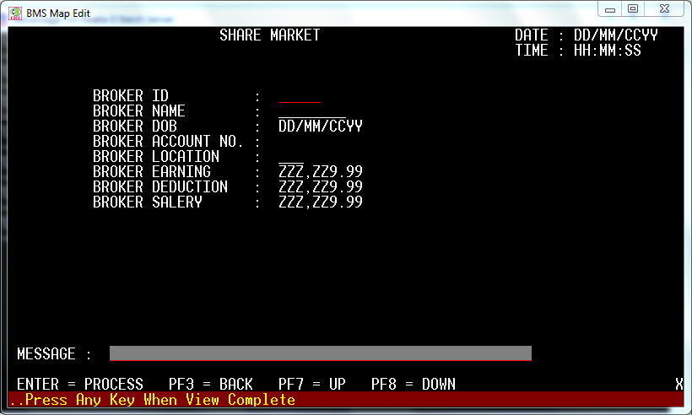

Slide 7
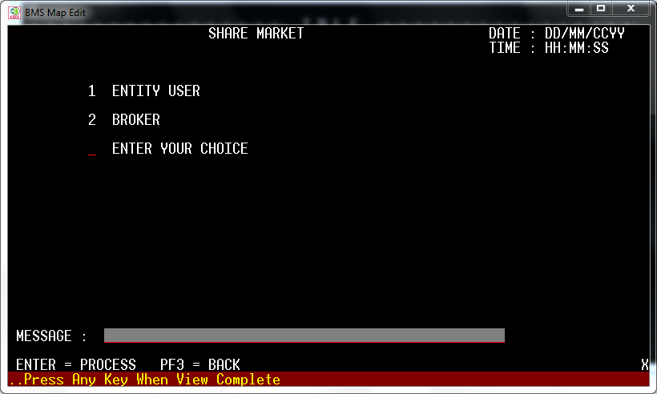
Notes:
On this page system want input as access is from user or broker.
If 1-entity user

