Slide 1
Tech proposal
Bangalore
6th April 2023

Slide 2


Log Tracing (ELK)
Monitoring (Prometheus)
IAM
Discovery
Events logs/ Audit Trail
Candidate Service
DB
Analytics
Messages
Email
Job Service
DB
Notification
Gateway/LB
Reporting
Peripheral Services
CRON
Cache
DB
Parser
Campaign Service
Search
Recommendation
Analytical Services
Domain services
Service Mesh
User Service
DB
Trends
DB
Organization sync
Publishers
Subscribers
Int2
ESB
Integration Services

Slide 3
Modules(Proposed)
Candidate
Job
Contest
User
Tenant
Peripheral
Parser(Resume/JD/Tenant)
Search
Mail
Notification
Messages
Master data(Locations/Zipcodes/Applicant status etc.)
Assessment
Integration
Inbound
Outbound
I18n capability

Slide 4
Technologies(Cloud ready)
Workflow | Technology
Client(Microfrontend) | Angular/React/Vue
Server(Microserver) | C#/Java/Python/Node
IAM(authentication and authorization) | OAuth2/LDAP
Gateway/LB/Reverse proxy | NGINX
Config server/Registry/Discovery | Consul
Reverse proxy cache | Varnish
Distributed caching/User session mgmt | Redis
Master data, catalog data | MongoDB
Eventlog/time series data | Cassandra
Transactions | RDBMS(MySQL)
Message broker/ async communication | Rabbit MQ/Apache Pulsar/Kafka
Application log trace | ELK
Domain service logs | Jaeger
Domain service(Control plane) | Linkerd
Domain service(Data plane) | Envoy
Resource monitoring | Prometheus
Container | Docker
Pod | Kubernetes
Recommendation engine/Trends
CDN
Artifactory | Jforg

Slide 5
Technologies(Cloud native - AWS)
Workflow | Technology
Client(Microfrontend) | Angular/React
Server(Microserver) | C#/Java/Python/Node
IAM(authentication and authorization) | IAM module/Recognition
Gateway/LB/Reverse proxy | Route 53
Config server/Registry/Discovery | ELB
Reverse proxy cache | ElastCache
Distributed caching/User session mgmt | Redis/ElastiCache
Master data, catalog data | Dynamo DB
Eventlog/time series data | RDS
Transactions | RDS
Message broker/ async communication | Eventbridge
Application log trace | Cloudwatch
Domain service logs | Jaeger
Domain service(Control plane) | Linkerd
Domain service(Data plane) | Envoy
Resource monitoring | Prometheus
Container | ECS/KUDOS
Mail/SMS | SMS/SNS
Recommendation engine/Trends | Sagemaker/Redshift/Athena/Glue
CDN | Cloudfront
Artifactory | Jforg/Octopussy/Nexus

Slide 6
AIM
CNCF cloud ready architecture so that it is easy to lift and shift when ever required to any cloud stack
To follow polyglot tech stack to leverage micro-service pattern on efficiency,productivity, independence, scalability

Slide 7
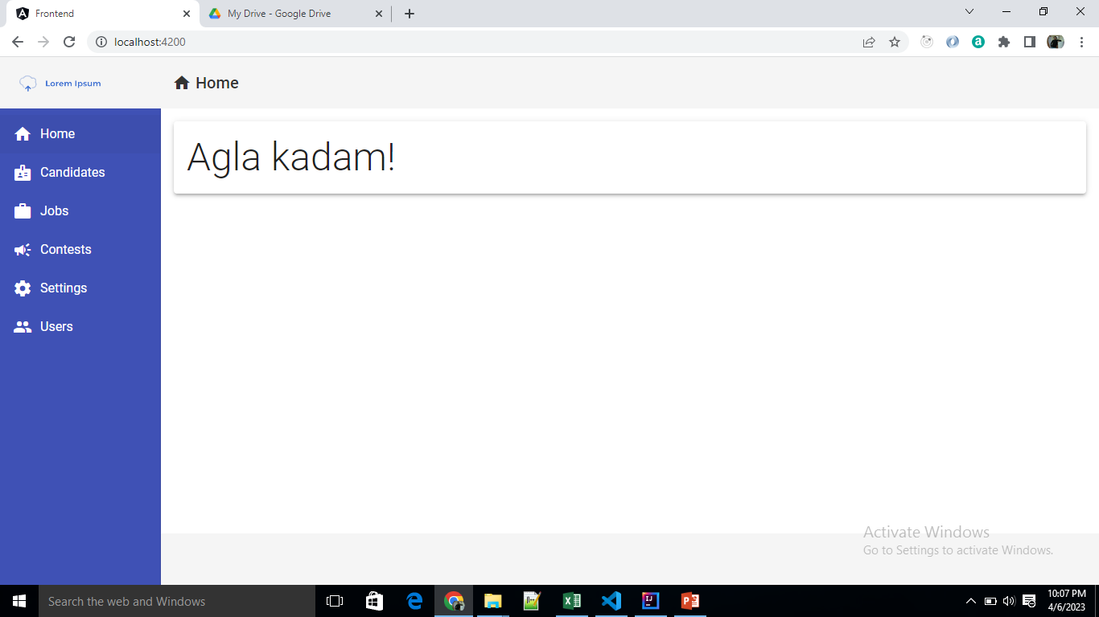
Sample

