Slide 1
Tech proposal
Bangalore
6th April 2023

Slide 2


Log Tracing (ELK)
Monitoring (Prometheus)
IAM
Discovery
Events logs/ Audit Trail
Candidate Service
DB
Analytics
Messages
Email
Job Service
DB
Notification
Gateway/LB
Reporting
Peripheral Services
CRON
Cache
DB
Parser
Campaign Service
Search
Recommendation
Analytical Services
Domain services
User Service
DB
Trends
Subscribers
DB
Inbound
Publishers
Outbound
ESB
Integration Services

Slide 3
Modules(Proposed)
Candidate
Job
Contest
User
Tenant
Peripheral
Parser(Resume/JD/Tenant)
Search
Mail
Notification
Messages
Master data(Locations/Zipcodes/Applicant status etc.)
Assessment
Integration
Inbound
Outbound
I18n capability

Slide 4
Technologies(Cloud ready)
Workflow | Technology
Client(Microfrontend) | Angular/React/Vue
Server(Microservice) | C#/Java/Python/Node
IAM(authentication and authorization) | OAuth2/LDAP
Gateway/LB/Reverse proxy/Static caching | NGINX
Config server/Registry/Discovery | Consul/any other opensource like etcd
Reverse proxy cache | Varnish
Distributed caching/User session mgmt | Redis
Master data, catalog data | MongoDB
Eventlog/time series data | Cassandra
Transactions | RDBMS(MySQL)/MongoDB
Message broker/ async communication | Rabbit MQ/Kafka
Application log trace | ELK
Domain service logs | Jaeger
Domain service(Control plane) | Linkerd
Domain service(Data plane) | Envoy
Resource monitoring | Prometheus
Container | Docker
Pod | Kubernetes
Recommendation engine/Trends
CDN
Artifactory | Jforg

Slide 5
Technologies(Cloud native - AWS)
Workflow | Technology
Client(Microfrontend) | Angular/React
Server(Microserver) | C#/Java/Python/Node
IAM(authentication and authorization) | IAM module/Recognition
Gateway/LB/Reverse proxy | Route 53
Config server/Registry/Discovery | ELB
Reverse proxy cache | ElastCache
Distributed caching/User session mgmt | Redis/ElastiCache
Master data, catalog data | Dynamo DB
Eventlog/time series data | RDS
Transactions | RDS
Message broker/ async communication | Eventbridge
Application log trace | Cloudwatch
Domain service logs | Jaeger
Domain service(Control plane) | Linkerd
Domain service(Data plane) | Envoy
Resource monitoring | Prometheus
Container | ECS/KUDOS
Mail/SMS | SMS/SNS
Recommendation engine/Trends | Sagemaker/Redshift/Athena/Glue
CDN | Cloudfront
Artifactory | Jforg/Octopussy/Nexus

Slide 6
AIM
CNCF cloud ready architecture so that it is easy to lift and shift when ever required to any cloud stack
To follow polyglot tech stack to leverage micro-service pattern on efficiency,productivity, independence, scalability

Slide 7
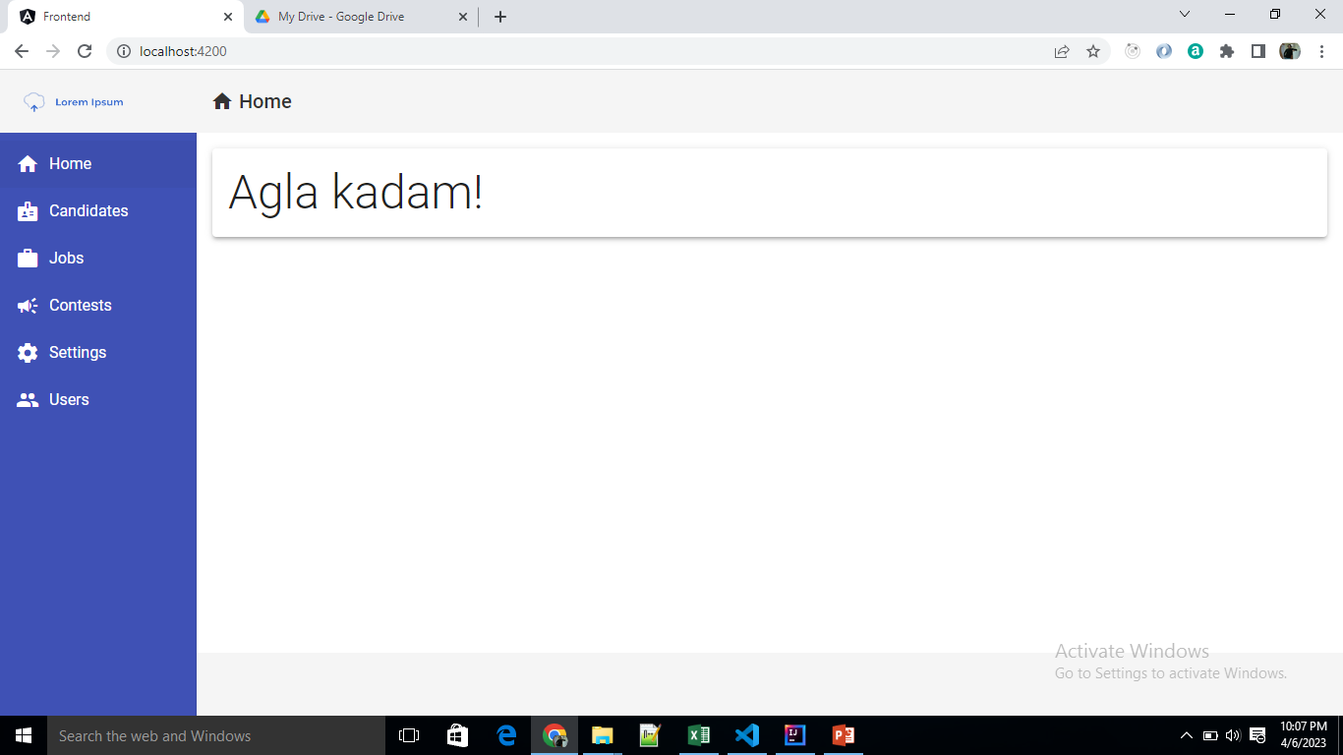
Sample

