Slide 1

Software Engineering – Project Management Module-2
Faculty :
Dr. Pulak Sahoo
Associate Professor
Silicon Institute Of Technology

Slide 2
Module2 Contents
Software Project Management - topics
Project Planning
Metrics for Project Size Estimation
Scheduling, Staffing
Project Estimation Techniques
COCOMO model
Halstead’s Software Science
Risk Management

Slide 3
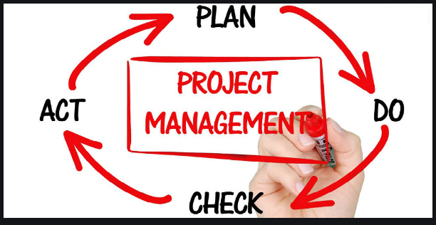
Software Project Management

Slide 4
Project Management life cycle
PLANNING
EXECUTE
CLOSURE
INITIATION
MONITOR & CONTROL
Monitoring : Compare Planned Progress with Actual Progress
Controlling : Taking corrective action if required
Notes:
Draw the diagram of Project Management life cycle.

Slide 5

Project planning

Slide 6
Project Planning in 10 Steps
0. Select Project
Identify project scope & objectives
Identify project infrastructure
Analyze project characteristics & Select SDLC model
Identify project deliverables & activities
Estimate effort for each activity
Identify activity risks
Allocate Resources
Review/Publish plan
& 10. Execute Plan & Lower level planning
Notes:
Explain the 10 Steps of Project Planning activity.

Slide 7

Step wise planning activities
Step Activities
0
1
2
Select Project (based on strategic evaluation)
Identify project scope & objectives (Have all parties agree to the objectives & commit to the success)
Id. Objectives of the project
Establish project authority (Project Manager)
Id. all stakeholders (List stakeholders & their needs)
Modify objectives based on stakeholder analysis
Establish communication methods (Whom & How)
Identify project infrastructure (Existing inf. h/w, s/w, logistics)
Establish relationship between project & strategic planning
( Decide priority of the project )
Id. Installation standards & procedures
Id. Project team organization

Slide 8

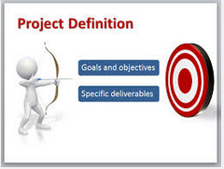
Step wise planning activities
Step Activities
3
4
Analyze project characteristics (for selecting appropriate methods)
Distinguish the project (Objective driven or Product driven)
Analyze other characteristics & . High level risks
Select lifecycle approach
Review overall resource estimates
Identify project deliverables & activities
Id. deliverables (SRS, Set of components, test plans/results)
Document generic product flows ( SRS → Design Module →
Develop Module → Test module, WBS)
Recognize product components
Produce activity network
Take into account(modify) stages & check points

Slide 9
Activity Network
A5
A2
A8
A1
A3
A9
A6
A7
A4
Notes:
Explain Activity Network with the help of an example along with bottom up estimation.

Slide 10




Step wise planning activities
Step Activities
5
6
7
Estimate effort for each activity
Carry out bottom-up estimates
Revise Plan to create controllable activities(long activities to
be broken down into smaller subtasks)
Identify activity risks
Id. & quantify activity based risks
(Id. risks, estimate - probability & impact)
Plan for countering the risks
Adjust overall plan to account for risks
Allocate resources
Id & allocate resources
Revise Plan/estimates based on resource constraints

Slide 11


Step wise planning activities
Step Activities
8
9 & 10
Review/Publish plan
Review quality aspects of the Project Plan
Document Plans & obtain agreement
Execute Plan & Lower level planning
Implement the documented plan
Plan in detail as you get more info.
Project Management is a Iterative process & Project Plan is updated
many times during a project

Slide 12
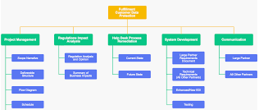
S/W Project Management Plan (SPMP)
WBS (Work Breakdown Structure)
Decomposition of project into smaller manageable parts – WBS Units
WBS Units
Each WBS unit must have a Clear Outcome, Accountability, is Trackable, has Well defined interface

Slide 13
“WBS” is created:
To Divide & Conquer & to estimate accurately
How WBS is done
Id. Logical components & minimize dependency between WBS Units
This is followed by “Bottom-Up” estimation approach

Slide 14
Bottom-up Estimate
A
A11 + A12 + A21 + A22
A11 + A12
A1
A2
A21 + A22
A11
A12
A21
A22
A11
A12
A21
A22

Slide 15
SPMP includes:
Size estimates (KLOC, FPs…)
Effort estimates
Cost estimates
Internal & External Milestones
Resource & Work allocation
Project schedule
Communication & Status Reporting plan
Risk management plan

Slide 16
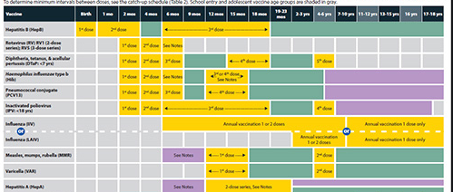
Project Schedule Estimation
“Calender Time” to deliver
Provides answer to “When can we deliver what”
Schedule estimation is done taking into account :
Deadline limits
Resources available
H/W Constraints
Internal & External dependencies
Done by constructing “Activity Network model” & using CPM (Critical Path Method)

Slide 17
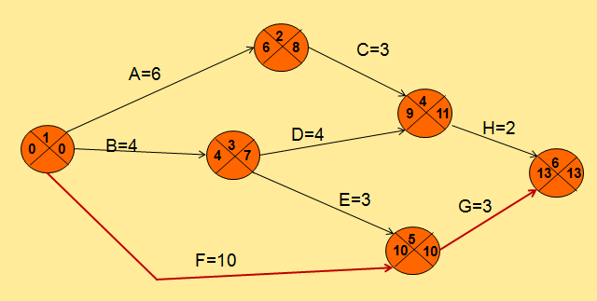
Activity network model & CPM (critical Path method)
Activities are “nodes”
Durations are “edges”
Direction of edges show “precedence / dependency” between activities

Slide 18
Scheduling of Activities : Activity network model (CPM method)
2
C=3
A=6
4
D=4
H=2
1
B=4
3
6
E=3
G=3
5
F=10

Slide 19
CPM n/w after forward pass
2
6
C=3
A=6
4
9
D=4
H=2
1
B=4
3
0
4
6
13
E=3
G=3
5
F=10
10

Slide 20
CPM n/w after backward pass
2
6
8
C=3
A=6
4
9
11
D=4
H=2
1
B=4
3
0
0
4
7
6
13
13
E=3
G=3
5
F=10
10
10

Slide 21
Critical Path
2
6
8
C=3
A=6
4
9
11
D=4
H=2
1
B=4
3
0
0
4
7
6
13
13
E=3
G=3
5
F=10
10
10

Slide 22
Critical Path
Difference (also called Slack or Float )
latest start/completion date – earliest start/completion date
Events/Tasks with 0 slack are Critical events
The path joining critical events is called “Critical Path”

Slide 23
Critical Path
Need to pay more attention to events on critical path
To Avoid delays
To shorten a project, the critical path must be shortened
By adding more resources/overtime

Slide 24

Project Estimation & COCOMO

Slide 25
Objectives
To understand different methods of “Estimating” projects
COCOMO approach

Slide 26
Introduction
A “Successful project” is the one that is
Delivered on-time
Within budget
Is of required quality
Realistic estimates are critical to achieve the above objectives

Slide 27
Estimating s/w projects
Estimation is done during below stages :
Strategic Planning (to prioritize the project)
Feasibility Study
Requirement Specification
Evaluation of supplier proposal
Project Planning

Slide 28
Basis of s/w estimating
Estimation is done based on below factors:
Based on Historical data
Env. factors, S/w & Tools used, staff experience have to considered
Based on Measure of work
Based on work content (like SLOC, KLOC)
Difficult to apply for app. building tools
Based on Complexity
Two programs with same SLOC may take different times based on complexity (complexity needs to be taken into account)

Slide 29
S/W Effort estimating techniques
Algorithmic methods
Uses characteristics of target system (Ex: size of system) & the implementation environment to predict effort
Empirical estimation techniques
Expert Judgment (Take expert advise to estimate)
Delphi Technique
Analogy (Estimate based on similar completed projects)
Parkinson (Estimate Based on staff effort available)
Price to win (Estimate to win the contract)
Top-Down (Overall effort is distributed to tasks)
Ex: Building a house based on sq. ft rate
Bottom-up (Effort of individual tasks are summed up)
Notes:
State and describe in brief the different Software estimation techniques used by the industry

Slide 30
Bottom-up VS Top-down estimation
Bottom-up estimation
Breaks the project up to tasks level
Called WBS (work breakdown structure)
Tasks can be executed by a single resource
Estimate effort for each task
Sum up to find total estimate
Top-down estimation
Parametric model used to estimate the effort based on characteristics of
the system & distribute to task level
Building a house (estimation based on sq. feet of area)
Estimation based on a characteristics of the system
Effort = System size X Productivity
Ex: 50 (Kloc) X 40 (man-days per Kloc) = 2000 man-days

Slide 31
Bottom-up Estimate
A
A11 + A12 + A21 + A22
A11 + A12
A1
A2
A21 + A22
A11
A12
A21
A22
A11
A12
A21
A22

Slide 32
Expert Judgement & Estimation by Analogy
Expert Judgment
People very knowledgeable about the s/w & type of project
can provide the estimate based on experience & expertise
Estimation by Analogy
Case-based reasoning
Estimation based on similar completed projects
Adjustments made based on the differences
Notes:
Describe the Expert Judgement and Estimation by Analogy techniques of estimation.

Slide 33
Delphi Method of estimation
The Delphi method is a process used to arrive at a group consensus (agreement) on estimation given a panel of experts
Experts respond to questionnaires
Their responses are aggregated and shared
In case of differences, further rounds of discussions take place to arrive at an agreement
Notes:
Describe the Expert Judgement and Estimation by Analogy techniques of estimation.

Slide 34
COCOMO Model
COCOMO (COnstructive COst MOdel) proposed by Boehm
Divides Software Projects / Products into Three classes based on development complexities:
Organic
Semidetached
Embedded
Notes:
Explain the COCOMO model of estimating a software project.

Slide 35
Elaboration of Product classes
Organic:
Relatively small project
Team Experienced with similar projects
Well-understood applications
Semidetached:
Project team consists of a mixture of experienced & inexperienced staff
Limited experience on similar systems
Embedded:
Complex system
The software is strongly coupled to complex hardware
Real-time systems

Slide 36
COCOMO Model (Cont.)
For each of the three product categories:
Boehm provides equations to predict:
Effort in person-months
Project duration in months
One PM is included in the effort
Takes into account productivity loss due to holidays, weekly offs...

Slide 37
COCOMO Model (cont.)
According to Boehm, Software cost estimation is done through three stages:
Basic COCOMO
Intermediate COCOMO
Complete COCOMO

Slide 38
(1) Basic COCOMO Model
Gives only an approximate estimation:
Effort = a1*(KLOC)^a2 PM
Tdev = b1*(Effort)^b2 Months
KLOC – Estimated code in kloc
a1,a2,b1,b2 - Constants for different categories of software products (Organic, Semi-detached, Emb.)
Tdev - Estimated time duration to develop the software in months

Slide 39
Development Effort & Time Estimation
Values of a1,a2 & b1,b2
Organic :
Effort = 2.4*(KLOC)^1.05 PM
Tdev = 2.5 (Effort)^0.38 Months
Semi-detached:
Effort = 3.0*(KLOC)^1.12 PM
Tdev = 2.5 (Effort)^0.35 Months
Embedded:
Effort = 3.6*(KLOC)^1.20PM
Tdev = 2.5 (Effort)^0.32 Months

Slide 40
(2) Intermediate COCOMO
Basic COCOMO model assumes
Effort and development time depend on product size alone
Several other parameters affect effort and development time:
EX:
Reliability of requirements
Availability modern tools
Size of data to be handled ...

Slide 41
Intermediate COCOMO
Intermediate COCOMO model:
Refines the initial estimate obtained by the basic COCOMO
by using a set of 15 cost drivers (multipliers)
Multiply cost driver values with the estimate obtained using the basic COCOMO
Effort = [Effort Basic_cocomo] * [CD1 * CD2 ... CD15 ] PM

Slide 42
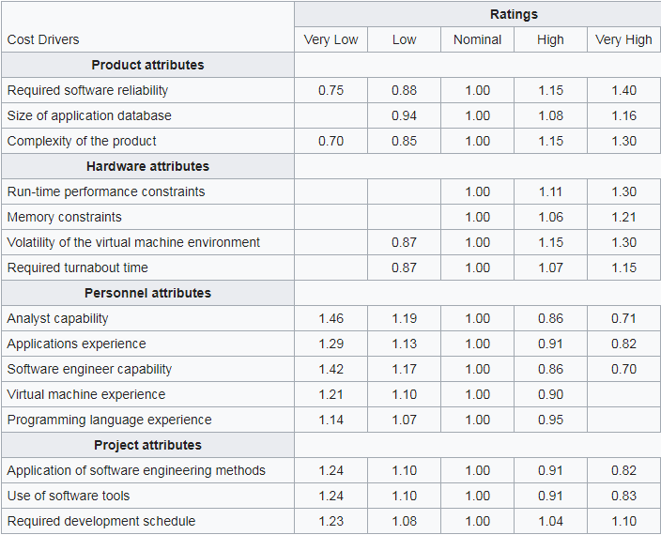
Cost Drivers

Slide 43
Shortcoming of basic and intermediate COCOMO models
In Both models:
Consider a software product as a single homogeneous entity
However, most large systems are made up of several smaller sub-systems
Some sub-systems may be organic type, some may be semi-detached or embedded
Notes:
Q. What is the shortcoming of basic and intermediate COCOMO models, that are taken care in complete COCOMO model? (Short)

Slide 44
(3) Complete COCOMO
Each sub-system may be of different types – organic, semi-detached or embedded
Cost of each sub-system is estimated separately
Costs of the sub-systems are added to obtain total cost
This Reduces the margin of error in the final estimate

Slide 45
Example
A Management Information System (MIS) for an organization with many branches has:
Database part (semi-detached)
Graphical User Interface (GUI) part (organic)
Communication part (embedded)
Costs of the components are estimated separately:
Summed up to give the overall cost of the system

Slide 46
Halstead’s Software Science
Halstead complexity measures are software metrics introduced by M.H Halstead in 1977
Consists of a number of metrics to measure complexity of code based on it’s algorithm
These metrics are computed statistically from the code
Halstead's goal was to identify measurable properties of software, and the relations between them
Notes:
Explain how Halstead’s Software Science is used to measure the complexity of a software program.

Slide 47
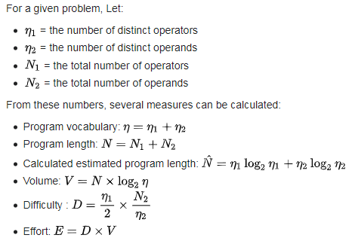
Metrics Calculation steps

Slide 48
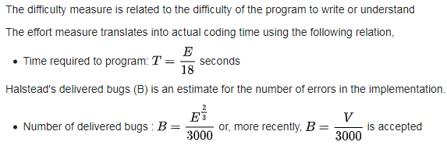
Metrics Calculation steps

Slide 49
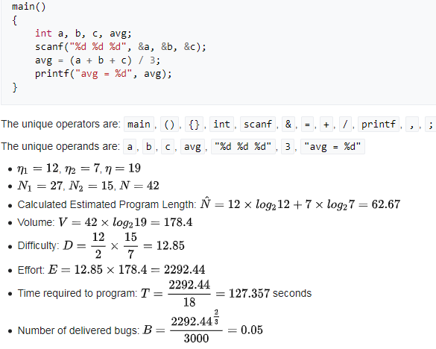
Example

Slide 50
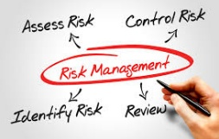
Risk Management

Slide 51

Identify Risks
Objective:
To identify the Risks that may cause a project to complete late or go over budget
Identify 3 types of risks :
Risks caused by Estimation difficulties
Risks caused by Assumptions made during planning
Risks caused by unforeseen events
Notes:
What are the different categories of risks and how to identify them?
Explain how risks in a project are caused by estimation difficulties, assumptions and unforeseen events. Medium

Slide 52


1. Estimation Difficulties
Some tasks are harder to estimate than others:
Due to lack of experience of the estimator OR
Due to nature of the task
Ex:
Debugging is harder to estimate than creating user manuals
Estimation can be improved by analyzing historical data

Slide 53

2. Assumptions
If assumptions made during planning are invalid,
Project will be at risk
Ex: Wrong selection of life cycle model or design approach
3. Unforeseen Events
There may be some rare unforeseen event happening
Ex: Tech. used becomes unstable / unsupported,
Drastic rule changes

Slide 54
Risk Engineering structure
Objectives:
To avoid or minimize effects of project risks
Risk Engg.
Risk Analysis
Risk Mgmt
Risk Id.
Risk Estimation
Risk
Evaluation
Risk
Planning
Risk
Control
Risk
Monitoring
Risk
Directing
Risk
Staffing
Notes:
Draw the Risk Engineering structure with relevant components.

Slide 55

Managing Risks
Risk Analysis:
Risk Identification : List all the risks affecting the project
Risk Estimation : Assessing the likelihood & impact of each risk
Risk Evaluation : Ranking the risks
Risk Management:
Risk Planning : Making ‘contingency plans’ & adding tasks to project.
May need a risk manager
Risk Control : Minimizing & Reacting to risks throughout the project
Risk Monitoring : On-going task. Risk likelihoods & impacts may change
Risk Staffing : Allocate Staff to manage risks in day-to-day basis

Slide 56

Risks Identification
If a risk affects activities on ‘critical path’ it will cause delay
Use checklist to Identify Risks (2 types)
Generic risks
Ex: Misunderstanding of requirements, Key person ill
Specific risks (for a given project) – More difficult to id.
Ex: Unknown techs used in the project, Safety-critical

Slide 57

1. Risk Analysis: 1.2. Risks Estimation
Determine “Likelihood” & “impact” (in monetary terms) of risks
Calculate ‘Risk Value” (Expected cost)
Risk Exposure = Risk likelihood X Risk Impact
Use “Risk Exposure” to prioritize or rank risks
Risk scoring can be expressed as (H, M, L) or in scale of 1-10
Notes:
Explain the steps of Risk Analysis and Risks Estimation.

Slide 58
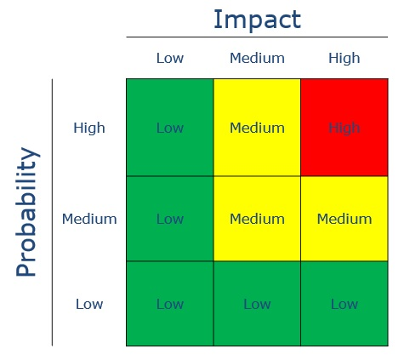
Risk Matrix
A risk matrix is a matrix that is used during risk assessment to define the level of risk by considering :
The “category of probability or likelihood” against the “category of consequence severity or impact”
This is a simple mechanism to increase visibility of risks & assist management decision making
Notes:
Explain the steps of Risk Analysis and Risks Estimation.

Slide 59

Strategies to Reduce Risks
5 Strategies are there :
Risk Prevention (Scheduling critical meetings early)
Likelihood Reduction (Prototyping reduces chance of freq. reqt. changes)
Risk Avoidance (Reduce functionality, Increase duration)
Risk Transfer (Contracting, Insurance)
Contingency Planning (Plan to minimize impact of remaining risks)
Notes:
What are the different strategies to reduce Risks?

Slide 60
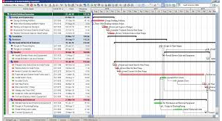
1. Risk Analysis: 1.3. Risks Evaluation – on schedule
All risks can not be eliminated
Some will delay the project
Id. such risks & their impact on duration
Can use 2 methods:
PERT
Uses 3 estimates : Most likely (m), Optimistic (a) & Pessimistic time (b)
PERT combines these 3 estimates into a single estimate
t = (a + 4m + b)
e 6

Slide 61
Using expected durations
The event dates are not the ‘earliest possible dates’
But ‘expected dates’

Slide 62
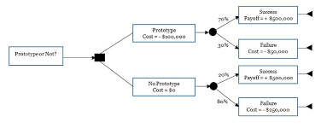
Risk Evaluation
(2) Using “Decision Tree Analysis”
It is important to see how a decision will affect the future profitability of a project
Ex:
Not replacing old systems with new ones could result in revenue loss
Replacing now will result in more spending
D.T analysis consists of evaluating expected benefits of taking each path from a decision point
Notes:
Explain the Risk Evaluation using “Decision Tree Analysis” approach.

Slide 63
Risk Evaluation
Expected Benefits
Decision trees
-100,000
Expansion
Don’t Replace
75,000
No Expansion
D
250,000
Expansion
Replace
No Expansion
-50,000

Slide 64
Thank You !!!

