Slide 1


INFOSYS SPRINGBOARD · VIRTUAL INTERNSHIP 7.0
FreightAI
Agentic AI for Maritime Freight Pricing and Route Optimization
AI pricing, live marine weather, customs intelligence and a risk approval gate — in one platform.
63 / 63
R² 0.9792
10
4
TESTS PASSING
ML PRICE ACCURACY
CUSTOMS JURISDICTIONS
AI SERVICES IN-LINE
GROUP 1 · SIX ENGINEERS
Naresh Ramavath
Nutan Jadhav
Biswajit Pradhan
Lead · Architecture · RAG
Frontend
Machine Learning
Syona Jain
Arpita Dash
Ishanvi Chavan
Frontend · UI/UX
Telemetry · Risk
QA · DevOps
Mentor: Bala · Live: freight-quote-generation-system-grp.vercel.app
Notes:
Good morning everyone. I am Naresh Ramavath from IIT Kharagpur. My team and I are presenting FreightAI — our project for the Infosys Springboard Virtual Internship, titled Agentic AI for Maritime Freight Pricing and Route Optimization. Our mentor for this project was Bala, and we are grateful for his guidance through every milestone. Here is the one-line context: when a company wants to ship goods by sea, someone has to tell them what it will cost. Today that someone is a human broker with spreadsheets and email. We turned that into a live web platform where AI agents draft the quote, check the weather on the actual sea route, validate customs rules, and score the risk before any human approves it. Everything I show you today is deployed and running live at the link on this slide, so you can try it yourself after the talk. Over the next few minutes I will show you why we built this, how it works inside, and what we learned. Let's start with why freight quoting needed a fix.

Slide 2



INTRODUCTION
What We Built
One web platform where a shipment is priced by AI, weather-checked, customs-checked and risk-approved — before booking.
THE JOURNEY
THE INTELLIGENCE
THE EVIDENCE
One shipment form — ports, cargo, HS code, weight.
Four AI services run in parallel, in-line.
Carrier agent and customs officer approve in turn.
Booking confirmed with an immutable reference.
ML predicts the market spot rate (R² 0.9792).
Marine telemetry scans the real sea waypoints.
Hybrid RAG cites the customs rule, never invents it.
A 5-factor MCDA score decides approve or hold.
Deployed live on Vercel, four seeded roles.
63 of 63 automated tests passing.
50 customs scenarios across 10 jurisdictions.
22 booking-flow and tenant-isolation tests.
FreightAI Agentic AI for Maritime Freight Pricing
02 / 25
Notes:
So what exactly did we build? In one sentence: a single web platform that takes a shipment from an idea to a confirmed booking, with AI doing the heavy lifting in between. The customer enters their shipment once — origin port, destination, cargo type, weight. The system instantly drafts priced quote options. But unlike a normal calculator, four AI services wake up at the same time. A machine learning model predicts what the market would actually charge. A weather agent checks storms along the real sea route. A customs engine validates the paperwork rules for that cargo and country pair. And a risk engine decides whether the quote can go out automatically or needs a human to approve it first. Everything runs live on Vercel right now, and it is backed by a full automated test suite — sixty-three tests, all passing, including fifty international customs scenarios and twenty-two booking flow tests. The rest of the slides unpack each of these pieces one by one.

Slide 3
BACKGROUND
Why Freight Quoting Needed a Fix
Sea freight moves most of world trade — yet the quote behind every booking is still a spreadsheet, an email thread and a broker's memory.
DAY 0
DAY 1–2
DAY 2–4
AFTER BOOKING
Shipper emails cargo details and port pair
Broker works rate sheets, quotes one carrier
Revisions by PDF — no audit of who changed what
Storm delay, wrong HS code, demurrage
24–48 hrs
Spreadsheets
After booking
industry quote turnaround
still the system of record
when weather & customs risk surfaces
FreightAI Agentic AI for Maritime Freight Pricing
03 / 25
Notes:
Let me give you some background on how freight quoting actually works today, because that is what shaped our design. Sea freight carries the bulk of world trade, and almost every container starts with the same slow ritual. A shipper emails their cargo details to a freight forwarder. The broker digs through rate sheets, maybe checks two or three carrier price lists, and emails back a number. That takes a day or two. Then comes revision after revision — more emails, more PDFs — before the shipper even sees a real price. Two to four days for a quote that is mostly arithmetic. And the painful part is what happens after booking: a storm delays the vessel, or a customs officer finds a missing certificate, and everyone is surprised. The information was always there; nobody checked it before the price was given. The industry runs on email threads and PDFs, in silos — the shipper, the agent and the customs officer never look at the same screen. That is the gap we wanted to close.

Slide 4




PROBLEM STATEMENT
The Problems We Found
Manual, inconsistent pricing
01
Weather blindness
02
Rates copied from sheets and old emails — two brokers, two prices, no explanation.
The price is fixed before anyone looks at the waves on the actual lane.
Customs guesswork
03
No governance
04
One wrong HS digit or a missing certificate of origin — and the box sits, accruing demurrage.
Hazardous cargo and thin-margin quotes go out with nobody's name against them.
Together: a fast-looking number that is actually slow, blind and unverified.
FreightAI Agentic AI for Maritime Freight Pricing
04 / 25
Notes:
When we dug into that process, we found four concrete problems. First, pricing is manual — brokers copy numbers out of spreadsheets and old emails, so the same shipment gets different prices from different people, and nobody can explain why. Second, weather blindness — the quote is issued with zero knowledge of a storm sitting right on the shipping lane; the delay shows up only after the customer has already booked and paid. Third, customs errors — a single wrong HS code digit or one missing certificate, and cargo sits at the border costing storage fees every day. And fourth, there is no risk check at all — a suspiciously cheap quote, a high-risk route, dangerous cargo: nothing stops it from being issued automatically. Each problem alone is annoying; together they mean the customer gets a fast-looking number that is actually slow, blind and unverified. We set our goals around fixing exactly these four problems.

Slide 5
OBJECTIVES
Our Goals
Four goals — each one answers one problem, one to one.
01
Price it in seconds, defensibly
SOLVES Manual pricing
ML market rate beside the rule-based cost build-up — target R² > 0.95.
02
Check the route that ships sail
SOLVES Weather blindness
Live marine telemetry at great-circle waypoints, not the straight line.
03
Retrieve customs law, never guess it
SOLVES Customs guesswork
Hybrid RAG over 10 jurisdictions; every checklist item carries its citation.
04
Put a named human on every risk
SOLVES No governance
5-factor MCDA score gates the quote — approve, advise, hold or block.
FreightAI Agentic AI for Maritime Freight Pricing
05 / 25
Notes:
From those four problems, we set ourselves four goals — and they map one to one. Goal one: prices should be instant and fair. Not a broker's guess — a machine learning model trained on five thousand real freight records, answering in seconds. Goal two: check the real route. When we quote Chennai to Rotterdam, we sample the actual ocean waypoints in between and ask a live marine weather API what the waves and wind are doing there right now. Goal three: get customs right. Instead of hoping the agent remembers the rules, we retrieve them — a retrieval system reads the actual regulations and generates the document checklist automatically. And goal four: gate the risk. Every shipment gets a five-factor risk score, and low scores flow out instantly while high scores are held for a human decision. Simple goals, but together they change what a quote means — from a static number to a verified decision.

Slide 6



OUR SOLUTION
Our Solution at a Glance
An orchestrator fans all four services out in parallel, merges their verdicts, and only then prices the shipment.
ML pricing
Customs RAG
GBR spot rate + margin floor
BM25 + vector, every rule cited
FreightAI core
Quote & booking engine
Weather agent
Risk gate
Open-Meteo marine telemetry
5-factor MCDA · approve or hold
FreightAI Agentic AI for Maritime Freight Pricing
06 / 25
Notes:
Here is the whole solution on one slide. In the center is the FreightAI core — the quote and booking engine. Around it sit the four services you will meet in detail later. On the left, ML pricing and the weather check: they make sure the number is right and the route is safe. On the right, the customs RAG assistant and the risk gate: they make sure the paperwork exists and a human sees anything suspicious. The arrows matter: every quote request passes through all four before a price ever reaches the customer. And underneath everything is the human workflow — shipper, company agent, customs officer — all working from the same data on the same platform, instead of three disconnected email threads. Nothing is black-box either: each service explains itself, showing the rule price next to the ML price, the wave heights behind the weather risk, and the exact factor contributions behind the risk score. That transparency was deliberate — people only trust AI they can inspect.

Slide 7



ARCHITECTURE
How the System Is Designed
Each service is its own Django app with its own test phase — every quote must clear all four before a price is shown.
CLIENT
React 19 + Vite client
Four RBAC dashboards · JWT session
API · ORCHESTRATOR
Django REST core + AI Orchestrator
Parallel fan-out · verdict merge · booking state machine
INTELLIGENCE
ML pricing
Weather agent
Customs RAG
Risk engine
GBR · joblib artifact
Open-Meteo · 6-hr cache
BM25 + TF-IDF + RRF
5-factor MCDA gate
DATA
Data layer
Django ORM stores · MongoDB audit trail
FreightAI Agentic AI for Maritime Freight Pricing
07 / 25
Notes:
Let me show you how the system is designed. At the top is the React 19 client — a single web app that renders a different dashboard depending on who logs in: shipper, company agent, customs officer or admin. It talks to a Django REST backend over standard REST calls. That backend is the brain of the workflow: it owns authentication, quotes, and the whole booking state machine from milestone four. Below the core sit the four intelligence services, drawn here as siblings because they run in parallel: the ML pricing model, the weather agent, the customs RAG engine and the five-factor risk engine. They are separate Django apps, so each one can be tested and evolved on its own — our test suite covers each phase independently. At the bottom is the data layer, where every quote, decision and status change is stored as an audit trail. One design rule to notice: every quote must pass through all four services before it gets priced. The architecture enforces the process — nothing skips the weather check or the customs validation.

Slide 8


WORKFLOW
How It Works, Step by Step
1
Input
2
AI check
3
Quote
4
Approvals
5
Booking
Ports, cargo, HS code, weight, volume, Incoterm
ML price · weather · customs RAG · risk score
Multi-carrier options, line-item cost build-up
Agent verifies · customs clears · gate decides
Customer confirms; immutable reference issued
THE GOVERNED STATE MACHINE
DRAFT
OPTIONS_AVAILABLE
QUOTE_SELECTED
APPROVED / REVISION
CUSTOMS_CLEARED
BOOKING_CONFIRMED
/quotes/estimate/
/quotes/generate/
/quotes/select/
/m4/verify/
/customs/signoff/
/m4/booking/confirm/
The approval gate
Revisions never overwrite
Risk ≤ 60 → the quote issues automatically. Risk > 60, hazardous cargo or missing documents → held for agent or customs sign-off.
A counter-offer creates a tracked revision the customer must accept. Every transition is validated and audited.
FreightAI Agentic AI for Maritime Freight Pricing
08 / 25
Notes:
Now let's walk the system end to end, exactly as a shipment experiences it. Step one, input: origin and destination ports, cargo type, HS code, weight, volume and the Incoterm — one form, one submission. Step two is where the AI wakes up: the orchestrator fans all four services out in parallel, so the ML price, the weather scan, the customs check and the risk score are computed together rather than one after another. Step three, quote: the customer sees competing carrier options, each with a line-item cost build-up, not a single opaque number. Step four is the human part — the carrier agent verifies capacity and documents, and customs reviews the dossier. Step five, booking, with an immutable reference. Now look at the rail underneath, because this is the part that makes it a system rather than a calculator. Every stage is a named state with exactly one endpoint that can produce it — DRAFT from quotes/estimate, OPTIONS_AVAILABLE from quotes/generate, then select, verify, customs sign-off, and finally booking confirm. The backend refuses any transition that is not on this path. And notice what a counter-offer does: it creates a tracked revision that the customer must explicitly accept. The original quote is never overwritten, so the question of what was offered and when always has an answer.

Slide 9



MODULE 1 · PRICING
How a Freight Price Is Built
Two independent price engines — a transparent formula and a trained model — reconciled by one orchestrator.
M1
Formula pricing
A predefined formula calculates the price
Shipment details
Pricing orchestrator
Recommended freight price
Origin, destination, weight, volume, mode, cargo type
Combines rule price + ML price, then applies a risk premium
M2
ML pricing
A trained model predicts the price
FreightAI Agentic AI for Maritime Freight Pricing
09 / 25
Notes:
Module one: pricing. I want to be precise here, because the ML model is only half of it. Underneath sits a deterministic rule engine, from milestone one — it computes great-circle distance between the ports, resolves chargeable weight as the greater of actual and volumetric weight, applies the Incoterms 2020 split so we know which costs are ours to quote, and then builds the price up in ten steps: base freight, bunker and currency surcharges, terminal handling at both ends, ISPS and documentation, haulage legs, hazardous handling where it applies, cargo insurance on the CIF formula, and finally margin. That build-up is what the customer sees line by line. On top of that sits milestone two: a Gradient Boosted Regressor trained on five thousand lanes, four thousand for training and a thousand held out. We benchmarked four families — linear and ridge land at 0.85, random forest 0.96, extra trees 0.97, and gradient boosting wins at 0.9792 R-squared, with a mean absolute percentage error of five and a half percent, about sixty-four dollars a quote. The strongest drivers are chargeable weight, lane distance and the bunker fuel index — exactly what an experienced broker would weigh, which is a good sign the model learned the domain rather than noise. And critically, the model never overrules the rule engine silently: both prices sit side by side on every quote. Every number on this slide comes from our benchmark report in the repository.

Slide 10
MODULE 1 · PRICING
M1 — The Rule-Based Formula
Every rupee is traceable: a deterministic build-up from distance, chargeable weight and two multipliers.
Chargeable weight (kg)
VARIABLES
1
d Distance in km
w Chargeable weight in tonnes
max(Actual weight, Volume × 250)
D Distance cost
C Additional cargo charge
2
Distance cost D
TRANSPORT MODE MULTIPLIER (m)
D = 3.5 × d × w × m
Road
Rail
Air
Ocean
1.0
0.85
3.2
0.65
3
Additional cargo charge C
C = D × (c − 1)
CARGO-TYPE MULTIPLIER (c)
General
Express
Cold chain
Hazardous
1.0
1.4
1.7
2.0
TOTAL PRICE
FIXED VALUES
(250 + D + C) × 1.12
Base handling
Rate / km / t
Fuel surcharge
Quote validity
₹250
₹3.5
12%
7 days
FreightAI Agentic AI for Maritime Freight Pricing
10 / 25
Notes:
Module one: pricing. I want to be precise here, because the ML model is only half of it. Underneath sits a deterministic rule engine, from milestone one — it computes great-circle distance between the ports, resolves chargeable weight as the greater of actual and volumetric weight, applies the Incoterms 2020 split so we know which costs are ours to quote, and then builds the price up in ten steps: base freight, bunker and currency surcharges, terminal handling at both ends, ISPS and documentation, haulage legs, hazardous handling where it applies, cargo insurance on the CIF formula, and finally margin. That build-up is what the customer sees line by line. On top of that sits milestone two: a Gradient Boosted Regressor trained on five thousand lanes, four thousand for training and a thousand held out. We benchmarked four families — linear and ridge land at 0.85, random forest 0.96, extra trees 0.97, and gradient boosting wins at 0.9792 R-squared, with a mean absolute percentage error of five and a half percent, about sixty-four dollars a quote. The strongest drivers are chargeable weight, lane distance and the bunker fuel index — exactly what an experienced broker would weigh, which is a good sign the model learned the domain rather than noise. And critically, the model never overrules the rule engine silently: both prices sit side by side on every quote. Every number on this slide comes from our benchmark report in the repository.

Slide 11


MODULE 1 · PRICING
M2 — Gradient Boosting, Tree by Tree
Trained on shipment features and actual freight prices, the model predicts a price for any new shipment.
Training data shipment features + actual freight prices
Gradient Boosting Regressor
Think of it as a series of small decision trees.
The model learns relationships between shipment characteristics and historical prices.
Tree 1
Tree 2
Tree 3, 4 …
Tree 200
Makes an initial prediction.
Learns to reduce the errors left by the earlier tree.
Each tree fits the errors that remain.
The combined prediction is the final price.
FINAL PREDICTION
F₀(x) initial prediction
hₜ(x) prediction from tree t
ŷ = F₀(x) + η · Σ hₜ(x)
η learning rate
200 boosting stages
t = 1 … 200
FreightAI Agentic AI for Maritime Freight Pricing
11 / 25
Notes:
On top of the rule engine sits milestone two: a Gradient Boosted Regressor. Think of it as a series of small decision trees. The first tree makes an initial prediction; every following tree learns to reduce the errors left by the trees before it. After two hundred boosting stages, the combined prediction is the final price. The formula at the bottom is the conceptual form of that additive model — an initial prediction plus the learning-rate-weighted sum of every tree's correction.

Slide 12





MODULE 1 · PRICING
Training Data & Model Benchmark
Five regression families trained on the same 5,000 lanes and scored on the same held-out 1,000.
5,000
12
Test-set comparison
R²
MAE
Total records
Input features
OLS Linear
0.8488
₹18,898
Ridge
0.8488
₹18,888
4,000
1,000
Random Forest
0.9649
₹7,663
Training records
Testing records
Extra Trees
0.9693
₹7,073
TRAIN / TEST SPLIT
Gradient Boosting
0.9792
₹5,307
Train 4,000 · 80%
Test 20%
Gradient Boosting wins — best R² and lowest MAE.
FreightAI Agentic AI for Maritime Freight Pricing
12 / 25
Notes:
We trained on five thousand lanes with twelve input features — four thousand for training and a thousand held out for testing. We benchmarked the model families on the same held-out set: linear and ridge land at 0.85 R-squared, random forest 0.96, extra trees 0.97, and gradient boosting wins at 0.9792 with the lowest mean absolute error. Every number on this slide comes from our benchmark report in the repository.

Slide 13
MODULE 1 · PRICING
How the Formula and ML Model Work Together
The champion model is accurate — and it still never overrules the rule engine silently.
CHAMPION TEST RESULTS
What drives the prediction
R² = 0.9792
Transport mode
62%
Distance
24%
Gradient Boosting Regressor
Fuel price
9%
₹5,307
5.54%
83.7%
Weight
4%
MAE
MAPE
Within 10% of actual
All other features
1%
RECOMMENDED PRICE
Rule price and ML price sit side by side on every quote.
(2 × Rule Price + ML Price) ÷ 2 × (1 + Risk Premium)
FreightAI Agentic AI for Maritime Freight Pricing
13 / 25
Notes:
The champion model explains about ninety-eight percent of price variance, with a mean absolute percentage error of five and a half percent, and more than eighty percent of predictions land within ten percent of the actual price. The strongest drivers are transport mode, distance and fuel price — exactly what an experienced broker would weigh, which is a good sign the model learned the domain rather than noise. And critically, the model never overrules the rule engine silently: the orchestrator combines the rule price and the ML price, applies the risk premium, and both prices sit side by side on every quote.

Slide 14
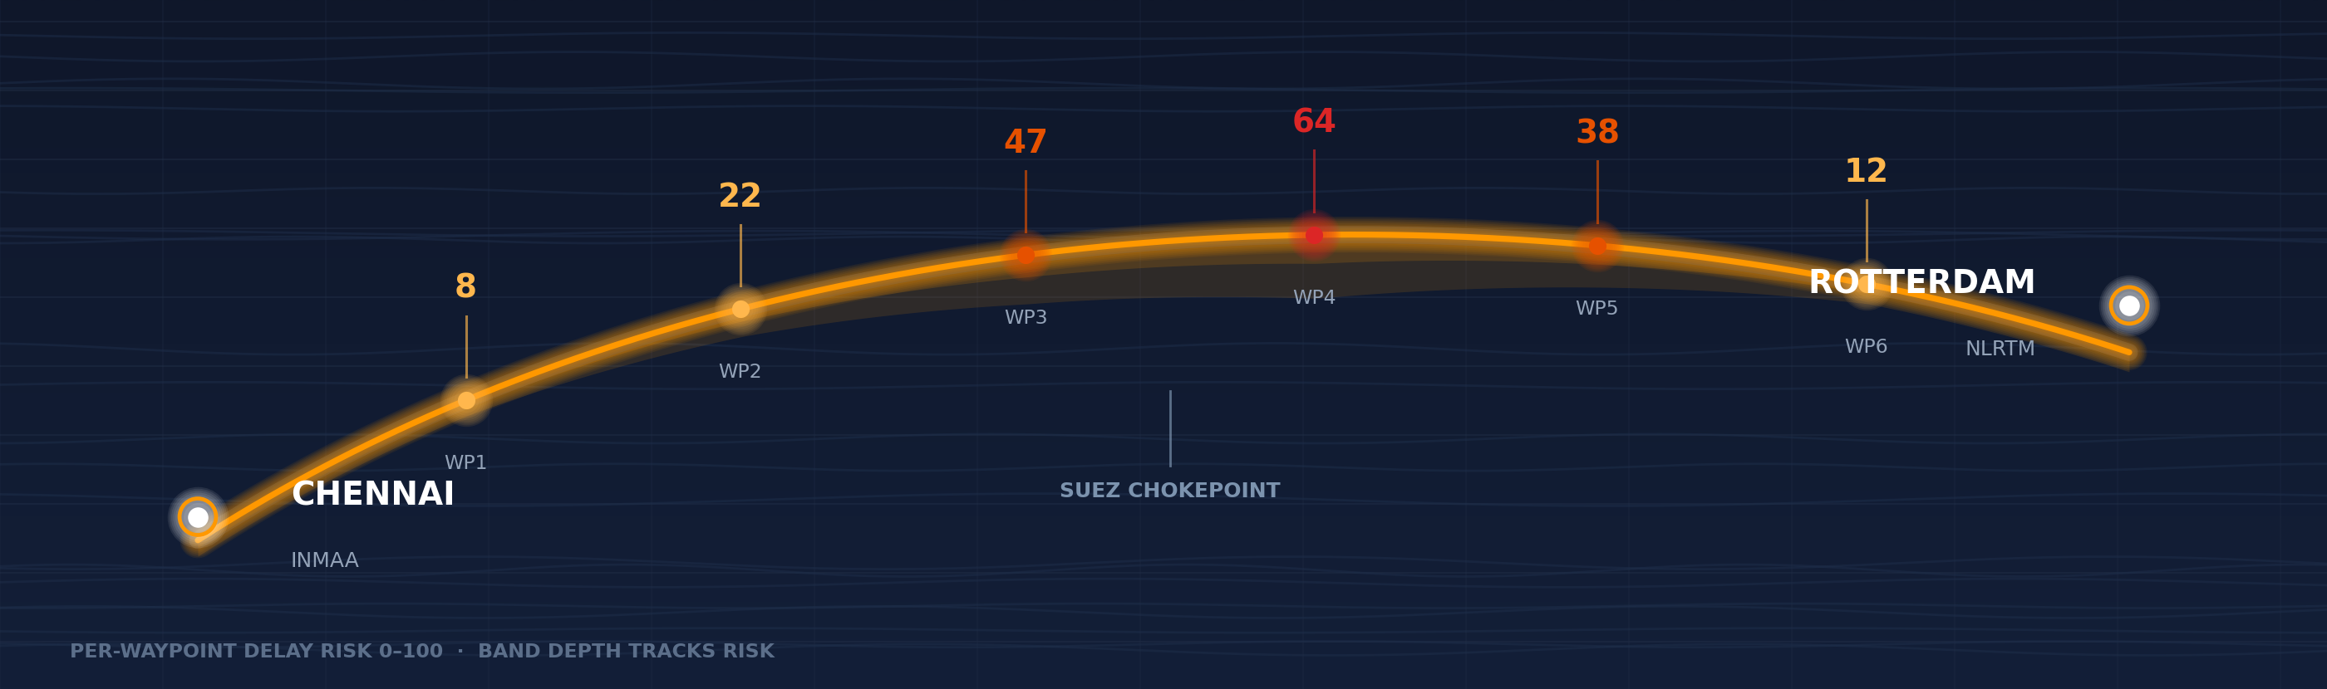



MODULE 2 · LIVE DATA
Live Weather Check
The quote knows the ocean before the ship does — sampled at the waypoints a vessel actually sails.
THE SAMPLE
THE TELEMETRY
THE VERDICT
THE FALLBACK
2–10 great-circle sea waypoints, each queried on its own.
Open-Meteo marine + forecast: wave height, swell, wind, storm.
Caution above 3.0 m, severe above 4.0 m — delay hours on the quote.
6-hour cache; if the API is down a seasonal model takes over — tested offline.
FreightAI Agentic AI for Maritime Freight Pricing
14 / 25
Notes:
Module two: the live weather check. This one came from a simple question — why does a quote know the price but not the ocean? Here is how it works. When a route is quoted, we sample it into between two and ten sea waypoints using great-circle interpolation. For each waypoint we call the Open-Meteo marine and forecast APIs and pull real telemetry: significant wave height, wind speed, storm warnings, precipitation. Each observation is converted into a zero-to-one-hundred risk score — waves above three meters, for example, push the score toward the dangerous end — and the route rolls up into a delay probability and estimated delay hours, which appear right on the quote. So the customer sees, before booking, that waypoint three has a forty-seven percent delay risk this week. Two engineering details I am proud of. First, resilience: if Open-Meteo is unreachable, a deterministic seasonal fallback keeps the pipeline running — we have an automated test proving that. Second, caching: waypoint data is cached for six hours, so live data stays fast without hammering the API. The quote now knows the ocean before the ship does.

Slide 15




MODULE 3 · COMPLIANCE
Customs Rules Assistant
Retrieval-augmented checks — BM25 keywords + vector search, and every answer is cited.
Shipment query
Hybrid retrieval
Re-rank & filter
Checklist + citations
6-digit HS code, commodity, origin, destination
BM25 lexical + TF-IDF vector, fused by RRF
Country match + HS-prefix boost
Mandatory docs, tariff flags, hold risk — each cited
Regulatory corpus — 10 jurisdictions
50 / 50
Chunked to 200–400 characters · validates B/L, invoice, packing list and certificate of origin against the HS code.
EU
US
China
India
Singapore
UCC / EORI
CBP / FMC / EAR
CBIC / ICEGATE
TradeNet
CUSTOMS SCENARIOS PASSED
UK
Japan
Australia
UAE
Brazil
Five statutory scenarios per jurisdiction, run on every build.
HMRC / CDS
ABF
Siscomex
No citation, no rule — the anti-hallucination contract.
test_50_customs_scenarios.py
FreightAI Agentic AI for Maritime Freight Pricing
15 / 25
Notes:
Module three: the customs rules assistant — my favourite piece, because it is a proper RAG system. The problem is that customs law is enormous and country-specific, and no human remembers it all. Our pipeline has four stages. The shipment query carries the six-digit HS code, the commodity and the country pair. Then hybrid retrieval: BM25 lexical matching catches exact legal terms and code references, TF-IDF vector search catches conceptual matches, and reciprocal rank fusion merges the two rankings. Then re-ranking boosts results where the country matches and the HS prefix aligns, so Indian electronics rules beat generic global text. Finally, generation turns the top evidence chunks into a document checklist — bill of lading, commercial invoice, packing list, certificate of origin, plus whatever that cargo specifically requires. The corpus spans ten jurisdictions: the EU under the Union Customs Code, the US with CBP and export administration rules, China, India's CBIC and ICEGATE, Singapore's TradeNet, the UK's HMRC and CDS, Japan, Australia's Border Force, the UAE and Brazil's Siscomex — chunked to two to four hundred characters so retrieval stays precise. And here is the rule that matters most: every checklist item must carry a citation to the regulation it came from. No citation, no rule. That is our anti-hallucination contract, and it is enforced, not aspirational. Fifty statutory scenarios, five per jurisdiction, all fifty pass on every build.

Slide 16
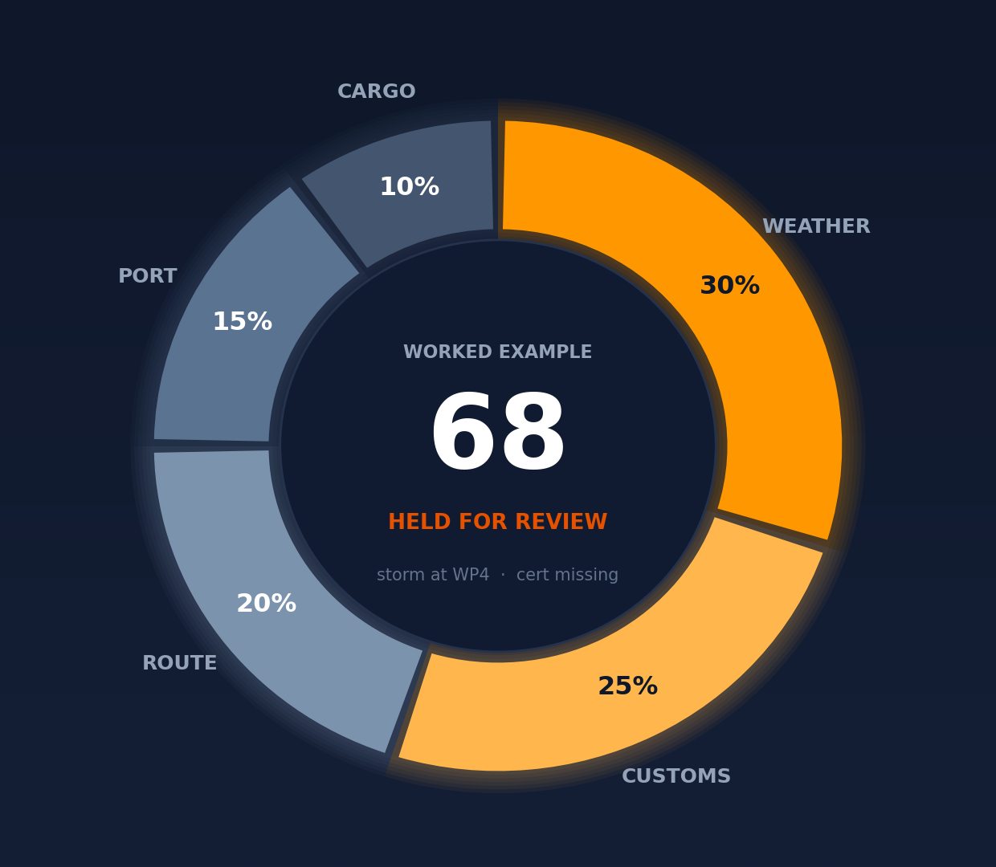
MODULE 4 · GOVERNANCE
Risk Score & Approval Gate
Five weighted factors, one composite score, one policy gate.
RISK = WEIGHTED SUM OF
30%
25%
20%
15%
10%
Weather
Customs
Route
Port
Cargo
COMPOSITE SCORE BANDS
APPROVE
HOLD
Score ≤ 60 — the quote issues automatically
Score > 60 · hazmat · missing documents
Worked example: 68 → held for review
Customs REJECTED is a hard block, whatever the score says. A compliance failure is not averaged away — every held quote reaches a named human with the factor breakdown attached.
FreightAI Agentic AI for Maritime Freight Pricing
16 / 25
Notes:
Module four is the gatekeeper: the risk score and approval gate. Every shipment gets a composite score from five weighted factors — and this formula is in the code, not just on the slide. Weather carries thirty percent, straight from the marine telemetry we just saw. Customs and compliance carry twenty-five: document completeness, embargo hits, tariff flags. Route and chokepoint risk carry twenty — think the Suez, the Malacca Strait, Bab-el-Mandeb. Port congestion carries fifteen, and cargo sensitivity — hazardous goods, perishables, restricted commodities — carries ten. The score then lands on a four-band policy. Zero to thirty issues the quote instantly. Thirty-one to sixty issues it with a cautionary advisory attached. Sixty-one to eighty is held for senior broker review. Above eighty is blocked outright — and separately, a customs rejection is a hard block whatever the numeric score says, because a compliance failure is not something you average away. The flow on the right shows that in practice, and the important detail is the last line: when a quote is held, it goes to a named human with the full factor breakdown attached, so they can see immediately that it was, say, the weather factor and the missing certificate that stopped it. AI proposes; the gate disposes; and a person is always accountable for the hold.

Slide 17
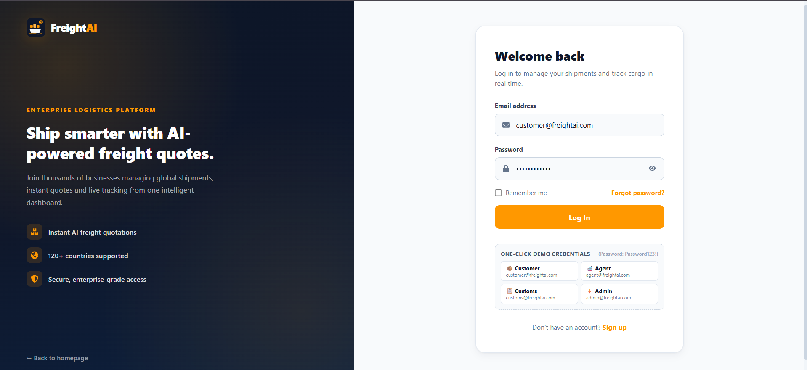
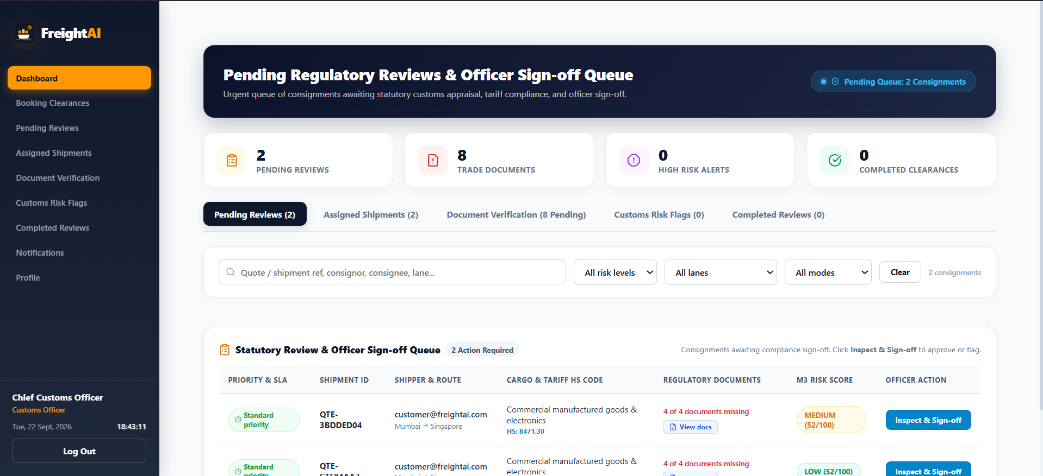
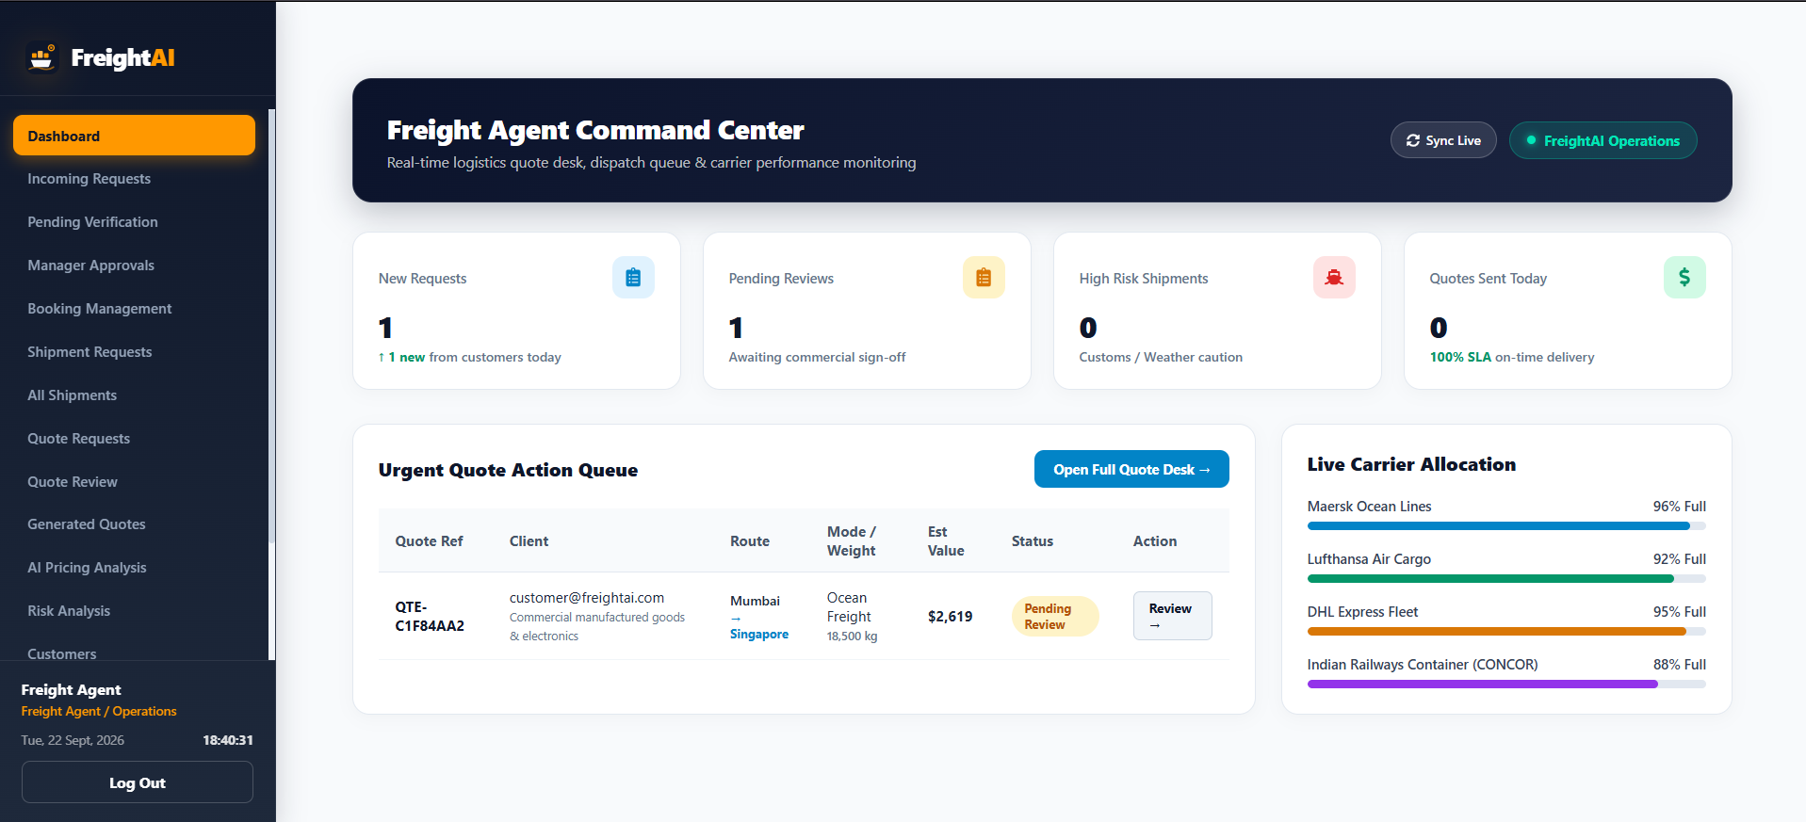

USER JOURNEY
One Secure Login, Three Roles
Each user is authenticated, their role identified, and routed to the dashboard their permissions allow.
SHIPPER
COMPANY AGENT
CUSTOMS OFFICER
Enters a registered email and password to securely access the platform.
The system authenticates the user and identifies the assigned role before granting access.
After login, each role is directed to its own dashboard based on its permissions.
Each user sees only the features and information for their role — privacy and controlled access across the platform.
FreightAI Agentic AI for Maritime Freight Pricing
17 / 25
Notes:
Who actually uses FreightAI? Three roles, in sequence — and the screenshots you see are the actual dashboards, captured live from the running app. First the shipper, on the left: their home screen shows shipments, quotes and tracking at a glance. They enter the shipment once, compare priced options side by side, select one company's quote, and later confirm the booking. Second, the company agent, in the middle: their incoming-requests queue is the M4 verification desk. The selected company reviews capacity, route, documents and commercial terms — and can approve, revise, reject, or ask the customer for information. A revision never overwrites the original quote; it creates a tracked revision. Third, the customs officer, on the right: the booking-clearances desk only ever shows requests a company has already approved. The officer checks the paperwork and customs risk, then clears or rejects with a written reason. Only after customs clears does the customer get the final confirm button. Around this flow sit strict isolation rules — competing carriers never see each other's queues, customs never sees a company's verification desk — and our twenty-two booking-flow tests verify those permissions explicitly.

Slide 18
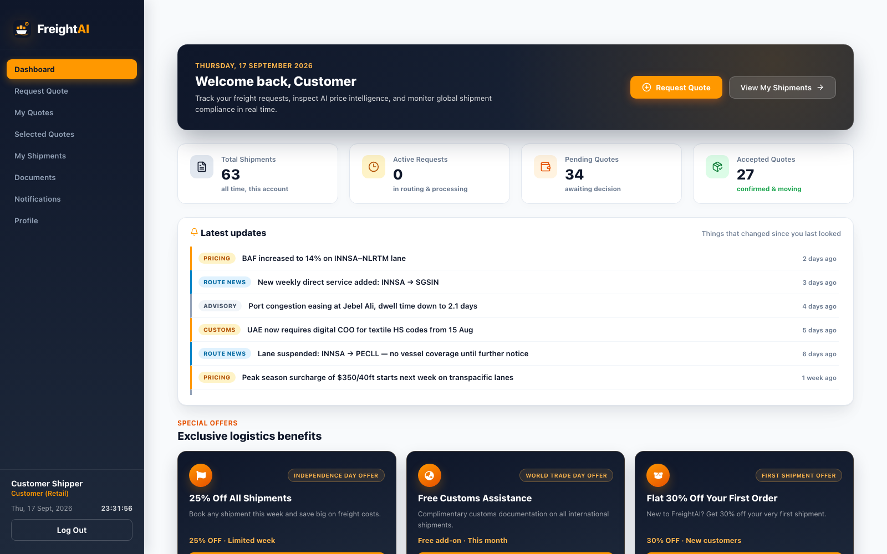
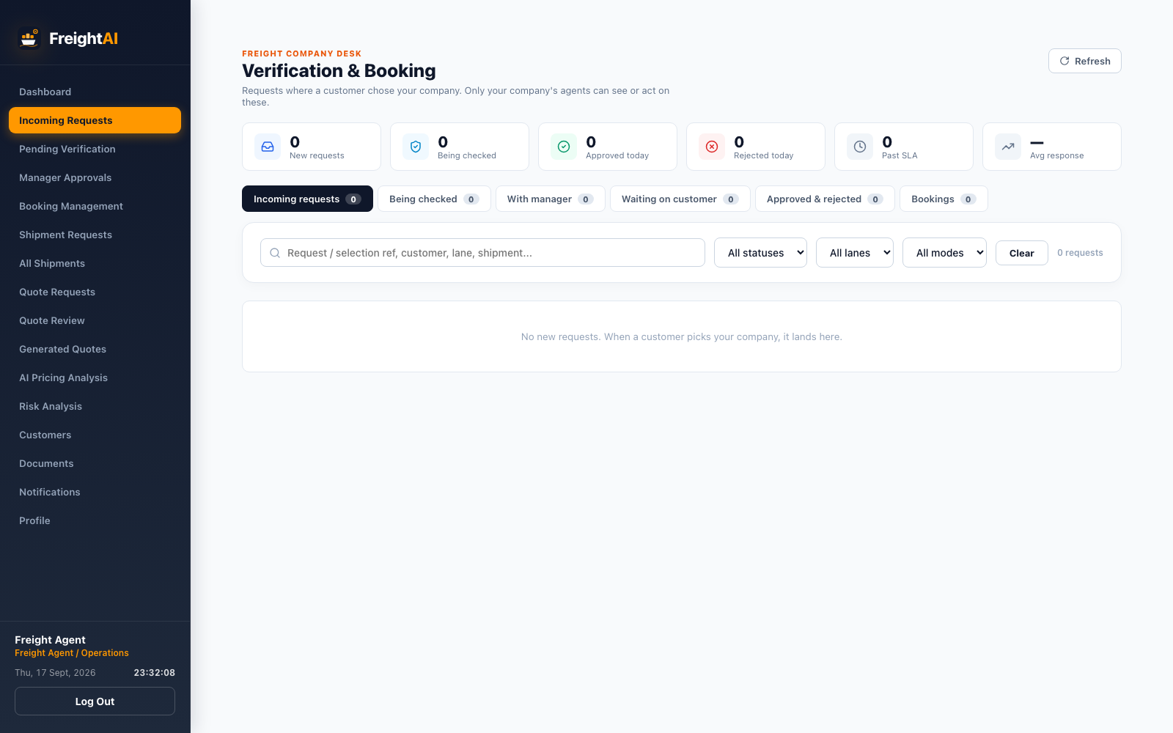
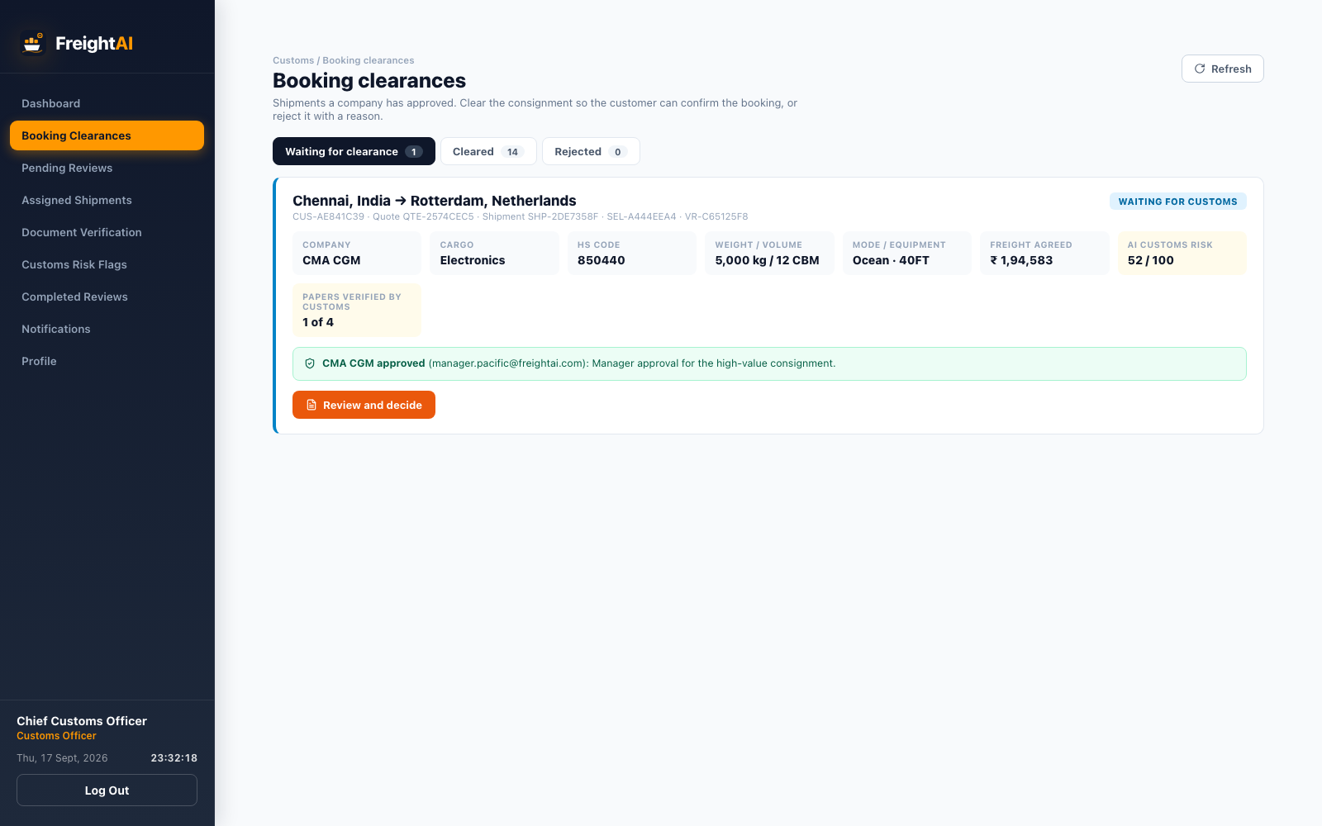
USER JOURNEY
Shipper → Agent → Customs Officer
1
SHIPPER
2
COMPANY AGENT
3
CUSTOMS OFFICER
Enters the shipment once, compares carriers, accepts or declines a revision, confirms the booking.
Checks vessel slot, equipment and documents. Four actions: approve, modify, reject, request info.
Sees carrier-approved dossiers only; clears or issues a deficiency notice with a written reason.
Multi-tenant isolation, proven by tests: one carrier's agent never sees another carrier's requests, bids or queue — and customs never sees a carrier's commercial desk.
FreightAI Agentic AI for Maritime Freight Pricing
18 / 25
Notes:
Who actually uses FreightAI? Three roles, in sequence — and the screenshots you see are the actual dashboards, captured live from the running app. First the shipper, on the left: their home screen shows shipments, quotes and tracking at a glance. They enter the shipment once, compare priced options side by side, select one company's quote, and later confirm the booking. Second, the company agent, in the middle: their incoming-requests queue is the M4 verification desk. The selected company reviews capacity, route, documents and commercial terms — and can approve, revise, reject, or ask the customer for information. A revision never overwrites the original quote; it creates a tracked revision. Third, the customs officer, on the right: the booking-clearances desk only ever shows requests a company has already approved. The officer checks the paperwork and customs risk, then clears or rejects with a written reason. Only after customs clears does the customer get the final confirm button. Around this flow sit strict isolation rules — competing carriers never see each other's queues, customs never sees a company's verification desk — and our twenty-two booking-flow tests verify those permissions explicitly.

Slide 19

TECHNOLOGY
Tools We Used
Boring choices on purpose — the time went into the AI logic, not the frameworks.
FRONTEND
BACKEND & RAG
AI / ML
TELEMETRY, QA & DEPLOY
React 19 + Vite 6
Four RBAC dashboards
Axios JWT interceptors
Leaflet route maps
Chart.js risk visuals
Django 5 + DRF, Python 3
Booking state machine
JWT role guards
Tenant-scoped querysets
Hybrid retrieval pipeline
scikit-learn Gradient Boosting
5,000-lane training set
joblib model artifacts
Rule-vs-ML comparison
Benchmark reporting
Open-Meteo weather agent
Geohash 6-hour cache
5-factor MCDA engine
Pytest suites (63 tests)
Vercel + Cloudflare tunnel
BUILT BY
BUILT BY
BUILT BY
BUILT BY
Nutan Jadhav · Syona Jain
Naresh Ramavath
Biswajit Pradhan
Arpita Dash · Ishanvi Chavan
FreightAI Agentic AI for Maritime Freight Pricing
19 / 25
Notes:
Quick tour of the toolbox, grouped the way we divided the work. Frontend: React 19 with Vite 6 — fast builds, one app shell that renders a different dashboard per role, Axios interceptors that keep the JWT session alive, and Context API for shared state like locations and quotes. Backend: Django 5 with Django REST Framework. The interesting part is not CRUD — it is the state machine that governs the whole booking workflow and the JWT role guards that enforce isolation between competing companies. AI and ML: scikit-learn for the Gradient Boosting pipeline, persisted with joblib; the hybrid BM25 plus TF-IDF retrieval for customs; and Open-Meteo's marine and forecast APIs for live telemetry. Data and deployment: Django ORM stores with a MongoDB audit trail, the full Pytest suite — sixty-three tests — and Vercel for hosting. We even added a keep-alive ping so the free-tier backend does not sleep during demos; that came from a real deployment lesson. Nothing exotic — every choice was boring on purpose, so we could spend our time on the AI logic, not on debugging shiny frameworks.

Slide 20
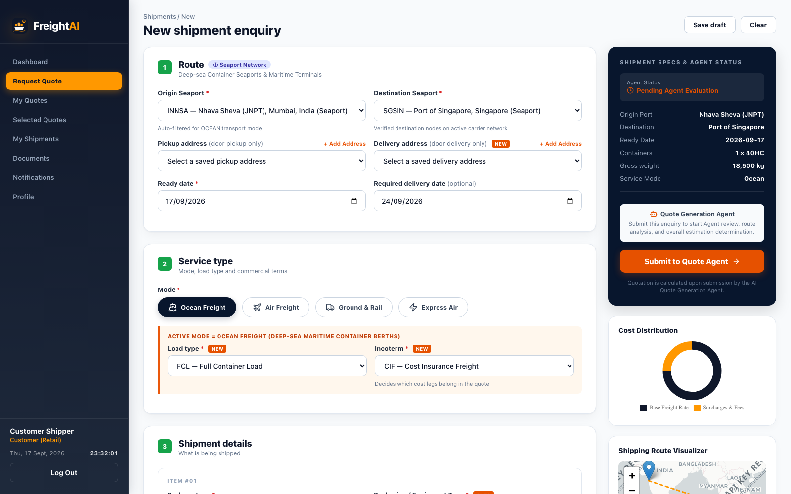
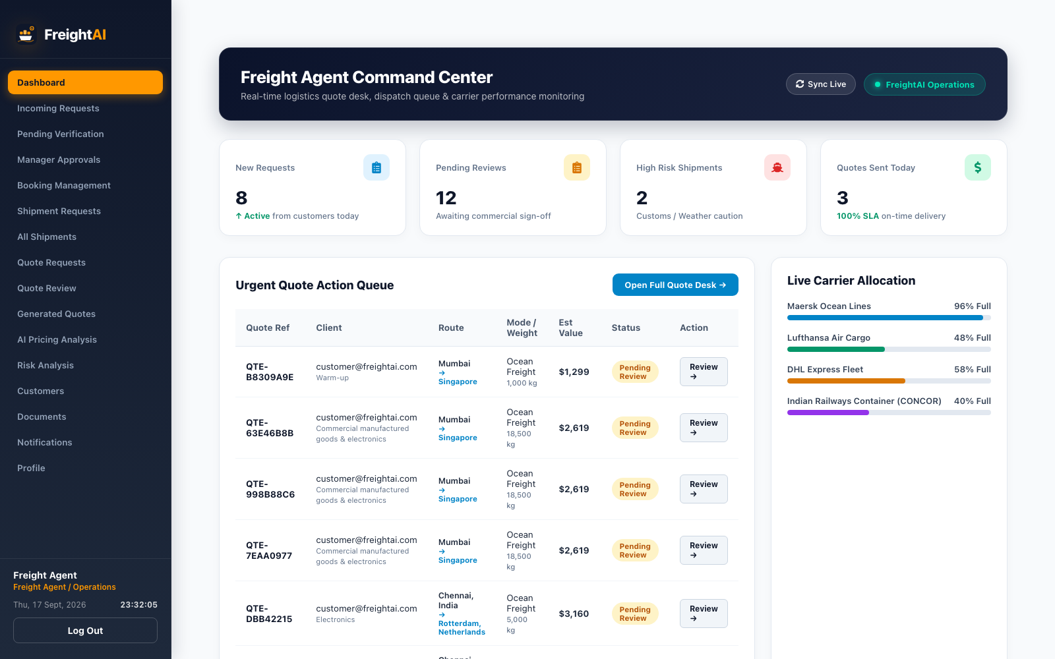

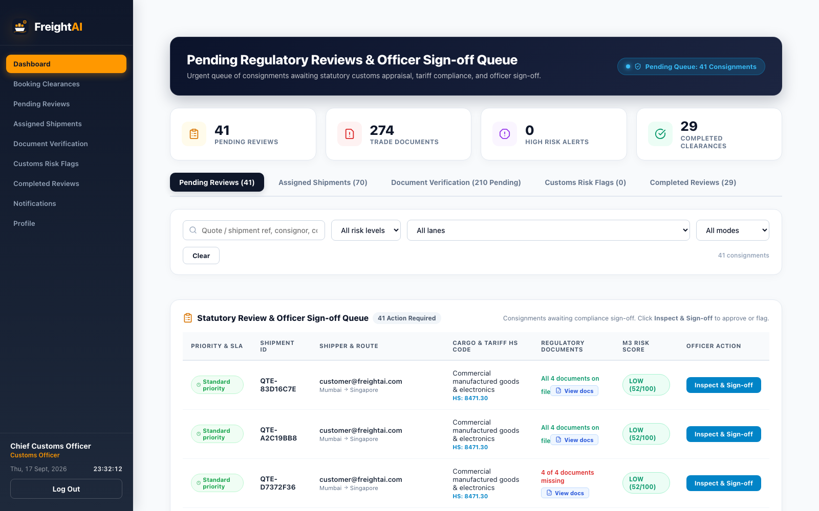
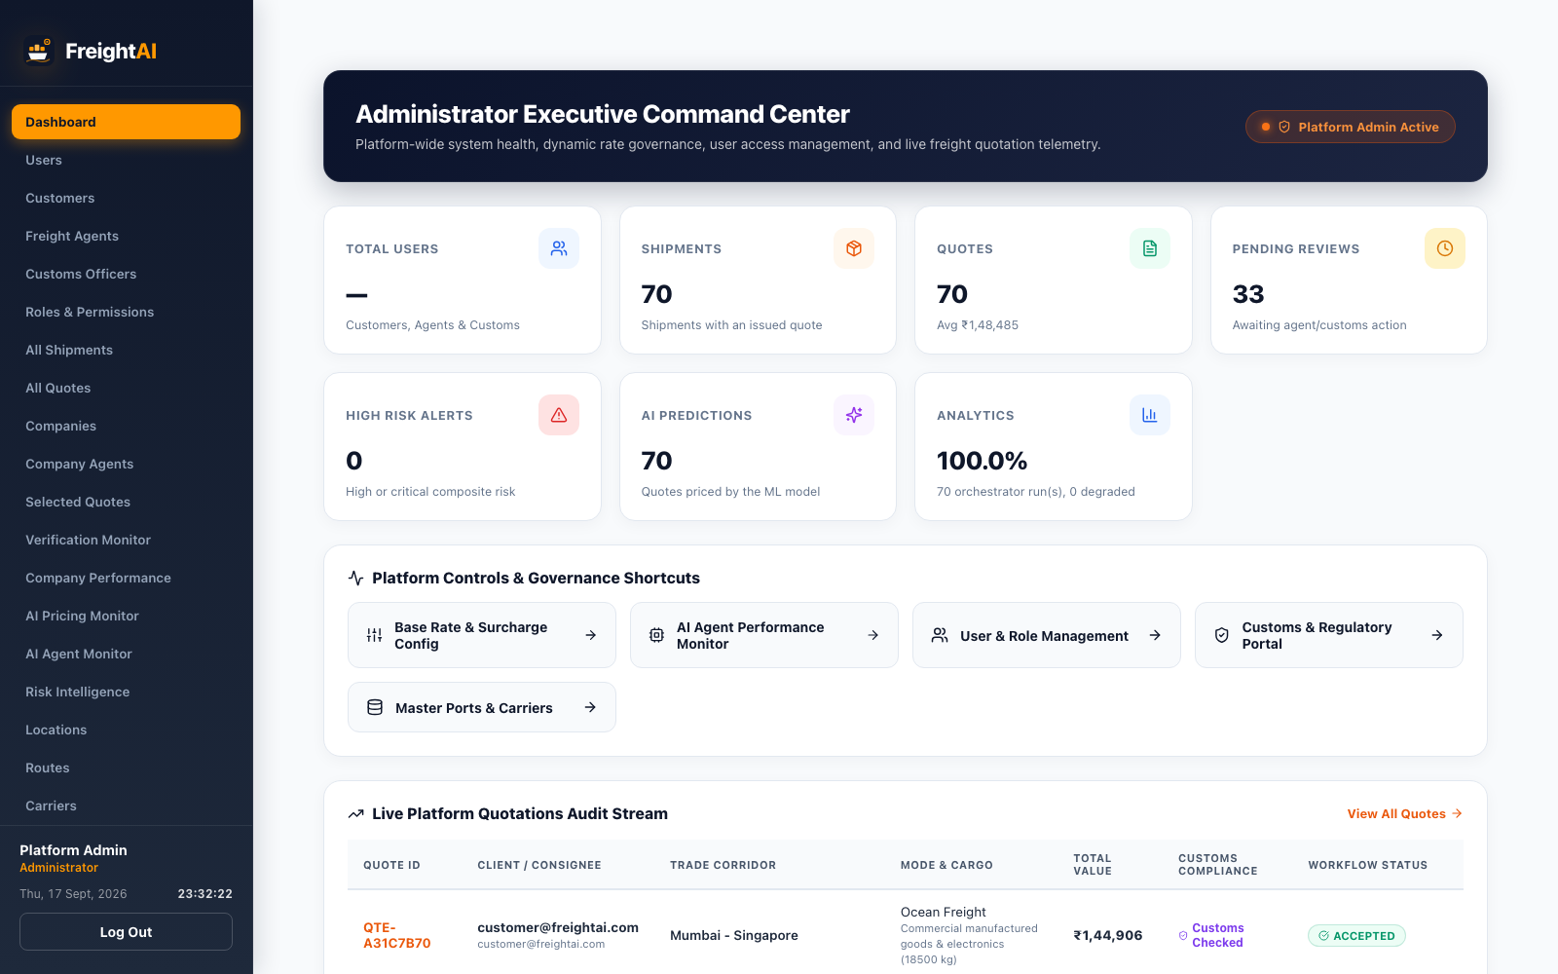
LIVE DEMO
See It Live
Try it now freight-quote-generation-system-grp.vercel.app
Demo logins
Seeded by the server at start-up
Shipper
customer@freightai.com
Agent
agent@freightai.com
Shipper · Quote request
Agent · Verification desk
Customs
customs@freightai.com
Admin
admin@freightai.com
Password
Password123!
Each role sees only its own data — log in and walk the full journey.
Customs · Clearance portal
Admin · Platform control
FreightAI Agentic AI for Maritime Freight Pricing
20 / 25
Notes:
Enough diagrams — let me show you the real thing. All four screenshots here are live captures from the running application, one per role. Top left is the shipper's request-quote screen: enter origin, destination, cargo and weight, and the AI analysis appears right in the quote — the ML-predicted price next to the rule-based price, weather alerts for the route, the customs checklist, and the risk score with its explanation. Next is the agent dashboard, where a company agent works their verification queue — shipment details, AI price guidance, risk context, and the approve, revise or request-information actions. Third is the customs portal, where an officer sees consignments, uploaded documents, and the customs risk assessment before clearing them for booking. And on the right, the admin's platform-control view — users, companies, quotes and the audit trail across the whole system. The band below shows the demo logins, which the server seeds automatically at start-up, so you can log in as each role and walk the full journey yourself. And this same app is deployed on Vercel at the address at the top — live right now. I would genuinely encourage you to run a quote while we take questions at the end.

Slide 21

IMPACT
What Our Project Changes
Freight quoting moves from an opinion to a verified, auditable decision.
48 hrs → sec
R² 0.9792
50 / 50
63 / 63
QUOTE TURNAROUND
ML ACCURACY · MAPE 5.54%
CUSTOMS SCENARIOS · 10 JURISDICTIONS
AUTOMATED TESTS PASSING
For shippers
For carriers, customs & the business
Competing carrier options in seconds, not a two-day email thread.
Weather delay probability and customs holds visible before booking.
Line-item cost build-up — surcharges and margin, not one opaque number.
AI drafts, named humans approve — the margin floor is never silently breached.
Fewer border holds: paperwork is checked at quote time, not at the port.
Every price, revision and clearance leaves an immutable audit trail.
FreightAI Agentic AI for Maritime Freight Pricing
21 / 25
Notes:
So what does all this actually change? Start with the headline: a quote that took the industry twenty-four to forty-eight hours now takes seconds — and it is a better quote, not just a faster one, because it arrives with the weather and customs work already done. Everything else on this row comes straight from our test and benchmark reports. The model explains ninety-eight percent of price variance at five and a half percent average error, which is a number you can defend to a customer. Fifty out of fifty customs scenarios pass across ten jurisdictions. Sixty-three of sixty-three automated tests pass. Underneath the metrics, the qualitative change splits by audience. For shippers: competing carrier options instead of one broker's pick, delay probability visible before they commit, and a line-item cost build-up instead of an opaque total — surcharges and margin, shown. For carriers, customs and the business: the AI drafts and a named human approves, the margin floor cannot be breached silently, paperwork is checked at quote time rather than at the port, and every price, revision and clearance leaves an immutable audit trail. That is the real shift — freight quoting moves from an opinion to a verified, auditable decision.

Slide 22

ENGINEERING STORY
Challenges We Faced & How We Solved Them
Every fix landed with a test — that is why the suite still passes 63 / 63.
CHALLENGE
WHAT IT COST US
HOW WE SOLVED IT
External APIs fail
Open-Meteo goes down; a demo cannot.
Seasonal fallback + 6-hour geohash cache; the offline path has its own test.
Multi-tenant isolation
Competing carriers share one database.
Tenant-scoped querysets at the ORM layer; 22 booking tests assert the negative cases.
Customs retrieval quality
Keyword search misses legal meaning; a model that invents a rule is worse than none.
BM25 + TF-IDF fused by RRF, citation-required generation, held to a 50-scenario benchmark.
Negotiation without data loss
A counter-offer that overwrites the quote destroys the audit trail.
Revisions are append-only records; the original quote is never mutated.
FreightAI Agentic AI for Maritime Freight Pricing
22 / 25
Notes:
Every project has its war stories — here are four of ours, each from real commits. First: external APIs fail. Open-Meteo goes down, and of course it picks demo day. We built a deterministic seasonal fallback plus a six-hour geohash-grid cache, and wrote a test that runs the entire pipeline with the API offline, so an outage degrades gracefully instead of killing a quote. Second: multi-tenant isolation. Competing carriers share one database, and trust-me-it-is-isolated is not an answer. We pushed tenant scoping down to the ORM querysets rather than filtering in views, and our booking tests assert the negative cases explicitly — that one carrier's agent gets nothing when reaching for another's queue. Third: customs retrieval quality. Plain keyword search kept missing legal meaning, and the opposite failure is worse — a model that confidently invents a regulation. Hybrid BM25 plus vector retrieval with RRF fixed the recall, citation-required generation fixed the invention, and the fifty-scenario benchmark catches regressions. Fourth, the one that taught us most about commercial software: negotiation without data loss. Our first counter-offer implementation simply updated the quote's price — and destroyed the record of what was originally offered. We made revisions append-only, so the original is never mutated. Every one of these fixes landed with a test, which is why the suite still passes sixty-three of sixty-three.

Slide 23




ROADMAP
What's Next
Four additions, in rough order of impact — each one a new service beside the existing four.
01
02
03
04
Live vessel tracking
Document OCR
Carbon & ESG scoring
Model retraining loop
AIS transponder feeds turn our waypoints into real positions and rolling ETAs.
Read the bill of lading and invoice; extract HS code, weight and value automatically.
CO₂ per lane from distance, vessel class and load factor; greener option at booking.
Feed booked-vs-predicted rates back into the GBR so it tracks the spot market.
Additive, not a rewrite — the payoff of building modular from day one.
FreightAI Agentic AI for Maritime Freight Pricing
23 / 25
Notes:
Where do we take FreightAI next? Four directions, in rough order of impact. First, live vessel tracking: we already compute the route waypoints, so ingesting AIS transponder feeds turns them into actual vessel positions and continuously updated ETAs — the delay warnings get sharper and they keep working after departure, not just at quote time. Second, document OCR: today the shipper types the HS code and the officer reads the PDF. Computer vision on bills of lading and commercial invoices would extract the code, weight and declared value before a human touches the form, which removes the single most common source of customs error. Third, carbon and ESG scoring: CO2 per lane from distance, vessel class and load factor, with the greener option surfaced at the moment of booking — the industry is under real regulatory pressure here and the data we already hold is most of what it needs. Fourth, and the one I would build first as an engineer: a retraining loop. Right now the model is trained once on five thousand historical lanes. Feeding booked-versus-predicted rates back in would let it track the spot market as it moves, instead of slowly drifting away from it. All four are additive — each is another service beside the four we have, not a rewrite. That was the payoff of building modular from day one.

Slide 24
CONCLUSION
What We Learned
01
02
03
AI earns trust only when it shows its working
Design for the integration that is down
Ship the whole loop, not the demo slice
The rule price beside the ML price, factor-level risk bars, and a citation under every customs rule — that is what made people use it.
Fallbacks, caches and an offline test are not defensive extras; on the day of the demo they are the product.
The quote was the easy half. Approvals, revisions, clearance, booking and the audit trail are what make it a system.
FreightAI Agentic AI for Maritime Freight Pricing
24 / 25
Notes:
Let me close with the three lessons this project taught us — the things I would tell a team starting something like this tomorrow. First, AI earns trust only when it shows its working. Our first ML price was just a number, and people were rightly suspicious of it. The moment we put the rule-based price beside the prediction, broke the risk score into factor-level bars, and put a citation under every customs rule, the suspicion disappeared. Users do not need the mathematics; they need to see the reasoning. Second, design for the integration that is down. The weather API will be unavailable during your most important demo — the interesting question is what your system does then. Fallbacks, caches and an offline test are not defensive extras you add at the end; on the day it matters they are the product. Third, ship the whole loop, not the demo slice. It would have been easy to stop at a pretty quote calculator and call it done. The quote turned out to be the easy half; the valuable half was everything after it — approvals, revisions that do not destroy history, customs clearance, booking, the audit trail — with tests proving each one. That full loop is what turned this from coursework into something a freight company could genuinely pilot. And building it as a six-person team, milestone by milestone, taught us code review, testing discipline, and how to split work that actually integrates at the end.

Slide 25


Thank you.
Questions?
FreightAI — Agentic AI for Maritime Freight Pricing and Route Optimization
GROUP 1 · THE TEAM
Naresh Ramavath
Nutan Jadhav
Team Lead · System Architect · RAG
Frontend Lead Engineer
Biswajit Pradhan
Syona Jain
Scan to open the live app
Machine Learning Engineer
Frontend Lead Engineer · UI/UX
freight-quote-generation-system-grp.vercel.app
Arpita Dash
Ishanvi Chavan
Backend & Telemetry Developer
QA & DevOps Specialist
Mentor: Bala · Infosys Springboard Virtual Internship 7.0
Notes:
That is FreightAI — thank you so much for your attention. To recap in one breath: my team and I built a live platform where a shipment gets an AI-predicted price, a marine weather check on its real route, a customs rules review with cited evidence, and a five-factor risk gate before any human approves and books it — backed by sixty-three passing tests and a fifty-scenario customs benchmark. The QR code on the right and the link on the left take you straight to the deployed application — sign up as a retail shipper, generate a quote, and you will see the ML price, the weather alerts and the risk explanation on one screen. I am happy to take questions now — on the machine learning model, the RAG pipeline, the risk gating policy, the booking workflow, or the deployment. If I do not know an answer on the spot, I will find out and follow up. Thank you to our mentor Bala and to Infosys Springboard for the opportunity and the guidance throughout this internship.

