Slide 1

Composition of Solutions for the n+k Queens Separation Problem
Biswas Sharma
Jonathon Byrd
Morehead State University
Department of Mathematics, Computer Science and Physics

Slide 2
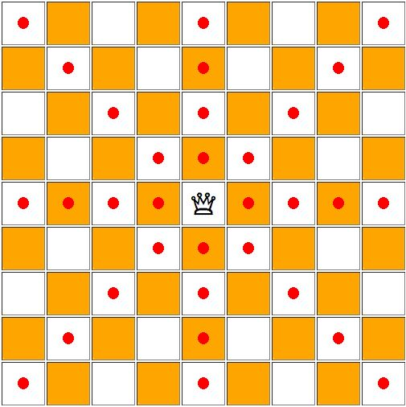
Queen’s Movements
Forward and backward
Left and right
Main diagonal and cross diagonal

Slide 3
n Queens Problem
Can n non-attacking queens be placed on an n x n board?
Yes, solution exists for n=1 and n ≥ 4.

Slide 4
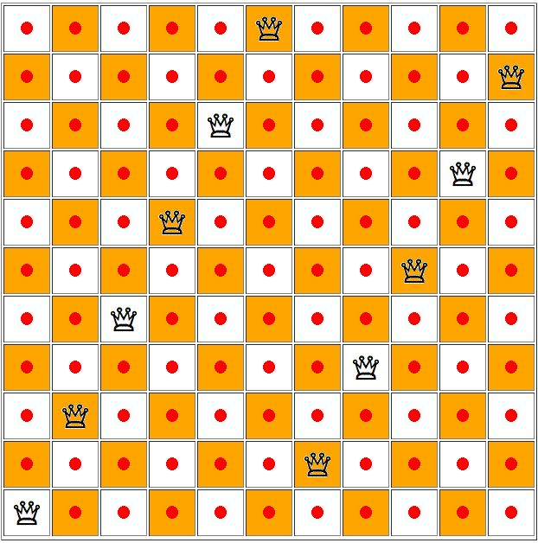
n Queens Problem
11 non-attacking queens on an 11 x 11 board

Slide 5
n + k Queens Problem
If pawns are added, they block some attacks and hence allow for more queens to be placed on an n x n board.
Can we place n + k non-attacking queens and k pawns on an n x n chessboard?
General solution exists when n > max{87+k, 25k}

Slide 6
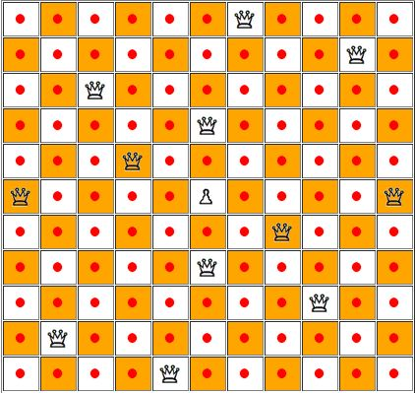
n + k Queens Problem
11 x 11 board with 12 queens and 1 pawn

Slide 7
n + k Queens Problem
Specific solutions for lesser n-values found for k=1, 2, 3 corresponding to n ≥ 6,7,8 respectively
We want to lower the n-values for k-values greater than 3
k values | Min board size (n)
1 | 6
2 | 7
3 | 8
k | n > max{87+k, 25k}
4 | 100
5 | 125
6 | 150

Slide 8
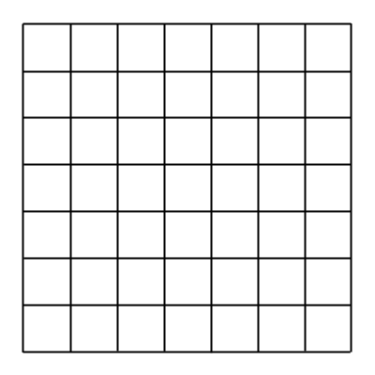
Composition of Solutions
Step 1: Pick and check an n Queens solution

Slide 9
Composition of Solutions
Step 1: Pick and check an n Queens solution

Slide 10
Composition of Solutions
Step 1: Pick and check an n Queens solution

Slide 11
Composition of Solutions
Step 1: Pick and check an n Queens solution

Slide 12
Composition of Solutions
Step 1: Pick and check an n Queens solution

Slide 13
Composition of Solutions
Step 1: Pick and check an n Queens solution

Slide 14
Composition of Solutions
Step 1: Pick and check an n Queens solution

Slide 15
Composition of Solutions
Step 1: Pick and check an n Queens solution

Slide 16
Composition of Solutions
Step 2: Copy it!

Slide 17
Composition of Solutions
Step 3: Rotate it!

Slide 18
Composition of Solutions
Step 3: Rotate it!

Slide 19
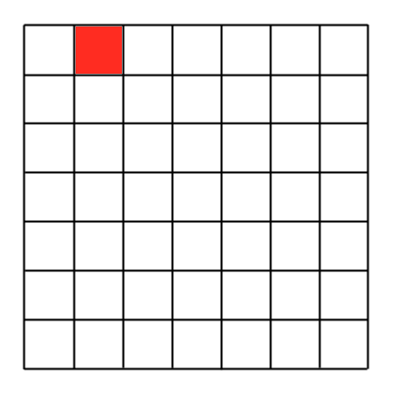
Composition of Solutions
Step 3: Rotate it!

Slide 20
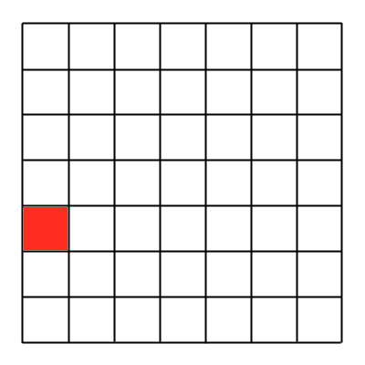
Composition of Solutions
Step 3: Rotate it!

Slide 21
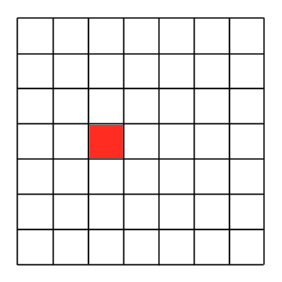
Composition of Solutions
Step 3: Rotate it!

Slide 22
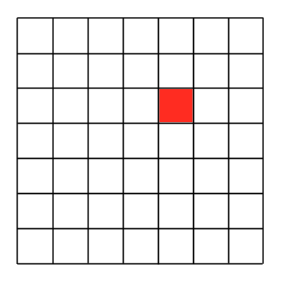
Composition of Solutions
Step 3: Rotate it!

Slide 23
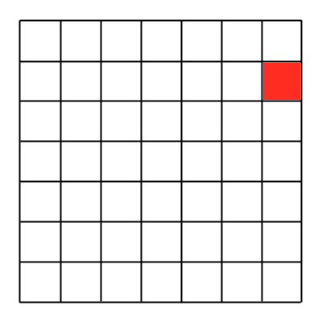
Composition of Solutions
Step 3: Rotate it!

Slide 24
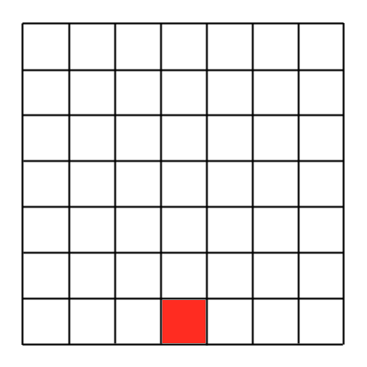
Composition of Solutions
Step 3: Rotate it!

Slide 25
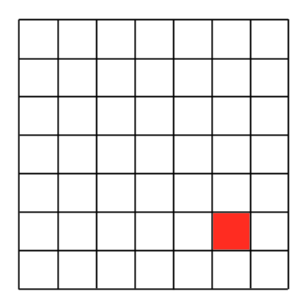
Composition of Solutions
Step 3: Rotate it!

Slide 26
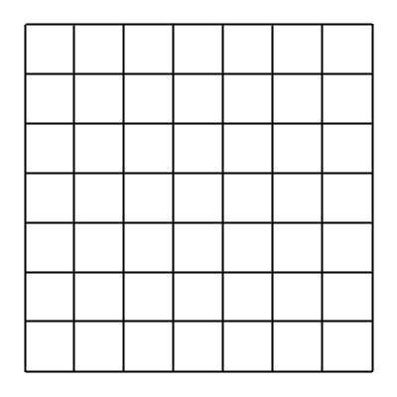
Step 4: Overlap it!
This is how we compose a (2n-1) board using an n board…
… and so all the composed boards are odd-sized.

Slide 27
Step 5: Place a pawn

Slide 28
Step 5: Place a pawn

Slide 29
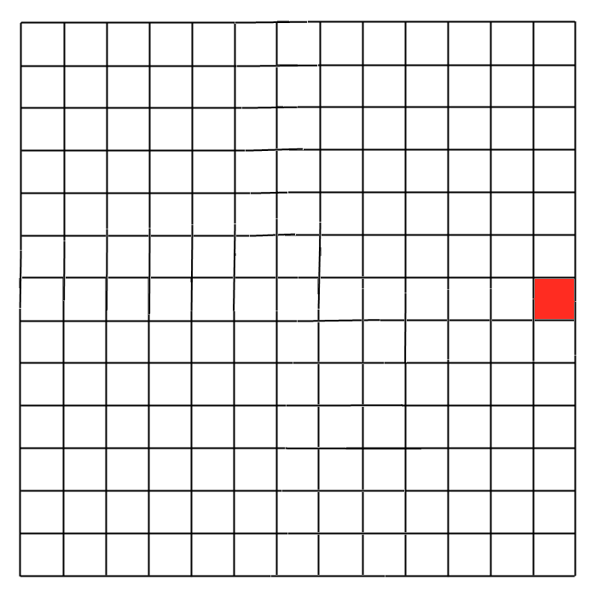
Step 6: Check diagonals

Slide 30

Step 6: Check diagonals

Slide 31
Step 6: Check diagonals

Slide 32
Step 6: Check diagonals

Slide 33
Step 6: Check diagonals

Slide 34
Step 6: Check diagonals

Slide 35
Step 6: Check diagonals

Slide 36
Step 6: Check diagonals

Slide 37
Step 7: Move Queens

Slide 38
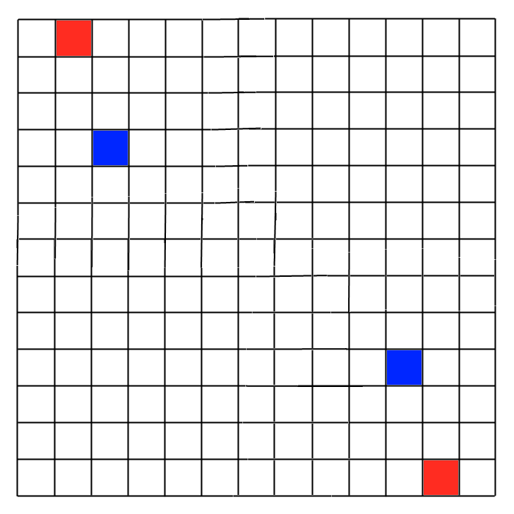
Step 7: Move Queens

Slide 39
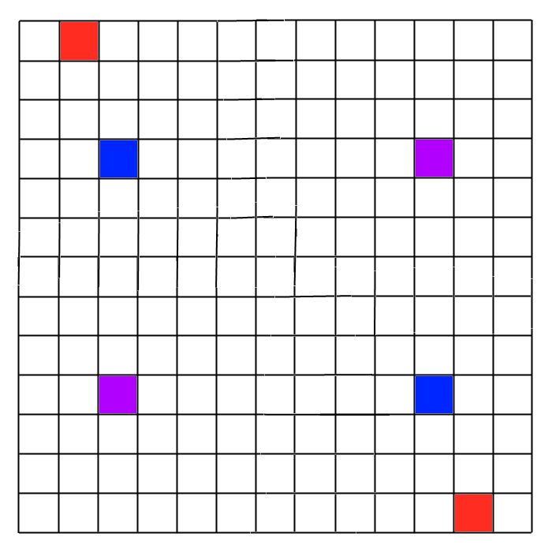
Step 7: Move Queens

Slide 40
Step 8: Check Diagonals

Slide 41
Step 8: Check Diagonals

Slide 42
Final Solution!

Slide 43
Composition of Solutions
Dealing with only k = 1
Always yields composed boards of odd sizes
n Solution | Composed Size (2n -1 )
7 | 13
8 | 15
9 | 17
10 | 19

Slide 44
Some boards are ‘weird’
E.g. boards of the family 6z, i.e., n = 6,12,18… boards that are known to build boards of sizes (2n-1) = 11,23,35…

Slide 45
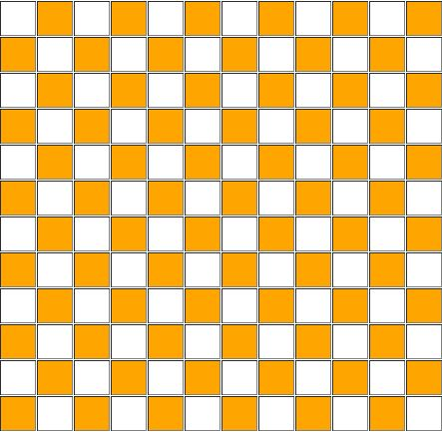
Some boards are ‘weird’
n = 12 board with no queen

Slide 46
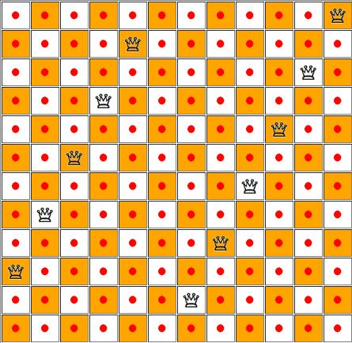
Some boards are ‘weird’
n = 12 board with 11 non-attacking queens

Slide 47
Some boards are ‘weird’
n = 12 board with 11 originally non-attacking queens and one arbitrary queen in an attacking position

Slide 48
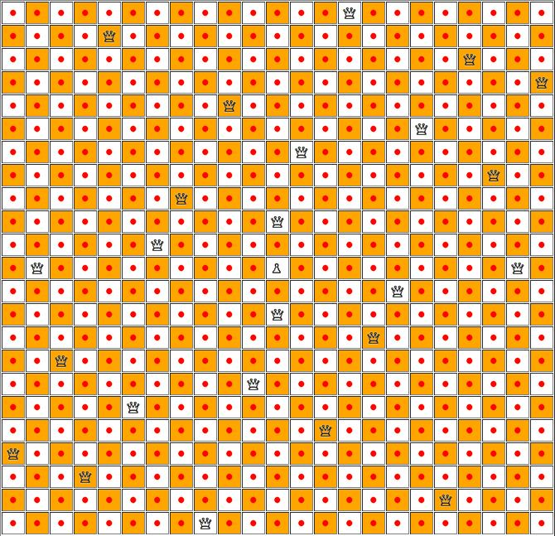
Some boards are ‘weird’
n = 23 board built from n = 12 board This board has 24 non-attacking queens and 1 pawn

Slide 49
Future Work
Better patterns for k = 1
Composition of even-sized boards
Analyzing k > 1 boards

Slide 50
Thank you
Drs. Doug Chatham, Robin Blankenship, Duane Skaggs
Morehead State University Undergraduate Research Fellowship

Slide 51
References
Bodlaender, Hans. Contest: the 9 Queens Problem. Chessvariants.org. N.p. 3 Jan. 2004. Web. 12 Mar 2012. <http://www.chessvariants.org/problems.dir/9queens.html>.
Chatham, R. D. “Reflections on the N + K Queens Problem.” College Mathematics Journal. 40.3 (2009): 204-211.
Chatham, R.D., Fricke, G. H., Skaggs, R. D. “The Queens Separation Problem.” Utilitas Mathematica. 69 (2006): 129-141.
Chatham, R. D., Doyle, M., Fricke, G. H., Reitmann, J., Skaggs, R. D., Wolff, M. “Independence and Domination Separation on Chessboard Graphs.” Journal of Combinatorial Mathematics and Combinatorial Computing. 68 (2009): 3-17.

Slide 52
Questions?
Thank you all

Slide 54
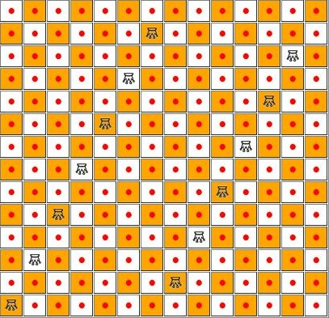
A ‘differently weird’ board
2+6z board (n=14)

Slide 55
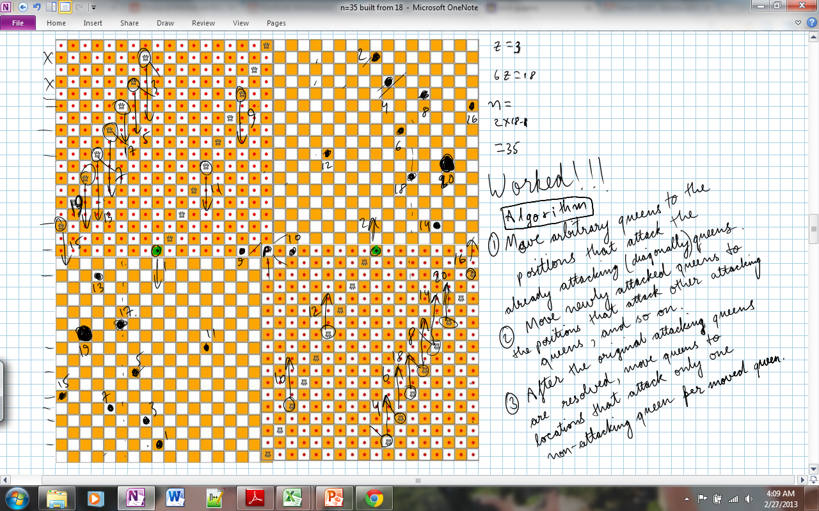
All-nighters (may) yield solutions

Slide 56
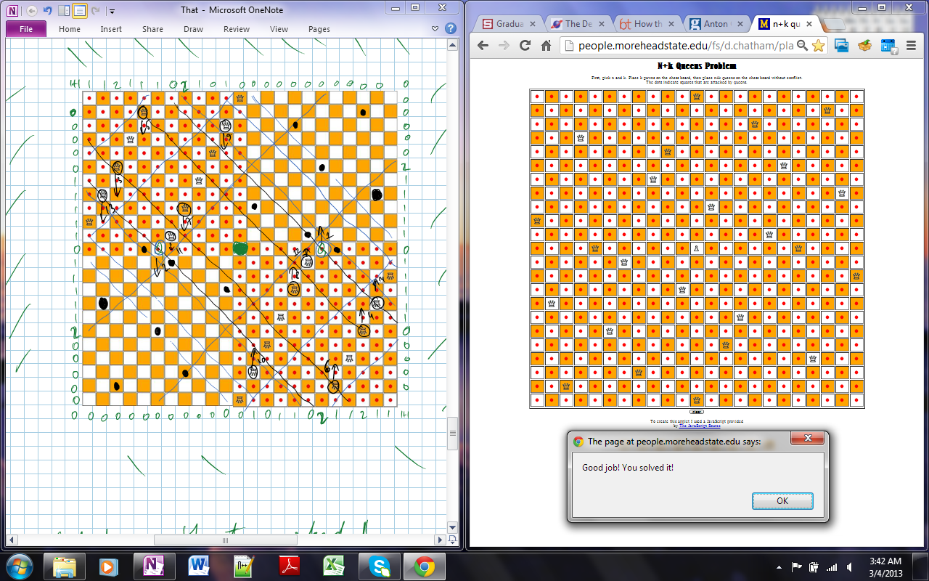
All-nighters (may) yield solutions

Slide 57
Example that doesn’t work
Step 1: Pick and check an n Queens solution

Slide 58
Example that doesn’t work
Step 1: Pick and check an n Queens solution

Slide 59
Example that doesn’t work
Step 1: Pick and check an n Queens solution
Problem!

Slide 60
Example that doesn’t work
Step 1: Pick and check an n Queens solution

Slide 61
Example that doesn’t work
Step 1: Pick and check an n Queens solution

Slide 62
Example that doesn’t work
Step 1: Pick and check an n Queens solution

Slide 63
Example that doesn’t work
Step 1: Pick and check an n Queens solution

Slide 64
Example that doesn’t work
Step 1: Pick and check an n Queens solution

Slide 65
Composition of Solutions
Step 2: Copy it!

Slide 66
Composition of Solutions
Step 3: Rotate it!

Slide 67
Composition of Solutions
Step 3: Rotate it!

Slide 68
Step 4: Overlap it!

Slide 69
Step 5: Place a pawn

Slide 70
Step 5: Place a pawn

Slide 71
Step 6: Check diagonals

Slide 72
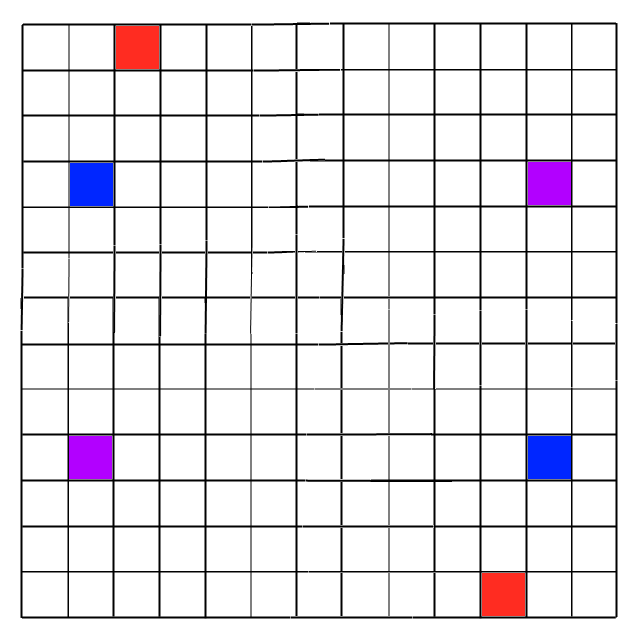
Step 7: Move Queens

Slide 73
Step 7: Move Queens

Slide 74
Step 8: Check Diagonals

Slide 75
Step 8: Check Diagonals

Slide 76
Review: Check Diagonals

Slide 77
Review: Check Diagonals

Slide 78
Review: Check Diagonals

Slide 79
Review: Check Diagonals

