Slide 1
GURGAON • 99ACRES • PYTHON EDA
Gurgaon Residential
Real Estate Market Analysis
DATASET
99acres residential property listings
Understanding pricing drivers, locality intelligence and value opportunities
• Combined source containing sales + rental listings
• 10,000+ residential listings
• 220+ Gurgaon localities
• Property, pricing, configuration and locality attributes
THE BUSINESS PROBLEM
A property’s listed price alone is not enough to evaluate value. Buyers need to understand what drives price, which localities command pricing power, and where space-to-price efficiency creates opportunity.
EDA SCOPE
Residential sales market • after sales/rental separation
THE ANALYTICAL CHAIN
RAW DATA
→
INSPECT
→
REDUCE
→
STANDARDIZE
→
SPLIT
→
REPAIR
→
ENGINEER
→
VALIDATE
→
EDA
→
INSIGHT
The objective was not simply to clean a dataset — it was to build a reliable analytical foundation for pricing, locality and value decisions.
GURGAON RESIDENTIAL REAL ESTATE MARKET ANALYSIS

Slide 2
01 • FRAME
01
Why analyse the market this way?
A property’s listed price is only one part of its value.
THE BUSINESS PROBLEM
ANALYTICAL OBJECTIVES
Buyers can easily compare asking prices — but price alone hides differences in size, configuration, locality premium and price-per-square-foot efficiency.
MARKET STRUCTURE
Inventory, pricing and BHK composition
PRICING DRIVERS
Area, configuration and valuation relationships
The analysis was designed to answer five decision questions:
01
What drives property prices?
LOCALITY PERFORMANCE
Volume, PPSF and market positioning
02
Which localities command pricing power?
LUXURY PROFILING
How the top end differs from the broader market
03
Where is the better space-to-price value?
04
What separates luxury from the broader market?
VALUE OPPORTUNITIES
Space-to-price efficiency across localities
05
Which micro-markets look strategically attractive?
FRAME
INSPECT
REDUCE
STANDARDIZE
SPLIT
REPAIR
ENGINEER
VALIDATE
ANALYZE
DECIDE

Slide 3
02 • INSPECT
02
Start with the source — not the assumptions
99acres residential listings formed the raw analytical material.
10,704
67
220+
Sale + Rent
raw rows
raw columns
Gurgaon localities
two markets
WHAT THE RAW DATA CONTAINED
FIRST PRINCIPLE
Property identifiers • locality • transaction type • BHK • bathrooms • area • price • furnishing • floor • property type • society/building information • brokerage • listing metadata and other scraped fields.
Before modelling or visualising, establish what each field represents, which fields are analytically usable, and where the source contains redundancy, metadata or mixed formats.
SOURCE
Kaggle • “Indian Real Estate – 99acres.com” • Gurgaon residential listings
FRAME
INSPECT
REDUCE
STANDARDIZE
SPLIT
REPAIR
ENGINEER
VALIDATE
ANALYZE
DECIDE

Slide 4
03 • REDUCE
03
Turn a scraped schema into an analytical schema
Not every column deserves to survive into the analysis.
67 RAW FIELDS
WHAT WAS RETAINED
The source contained useful property attributes alongside fields created for scraping, presentation or platform operations.
Identity
PROP_ID • PROP_NAME
Location
CITY • LOCALITY • SOCIETY
Configuration
BHK • BATHROOMS • BALCONY
Image URLs
Duplicate area fields
JSON / metadata fields
Contact / scraping metadata
Physical
AREA • FLOOR • TOTAL FLOORS
Valuation
PRICE • PRICE_SQFT • BROKERAGE
Attributes
FURNISH • FACING • AGE
↓
Business
PROPERTY_TYPE • CLASS_LABEL
21 CORE ANALYTICAL FIELDS
Decision logic: reduce noise → preserve business meaning → make downstream analysis easier to interpret.
FRAME
INSPECT
REDUCE
STANDARDIZE
SPLIT
REPAIR
ENGINEER
VALIDATE
ANALYZE
DECIDE

Slide 5
04 • STANDARDIZE
04
Make the raw values comparable
The biggest analytical risk was not the charts — it was inconsistent source formats.
RAW LISTING
ANALYTICAL VALUE
→
WHY THIS MATTERS
PRICE
PRICE
Without standardisation, aggregations, distributions, PPSF calculations and locality comparisons can be numerically correct but analytically wrong.
The cleaning step therefore converted mixed text/unit representations into consistent numeric fields before analysis.
“2.63 Cr” / mixed text formats
₹26,300,000
AREA
AREA
“3434 sq.ft.” / text
3,434 sq.ft.
PRICE + AREA became reliable analytical measures.
FRAME
INSPECT
REDUCE
STANDARDIZE
SPLIT
REPAIR
ENGINEER
VALIDATE
ANALYZE
DECIDE

Slide 6
05 • REPAIR
05
Missing values were treated by meaning, not by habit
The goal was to preserve useful records without inventing property characteristics.
FIELD
RAW NULLS
TREATMENT
WHY
PRICE
1,077*
Median
Skewed variable; retain records without luxury outlier influence
AREA
5
Remove
Critical for valuation/PPSF; too few to justify imputation
BEDROOM_NUM
191*
Mode
Discrete configuration
BALCONY_NUM
201*
0
Missing treated as absent / unspecified
FLOOR_NUM
1,269*
Median-based
Preserve distribution; reduce outlier influence
BROKERAGE
72*
0
Unavailable / non-applicable information
*Counts shown from the sales-market missing-value audit after market segmentation; source notebook reports slightly different totals at different cleaning checkpoints.
FRAME
INSPECT
REDUCE
STANDARDIZE
SPLIT
REPAIR
ENGINEER
VALIDATE
ANALYZE
DECIDE

Slide 7
06 • SPLIT
06
Do not mix two different pricing systems
Sale price and monthly rent answer different economic questions.
SALES MARKET
RENTAL MARKET
10,155 listings
549 listings
21 analytical fields
21 analytical fields
Objective: valuation, pricing drivers, locality premiums, buyer value and investment opportunities.
Retained separately because rent, yield and monthly affordability follow different pricing dynamics.
KEY DECISION
All subsequent EDA in this notebook focuses on the residential sales market.
FRAME
INSPECT
REDUCE
STANDARDIZE
SPLIT
REPAIR
ENGINEER
VALIDATE
ANALYZE
DECIDE

Slide 8
07 • ENGINEER
07
Create metrics that make the business question measurable
Feature engineering turned raw fields into comparable market measures.
01
PRICE PER SQ.FT.
02
BHK
PRICE ÷ AREA
BEDROOM_NUM → BHK
Why:
Standardises valuation so a ₹3 Cr 1,500 sq.ft. home can be compared with a ₹3 Cr 3,000 sq.ft. home.
Why:
Aligns the analytical vocabulary with how buyers, renters, developers and property platforms describe housing configuration.
These engineered fields become the backbone of locality comparison, valuation analysis and the later dashboard model.
FRAME
INSPECT
REDUCE
STANDARDIZE
SPLIT
REPAIR
ENGINEER
VALIDATE
ANALYZE
DECIDE

Slide 9
08 • VALIDATE
08
Outliers were investigated before they were removed
The question was not “what looks extreme?” — it was “what can distort the market signal?”
AREA CHECK
PPSF CHECK
IMPACT
250
sq.ft. minimum
₹5,222
10,150
50,000
1st-percentile threshold
sales records before validation
sq.ft. maximum
Below this lower tail was treated as anomalous — a percentile-based rule rather than an arbitrary cutoff.
→
Why?
10,010
Extreme areas created unrealistic valuation and PPSF signals.
final analytical records
140 removed • ~1.38%
FRAME
INSPECT
REDUCE
STANDARDIZE
SPLIT
REPAIR
ENGINEER
VALIDATE
ANALYZE
DECIDE

Slide 10
THE TURNING POINT
Only now does the EDA really begin.
After reduction, standardisation, market separation, business-aware missing-value treatment and anomaly validation, the dataset is ready for market analysis.
10,010
222
₹25.0M
₹12,382
sales properties
localities
median price
median PPSF
EDA QUESTIONS NOW BECOME MEASURABLE
How is inventory structured?
Where is pricing concentrated?
What drives value?
Where is the opportunity?
FRAME
INSPECT
REDUCE
STANDARDIZE
SPLIT
REPAIR
ENGINEER
VALIDATE
ANALYZE
DECIDE

Slide 11
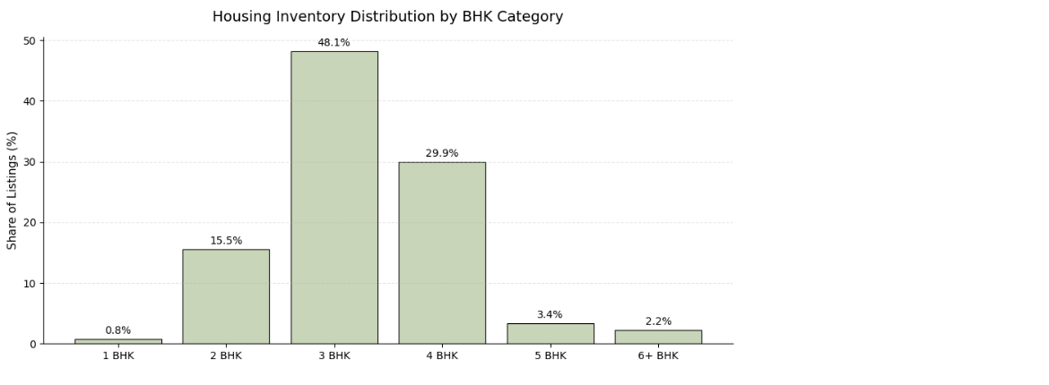
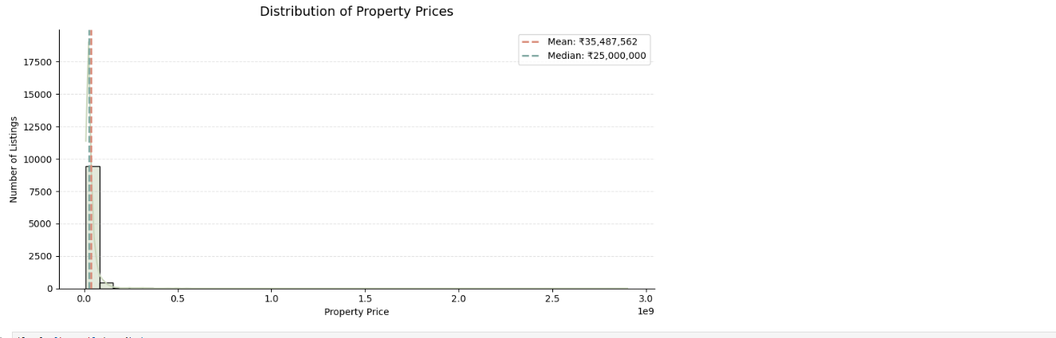
09 • ANALYZE
09
First finding: Gurgaon is predominantly a family-oriented market
Market structure matters before market opportunity.
EDA SCOPE • RESIDENTIAL SALES MARKET | The combined 99acres source was separated into sales and rental before this analysis.
BHK STRUCTURE
PRICE STRUCTURE
3 BHK (48.1%) + 4 BHK (29.9%) account for 78%+ of listings.
Median price ≈ ₹2.5 Cr; 90% of listings are below ≈ ₹6.25 Cr.
FRAME
INSPECT
REDUCE
STANDARDIZE
SPLIT
REPAIR
ENGINEER
VALIDATE
ANALYZE
DECIDE

Slide 12
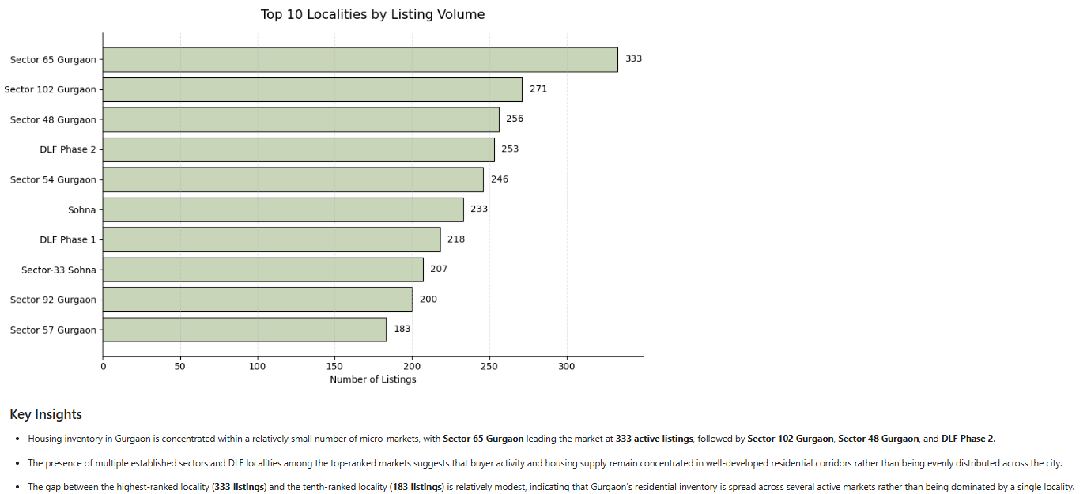
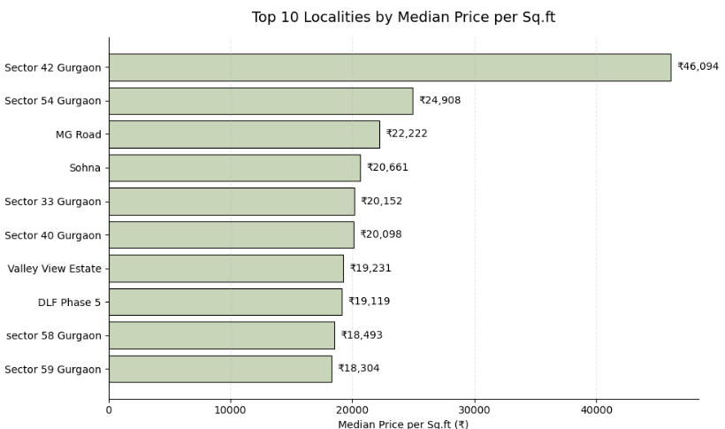
10 • ANALYZE
10
Second finding: supply and pricing power are not the same thing
Locality intelligence requires looking at both volume and valuation.
INVENTORY CONCENTRATION
PRICING POWER
Sector 65 leads with 333 listings; several established sectors form the major supply corridors.
Sector 42 reaches ≈₹46,094 PPSF — far above the broader market median.
FRAME
INSPECT
REDUCE
STANDARDIZE
SPLIT
REPAIR
ENGINEER
VALIDATE
ANALYZE
DECIDE

Slide 13
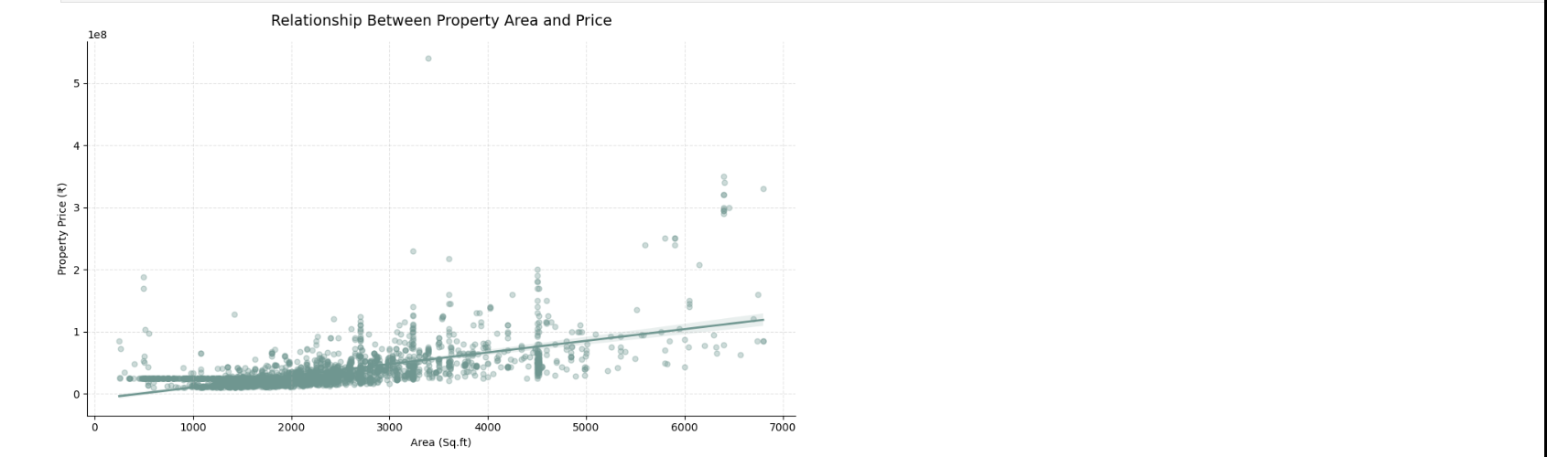
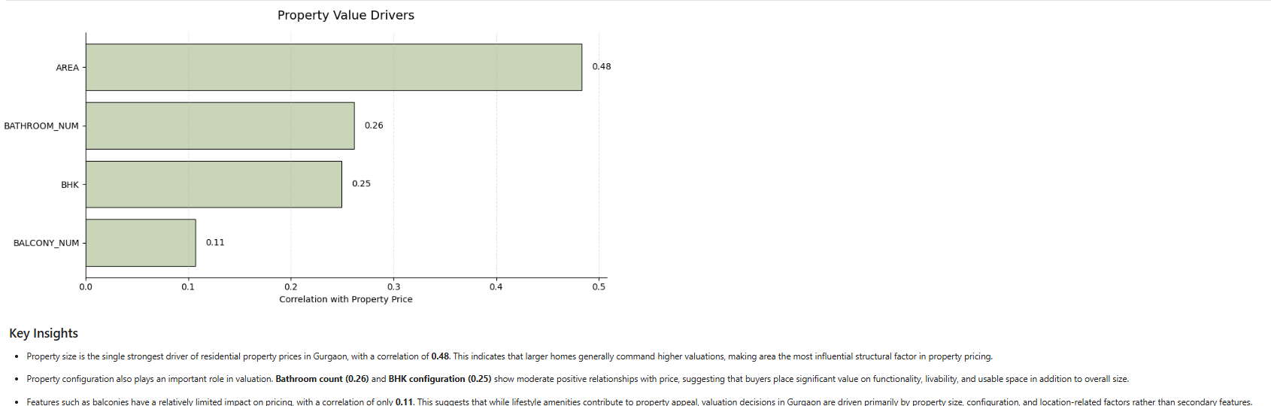
11 • ANALYZE
11
Third finding: size matters — but size is not the whole story
Area is the strongest measurable structural driver, while location still creates premiums.
AREA ↔ PRICE
OTHER DRIVERS
Correlation ≈ 0.48. Larger properties generally command higher valuations.
Bathrooms ≈0.26 • BHK ≈0.25 • Balconies ≈0.11 — useful signals, not causal proof.
FRAME
INSPECT
REDUCE
STANDARDIZE
SPLIT
REPAIR
ENGINEER
VALIDATE
ANALYZE
DECIDE

Slide 14
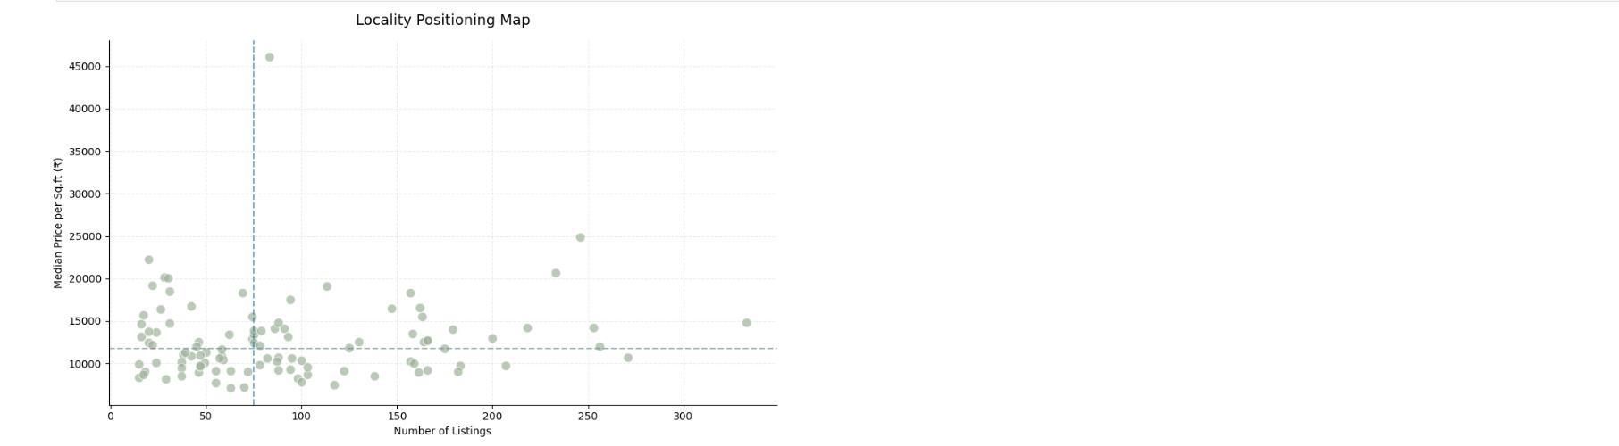
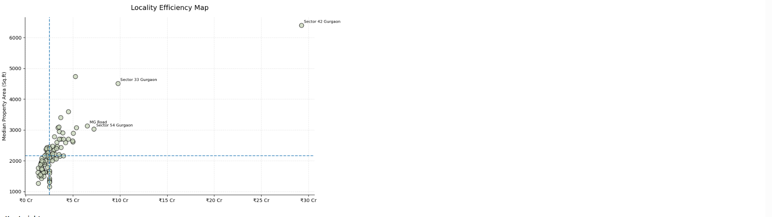
12 • ANALYZE
12
Fourth finding: the best market is not always the most expensive
Two-dimensional locality analysis reveals where volume, pricing and space intersect.
POSITIONING
EFFICIENCY
High-volume + above-median PPSF localities are strategically important micro-markets; premium pricing can exist without huge inventory.
Sector 42 combines exceptional size (~6,400 sq.ft.) with the highest prices; Sector 33, MG Road and Sector 54 offer large homes without the same extreme price level.
FRAME
INSPECT
REDUCE
STANDARDIZE
SPLIT
REPAIR
ENGINEER
VALIDATE
ANALYZE
DECIDE

Slide 15
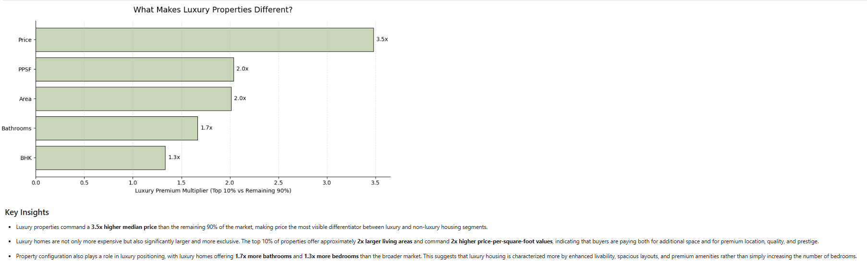
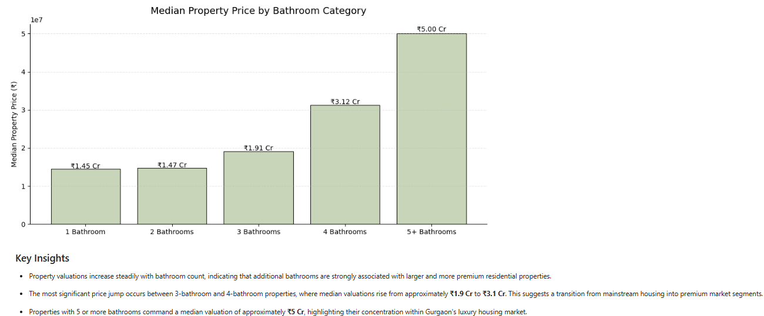
13 • ANALYZE
13
Fifth finding: luxury is a different product, not simply a higher price
The top 10% of properties exhibit a materially different physical and valuation profile.
LUXURY PREMIUM
CONFIGURATION
Top 10%: 3.5× median price • 2× area • 2× PPSF • 1.7× bathrooms • 1.3× BHK.
The strongest bathroom premium appears at 4+ bathrooms, signalling a shift toward premium/luxury housing.
FRAME
INSPECT
REDUCE
STANDARDIZE
SPLIT
REPAIR
ENGINEER
VALIDATE
ANALYZE
DECIDE

Slide 16
14 • DECIDE
14
What the analytical journey ultimately tells us
The value of the project is the chain of evidence — not any single chart.
01
Market
Gurgaon is predominantly an upper-middle / family-oriented residential market.
02
Location
Locality can create substantial pricing power beyond property size.
03
Size
Area is the strongest measurable structural correlate of price.
04
Luxury
The top end behaves like a distinct segment with larger homes and higher PPSF.
05
Value
Space-to-price efficiency reveals opportunities hidden by headline price rankings.
RAW LISTINGS → TRUSTWORTHY DATA → MARKET EVIDENCE → BUYER / INVESTOR INTELLIGENCE
FRAME
INSPECT
REDUCE
STANDARDIZE
SPLIT
REPAIR
ENGINEER
VALIDATE
ANALYZE
DECIDE

