Slide 1

Customized clothing store - Custom wear
Usability testing and project closure presentation on
PRESENTED BY:
BISWASH POUDEL
BIBEK POKHAREL
SANDIP NEUPANE
SHISHIR GAUTAM
MANRAJ GURUNG
LOBSANG LAMA
DATE: 2024-12-05

Slide 2
agenda
INTRODUCTION
PROJECT PLANNING REVIEW
REQUIREMENTS GATHERING
RESOURCES ESTIMATION AND ALLOCATION
DESIGN PROCESS OVERVIEW
WIREFRAMES AND PROTOTYPES
USABILITY TESTING
SUMMARY

Slide 3
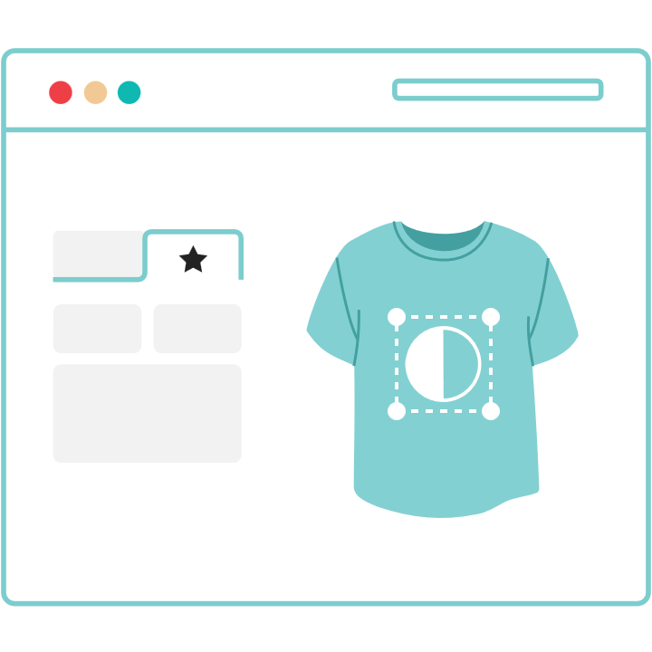
INTRODUCTION
Custom Wear is a platform allowing users to design and purchase customized clothing.
Problem Statement: Address issues like restricted sizes and limited personalization in online clothing.
Objective: To change how people shop for clothes by providing an easy-to-use customization platform.
Targeted Audience: Ideal for anyone looking to customize their wardrobe and make a fashion statement.

Slide 4
Project planning overview
Major Steps:
Defined project goals and objectives.
Conducted thorough requirements gathering.
Allocated resources and established team roles.
Utilized tools and workflows to manage progress.
Timeline:
Weeks 1-4: Ideation and Requirement Gathering.
Weeks 5-8: Planning and Resource Allocation.
Weeks 9-10: Risk Management and Workload Planning.
Weeks 11-13: Design, Testing, and Iterations.
Week 14: Final Presentation.

Slide 5
Requirements gathering
Techniques Used:
Brainstorming: Identified features like real-time previews and guided measurements.
User Observation: Analyzed user interactions with prototypes.
Surveys: Collected data on user preferences for customization, pricing, and feature importance.
Insights:
High demand for accurate sizing tools and visualization features.
Users prefer a guided interface for better customization experiences.

Slide 6
Resources estimation & allocation
Team Roles:
Design: Lobsang (UI/UX Design)
Front-end: Biswash (User Interface Implementation)
Back-end: Bibek, Shishir (Server Logic, API Integration)
Database: Sandip (Data Management)
DevOps: Manraj (Deployment, Automation)
Tools Used:
Design: Figma, Development: React, Node.js, Hosting: AWS, Project Management: Jira (Kanban board setup)

Slide 7
Design process overview
Personas:
Example: Chriselle, a fashion blogger seeking unique styles to showcase.
User Stories:
"As Chriselle, I want easy customization and sharing options to promote products online.“
Core Features:
Real-time customization previews.
Guided measurement inputs.
Seamless checkout and payment processes.

Slide 8
WIREFRAMES & PROTOTYPES
Wireframes (Created in Figma):
Login Page: Simple layout with username and password fields.
Customization Page: Interactive interface displaying product and customization options.
Checkout Page: Detailed order summary and payment fields.
Key Prototype Features:
Customization Tool: Enables real-time updates for design elements.
Preview Feature: Visualizes user customizations instantly.
Checkout Process: Simplifies payment with secure methods.

Slide 9
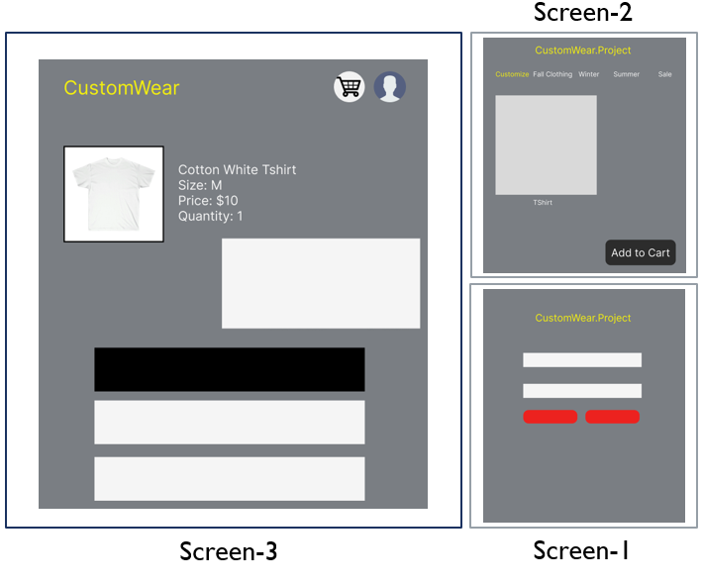
Image: Wireframes

Slide 10
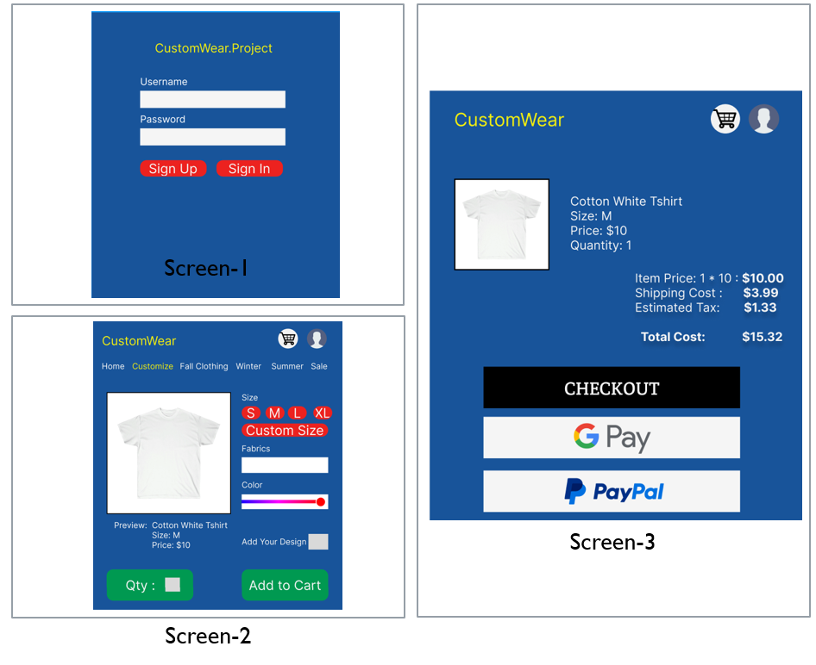
Image: Prototypes

Slide 11
Usability testing
Testing Scope:
Focused on three core features: Login Page, Customization Tool, and Checkout Process.
Process:
Conducted with 5 participants.
Participants completed tasks like logging in, designing an outfit, and completing a purchase.
Monitored user interaction, time taken for tasks, and feedback provided.
Findings:
Login Page: Users found it simple but suggested an option for social media login.
Customization Page: Real-time previews were appreciated for their accuracy.
Navigation between customization options (e.g., color, size, patterns) needed streamlining
Checkout Process: Users found the process secure but requested clearer cost breakdowns.

Slide 12
Usability testing
Actions Taken:
Added a social media login feature.
Streamlined navigation on the customization page with categorized tabs.
Included a detailed cost breakdown and progress indicator during checkout.
Key Features Evaluated:
Customization Tool: Enabled real-time updates and smooth modifications.
Preview Functionality: Provided users with clear visuals of their designs.
Checkout Process: Maintained simplicity while improving transparency.

Slide 13
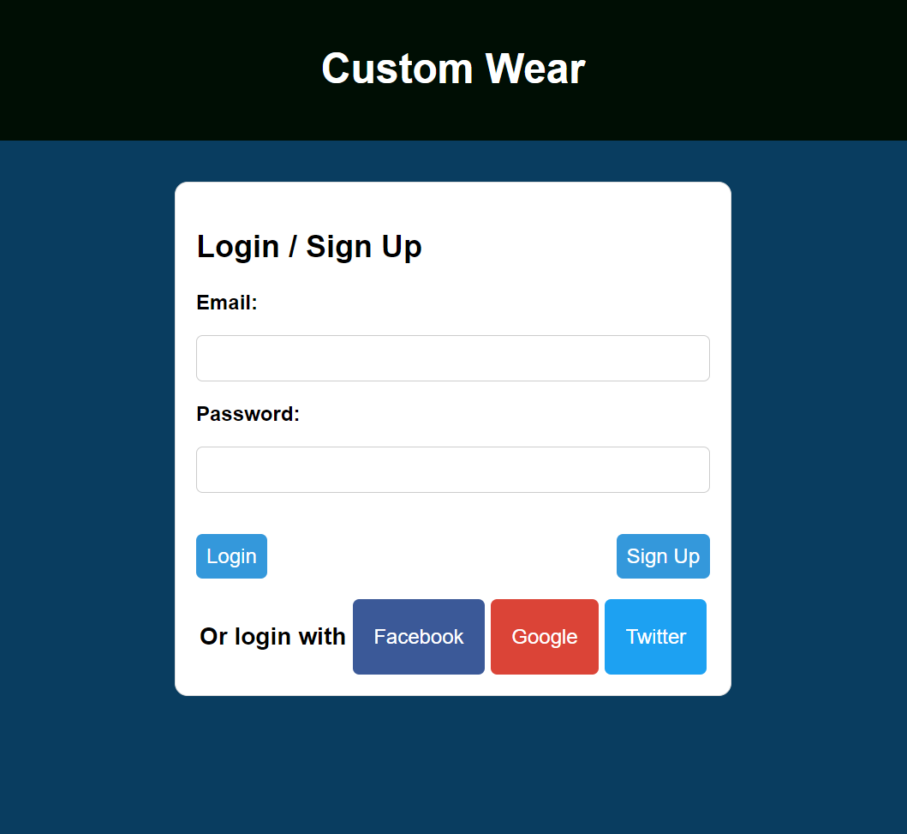
Login/Sign Up Page with Social Media Login Option

Slide 14
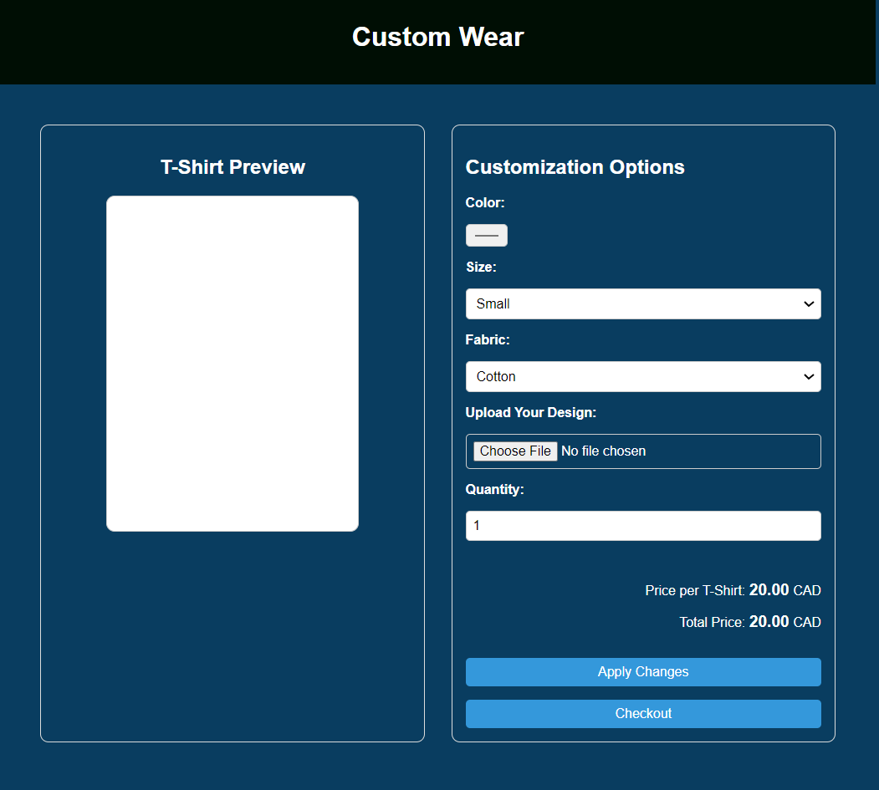
Customization Page

Slide 15
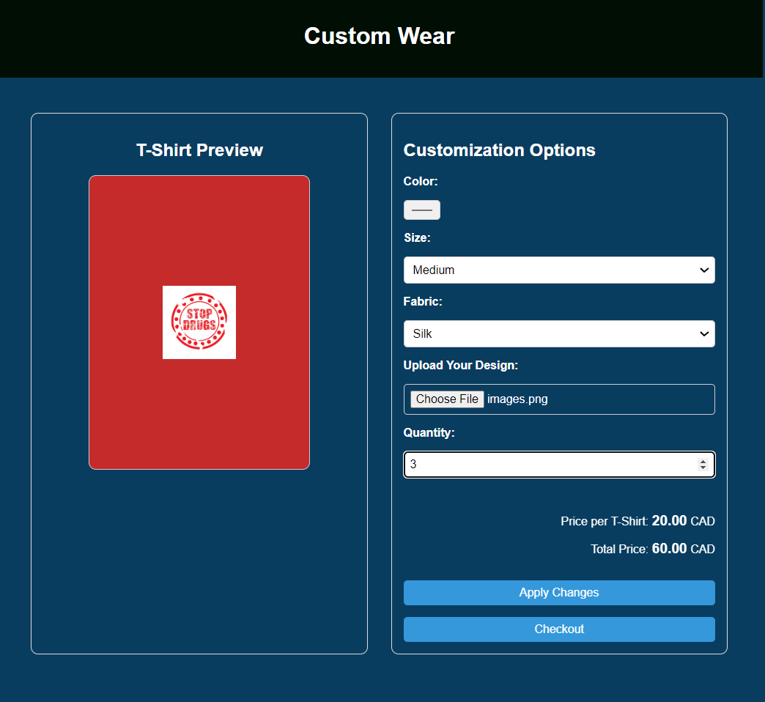
Red Coloured Customized T-Shirt with User Uploaded Image

Slide 16
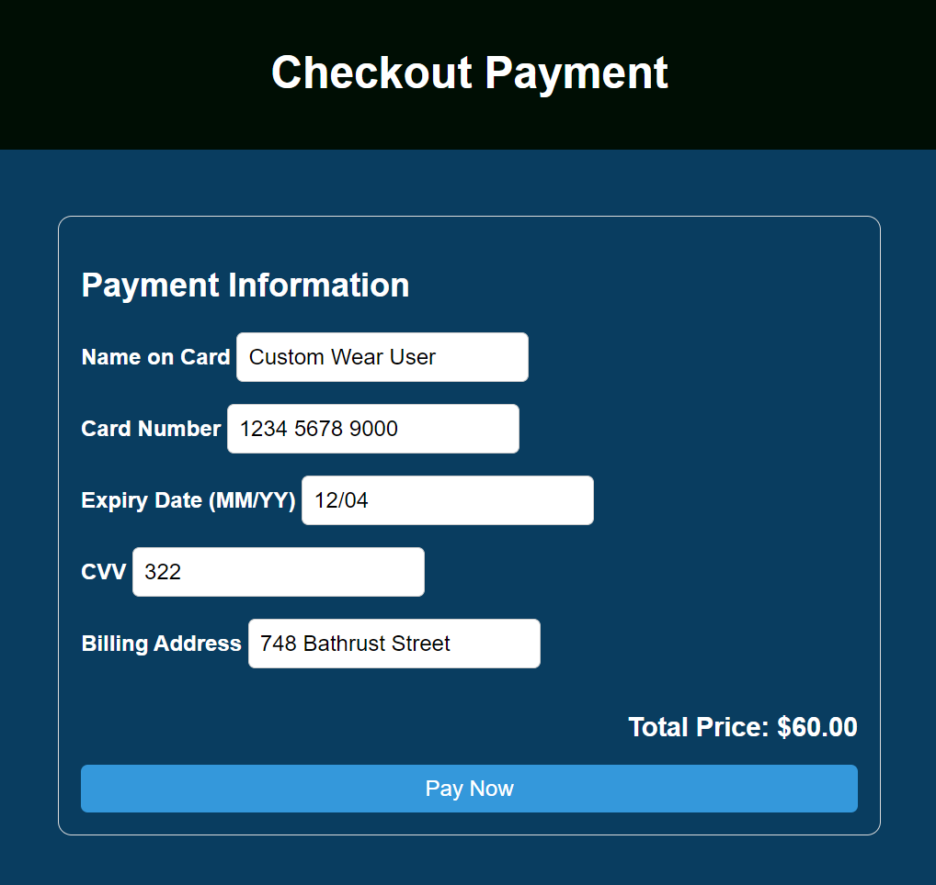
Checkout Page

Slide 17
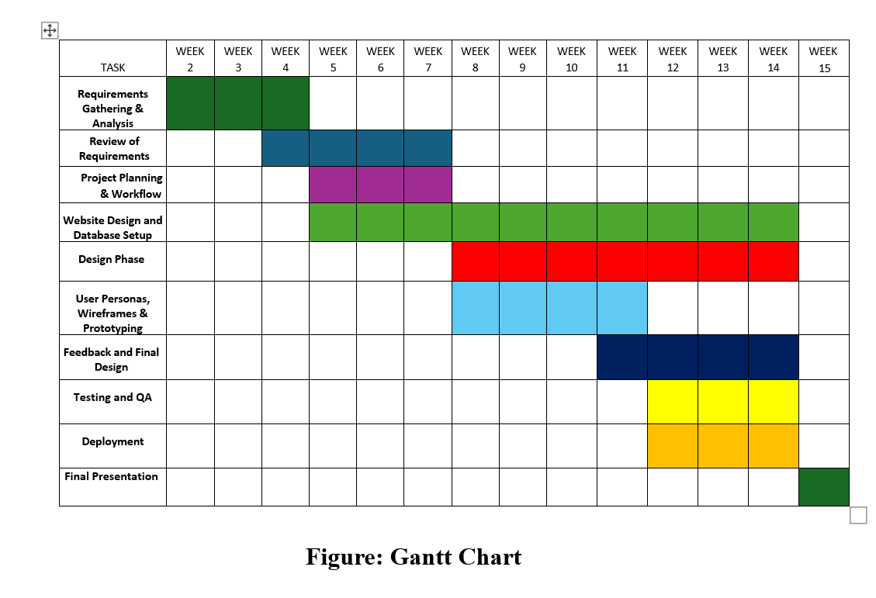
WEEK
14

Slide 18
SUMMARY
Achievements:
Developed a functional prototype meeting core requirements.
Successfully managed risks and resources.
Key Takeaways:
User-centric design and planning are vital.
Effective team collaboration ensures timely delivery.

Slide 19

This Photo by Unknown Author is licensed under CC BY-SA-NC

Slide 20


