Slide 1
Business Analytics

Slide 2
Logistic Regression
Logistic Regression Theory
Logistic Regression Case
Gains curve and Gini
K-S stat
Score Card Development

Slide 3
Logistic Regression - Introduction
Logistic regression is used to analyze relationships between a dichotomous dependent variable and metric or dichotomous independent variables.
Logistic regression combines the independent variables to estimate the probability that a particular event will occur, i.e. a subject will be a member of one of the groups defined by the dichotomous dependent variable.
The value produced by logistic regression is a probability value between 0.0 and 1.0.
If the probability for group membership in the modeled category is above some cut point (the default is 0.50), the subject is predicted to be a member of the modeled group. If the probability is below the cut point, the subject is predicted to be a member of the other group.
For any given case, logistic regression computes the probability that a case with a particular set of values for the independent variable is a member of the modeled category.

Slide 4
Logistic Regression – Variable Requirements
Logistic regression analysis requires that the dependent variable be dichotomous.
Logistic regression analysis requires that the independent variables be numerical or dichotomous.
If an independent variable is nominal level and not dichotomous, we need to dummy code the variable.
Logistic regression does not make any assumptions of normality, linearity, and homogeneity of variance for the independent variables.
The regression equation is
Log(p/(1-p)) = a + b1 x1 + b2 x2 +….. +bn xn + e
Log(p/(1-p)) = η (linear predictor)

Slide 5
Logistic Regression – Methods for including variables
There are three methods available for including variables in the regression equation:
The simultaneous method in which all independents are included at the same time
The hierarchical method in which control variables are entered in the analysis before the predictors whose effects we are primarily concerned with.
The stepwise method (in-built functionality in SAS and SPSS) in which variables are selected in the order in which they maximize the statistically significant contribution to the model.
For all methods, the contribution to the model is measures by model Deviance or AIC.
A better model will have a lower Deviance/AIC
Deviance is calculated from Maximum-likelihood estimation (MLE)
MLE is an interactive procedure that successively tries works to get closer and closer to the correct answer.
A perfect model will have MLE = 0
Deviance = 2 (log Likelihood of perfect model – log Likelihood of current model)
AIC = Deviance + # parameters in model

Slide 6
Logistic Regression – Overall Test of Relationship
The overall test of relationship among the independent variables and groups defined by the dependent is based on the reduction in the likelihood values for a model which does not contain any independent variables and the model that contains the independent variables.
This difference in likelihood follows a chi-square distribution, and is referred to as the model chi-square.
The significance test for the model chi-square is our statistical evidence of the presence of a relationship between the dependent variable and the combination of the independent variables.

Slide 7
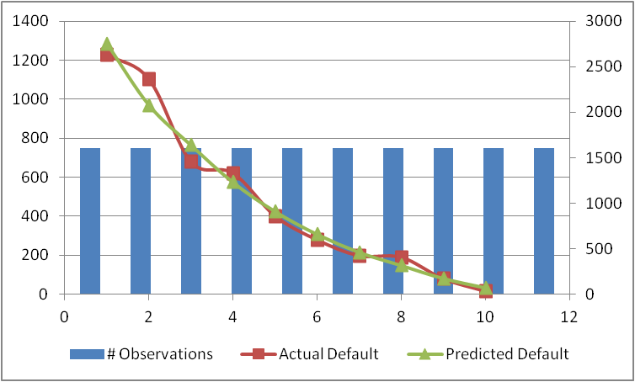
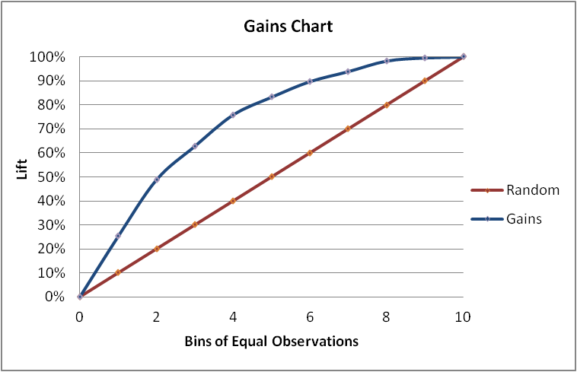
Logistic Regression – Gains curve and Gini (Validation)
Bins | # Observations | Actual Default | Predicted Default | Cumulative Actual | Lift | Random | Area | Gini
0 | 0 | 0 | 0 | 0 | 0 | 0 | 0.00000 | 45.77%
1 | 1606 | 1227 | 1284.957 | 1227 | 25.64% | 10.00% | 0.0128
2 | 1606 | 1101 | 970.2386 | 2328 | 48.65% | 20.00% | 0.0371
3 | 1606 | 678 | 765.3812 | 3006 | 62.82% | 30.00% | 0.0557
4 | 1606 | 620 | 574.6954 | 3626 | 75.78% | 40.00% | 0.0693
5 | 1606 | 401 | 425.5729 | 4027 | 84.16% | 50.00% | 0.0800
6 | 1607 | 278 | 308.8064 | 4305 | 89.97% | 60.00% | 0.0871
7 | 1606 | 197 | 216.289 | 4502 | 94.09% | 70.00% | 0.0920
8 | 1606 | 189 | 149.3579 | 4691 | 98.04% | 80.00% | 0.0961
9 | 1606 | 79 | 82.53703 | 4770 | 99.69% | 90.00% | 0.0989
10 | 1607 | 15 | 34.83957 | 4785 | 100.00% | 100.00% | 0.0998

Slide 8
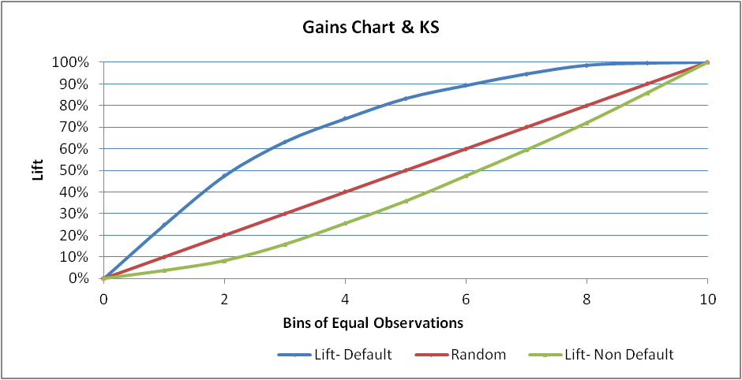
Logistic Regression – KS Stat (Validation)
Bins | # Observations | Actual Default | Actual Non Default | Predicted Default | Cumulative Default | Cumulative Non Default | Lift- Default | Lift- Non Default | Random | Area | Gini
0 | 0 | 0 | 0 | 0 | 0 | 0 | 0 | 0 | 0 | 0.00000 | 45.77%
1 | 1606 | 1227 | 379 | 1285 | 1227 | 379 | 25.64% | 3.36% | 10.00% | 0.0128
2 | 1606 | 1101 | 505 | 970 | 2328 | 884 | 48.65% | 7.84% | 20.00% | 0.0371
3 | 1606 | 678 | 928 | 765 | 3006 | 1812 | 62.82% | 16.07% | 30.00% | 0.0557
4 | 1606 | 620 | 986 | 575 | 3626 | 2798 | 75.78% | 24.81% | 40.00% | 0.0693
5 | 1606 | 401 | 1205 | 426 | 4027 | 4003 | 84.16% | 35.50% | 50.00% | 0.08
6 | 1607 | 278 | 1329 | 309 | 4305 | 5332 | 89.97% | 47.28% | 60.00% | 0.0871
7 | 1606 | 197 | 1409 | 216 | 4502 | 6741 | 94.09% | 59.78% | 70.00% | 0.092
8 | 1606 | 189 | 1417 | 149 | 4691 | 8158 | 98.04% | 72.34% | 80.00% | 0.0961
9 | 1606 | 79 | 1527 | 83 | 4770 | 9685 | 99.69% | 85.88% | 90.00% | 0.0989
10 | 1607 | 15 | 1592 | 35 | 4785 | 11277 | 100.00% | 100.00% | 100.00% | 0.0998
Difference: Cumulative Default & Non Defaullt
0
22.28%
40.81%
46.75%
50.97%
48.66%
42.69%
34.31%
25.69%
13.80%
0.00%
The difference between %Cumulative Default (Bad) and Non Default (Good) is 50.97% which is occurring at 4th decile
At 4th decile, model is able to capture 75.78% of total bads
i.e. if we follow the model, in 40% of records we can capture 75.78% of total bads
The K-S of the model is 50.97% at 4th decile

Slide 9
Scorecard Performance Checks- Comparison with Model results
Comparing the performance of model on Training and Testing records
 | Training | Testing/ Validation
Gini Coeff | 45.53% | 45.77%
KS | 51.23% | 50.97%
The numbers are comparable
Hence, we can conclude that model is getting validated

Slide 10
Scorecard Development
Need for a scorecard
Conversion of Logistic Regression Output to a Score
Performance Measure of Score

Slide 11
Why Scorecard?
Output of logistic regression is probability values in the range of (0,1)
Model results are used by
Risk managers to select/reject customers
Management to take strategic decisions
End customers to assess their credit worthiness
As an input to some other model
Using the raw output will be cumbersome and will pose technical and mathematical challenges to deal with
Conversion of raw probabilities to a more readable format (without compromising on the effectiveness) will solve the above mentioned problems
The transformed probabilities are the scores and the set is the Scorecard

Slide 12
Scorecard Performance Checks
Basic checks are:
How well the scorecard rank orders the “Target Variable”
Gini coefficient
K-S stat
Steps involved are:
Sort the data/records by Score
Create bins of equal weights (observations in logistic regression)
Calculate average of “Target Variable” in each bin
Calculate Gini coefficient (as described in earlier section)
Calculate K-S (as described in earlier section)

