Slide 1
Ex-Refugee Help Tool
Make lives easier.
Learning tool.
Easier to ask for help.
Focused on Community Growth.

Slide 2
Permits or Consent
No building consent .
"Courtesy Consent" from Organizations.
Terms and Conditions for users.

Slide 3
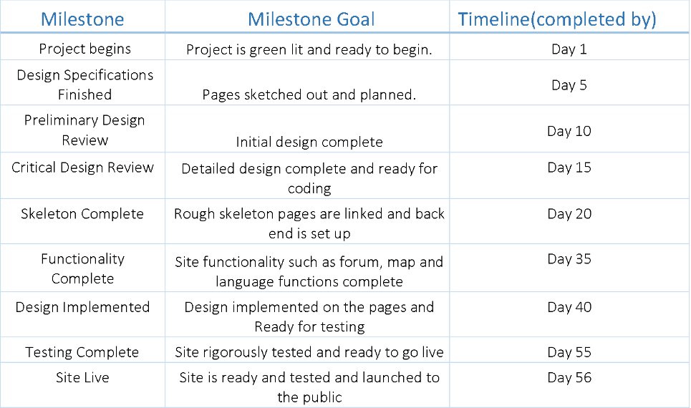
Milestones and Timeline

