Slide 1
Verification
Fall 2023
Tufts University
Instructors: Joel Grodstein, Scott Taylor
joel.grodstein@tufts.edu
Introduction

Slide 2
What’s in this lecture
The course – once quickly
Why do we care about verification?
What is a verification engineer?
What we’ll learn
Resources
Notes:
The format of the course is the coronavirus version!

Slide 3
What is verification?
Trying to find the bugs in a design
You’ve found your own bugs in your own designs
  probably hasn’t been easy
  gets exponentially worse for larger designs ☹
Verification is a separate specialty
  Typically more verification engineers than design engineers!
  And design engineers spend over half their time in verification
Notes:
The “exponentially worse” is because the number of states in the final machine is the product of those in its pieces. And more state = more cross products.

Slide 4
Instructor
Instructor: Joel Grodstein
Office Hours:
  Tue/Th 11-noon or after class
Background
  30 years in the semiconductor industry
  2nd career as a half-time lecturer here

Slide 5
Instructor
Instructor: Scott Taylor
Office Hours:
  TBD
Background
  30 years in the semiconductor industry, mostly in verification
  15 years at Intel, currently at Nvidia (7 years)
  Currently on CPU verification for self-driving cars
  Principal engineer
  Doing this course for the fun of it
  They pay me to break things ☺

Slide 6
Prerequisites
Ability to program with a Hardware Description Language
  We’ll be using SystemVerilog
  VHDL is fine
  C++ is actually fine, too
Basic computer architecture
  Understand what gates, flops, clocks, memories are (ES4)
  Understand what a pipeline is, basic CPU arch (EE126)
  But most importantly…
Attitude
  You like to break things
  You enjoy detective work & are good at finding patterns
  You enjoy automating stuff
  Mix of HW and SW
Notes:
Note the CPU architecture is more for the examples than anything else; we’ll be building a router, not a CPU

Slide 7
Assignments
Work in small groups
  2-3 people
  one group for the 2 FIFO assignments, one for the 4 mesh assignments, and one for the mesh debug challenge
Programming assignments
  write our own FIFO & mesh (or parts of them)
  write parts of our own testbench(es)
  mesh challenge at the end
Oral group quizzes
  the quiz on the Testbenches unit is replaced by writing a short summary of two of the embedded discussions
Notes:
The two FIFO assignments are definitely less work than the four mesh ones. But it’s hard to switch people when a group of assignments all builds the same code base.

Slide 8
Format
Mostly a traditional classroom, except…
Some topics are flipped
  5-10 minute videos
  Classroom discussions, any questions
Other activities
  oral group quizzes
  debug/etc. help
  during office hours (or class slots when flipped)

Slide 9
Goals for week 1
Course website
  https://www.ece.tufts.edu/ee/165/
  Most everything except grades
Form small groups

Slide 10
What’s in this lecture
The course – once quickly
Why do we care about verification?
What is a verification engineer?
What we’ll learn
Resources
Notes:
The format of the course is the coronavirus version!

Slide 11
First claim
Verification is a big (and getting bigger) job market

Slide 12
Job statistics
2022 Wilson Group Verification Study
  full 1-hour video at
  https://verificationacademy.com/seminars/2022-functional-verification-study
Notes:
You must register to get the video (free registration).
Surveyed 1500 people (across all major EDA companies).
Crossover point where more verif. engineers than design happened in 2014.

Slide 13
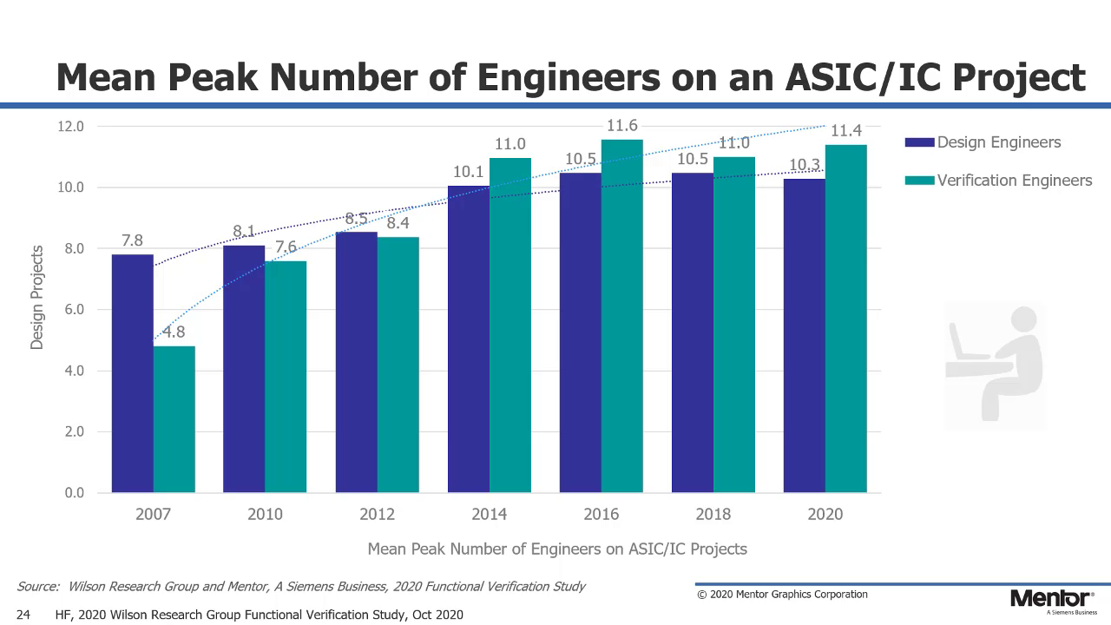
2022 roughly even
CAGR for verif(design) is 5.5%(1.5%) from 2012-2020
47% of design-eng time is spent in verif, 53% in design
Notes:
Remind them what CAGR stands for
The 2022 survey said roughly even numbers of design and verif engineer per project.

Slide 14
Typical schedule
small team moves to next project
huge team ramps up
team leaders write a paper
team ramps down
concepts done
all units coded
top-level assembled
Tapeout 1
Tapeout 2
sales
Which milestone is most “important?”
  If your definition of “important” includes the company staying afloat…
  “time to other peoples’ money”
  Customers really, really dislike giving you money for a broken product!
  Silicon spins take lots of time
Notes:
Customers don’t pay you for writing beautiful papers… unfortunately.
Message – the way to improve time to other peoples’ money is to *not* have 10 tapeouts.
In other words, verify!
That’s why verification is financially necessary.

Slide 15
Cost of a bug fix
Early in design: 1 engineer week ($5K)
Late in design: 1 week tapeout slip = $2M
  or 1 week = 1% performance
Post-silicon: 1 extra tapeout ($+2 months) = $20M
Post-FRS: lose 20% of your customers = $20M/year
After substantial field volume: recalls
  1995 Pentium fix = $495M
400x
4000x
100,000x
Notes:
Assume you’re selling a GPU; 1M units/year, $100/unit. so $100M/year or $2M/week
Hard to compute the cost of a tapeout (depends on your volume, etc and how many layers it involves). Scott’s numbers are $1M/layer, or $40M for a full-layer tapeout and $20M for metal-only. I’ll use $50M since Scott’s numbers are slightly old.

Slide 16
Design trends
Increasing use of multicore, SOC
  designers “just” assemble existing pieces
  harder than it sounds, but still!
  lots of individual pieces → large cross-product space to verify
Notes:
I.e., this is another reason why verification teams are growing faster than design teams

Slide 17
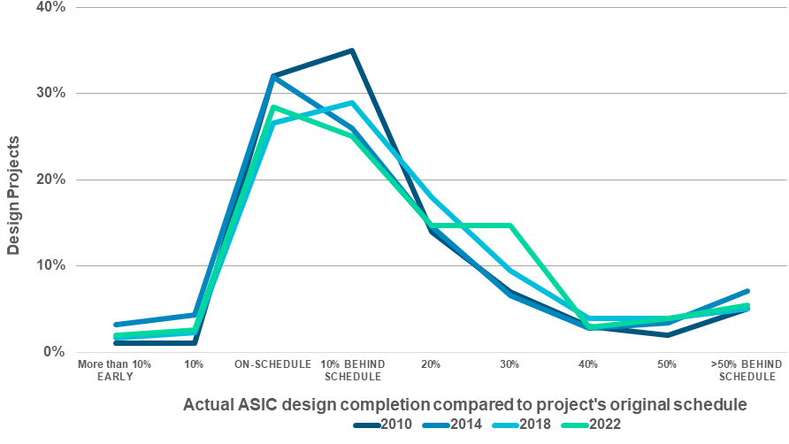
How late are you?

Slide 18
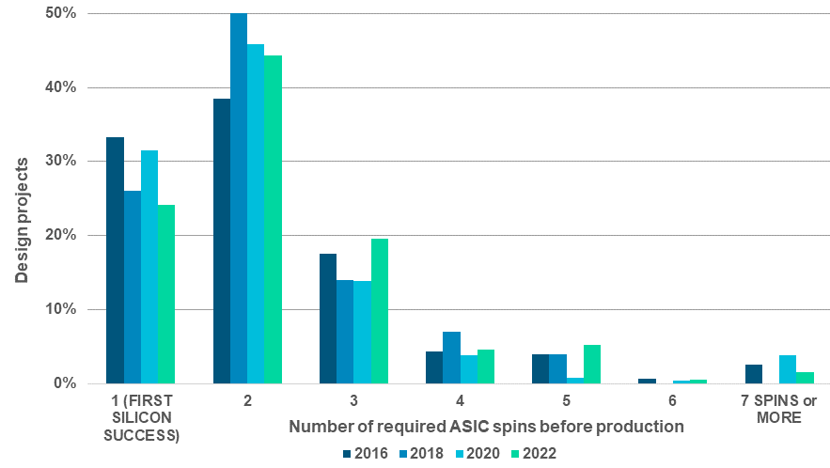
ASIC number of respins

Slide 19
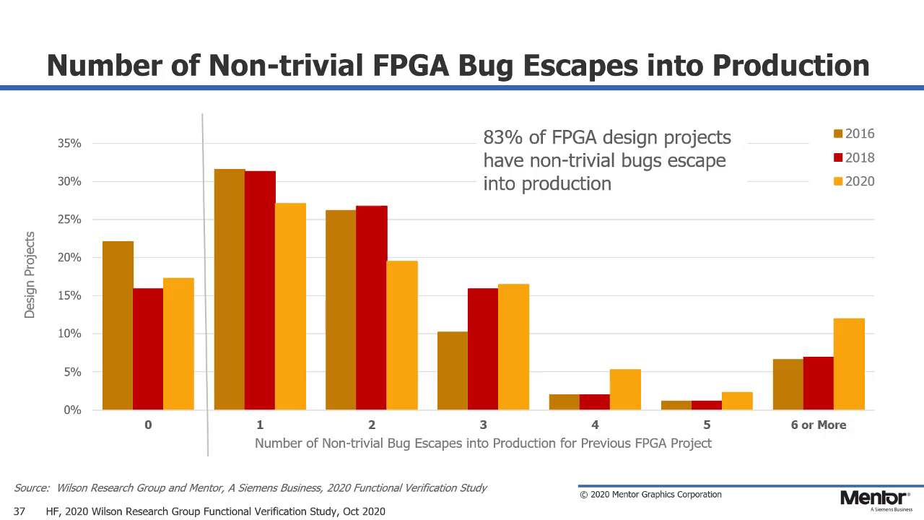
Notes:
Extra spins are of course much cheaper and faster with FPGAs, which changes the economics a lot. But silicon debug is still lots harder than debugging a failed verification test, due to the reduced visibility. So the message is that without sufficient pre-silicon verification, you still get customer bugs.

Slide 20
Errata
Errata happen all the time
Intel Core 8th and 9th gen (Coffee Lake)
  137 errata in released chips
  https://www.intel.com/content/dam/www/public/us/en/documents/specification-updates/8th-gen-core-spec-update.pdf

Slide 21
Why so many escapes?
Why don’t those idiots get things right the first time?

Slide 22
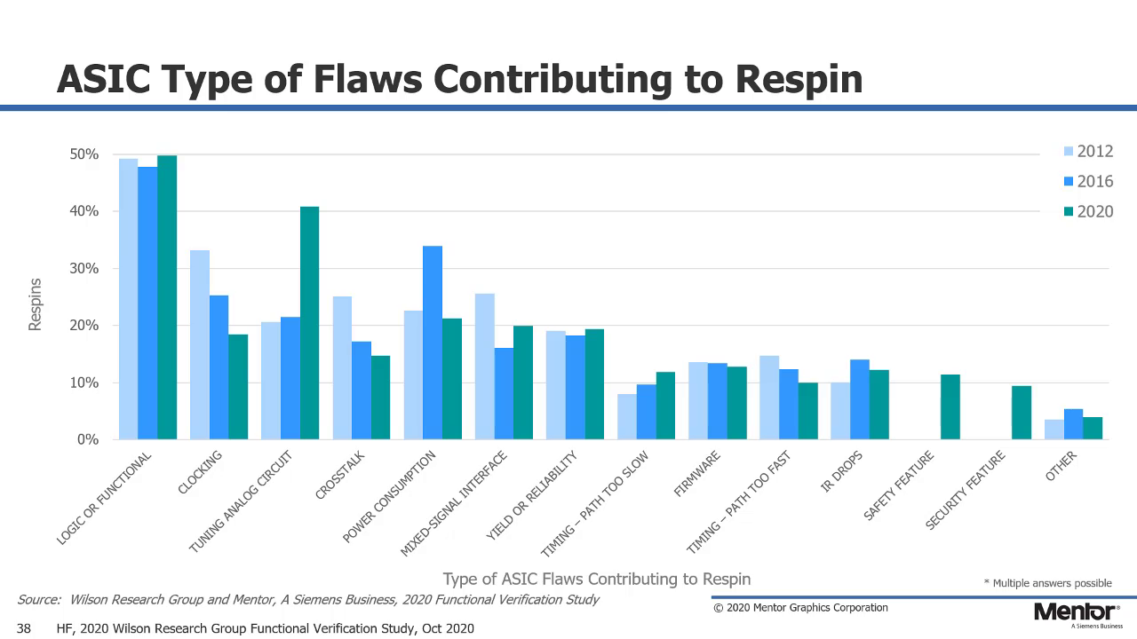
what do think about this data?
Notes:
Here’s why those idiots don’t get it right the first time!
For the security features: security is getting more and more important, which means it’s an area where new features are being added and code bases are changing all of the time. Result – lots of bugs! And maybe some last-minute spec changes also.

Slide 23
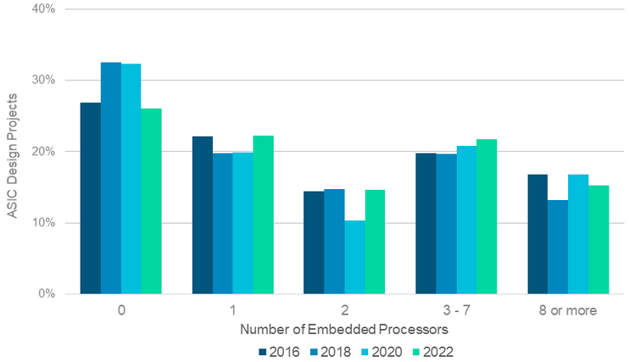
Number of embedded processors
And this, too!
Notes:
And this too!

Slide 24
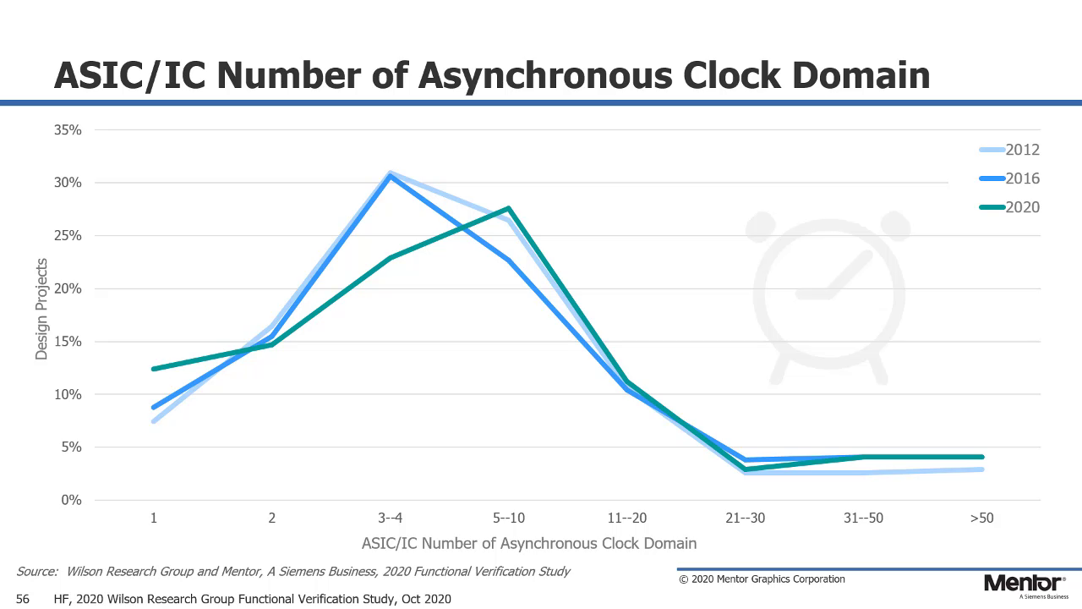

Slide 25
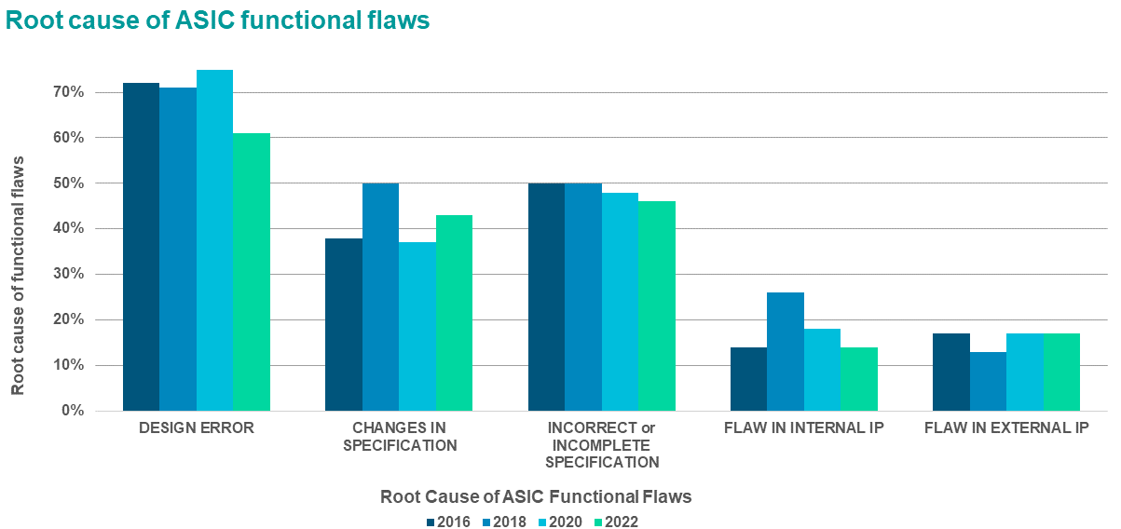
Notes:
Yes, design errors are the most common escape to silicon. But spec changes happen all the time – and as the worlds keeps changing quickly, specs become more and more fluid.

Slide 26
George Bernard Shaw
“The single biggest problem in communication is the illusion that it has taken place”

Slide 27
What’s in this lecture
The course – once quickly
Why do we care about verification?
What is a verification engineer?
What we’ll learn
Resources

Slide 28
What is verification?
Or – what isn’t it? ☺
Is it…
  finding ALL the bugs?
  proving that there are NO bugs?
  guaranteeing production-ready first silicon?
  showing that we’ve eliminated the likely sources of bugs that may block silicon bringup?
good luck with that goal!
more on Formal later…
life doesn’t come with guarantees ☹

Slide 29
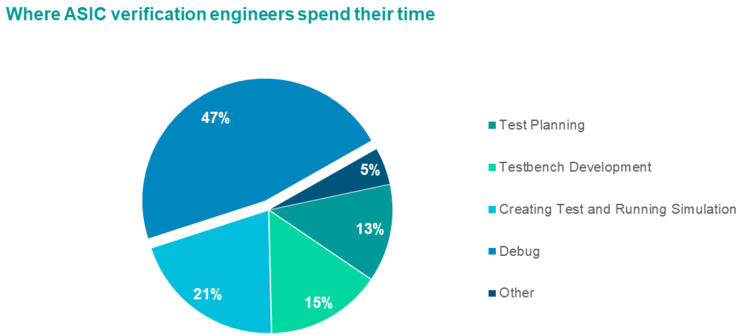

Slide 30
Verification skills
Verification requires a jack-of-all-trades
  we now call it diversity of skills ☺
Architecture design, HW design
  To understand the thing you’re writing tests for!
Software skills
  20% of time spent in testbench development
Debug skills
  41% of your time ☺
Paranoia
  must think what’s most likely to break
Levelheaded
  You are the agent of turmoil

Slide 31
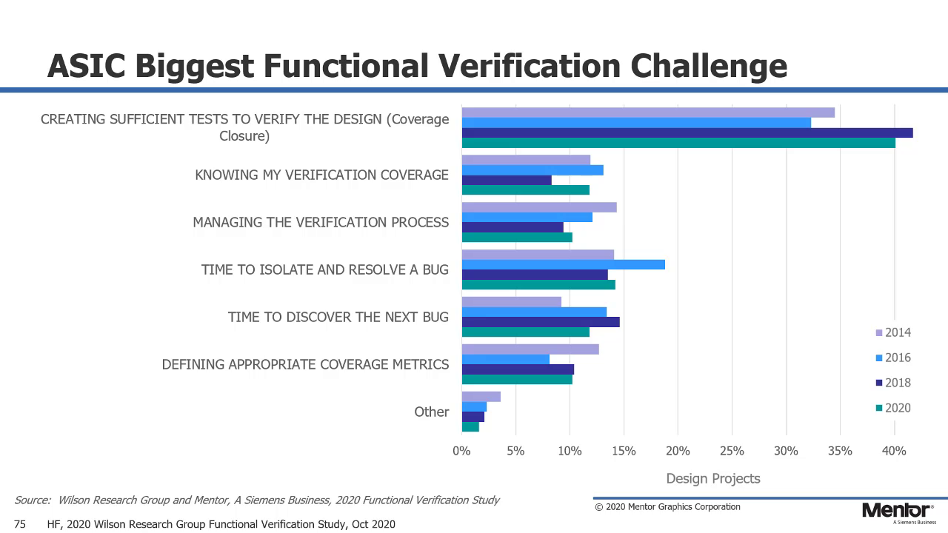
what do you think about tradeoffs between these two?

Slide 32
Evolution of verification
The “good old days”
  designs were relatively simple
  everyone “verified” their own work
  and it usually worked fine!
But then designs got more complex
  Billions of transistors, numerous clock domains, embedded CPUs, …
  Too many tests to write
  Specialized infrastructure and skills are needed
  And so… specialists are needed!
Realization: verifying your own design is a bad idea
  We humans are really bad at finding our own flaws
Notes:
Nvidia Ampere = over 50 billion transistors

Slide 33
War stories
a.k.a. “learn what a verification engineer does by hearing some horror stories”

Slide 34
Pentium FDIV bug
Oct 19, 1994 discovered by Thomas Nicely
Oct 24: reported to Intel
  previously discovered (but not publicized) by Intel
Oct 30: reported to friends for independent confirmation
Nov 7 EE Times article
Nov 21 CNN article
  Intel offers to replace parts for users who can show they were “affected”
  Public outcry; IBM joins condemnation
Dec 1994: Intel replaces for “all users who request it”
Jan 1995: $495M charge against earnings ($750M today)
Background: Intel had gone from a no-name PC-component supplier to starting “Intel Inside” in 1991
Notes:
The original bug find was by Tom Kraljevic, a Purdue intern student working for Intel in Hillsboro! But Intel never made it public (or so says Wikipedia).
Yes, the half-billion dollar charge was from, according to Wikipedia, “only a small fraction of users” requesting replacement CPUs.
Did they mishandle the issue? Perhaps. They were learning how big, famous companies must behave!
The motto – if you’re successful and you make money – then everyone wants a piece of you.

Slide 35
Spectre / Meltdown
Ways to exploit hardware security holes
The holes have been in CPU hardware for many years
Nobody thought of them until recently – why not?
  Thousands of verification engineers, and nobody wrote the right test ☹
  Again: verification doesn’t prove the design works perfectly!
Notes:
OK, that’s quite an oversimplification of why the bugs slipped through for so long! Scott’s more detailed story is that back in the day, the existence of possible side channels was known at Intel. But that was before the advent of a user-accessible fine-grained timer, so Intel (correctly) concluded that there was no way to exploit the problem -- and proceeded to forget all about it. Then later they did add a fine-grained times and forgot that there would be consequences! (It’s even a bit more complex than this; I think there was another dependency or two in addition to the fine-grained timer).

Slide 36
Intel server reset bug
Nearly all chips need to be reset
How hard is it to get reset right?
  Really hard!
  Multiple clock domains, voltage domains, turning on power supplies and clocks…
Bug in clock crossing hardware
  Chips would not come out of reset
  Lots of on-die debugging logic; almost none of it would function during reset!
  4 weeks of frantic all-hands-on-board debug found a lousy workaround
  fixed on second tapeout
Notes:
This is from an unspecified server chip ☺.

Slide 37
What’s in this lecture
The course – once quickly
Why do we care about verification?
What is a verification engineer?
What we’ll learn
Resources

Slide 38
Skills we’ll learn
Learn how to verify a register-transfer level (RTL) description of a chip
Learn a verification mindset
Understand the business of verification
Learn about the life of a verification engineer
Learn SystemVerilog
Notes:
By the end of the course, this is what we’ll know

Slide 39
Topics in order
Intro to verification and the course (this lecture!)
Intro to SystemVerilog and a FIFO
Understanding a design
Verification – the big concepts
The mesh
Testbenches
Stimulus: directed vs. random tests
Correctness: knowing if your test passed
Coverage
Developing a test plan
Post silicon verification

Slide 40
Big words
A testplan lists
  what to test
  how to test it
  what’s your infrastructure
  resources needed
A testbench includes
  Your drivers, monitors, checkers, scoreboards, …
Notes:
“Resources” includes human (how many engineers), time (How long will it take), and sometimes cost (we need to buy this software tool license, or this rack of servers and hard drives)

Slide 41
Types of tests
Directed test
  A test, typically written by hand, to test a specific feature with a specific (typically) hand-chosen stimulus
Random-code generator
  Like the name says!
  Generate tons of random input
Pros and cons of each?
  An RCG can generate lots of tests, fast!
  And you test stuff you never thought of
  But how do you know what the right answer is?
  How do you know if you’ve tested a given feature?

Slide 42
Intro to SystemVerilog
This is not primarily a language course
  it’s about learning verification concepts
But SV is
  overwhelmingly used in verification
  underwhelmingly taught at universities
How we’ll learn it
  videos on the basics, and on common mistakes
  Spear textbook has more
  Learn by doing; from simple stuff to harder
  We’re here for questions!
Our running examples are all in SV, as is the testbench
Verification code in industry is heavily object-oriented

Slide 43
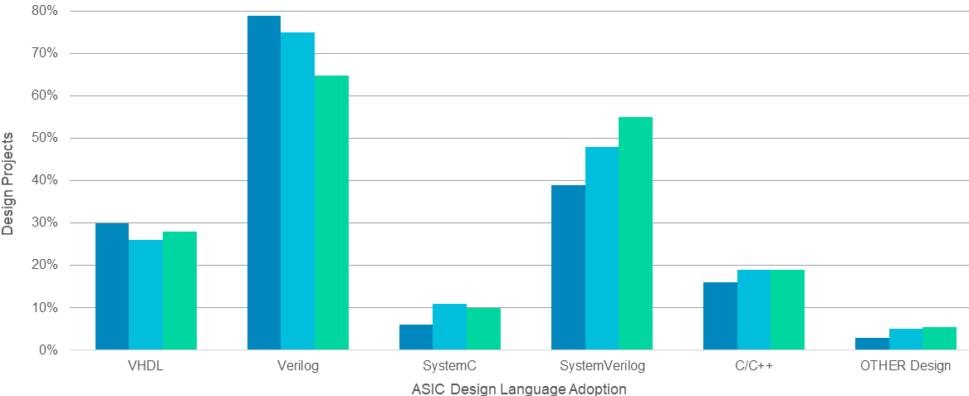
ASIC design language

Slide 44
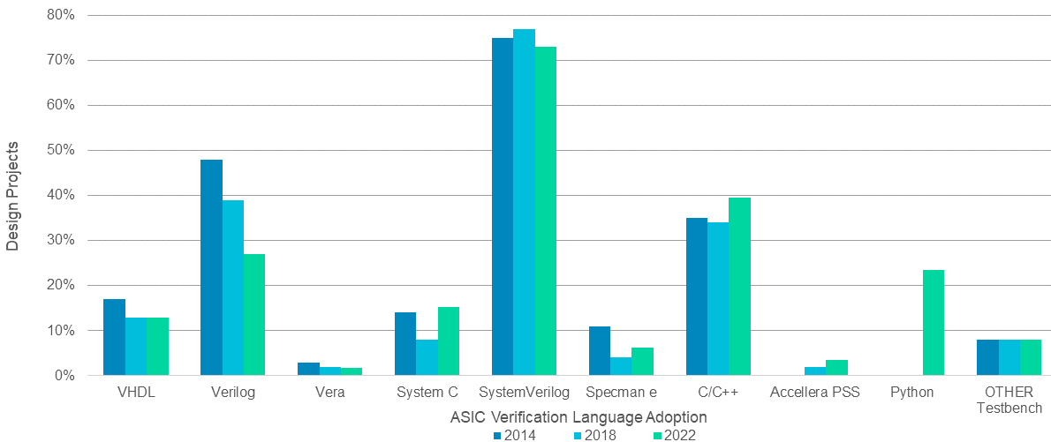
ASIC verification language

Slide 45
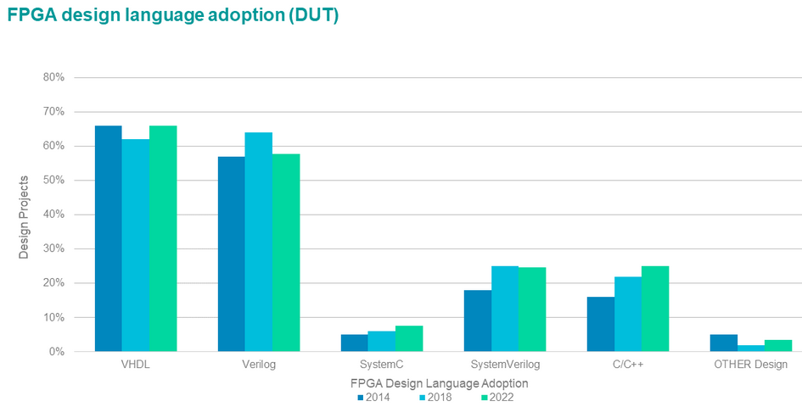
FPGA design language

Slide 46
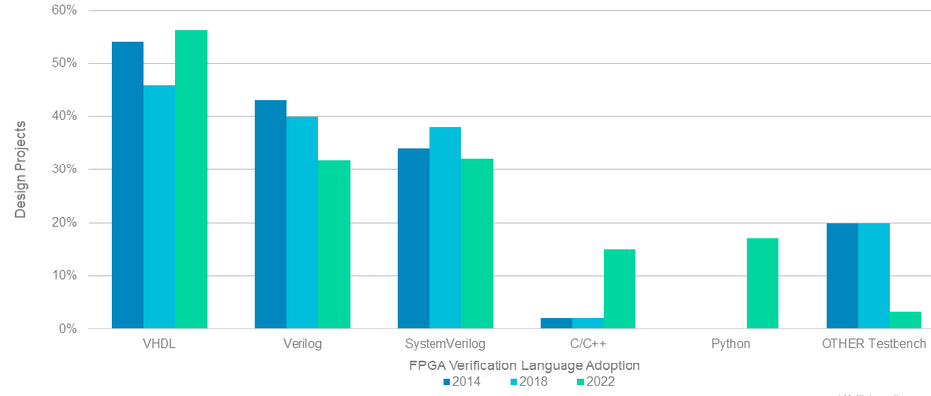
FPGA verification language

Slide 47
Formal verification
Mathematical proofs that the design does X
X may be
  two mux selects are never on in the same cycle
  floating-point multiplier gives correct answer for all inputs
  or most anything else
  can be great when it succeeds ☺
  requires expertise to get it to succeed ☹

Slide 48
Verification mindset
How do we know when a design is ready to tape out?
bug count
Bugs are good!
time
The faster you find bugs up front, the faster you can finish!
  As noted: fixing bugs early is relatively cheap
  The bugs are there; finding them is good
  When you find a bug, shout it from the rooftops!

Slide 49
Example #1: FIFO
Items go in… come out in the same order
Won’t make it asynchronous
  Why is asynch harder?
rst
clk
wr_clk
rd_clk
wr_en
rd_en
wr_data
rd_data
empty
full

Slide 50
Example #2: mesh routing fabric
30
31
32
33
Main design for this course: a mesh
  N x N grid of mesh stops (MS)
  A MS can accept a packet from the environment
  Fabric routes packets to their destination MS
20
21
22
23
10
11
12
13
00
01
02
03

Slide 51
What we won’t cover
This is just an introductory course
Lots of formal verification
UVM (Universal Verification Methodology)
  Almost universally used
  We’ll run out of time to cover it
  But you’ll know enough to pick it up quite quickly if you use it on the job

Slide 52
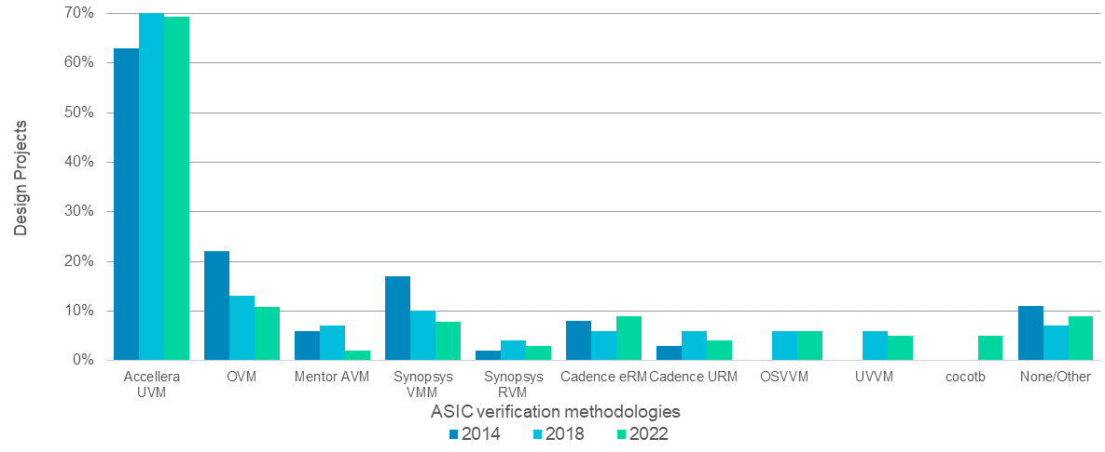

Slide 53
The rest of the course
We know the problem to be solved
  Just find the mistakes that the design team overlooked
  Bigger, more complex designs → problem will get worse, not better
We know the names of the technologies we’ll use
What’s left
  learn them
  apply them
  hone your spidey sense ☺

Slide 54
What’s in this lecture
The course – once quickly
Why do we care about verification?
What is a verification engineer?
What we’ll learn
Resources
Notes:
The format of the course is the coronavirus version!

Slide 55
Grading
Grade Formula
  Programming Assignments ≈65%
  Quizzes ≈ 35%
No tests
Final mesh-debug challenge

Slide 56
Late Assignments + Academic Integrity
10% grade reduction per day
Copying even small portions of assignments from other students or open-source projects and submitting them as your own will be a violation of academic integrity. Sharing code with other students would also be considered an offense.
The best way to ensure that your code is your own is to only have high level discussions with other students and never share a line of code.

Slide 57

Resources
“System Verilog for Verification” by Chris Spear (2nd Ed 2008)
  free online at Tisch
  More detail on some of the topics we cover here
  Reasonably good general overview

Slide 58
Resources
IEEE Standard for SystemVerilog
  Just type that into JumboSearch, then download the pdf (free online at Tisch)
  IEEE standard 1800-2017
  2017 version of the standard (previous was 2012)
  1300-page definitive standard on SystemVerilog
  Surprisingly easy to navigate and read (well-organized chapters)

Slide 59
Resources
http://www.sunburst-design.com
  A SV training company
  http://www.sunburst-design.com/papers/ is a very nice collection of the papers they’ve written
  many of them are tutorial papers or “why you should code this way” papers
  but their target is working professionals in the field

Slide 60
Resources
Comprehensive Functional Verification: The Complete Industry Cycle (Systems on Silicon, Bruce Wile, 2005
  Not available at Tisch
  $60 on Amazon/Kindle
  Encyclopedic information on verification (600+ pages)

Slide 61
That’s all there is
That’s all there is to the course
  except, well, all of the actual details
Questions?

