Slide 1
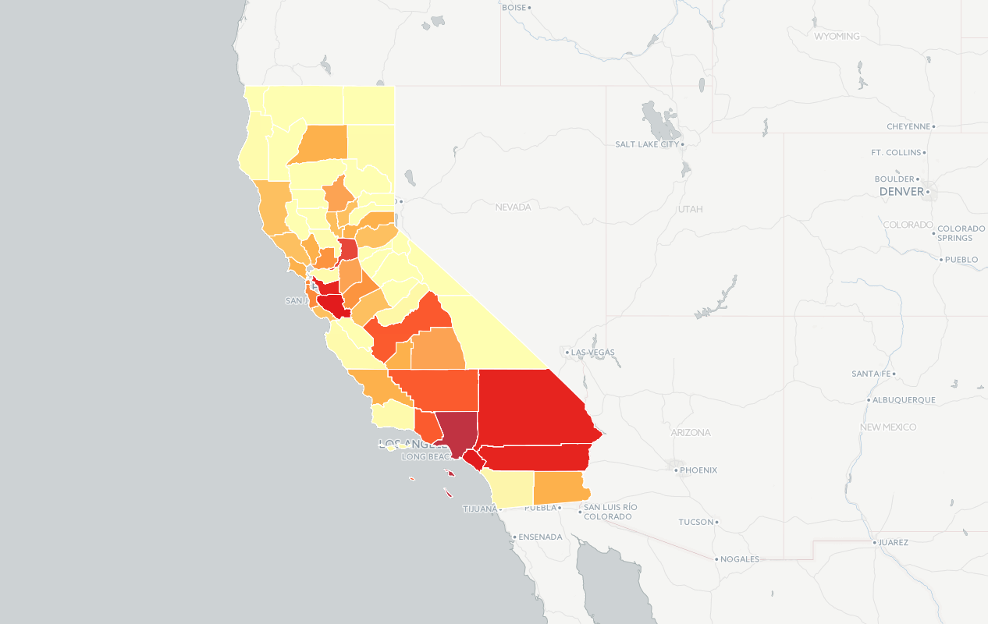
NESW Workshop Data Journalism Experiment Group 3 Apr 2015 – Water It’s all about the data

Slide 2
NESW Workshop Data Journalism Experiment Group 3 Apr 2015 – Water – Issues & Questions
California Water is in the headlines
That leads us to ask:
What is the ground water usage for agriculture versus other uses in Calif.?
Wondering too – How much water goes to grow feed for lifestock overseas?
We didn’t get there – but we had an interesting day

Slide 3
NESW Workshop Data Journalism Experiment Group 3 Apr 2015 – Water- Find the source
We went to http://waterdata.usgs.gov/ca/nwis/nwis.
We found a 'dat' file by county all years.. with a bunch of categories… With the panda lib invoked we threw a file in a python folder in the notebook… w some stuff scrubbed out..
We mucked around in Exel cause we thought we’d see things (that we could exploit later in Python). Couldn’t handle the data.

Slide 4
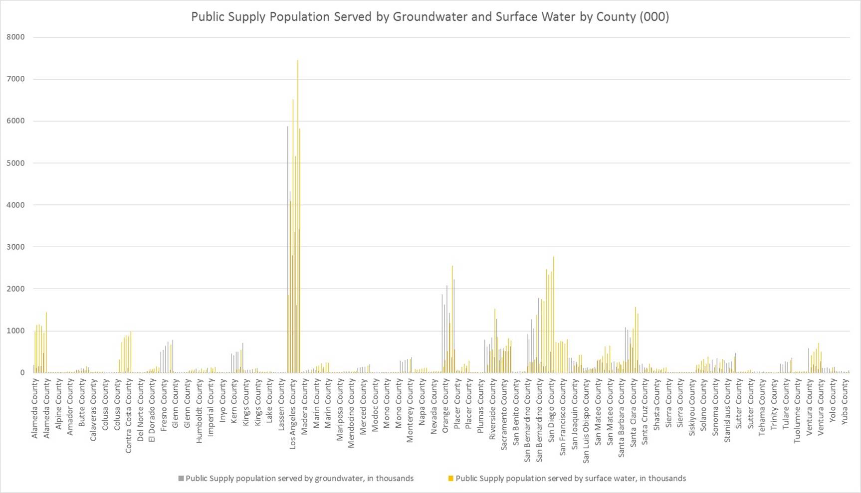
NESW Workshop Data Journalism Experiment Group 3 Apr 2015 – Water- eXCEL

Slide 5
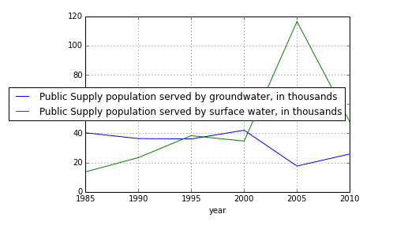
NESW Workshop Data Journalism Experiment Group 3 Apr 2015 – Water From iPython2CartoDB
We went back to iPython panda lib…
Notes:
One could say we got bogged down in scrubbing the data..
We plotted two things, worked where we had data.. we wanted to replace missing values that were represented by "-" dashes .., that was a challenge … but found df.replace could o that
That golf course had data issues.. so we said the heck with that… but we came back to it…
One could say we got bogged down in scrubbing the data..
We lost a file.. we had some format issues..
Brian tried to bring county shape files into cartoDB, which he is matching on id's through python; there is a format called Geo Json… lightweith way to map dif properties of geographi ata… there are services online.. that work with it.
Graffing of data by county was problematic too…

Slide 6
More
how about peoples supplied by ground water vs supplied by surface water?
Anyway a step forward was CartoDB
Again we faced merge, format etc issues.
We wonder: How do we tell it (CartoDB) what we need? Say, domestic public supply population serviced by surface water v groundwater.
Notes:
how about peoples supplied by ground water vs supplied by surface water?
Anyway a step forward was CartoDB
Again we faced merge, format etc issues.
We wonder: How do we tell it (CartoDB) what we need? Say, domestic public supply population serviced by surface water v groundwater.

Slide 7
NESW Workshop Data Journalism Experiment Group 3 Apr 2015 – Water
We took census data to get county shapes… the shapes are from census bureau and the colors are from the our waterDAT file.. (Thanks Jeremy)
We merged census and water and there were some interesting discussion around what it meant.
LA used the most water…..

Slide 8
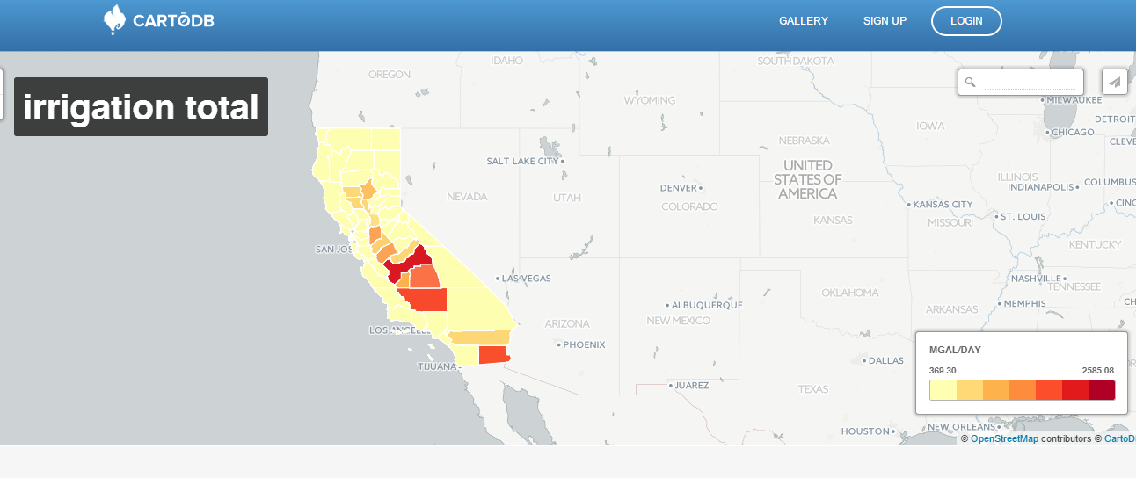
NESW Workshop Data Journalism Experiment Group 3 Apr 2015 – Water – No surprise. But we are digging a deeper well…
http://cdb.io/1OrhThC

