Slide 1
Adventures in Multiple Sclerosis Clinical Trials Data
or, if Excel ain’t broke, don’t use iPython

Slide 2
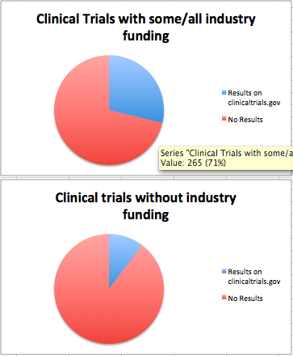

Slide 3
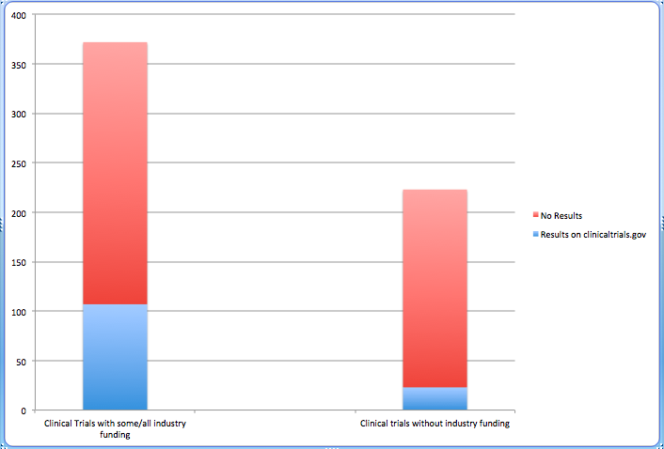

Slide 4
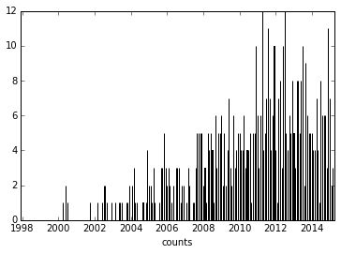
Chart of completion date of 570 studies in clinicaltrials.gov related to "multiple sclerosis."

Slide 5
