Slide 1

Keylogger Detection and Termination System
Presented By: Presented To:
Name: Bittu Kumar Guide: Mrs. Shibya Swaroop
Reg. No.: 222025109271 HOD: Dr. Naghma Khatoon
Department: B.Tech(CSE)
Semester: 7th Date: 18 Nov 2025

Slide 2
Problem Statement
Challenge:
Keyloggers represent one of the most dangerous and stealthy types of malware, silently recording every keystroke and compromising sensitive data.
Key Issues:
> Some keyloggers operate at kernel level, remaining undetected
> Current systems Lack behavioral and proactive defense mechanisms
> Resource-heavy detection systems discourage continuous monitoring
Impact
Financial theft, identity fraud, unauthorized access, and data breaches affecting individuals and enterprises

Slide 3
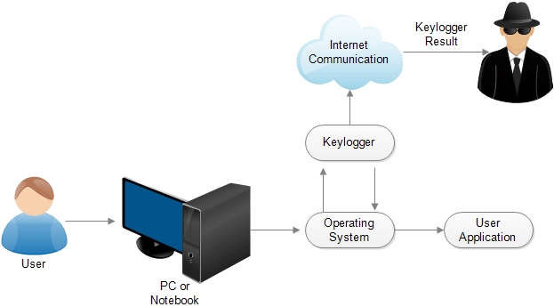
Working of Keyloggers

Slide 4
Project Objectives
Intelligent Detection Framework
Develop behavioral and heuristic-based analysis to identify keyloggers through actions rather than code signatures
Decoy Input Injection
Implement proactive defense by injecting virtual keystrokes to trap hidden keyloggers
Minimize False Positives
Use decision fusion models to optimize detection accuracy with minimal false alarms
User-Friendly Interface
Create intuitive dashboard for monitoring, analysis, and forensic review

Slide 5
System Architecture
1
Input Capture Layer
Low-level monitoring of keyboard and mouse events with minimal overhead
2
Detection Engine
Behavioral analysis + heuristic rules for comprehensive threat identification
3
Process Monitoring
Constant surveillance of processes, system hooks, and API access patterns
4
Decision Fusion and Response
Intelligent aggregation and automatic threat neutralization

Slide 6
Detection Components
1) Suspicious Process Scanner
> Multi-factor threat scoring (0-100%) based on naming, path, and resource usage
> Categorization into Medium (30-49%), High (50-69%), and Critical (70-100%) levels
2) Startup & Persistence Monitor
> Scans ~/.config/autostart/, systemd services, and cron jobs
> 80% detection rate of autostart configurations in testing
3) Network Activity Analyzer
> Monitors external connections from suspicious processes
> Flags potential data exfiltration attempts
4) Input Device Access Monitor
> Tracks processes with open handles to /dev/input/* devices
> Identifies both hardware and software-based keystroke capture

Slide 7
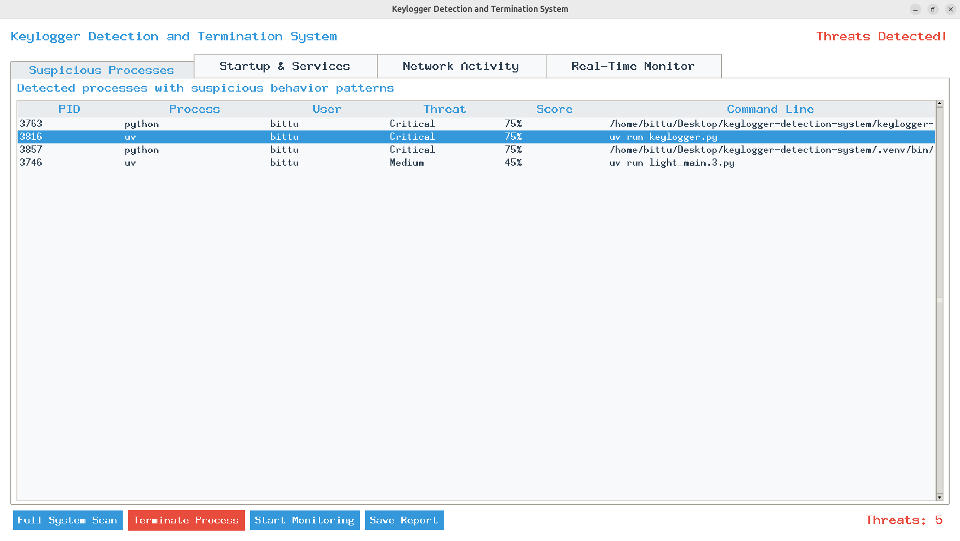
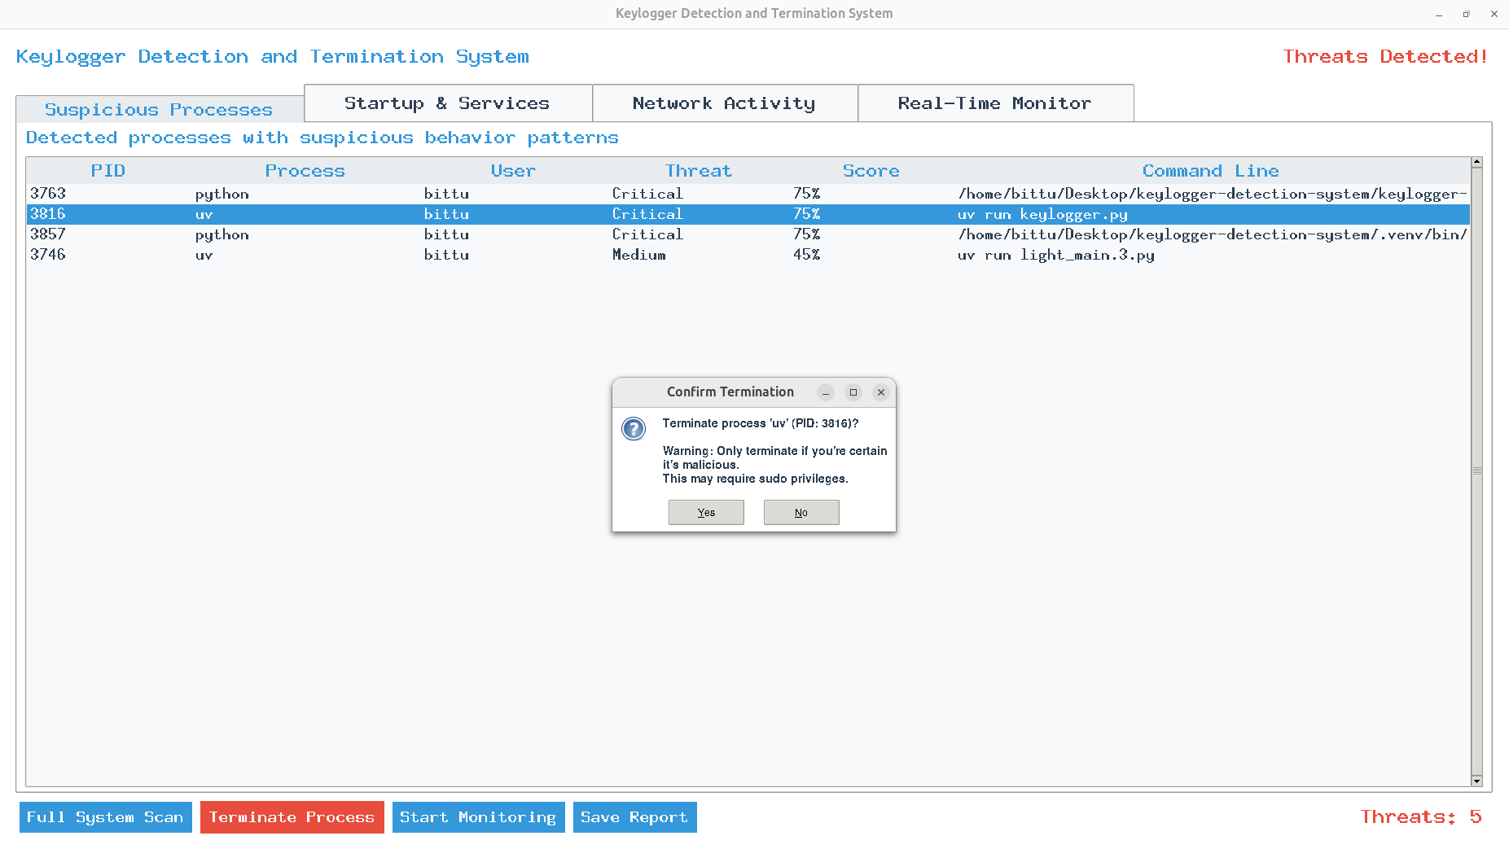
System Interface
1) Suspicious Process Detection
2) Suspicious Process Termination

Slide 8
Limitations
Technical Limitations
> Advanced Evasion: Sophisticated malware with polymorphic code and anti-debugging can bypass detection
> Kernel-Level Threats: Rootkit-level keyloggers can hide from user-space detection
> False Positives: Legitimate admin tools may trigger alerts
> Resource Impact: May affect older hardware during continuous monitoring

Slide 9
Conclusion
The Keylogger Detection and Termination System successfully demonstrates that effective security monitoring is achievable through open-source solutions combining behavioral intelligence, proactive defense, and user-centric design.
Key Achievements:
Integrates behavioral analysis, process monitoring, and heuristic rules
80%+ detection rate with 30% false positives in testing
Minimal resource consumption suitable for continuous monitoring
Easy threat neutralization with a single click
Intuitive interface making advanced security accessible to all users

Slide 10
Thank You!

