Slide 1
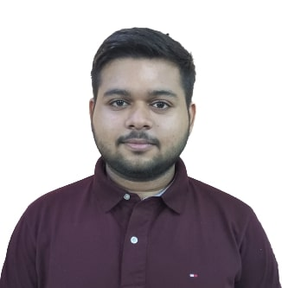
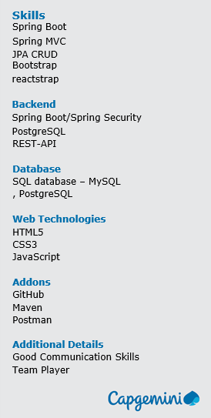


Prakhar Pathak
Analyst/Software Engineer
Bachelor of Technology
Electronics & Communication : 2018-2022
Skills
Bangalore
prakhar.pathak@capgemini.com
+91 9958875868
A4
Full Stack Developer
Java Development knowledge, Spring boot and spring cloud framework including microservice architecture and spring security.
Hands on experience in implementing spring boot application and Experience in creating documentation with swagger and in unit testing using Junit, Mockito including code quality compliance using Sonarqube.
Basic understanding of deploying spring boot applications in GCP Cloud environment, creating VM instance , bucket, load balancing, deployment, traffic-handling using GCP Cloud.
Hands on experience in developing web pages using HTML5, CSS3, Object Oriented Java script, ES6, JSON, XML. Good understanding of Document Object Model (DOM) and DOM Functions.
Basic understanding of Data Structure, OOPs in C++ .
CROP-DEAL BASIC
Completed end to end case study of Crop-deal basic portal along with JWT authentication, Swagger and payment gateway. React Bootstrap is used for user interface.
Learning- management System
Developed LMS using Spring Boot, PSQL and tested all API through Postman
Text Detection using EAST model
EAST is used to detect and make bounding boxes surrounding text. Pytesseract is used to recognize the bounded text.
Certifications – Introduction to HTML, Getting started with Python, AWS CCP certification.
Check out my work on GitHub

