Slide 1

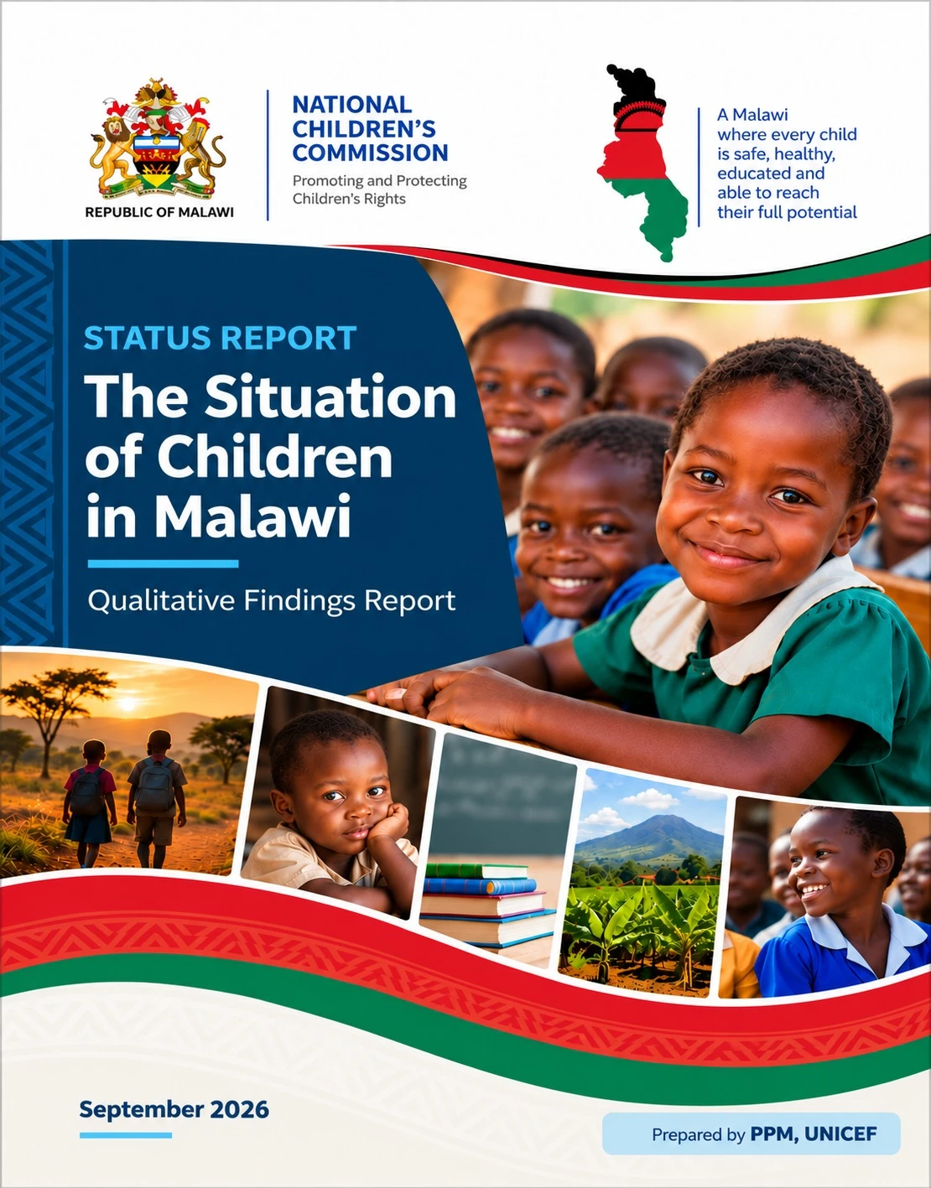
Notes:
Cover page: The Situation of Children in Malawi, Qualitative Findings Report, National Children's Commission, September 2026.

Slide 2




MALAWI | CHILD MARRIAGE EVIDENCE BRIEF
IDENTIFY
factors linked to child marriage
UNDERSTANDING
THE EVIDENCE
INTERPRET
associations, not causes
CONNECT
interconnected vulnerabilities
Child Marriage: What the Quantitative Analysis Tells Us
Daniel Kalunga
Quantitative Analysis Briefing
Monitoring and Evaluation Specialist
ACT
inform programming
unicef
for every child
Associations, not causes. Patterns, not prevalence. Evidence for every child.
Notes:
Opening frame. This briefing summarises what the quantitative analysis tells us about child marriage, and just as importantly, what it does not tell us.
The four words on the right are the logic of the deck. Identify the factors that are associated with child marriage. Interpret them carefully, as associations rather than causes. Connect them, because they cluster together. And act, by using them to inform programming.
The tagline is the discipline we need to keep throughout: associations, not causes; patterns in the sample, not national prevalence.

Slide 3













Understanding the Evidence
01
PURPOSE
What the quantitative analysis set out to do, and how its results should be read.
PURPOSE OF THE ANALYSIS
VULNERABILITIES EXAMINED
Examine factors associated with respondents reporting child marriage.
Identify patterns of vulnerability within the sampled population.
Early sexual activity
Early childbearing
Child labour
Poverty
Orphanhood
Explore how child marriage intersects with early sex, early childbearing, child labour, poverty and orphanhood.
Sexual & reproductive
Sexual & reproductive
Economic
Economic
Protection
Each factor was tested for its association with respondents reporting child marriage.
USE THE RESULTS FOR
Further investigation
Programming discussions
Hypothesis generation
KEY POINT
These findings identify associations within the study population. They do not establish causes of child marriage.
03 / 10
Notes:
Start with what the analysis was for.
Left: three purposes. Examine the factors associated with respondents reporting child marriage. Identify patterns of vulnerability within the sample. And explore how child marriage intersects with other vulnerabilities.
Right: the five vulnerabilities that were examined, grouped into sexual and reproductive, economic, and protection vulnerabilities. Those groupings come back at the end when we talk about programming.
Bottom: how the results should be used. They are evidence for further investigation, for programming discussions and for generating hypotheses.
Close on the key point: these are associations within the study population, not causes of child marriage.

Slide 4










How Were the Findings Generated?
02
METHODOLOGY
A multi-stage sample and regression analysis produced an odds ratio for each factor.
STUDY DESIGN
WHAT DOES AN ODDS RATIO TELL US?
WORKED EXAMPLE
Multi-stage sampling approach.
An OR compares the odds of reporting child marriage between two groups.
OR = 5.14
Data collected across 13 districts and a city.
OR > 1
Higher odds in the group with the factor
Respondents who reported sex before age 18 had approximately 5 times the odds of reporting child marriage, compared with those who did not report sex before age 18.
Relationships examined between child marriage and selected vulnerabilities.
OR = 1
No difference between the two groups
Regression analysis used to estimate odds ratios (ORs).
OR < 1
Lower odds in the group with the factor
IT DOES NOT MEAN
“Early sex causes child marriage.”
PRINCIPLE
Odds ratios should be interpreted as associations rather than causal effects.
04 / 10
Notes:
How the findings were generated.
Left: the study design. A multi-stage sample, data collected across 13 districts and a city, and a regression analysis that estimates an odds ratio for each factor.
Centre: how to read an odds ratio. It compares the odds of reporting child marriage between two groups. Above one means higher odds in the group with the factor, one means no difference, below one means lower odds.
Right: a worked example. An odds ratio of 5.14 for early sex means respondents who reported sex before 18 had about five times the odds of reporting child marriage, compared with those who did not.
Bottom: be explicit about what it does not mean. It does not mean early sex causes child marriage. Odds ratios are associations, not causal effects.

Slide 5










Limitations and Guidance on Interpretation
03
LIMITATIONS
Read the results as patterns within the sample, not as national facts or as causes.
1
NOT NATIONAL PREVALENCE
2
ODDS RATIO ≠ CAUSATION
3
USEFUL FOR PATTERNS AND PRIORITIES
The analysis was conducted without sampling weights.
A high OR indicates a statistical association, not proof that one factor caused another.
The findings allow us to identify:
USE LANGUAGE SUCH AS
Patterns within the sampled population
Among respondents…
WHAT THE OR SHOWS
Differences between sub-groups
In the sampled population…
Factor
◄ ►
Child marriage
The analysis found…
Associations between vulnerabilities
Reported higher / lower levels…
WHAT IT DOES NOT SHOW
Areas of concern requiring further investigation
AVOID
Factor
►
Child marriage
“X% of children in Malawi experience…”
Relationships that may inform programming and policy discussions
GUIDANCE
Report every finding as a pattern among respondents, never as a national rate or a proven cause.
05 / 10
Notes:
Three cautions before we look at the numbers.
One: these are not national prevalence figures. The analysis did not apply sampling weights, so we talk about respondents and the sampled population, never about a percentage of children in Malawi.
Two: an odds ratio is not causation. It tells us that a factor and child marriage tend to occur together. It does not tell us that one causes the other.
Three: what the findings are good for. Patterns, differences between sub-groups, how vulnerabilities cluster, where to investigate further, and what to bring into programming and policy discussions.

Slide 6




Child Marriage Is Associated with Multiple Vulnerabilities
04
OVERVIEW OF FINDINGS
The regression analysis shows a cluster of interconnected factors.
ODDS RATIOS FOR REPORTED CHILD MARRIAGE
WHAT IT MEANS
Two children
About 6 times the odds
Early sex
About 5.1 times the odds
One child
About 4.8 times the odds
Child labour
About 2.1 times the odds
Poverty
About 1.9 times the odds
Double orphan
Significantly associated
OR = 1 would mean no difference in odds. All six factors sit above it.
of reporting child marriage, compared with respondents without the factor.
KEY MESSAGE
Child marriage occurs within a broader pattern of interconnected vulnerabilities, not alongside a single factor.
06 / 10
Notes:
This is the headline result. Six factors are associated with respondents reporting child marriage, and every one of them has an odds ratio above one.
The purple bars are sexual and reproductive experiences: having two children, early sex, having one child. They carry the largest odds ratios, between about 4.8 and 6.
The teal bars are economic: child labour at 2.14 and poverty at 1.94.
The orange bar is protection: being a double orphan, at 1.47, which was significantly associated with child marriage.
The point is not any single bar. It is that the factors cluster. Child marriage sits inside a wider pattern of vulnerability.

Slide 7






Early Sex and Childbearing: Strongest Associations
05
SEXUAL AND REPRODUCTIVE VULNERABILITY
Early reproductive experiences are strongly associated with reported child marriage.
EARLY SEX
HAVING ONE CHILD
HAVING TWO CHILDREN
5.14 × the odds
4.81 × the odds
5.96 × the odds
Respondents who reported sex before age 18 had approximately 5.1 times the odds of reporting child marriage.
Respondents who had one child before age 18 had approximately 4.8 times the odds of reporting child marriage.
Respondents who had two children before age 18 had approximately 6 times the odds of reporting child marriage.
Compared with those who did not report sex before age 18.
Compared with those who had no child.
Compared with those who had no children.
WHAT LINKS THEM
Child marriage
Early sexual activity
Early childbearing
INTERPRET
The overlap is strong, but it does not show that early sex or childbearing independently causes child marriage.
07 / 10
Notes:
The strongest associations are with early reproductive experiences.
Early sex: about five times the odds. Having one child before 18: about 4.8 times. Having two children before 18: about six times.
Each card names its comparison group, because an odds ratio only makes sense against that group.
These three findings show a strong overlap between child marriage, early sexual activity and early childbearing.
But be careful with the direction. The data cannot tell us whether early sex or childbearing leads to marriage, whether marriage leads to them, or whether something else drives both. They should not be presented as independent causes.

Slide 8






Poverty, Child Labour and Orphanhood
06
ECONOMIC AND PROTECTION VULNERABILITY
Economic vulnerability is closely connected to child marriage.
CHILD LABOUR
POVERTY
ORPHANHOOD
2.14
× the odds
Respondents involved in child labour had approximately 2.1 times the odds of reporting child marriage.
1.94
× the odds
Respondents experiencing poverty had approximately 1.9 times the odds of reporting child marriage.
1.47
significant
Double orphanhood was significantly associated with child marriage.
HOW THESE FACTORS MAY BE CONNECTED (BASED ON QUALITATIVE EVIDENCE)
Economic hardship
Poverty, hunger
Child labour
School disruption
Increased vulnerability
Loss of parental protection
Higher risk of early marriage
CAUTION
This is an explanatory pathway from the combined evidence. Do not present it as a proven causal pathway.
08 / 10
Notes:
Economic and protection vulnerabilities show smaller but still meaningful associations.
Child labour: about 2.1 times the odds of reporting child marriage. Poverty: about 1.9 times. Double orphanhood was significantly associated, with an odds ratio of 1.47.
The panel below is where the qualitative evidence helps. It suggests one way these factors may connect: economic hardship pushes children into labour and out of school, that increases their vulnerability, including through loss of parental protection, and that raises the risk of early marriage.
Present this as an explanatory pathway that emerges from the combined evidence. It is not a proven causal chain.

Slide 9




What Do These Findings Mean for Programming?
07
PROGRAMMING
Child marriage should be understood as part of a broader vulnerability system.
ECONOMIC VULNERABILITY
EDUCATION & PROTECTION
SEXUAL & REPRODUCTIVE
CHILD MARRIAGE
Poverty
Hunger
Child labour
School disruption
Loss of parental protection
Exposure to harmful environments
Early sexual activity
Early pregnancy
Early childbearing
The outcome these vulnerabilities converge on
WHAT THE EVIDENCE CAN SUPPORT
WHAT IT SHOULD NOT BE USED FOR
Identify priority vulnerabilities
Generate research questions
Strengthen programme design
Identify areas for qualitative investigation
Explore convergence between quantitative and qualitative evidence
National prevalence estimates
Causal claims
Donor reporting of these figures as national statistics
KEY MESSAGE
Quantitative findings show who is more vulnerable and how vulnerabilities intersect. Qualitative evidence explains how and why.
09 / 10
Notes:
What this means for programming.
Top: treat child marriage as the end point of a vulnerability system, not a stand-alone issue. Economic vulnerability, education and protection vulnerability, and sexual and reproductive vulnerability all converge on it.
Bottom left: what the evidence can legitimately support. Identifying priority vulnerabilities, generating research questions, strengthening programme design, targeting qualitative investigation, and exploring where the quantitative and qualitative evidence converge.
Bottom right: what it should not be used for. Not national prevalence estimates, not causal claims, and not donor reporting of these figures as national statistics.
Close on the key message: the numbers tell us who is more vulnerable and how vulnerabilities intersect; the qualitative evidence helps explain how and why.

Slide 10











CLOSING
From Associations to Action
The findings matter most when they change what we investigate and how we programme.
1. IDENTIFY THE PATTERNS
2. INTERPRET WITH CARE
3. INVESTIGATE AND ACT
Six factors cluster around reported child marriage
Associations within the sample, not national facts
Use the signals to shape the next step
Early sex and childbearing
Poverty and child labour
Orphanhood
Not prevalence
Not causation
Among respondents
Qualitative study
Programme design
Integrated response
Strongest: early reproductive experiences.
Use population-specific language.
Respond to the system, not one factor.
Child marriage sits inside a system of interconnected vulnerabilities. The numbers show where to look; qualitative evidence shows why.
10 / 10
Notes:
Close by pulling the thread together.
One: identify the patterns. Six factors cluster around reported child marriage, and the strongest associations are with early sex and early childbearing.
Two: interpret with care. These are associations within the sample. Not prevalence, not causation. Use population-specific language every time.
Three: investigate and act. Use the findings to target qualitative follow-up and to design an integrated response that addresses the vulnerability system, not a single factor.
Final line: the numbers show where to look; the qualitative evidence shows why.

