Slide 1


Pondicherry University
Analysis of Network Structure in Large-scale Web Data in India
Presented by Bitan Majumder
Student ID: 24MSCSCPY0005
23 February 2026

Slide 2

Table of Contents
Introduction
Analytics and Observations
01
Definition of the Domain along with a detailed discussion of the problem statement and Data description. It also contains the features of the dataset.
03
All the analytical results along with suitable diagrams are provided here. It also talks about the important observations that could be made from these results.
Methodology
Further Plans
02
This section contains the overview of the methodology that is being used in this project so far. It includes pre-processing steps, network structure development etc.
04
It briefly describes the research idea ahead.

Slide 3

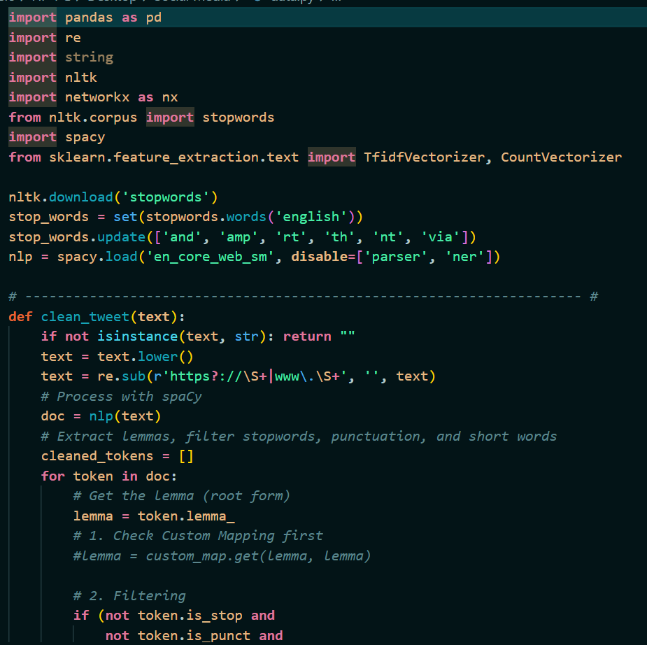
Introduction
Social Network Analysis as a pillar of Computational Social Science
Computational Social Science (CSS) is an interdisciplinary field that investigates social phenomena by applying advanced algorithmic methods to massive, digitized datasets. Within this framework, Social Network Analysis (SNA) serves as a foundational pillar by providing the mathematical and structural logic needed to map the complex web of relationships that define human systems. While other CSS domains might focus on individual sentiment or behavior, SNA leverages the field’s computational power to move beyond the individual, uncovering the hidden topologies and influence patterns that govern how information and social capital flow across global scales.

Slide 4
Data Description and Discussion
The theme of my project is the analysis of social media data based in Indian-context using network structures. For this purpose, I have taken up the incident of Pahalgam attack. The Pahalgam attack took place on April 22nd, 2025. 7 days after the attack, around 12500 tweets were collected from X (formerly Twitter) using scraping method. This is the dataset of my task. The dataset has 30 columns, including tweet_id, author_id, creation time, language, text, likes, replies etc. To make a qualitative analysis of the tweets I handpicked 150 tweets randomly and went through them to understand the sentiment of the tweets.
Qualitative Analysis of the data
Most of the tweets are factual, as they are tweeted by famous News outlets and mode of the tweet is reporting type.
Some tweets contained Sarcasm, mostly targeting Pakistan Army and Government for their actions in the aftermath of the attack, defending their global picture.
Some speculative statements are there, where authors are claiming things that might be really serious, without any factual evidence.
Tweets also contained offensive words, verbal abuse and hatred.
A few tweets were there supporting peace and unity, condemning terrorist activities
Although this subset represents a fraction of the total corpus, it accurately reflects the core discourse. While additional peripheral themes may exist, the identified categories represent the most statistically and contextually significant trends.

Slide 5
Data Cleaning and Pre-processing
01
For this task I have only used the ‘text’ column of the dataset. Each row in this column denotes a tweet. However, these rows contain redundant data like URLs, hashtags, and emojis which are not useful for the purpose and might cause trouble as the embedding could be different than the usual. So, data cleaning is required.
For cleaning the data, I first removed the stopwords present in the data like ‘and’, ‘the’, ‘is’ etc. Then removed any URLs present in the tweets using regular expressions.
Another important step of pre-processing is Lemmatization. It s a text normalization technique that reduces inflected words to their dictionary base form, called a lemma, using vocabulary and morphological analysis. For example – ‘Pakistani’, ‘Pakistan’s’, ‘Pakistan’, all are converted into base word ‘Pakistan’. I used spaCy lemmatizer here.
Methodology

Slide 6
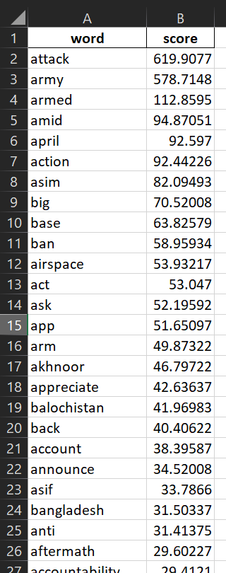

Selecting top 200 words using TF-IDF
02
TF-IDF refers to Term Frequency-Inverse Document Frequency. It is a statistical method which is widely used as a measure of importance of a word to a document or corpus. Here is a breakdown of individual terms –
TF measures the frequency of a term within a document.
IDF measures the rarity of a term across a collection of documents.
In the context of this task, every term is a word which is left after pre-processing, and every document is a tweet or row in the ‘text’ column.
After calculating the TF-IDF score of each word in the dataset, I picked up the top 200 words. These are the words which came most frequently among the tweets. I will build the word co-occurrence network on the vocabulary of these 200 words.

Slide 7

Building the Word Co-occurrence Network
03
After retrieving the list of top 200 words from the dataset that has the maximum frequency, I tried to build a word co-occurrence network out of them. The idea is to present each word as a node and if any two words have appeared in same tweets more than twice, they will have an edge in between, where the weight of the edge would be the total number of tweets in which both of those words appeared.
I used simple linear algebra techniques to build this network. Primarily I used CountVectorizer from scikit-learn to form a matrix that will tell if a certain word has appeared in a tweet. It is a Binary matrix. If the cell value is 1 then the corresponding word is present in the corresponding tweet, else it is not present. This way a 12500x200 dimension matrix is formed.
Now that the word-tweet matrix is available, I calculated the dot product of the matrix with it’s transpose to get the word-co-occurrence matrix.
$$word_{cooccurrence}={\left(word_{tweet}\right)}^{T}∙(word_{tweet})$$
Finally, I used coordinate list format to store this word-cooccurrence matrix into a sparse matrix which will be easier to form a graph, after setting all diagonals as 0. Using NetworkX I built the graph.
 | Word 1 | Word 2 | Word 3
Tweet 1 | 1 | 0 | 1
Tweet 2 | 1 | 0 | 0
Tweet 3 | 0 | 1 | 1

Slide 8
Vectorization and Clustering
04
All the words are vectorized using Word2Vec, not just top 200 words. The vector size is 100. Word2vec is a popular Google-developed machine learning technique used in natural language processing (NLP) to map words into high-dimensional, numerical vector spaces. It learns semantic relationships by training a shallow, two-layer neural network to predict words based on their surrounding context, enabling applications like word analogies (e.g., "king - man + woman = queen").
After the vectorization is done, to reduce the dimensionality of the embedding space, I applied Principal Component Analysis Principal Component Analysis (PCA) is an unsupervised machine learning technique that reduces the dimensionality of large datasets while preserving as much variance as possible. It reduced the dimension of the embedding space to 2.
After vectorization I intended to form a clustering out of them. I applied K-Means clustering. It is an unsupervised machine learning algorithm that partitions unlabeled data into K distinct, non-overlapping clusters based on feature similarity. It iteratively assigns data points to the nearest centroid and updates centroids until convergence, minimizing within-cluster variance.
To determine the number of clusters I calculated 2 metrices, Silhouette Score and Davies-Bouldin Index that gave me the right number of clusters for this task by evaluating the cluster structures. The silhouette score is a metric used to calculate the goodness of a clustering technique, ranging from -1 to +1, where a higher value indicates well-defined, dense clusters that are properly separated. It measures how similar a data point is to its own cluster (cohesion) compared to other clusters (separation). The Davies-Bouldin Index (DBI) is an internal evaluation metric used to validate clustering algorithms, with lower values indicating better performance. It measures the average "similarity" between each cluster and its most similar one, where a lower score signifies that clusters are well-separated and internally compact.

Slide 9
Block-diagram
Leiden
TF-IDF
Co-occurrence Network
Centrality
Twitter Data
Word2Vec
PCA
K-Means

Slide 10

01
Graph structure
Analytics and Observations
The graph that I got from the dataset has 179 nodes and 744 edges in total. It signifies that not all words are connected with each other. Figure 1 shows a sample of the co-occurrence list that has 3 columns – ‘Source’ as the source node, ‘Target’ as the end node and ‘Weight’ as the corresponding edge weight.
To get a better visualization of the graph structure and identify communities in the graph I used Gephi software. Figure 2 depicts the word-cooccurrence graph.

Slide 11
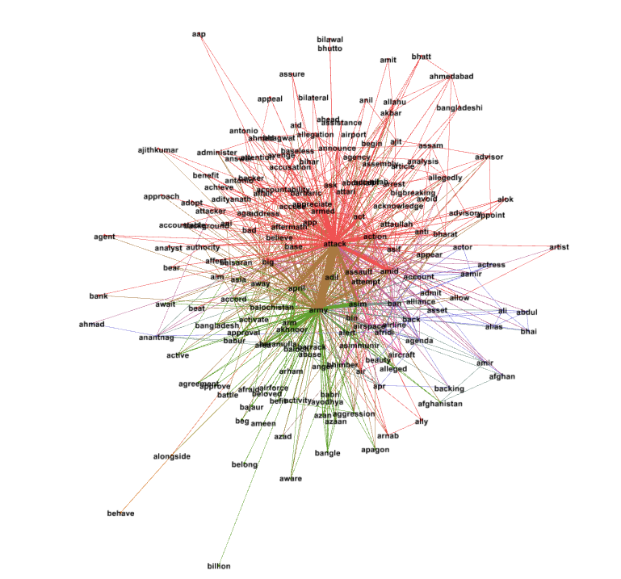
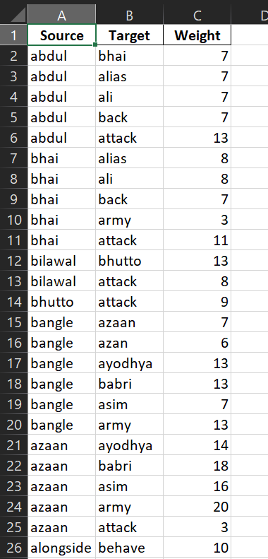
Fig 1: Table of Co-occurrence network Edges
Fig 2: Graph representing the Word-Cooccurrence network

Slide 12
02
03
Community Detection
Centrality Measure
On Gephi I applied Leiden Community Detection algorithm to identify different communities from the graph. Leiden clustering is a community detection algorithm used in network analysis. It identifies groups of nodes that are more densely connected to each other than to the rest of the network. I used Modularity as the quality function and set the resolution factor to 0.75 (trial and error method) on 100 iterations to get a quality of 0.33675 and 5 communities. I had set the resolution in a way that will give only fewer and larger communities. Given the ratio of total nodes and number of communities it can be said that the graph is a fairly coarse division. Also, the quality value suggests that the 5 communities are dense compared to a random network.
Apart from community detection I also measured the Eigen value centrality and Betweenness centrality of each word.
Eigenvector Centrality measures a node's influence in a network by assigning scores based on the principle that connections to high-scoring nodes contribute more than equal connections to low-scoring nodes.
Betweenness centrality measures a node's influence in a network by quantifying how often it acts as a bridge along the shortest paths between all other node pairs.
It appeared that word ‘attack’ comes top in both the cases with Eigenvector centrality score of 0.6091 and Betweenness centrality score of 0.5360.

Slide 13
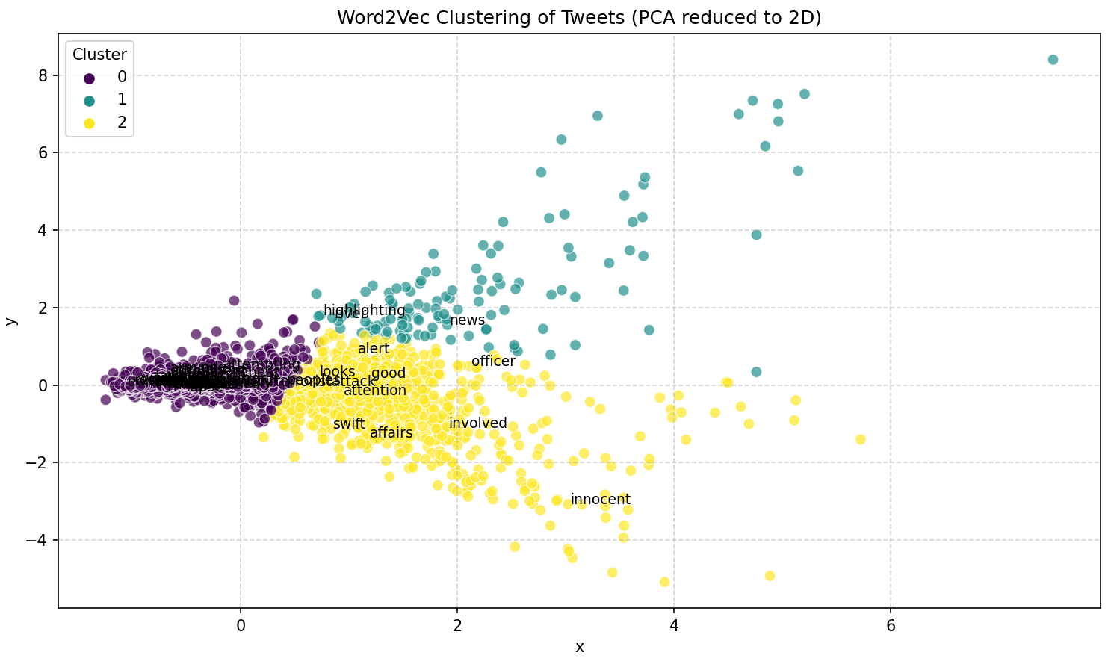
04
Clustering on Word Vectors
After pre-processing total 4784 words were put in the embedding space. The Silhouette score and Davies-Boulding index, both suggested that the ideal number of clusters in this task will be 3 or 4. I decided to take 3 as the value of K in Clustering. The cluster sizes are – 1057, 3615 and 111 respectively. The size of clusters describe the high imbalance of data distribution which is practical in the context of this task as its real-world social media data which contains different spectrum of words and also significant amount of noise.
Figure 3 depicts the diagram of the clustering.
Fig 3: Cluster diagram

Slide 14
Move forward.
Future Ideas ahead

Slide 15
After going through the experiments, I have the Word-cooccurrence Network. There are 5 communities in which the nodes of the network is divided. On the other hand, Clustering was performed on the reduced vectors of words that produced 3 clusters.
The primary idea ahead is to identify the entities from the network and define some stance vocabularies in support of war or violence and against that. The entities here are mainly names of persons or organizations. Now these two groups will be employed to understand the stance of each entity. Network-based scoring will be done. The shortest path from an entity to a pro-war word will be calculated. The same will be done for anti-war word also. Finally, the stance will be calculated by calculating their difference.
Another approach is to identify pro-war and anti-war communities from the detected communities. Then calculate the density of each community and also applying clustering on them. The idea behind this approach is to understand whether same support groups will have similar vocabularies.
A third approach is to analyze the clusters of the word vectors and identify any patterns in the clusters. If found, these patterns could lead to insightful discoveries in future.
01
02
03

Slide 16
Pondicherry University
Thank You
Presented by Bitan Majumder
Student ID: 24MSCSCPY005
23 February 2026

