Slide 1

Università degli Studi di Cagliari Facoltà di Scienze Corso di Laurea Magistrale in Informatica A.A. 2022/23 ProtoAave: a minimal implementation of Aave
Cryptocurrencies, smart contracts, and decentralized finance
Studente Docente
PISEDDU Enrico Prof. BARTOLETTI Massimo
(matr. 60/73/65222)

Slide 2
Introduction and goal
What is Aave? (borrow, deposit, redeem, liquidations …)
The work proposed: ProtoAave
Goal: summarize the main features of Aave, focusing mainly on borrow and deposit actions, on collateral and interests
ProtoAave: a minimal implementation of Aave

Slide 3
Background (1/3)
Basic definitions:
Decentralized Finance (DeFi)
financial system based on blockchain
actions are executed without a trusted authority
users have a direct and total control of their assets
tokens
cryptocurrencies
ProtoAave: a minimal implementation of Aave

Slide 4
Background (2/3)
Basic definitions:
Lending Pools (LPs)
a direct implementation of DeFi
they are decentralized applications (dApps)
they allow users to deposit and borrow crypto-assets
A LP has one or more reserves, each of them representing a specific asset
ProtoAave: a minimal implementation of Aave

Slide 5
Background (2/3)
Borrow and deposit on Lending Pool reserves
Collateralization
it represents an amount of crypto-asset deposited as a “security” for loans
loans can be under|over-collateralized
liquidation scenario
Health Factor = UserCollateral/UserBorrows
Interests for borrowers and lenders:
they depends on time and on Utilization Rate of the reserve
If a reserve is overused: high interests must be paid by borrowers, high interests for lenders
If a reserve is underused: low interests must be paid by borrowers, low interests for lenders
ProtoAave: a minimal implementation of Aave

Slide 6
Tools used
Solidity language
Remix IDE
(Metamask) and waffle-ethereum library for testing
4 smart contracts:
LendingPool, ERC20 and its interface, Ownable and the library WadRayMath
ProtoAave: a minimal implementation of Aave

Slide 7
ProtoAave
A minimal implementation of Aave
It focuses on deposit and borrow actions, when they can be executed, how modify the state of the LP and how users’ data change after these actions
Actors involved:
The “Owner” of the Lending Pool: the address that deploys the contract and adds reserves
Price Oracle: the address set by the owner that can modify tokens’ prices
Users: borrowers and lenders. They interact with the LP by sending it transactions
ProtoAave: a minimal implementation of Aave

Slide 8
ProtoAave: borrow function
borrow (address reserve, uint256 amountToBorrow){
require(amountToBorrow > 0)
require(LiquidityOfLendingPool >= amountToBorrow)
Compute User Data //(total liquidity, collateral, borrows, LoanToValue, …, HF)
require(HF > threshold) // threshold is tipically = 1
Compute the fee (0.0025%) for the amountToBorrow
require(fee > 0)
Compute needed collateral to cover the borrows
require(user’s collateral >= collateral needed)
Update the state of Lending Pool on borrow action
Transfer to msg.sender the amountToBorrow required
ProtoAave: a minimal implementation of Aave

Slide 9
ProtoAave: deposit function
deposit (address reserve, uint256 amountToDeposit, bool useAsCollateral){
require(amountToDeposit > 0)
require(msg.sender allows the deposit) //allowance method of ERC20
Transfer the amountToDeposit to Lending Pool
Mint an amount of aTokens
Update the state of the reserve
Eventually set user uses this reserve as collateral
}
ProtoAave: a minimal implementation of Aave

Slide 10
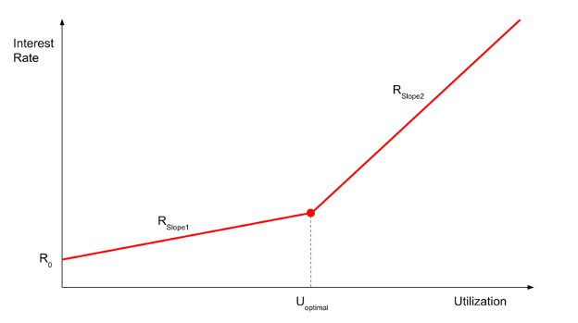
ProtoAave: other important functions
User data
total liquidity, total collateral, total borrows and health factor
Computing interests
depends on time and on the utilization of the reserve
Collateral needed to cover a borrow position
Say if a user can set a reserve as collateral or not (HF)
ProtoAave: a minimal implementation of Aave

Slide 11


ProtoAave vs Aave: main differences
 | Aave | ProtoAave
ERC20 tokens
Deposit and borrow Ethers
Interest rates | Variable or stable | Only variable
aTokens (minted) implementation | ERC20 contract | In a Solidity mapping
LP configuration:
In Aave, a reserve can be activated or deactivates, freezed or not, enabled or not for borrows or collateral
In ProtoAave, once the reserve is added, it is ready for all operations
Other differences: data structures holding users data and reserves data
ProtoAave: a minimal implementation of Aave

Slide 12
Evaluation (1/4)
Tools used:
typescript language
waffle-ethereum library
ethers.js library
chai library for assertion
ProtoAave: a minimal implementation of Aave

Slide 13
Evaluation (2/4)
How testing smart contracts (after installing the previous tools)
Upload all contracts in ./contracts
run the command “npm run build”
(ABIs are .json files in ./build)
Write tests in .ts files
run tests with “npm test”
ProtoAave: a minimal implementation of Aave

Slide 14
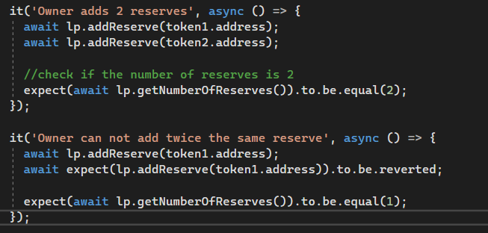
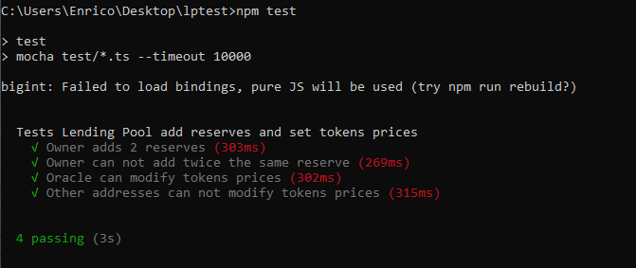
Evaluation (3/4)
Example of test:
Example of output:
ProtoAave: a minimal implementation of Aave

Slide 15
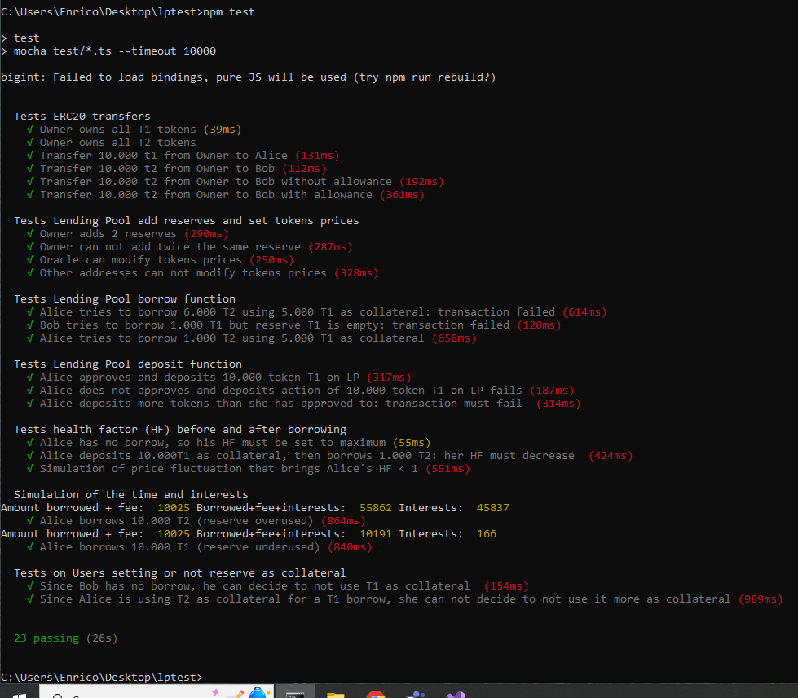
Evaluation (4/4)
Tests involve:
ERC20 contract
LP configuration
LP Borrow function
LP Deposit function
Health factor
Interests
ProtoAave: a minimal implementation of Aave

Slide 16
Conclusions
A minimal implementation of Aave
We focus on borrow and deposit, on collateral and interests
A tool for testing smart contracts
ProtoAave: a minimal implementation of Aave

