Slide 1
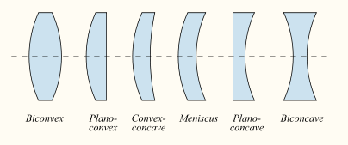
REFRACTION THROUGH LENSES
A lens is made up of a transparent refracting medium, generally of some type of glass, with spherically shaped surfaces on the front and back.
A ray incident on the lens refracts at the front surface (according to Snell's law) propagates through the lens, and refracts again at the rear surface.

Slide 2
TYPES OF LENS
Lenses are generally classified into two main groups: those that converge light rays (like concave mirrors) and those that diverge the light rays (like convex mirrors)
Convex or Converging Lens: is a lens that converges all light rays passing through it to meet at a point called focus. Convex lenses are thick at the centre and thin at the edges.
2. Concave or Diverging Lens: is a that diverges all the light rays passing
through it away from a point (focus). Concave lenses are thin at the centre
and thick at the edges.

Slide 3
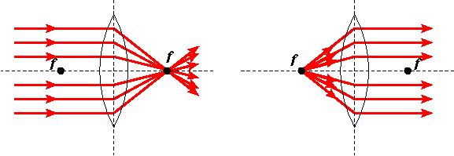
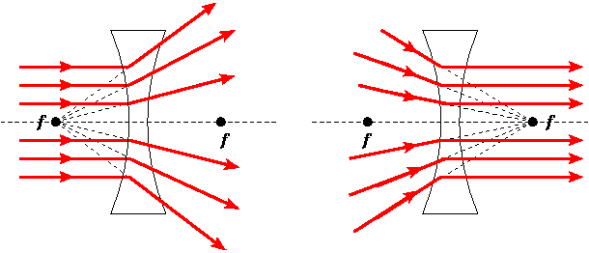
Converging Lens
Diverging Lens
Rays converging at a point called focus
Rays diverging away from a point called focus

Slide 4
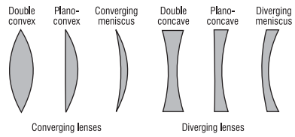
Shape of the Two Main types of Lenses

Slide 5
BASIC TERMS RELATED TO SPHERICAL LENS
Centre of curvature: A lens, either a convex lens or a concave lens is a combination of two spherical surfaces. Each of these surfaces forms part of the sphere. The centre of these two spheres are called centre of curvature represented by C1 and C2
Principal axis: Imaginary straight line passing through the two centres of curvature
Optical Centre: The central point of lens is its optical centre (O). A ray of light, when passes through 'O' it remains undeviated i.e. it goes straight.
Principal focus of a converging lens: is a point on its principal axis to which light rays parallel to the principal axis converge after passing through the lens
Principal focus of a diverging lens: is a point on its principal axis from which light rays, originally parallel to the principal axis appear to diverge after passing through the lens.
Focal length (f) of a lens: is the distance of the principal focus from the optical centre.
Aperture: The effective diameter of the circular outline of a spherical lens

Slide 6
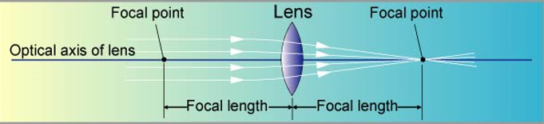
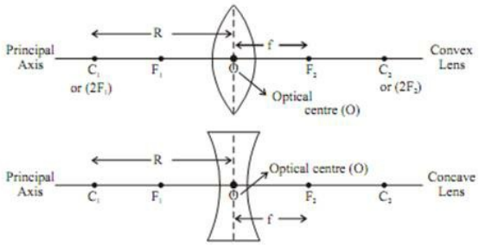

Slide 7
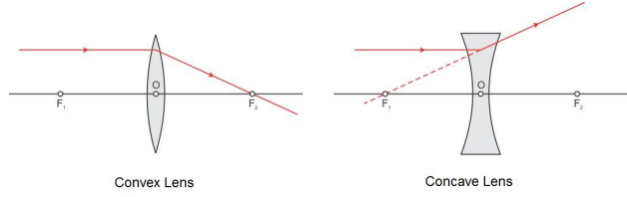
Rules for Tracing Images Formed by Spherical Lens
Rule 1: A ray which is parallel to the principal axis, after refraction passes through the principal focus on the other side of the lens in case of a convex lens or appears to diverge from the principal focus on the same side of the lens in case of a concave lens.

Slide 8
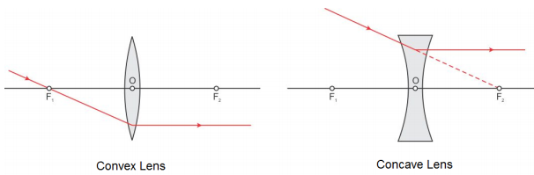
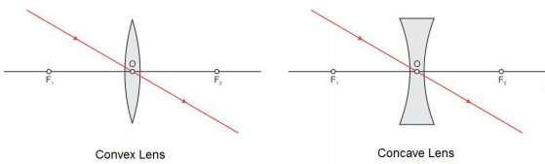
Rule 2: A ray passing through the principal focus of a convex lens or appearing to meet at the principal focus of a concave lens after refraction emerges parallel to the principal axis.
Rule 3: A ray passing through the optical centre of a convex lens or a concave lens emerges without any deviation.

Slide 9
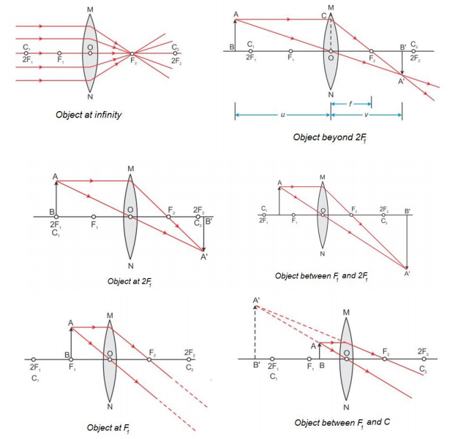
Image Formation by Convex Lens (Ray Diagrams)

Slide 10
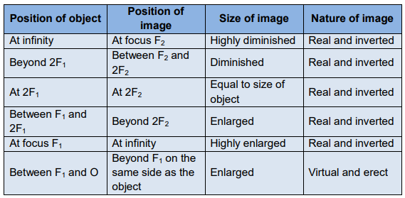
Nature, position and relative size of the image formed by a convex lens for various positions of the object
Note: Convex lens forms virtual and erect image when the object is between focus F and the optical centre O

Slide 11
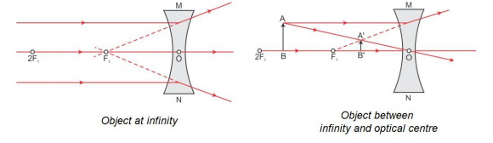
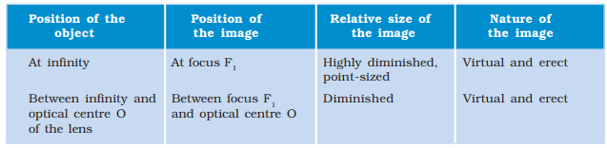
Image Formation by Concave Lens (Ray Diagrams)
Note: For Concave lens, no real image is formed and the image is formed between F and O irrespective of where the object is placed apart from infinity.

Slide 12
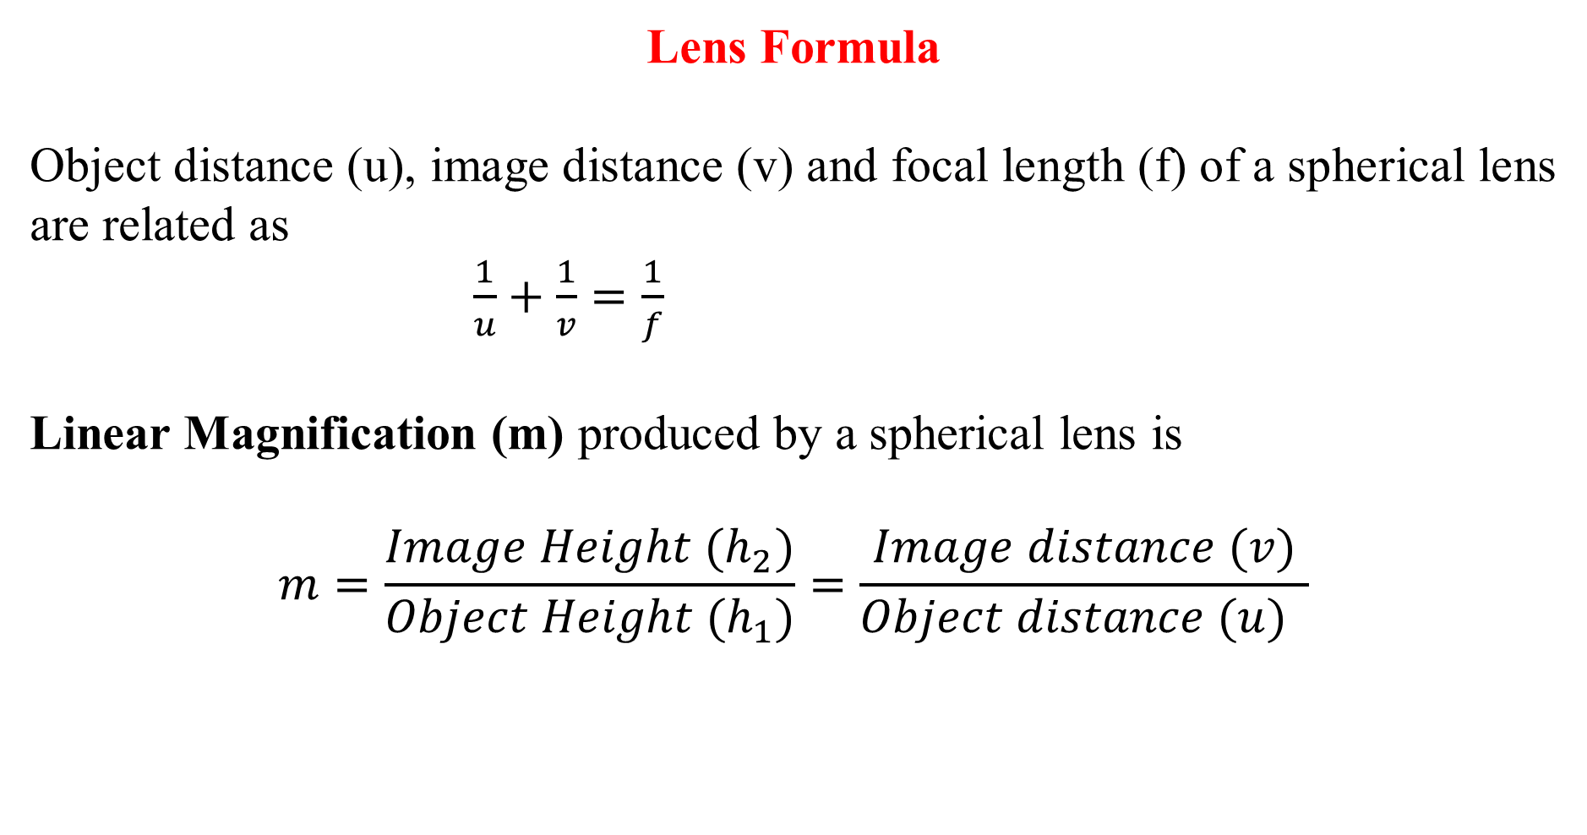
Lens Formula
Object distance (u), image distance (v) and focal length (f) of a spherical lens are related as
$\frac{1}{u}+\frac{1}{v}=\frac{1}{f}$
Linear Magnification (m) produced by a spherical lens is
$$m=\frac{Image Height (h_{2})}{Object Height (h_{1})}=\frac{Image distance (v)}{Object distance (u) }$$

Slide 13
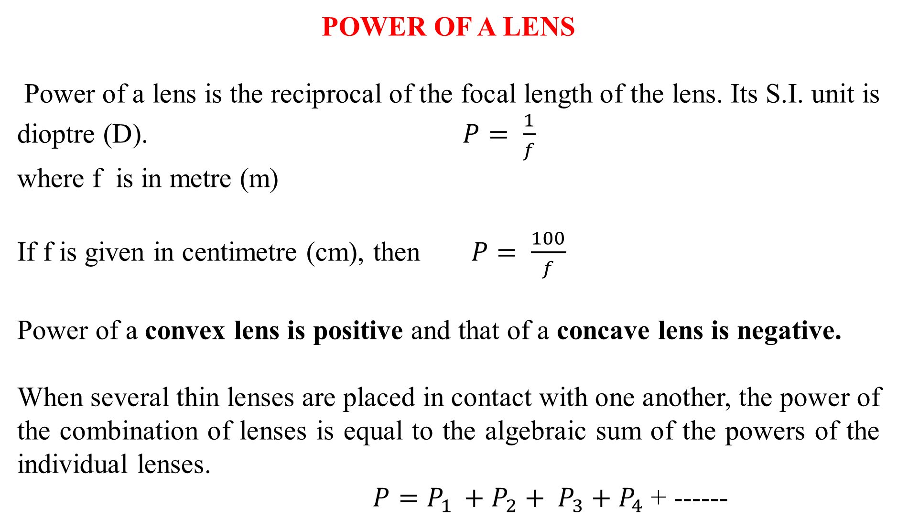
POWER OF A LENS
Power of a lens is the reciprocal of the focal length of the lens. Its S.I. unit is dioptre (D). $P= \frac{1}{f}$
where f is in metre (m)
If f is given in centimetre (cm), then $P= \frac{100}{f}$
Power of a convex lens is positive and that of a concave lens is negative.
When several thin lenses are placed in contact with one another, the power of the combination of lenses is equal to the algebraic sum of the powers of the individual lenses.
$P=P_{1 }+P_{2}+ P_{3}+P_{4}$ + ------

Slide 14
Sign convention for thin lens formula
Light travels initially from left to right toward the lens.
Object distance u is positive for real objects located to the left of the lens and negative for virtual objects located to the right of the lens.
Image distance v is positive for real images formed to the right of the lens and negative for virtual images formed to the left of the lens.
The focal length f is positive for a converging lens, negative for a diverging lens.
The radius of curvature r is positive for a convex surface, negative for a concave surface.

Slide 15
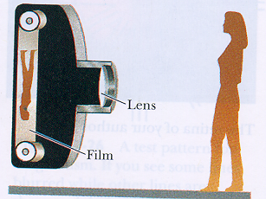
APPLICATIONS OF LENSES: I. Cameras
The pinhole camera can produce a sharp picture if the pinhole is small
The amount of light striking the film is small. Very long exposure times are needed to make impression on the film
By using converging lens instead of a pinhole the exposure time can be greatly reduced.
Bigger lens better picture quality
Focus free cameras: can form sharp
images from objects far away (object
distance fixed to infinity, image
formed at the focal plane)
Auto focus cameras: can vary the
position of the lens relative to the
film--> can focalize all images on
the film

Slide 16
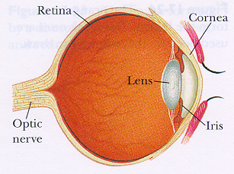
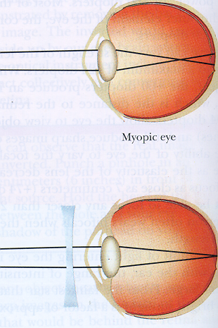
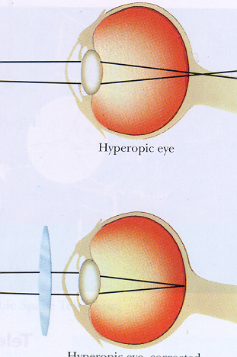
II. Our eyes and eye glasses
Eyes: an optical system that can form a real, virtual and reduced size image on the retina
Multiple refractors: cornea, the lens and some fluids (total power: 60 diopters, lens only: 20 diopters)
the lens can vary its focal length (20-24 diopters) (eyes like an auto-focus camera) (auto-focusing property decreases with age)
eye problems:
- myopia (nearsightedness): clear images formed in front of the retina, corrected by eyeglasses with diverging lenses)
- hyperopia (farsightedness): clear images are formed behind the retina, corrected by eyeglasses with converging lenses)
Eye defects and Corrections

Slide 17
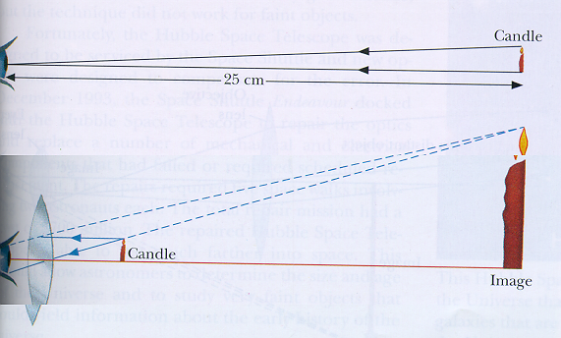
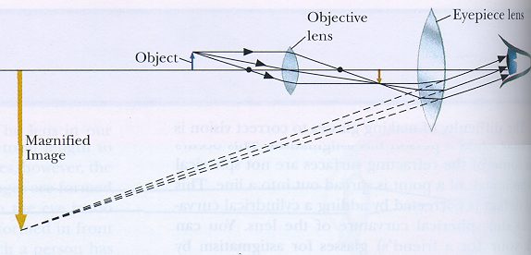
III. Magnifiers (Microscopes)
The size of the images seen by our eyes depends on the objects actual size and on its distance away
What really matters is the angular size of the object
The angular size can be increased by bringing closer to the eye: if too close we cannot focus on it
We can get both an increased angular size and sharp image by using converging lens.
Magnifying glass and microscope (magnification is the product of the magnification of the objective and eyepiece lens)

Slide 18
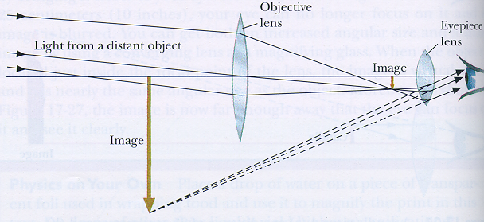
IV Telescopes
The idea is again to increase the angle through which we observe a distant object: impression of getting it closer
Done by using converging lenses--> refracting telescopes
magnification of the telescope: ratio of the focal lengths of the objective and eyepiece
to get big magnification: long telescopes
as magnification increases the brightness decreases
to get big brightness --> big objective lens, BUT: but big lens --> big aberrations
good telescopes: expensive! Cheaper possibility to use big curved mirror (no chromatic aberration)--> reflecting telescopes

Slide 19
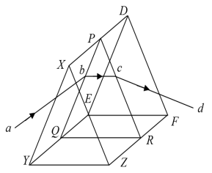
REFRACTION THROUGH PRISMS
A glass prism is a transparent object which has two plane surfaces, XDEY and XDF Z, inclined to each other (Fig 1). The angle between the inclined plane surfaces XDF Z and XDEY is known as the angle of the prism, or the refracting angle, the line of the intersection XD of the planes is known as the refracting edge.
Glass prisms are often used to bend light in a given direction as well as to bend it back again. The process of refraction in prisms is understood easily with the use of light rays and Snell’s law.
Fig. 1

Slide 20
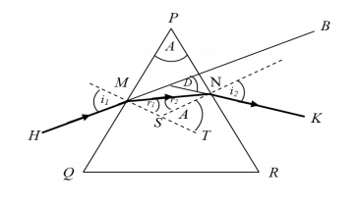


Relationship Between the Refractive Index N, Prism Apex Angle A, and Minimum Angle of Deviation dm
When a light ray enters a prism at one face and exits at another, the exiting ray is deviated from its original direction. The prism shown is isosceles in cross section with apex angle A = 30° and refractive index n = 1.50. The incident angle θ and the angle of minimum deviation Dm are shown on the diagram.
A = $r_{}+ r_{\begin{aligned} \\ i−r+i−r=Dm\end{aligned}}$

Slide 21
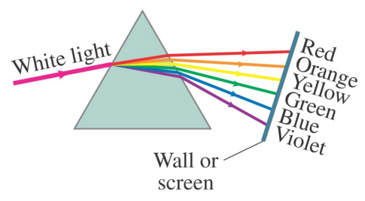
Visible Spectrum and Dispersion
The index of refraction of many transparent materials, such as glass and water, varies slightly with wavelength. This is how prisms and water droplets create rainbows from sunlight.
Dispersion is the separation of light into colors arranged according to their frequency, by interaction with a prism or diffraction grating. The spreading of light into the full spectrum is called dispersion

Slide 22
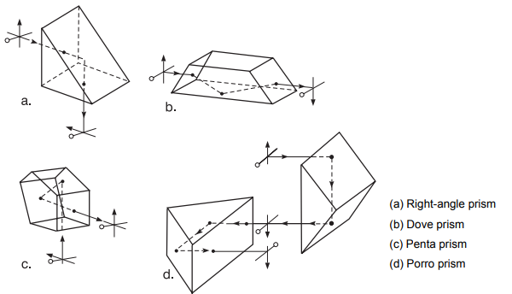
Special Applications of Prisms
Prisms that depend on total internal reflection are commonly used in optical systems, both to change direction of light travel and to change the orientation of an image.
Figure a – d. Image manipulation with refracting prisms

Slide 23
Example 1: An object is placed 6 cm in front of a diverging lens of focal length 12 cm. Find the position of the image.
Solution: Since the lens is diverging, f = - 12 cm.
The object is real, u = 6 cm
Using 1/v + 1/u = 1/f
1/v + 1/6 = - 1/12
1/v = - 1/12 – 1/6 = -3/12
V = - 12/3 = -4
Since v is negative in sign, the image is virtual and it is 4 cm from the lens

Slide 24
Example 2: A beam of light, converging to a point 1o cm behind a converging lens, is incident on the lens. Find the position of the point image if the lens has a focal length of 40 cm.
Solution: Because it is behind the lens, u = - 10 cm.
Since the lens is converging, f = 40 cm
Using 1/v + 1/u = 1/f
1/v – 1/10 = 1/40
1/v = 1/40 + 1/10 = 5/40
V = 40/5 = 8
Since v is positive in sign, the image is real and it is 8 cm from the lens

Slide 25
EXERCISE
An object 5 cm in length is held 25 cm away from a converging lens of focal length 10 cm. Draw the ray diagram and find the position, size and the nature of the image formed.
2. A concave lens of focal length 15 cm forms an image 10 cm from the lens.
How far is the object placed from the lens? Draw the ray diagram.
3. The magnification produced by a plane mirror is +1. What does this mean?
4. A glass prism of angle 72⁰ and index of refraction 1.66 is immersed in a liquid of refractive index 1.33. What is the angle of minimum deviation for a parallel beam of light passing through the prism?

Slide 26
EXERCISE
5. An object 5.0 cm in length is placed at a distance of 20 cm in front of a convex mirror of radius of curvature 30 cm. Find the position of the image, its nature and size.
6. An object of size 7.0 cm is placed at 27 cm in front of a concave mirror of focal length 18 cm. At what distance from the mirror should a screen be placed, so that a sharp focussed image can be obtained? Find the size and the nature of the image.
7. Find the focal length of a lens of power – 2.0 D. What type of lens is this?
8. A doctor has prescribed a corrective lens of power +1.5 D. Find the focal length of the lens. Is the prescribed lens diverging or converging?

