Slide 1
ENEL – HBase Region Manager Tool (aka `Region Normalizer)
Rafael Arana
Cloudera Professional Services

Slide 2
Introduction
ENEL Exabeat projects use a custom pre-split policy on table creation do split the regions in three different stages ( hot, warm & cold) based on the date included as first part of the HBASE key (YYYYMM).
This key design requires custom logic to split and merge regions.
This document propose a custom approach for ENEL to automate this activities
V1 was implemented as a Custom RegionNormalizer More info at JIRA - HBASE-13103).
In v2 the tool has been refactored to be used as a Command Line Tool to have from flexibility in the parametrization and scheduling.

Slide 3
Region Manager Tool

Slide 4
Region Manager Tool scope
The Region Manager Tool will handle:
a non-uniform number of regions in three different stages: hot, warm and cold, being the data density & access patterns different per stage.
They key will include the year and month
The boundaries between the stages (hot, war & cold) will defined by number an 3xpiration period by stage in months.
The normalizer can be run via command line and scheduled via Control-M.
It can also manage tables without stages.

Slide 5
Functionality
It can be run per table adjusting the logic and parameterization for each table.
Current implementation supports the following criteria:
Staged (Hot, warm & cold) vs no staged tables.
(DEFAULT) Max. size per regions using Hfile storage size ( customizable per stage)
Min. number of regions ( customizable per stage).
Max. number of regions ( customizable per stage).
Average regions size, using HFILE storage size.

Slide 6
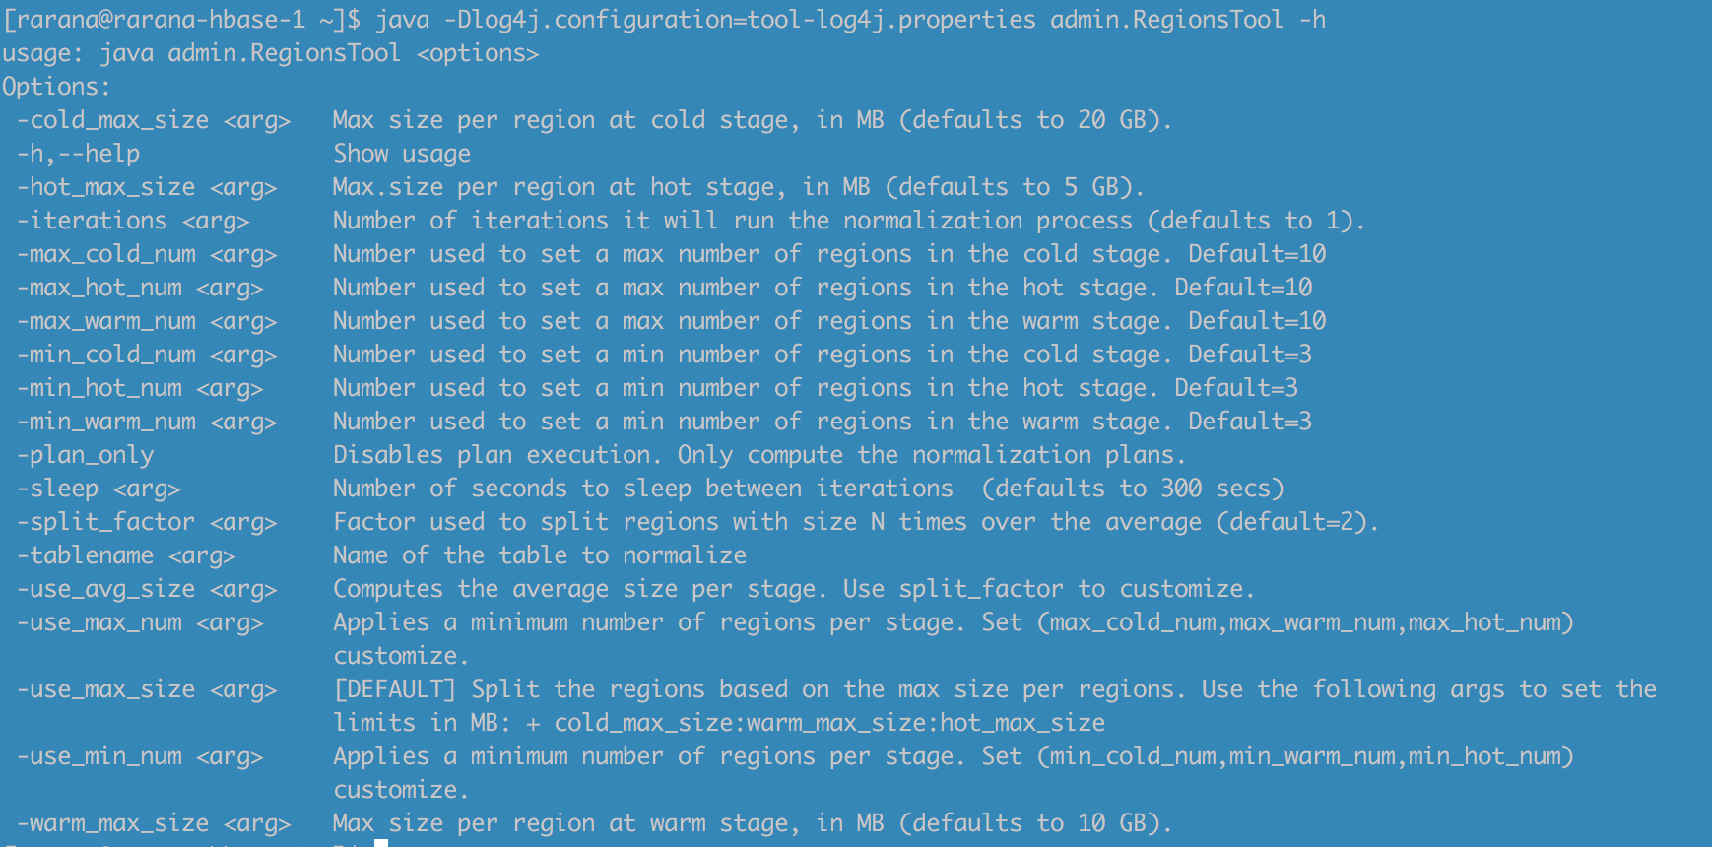
Which arguments can I use?
Just provide the –h or –help to list all:
Notes:
usage: java admin.RegionsTool <options>
Options:
-cold_max_size <arg> Max size per region at cold stage, in MB (defaults to 20 GB).
-h,--help Show usage
-hot_max_size <arg> Max.size per region at hot stage, in MB (defaults to 5 GB).
-iterations <arg> Number of iterations it will run the normalization process (defaults to 1).
-max_cold_num <arg> Number used to set a max number of regions in the cold stage. Default=10
-max_hot_num <arg> Number used to set a max number of regions in the hot stage. Default=10
-max_num <arg> Number used to set a max number of regions. Default=10
-max_size <arg> Max size per region, in MB (defaults to 10 GB).
-max_warm_num <arg> Number used to set a max number of regions in the warm stage. Default=10
-min_cold_num <arg> Number used to set a min number of regions in the cold stage. Default=3
-min_hot_num <arg> Number used to set a min number of regions in the hot stage. Default=3
-min_num <arg> Number used to set a min number of regions. Default=3
-min_warm_num <arg> Number used to set a min number of regions in the warm stage. Default=3
-no_stage Use for those tables without sets/stages of regions.
-num_cold_months <arg> Number of months used as expiration period for cold data. Only used for staged tables.
Default=36
-num_hot_months <arg> Number of months used to divide hot from warm data . Only used for staged tables. Default=8
-num_warm_months <arg> Number of months used divide warm from cold data. Only used for staged tables. Default=18
-plan_only Disables plan execution. Only compute the normalization plans.
-sleep <arg> Number of seconds to sleep between iterations (defaults to 300 secs)
-split_factor <arg> Factor used to split regions with size N times over the average (default=2).
-tablename <arg> Name of the table to normalize
-use_avg_size <arg> Computes the average size per stage. Use split_factor to customize.
-use_max_num <arg> Applies a minimum number of regions per stage. Set (max_cold_num,max_warm_num,max_hot_num)
customize.
-use_max_size <arg> [DEFAULT] Split the regions based on the max size per regions. Use the following args to set
the limits in MB: + cold_max_size:warm_max_size:hot_max_size
-use_min_num <arg> Applies a minimum number of regions per stage. Set (min_cold_num,min_warm_num,min_hot_num)
customize.
-warm_max_size <arg> Max size per region at warm stage, in MB (defaults to 10 GB).

Slide 7
Region Manager Tool
Usage

Slide 8
Limit Region by Size (in MB)
# Show the valid arguments
./region-tool.sh –help
# Use default planner (StagedMaxSizeRegionPlanner) with default properties
./region-tool.sh -tablename testtable
# Use default planner (planner.StagedMaxSizeRegionPlanner) with default properties
./region-tool.sh -tablename testtable
# Use default planner (planner.StagedMaxSizeRegionPlanner) with custom sizes
./region-tool.sh -tablename testtable -cold_max_size 5000 -warm_max_size 10000 -hot_max_size 15000
# Use default planner (planner.SimpleMaxSizeRegionPlanner) without stages and default size (10 GB)
./region-tool.sh -tablename testtable –no_stages
# Use default planner (planner.SimpleMaxSizeRegionPlanner) without stages and setting the size (in MB)
./region-tool.sh -tablename testtable –no_stages –max_size 15000

Slide 9
Adjust Region Size to the Average
# Use StagedMaxSizeRegionPlanner and StagedAverageSizeRegionPlanner with default properties (split factor = 2 )
./region-tool.sh -tablename testtable -use_avg_size true
# Use StagedMaxSizeRegionPlanner and StagedAverageSizeRegionPlanner with custom split factor
./region-tool.sh -tablename testtable -use_avg_size true -split_factor 3
# Use StagedAverageSizeRegionPlanner with default properties and disabling regions limit by size
./region-tool.sh -tablename testtable -use_max_size false -use_avg_size true
# Use SimpleMaxSizeRegionPlanner and SimpleAverageSizeRegionPlanner with default properties (split factor = 2 )
./region-tool.sh -tablename testtable –no_stages -use_avg_size true
# Use SimpleMaxSizeRegionPlanner with default properties (split factor = 2 )
./region-tool.sh -tablename testtable -use_max_size false -use_avg_size true -split_factor 2 –no_stages

Slide 10
Limit maximum number of regions
# Use StagedMaxSizeRegionPlanner and StagedMaxNumberRegionPlanner with default properties
./region-tool.sh -tablename testtable -use_max_num true
# Use StagedMaxSizeRegionPlanner and StagedMaxNumberRegionPlannerwith custom split factor
./region-tool.sh -tablename testtable -use_max_num true -max_hot_num 20 -max_warm_num 25 -max_cold_num 30
# Use StagedMaxNumberRegionPlanner with default properties and disabling regions limit by size
./region-tool.sh -tablename testtable -use_max_size false -use_max_num true
# Use SimpleMaxSizeRegionPlanner and SimpleMaxNumberRegionPlannerwith default properties (split factor = 2 )
./region-tool.sh -tablename testtable –no_stages -use_max_num true
# Use SimpleMaxNumberRegionPlanner with default properties (split factor = 2 )
./region-tool.sh -tablename testtable -use_max_size false -use_max_num true–no_stages

Slide 11
Setting a minimum number of regions
# Use StagedMaxSizeRegionPlanner and StagedMinNumberRegionPlanner with default properties (split factor = 2 )
./region-tool.sh -tablename testtable –use_min_num true
# Use StagedMaxSizeRegionPlanner and StagedMinNumberRegionPlanner with custom properties
./region-tool.sh -tablename testtable –use_min_num true -min_cold_num 10 -min_warm_num 15 -min_hot_num 30
# Use StagedAverageSizeRegionPlanner with default properties and disabling regions limit by size
./region-tool.sh -tablename testtable –use_max_size false -use_min_num true
# Use SimpleMaxSizeRegionPlanner and SimpleMinNumberRegionPlanner with default properties
./region-tool.sh -tablename testtable –no_stages –use_min_num true
# Use SimpleMinNumberRegionPlanner with custom properties
./region-tool.sh -tablename testtable -use_max_size false –use_min_num true -min_hot_num 30 -no_stages

Slide 12
Bonus - Iterations
# Enabling all
./region-tool.sh -tablename testtable –use_min_num true -use_max_num true -use_avg_size true
# Run 3 iterations sleeping 30 secs between each iteration
./region-tool.sh -tablename testtable -iterations 2 -sleep 30
# Debugging - Calculate & print the Normalization Plans but DON’T EXECUTE
./region-tool.sh -tablename testtable –report
# Setting custom stage split boundaries
./region-tool.sh -tablename testtable -num_hot_months 8 -num_warm_months 12 –num_cold_months 12

Slide 13
Which arguments can I use?
Get the full list of argument with–h or –help to list all:
Notes:
usage: java admin.RegionsTool <options>
Options:
-cold_max_size <arg> Max size per region at cold stage, in MB (defaults to 20 GB).
-h,--help Show usage
-hot_max_size <arg> Max.size per region at hot stage, in MB (defaults to 5 GB).
-iterations <arg> Number of iterations it will run the normalization process (defaults to 1).
-max_cold_num <arg> Number used to set a max number of regions in the cold stage. Default=10
-max_hot_num <arg> Number used to set a max number of regions in the hot stage. Default=10
-max_num <arg> Number used to set a max number of regions. Default=10
-max_size <arg> Max size per region, in MB (defaults to 10 GB).
-max_warm_num <arg> Number used to set a max number of regions in the warm stage. Default=10
-min_cold_num <arg> Number used to set a min number of regions in the cold stage. Default=3
-min_hot_num <arg> Number used to set a min number of regions in the hot stage. Default=3
-min_num <arg> Number used to set a min number of regions. Default=3
-min_warm_num <arg> Number used to set a min number of regions in the warm stage. Default=3
-no_stage Use for those tables without sets/stages of regions.
-num_cold_months <arg> Number of months used as expiration period for cold data. Only used for staged tables.
Default=36
-num_hot_months <arg> Number of months used to divide hot from warm data . Only used for staged tables. Default=8
-num_warm_months <arg> Number of months used divide warm from cold data. Only used for staged tables. Default=18
-plan_only Disables plan execution. Only compute the normalization plans.
-sleep <arg> Number of seconds to sleep between iterations (defaults to 300 secs)
-split_factor <arg> Factor used to split regions with size N times over the average (default=2).
-tablename <arg> Name of the table to normalize
-use_avg_size <arg> Computes the average size per stage. Use split_factor to customize.
-use_max_num <arg> Applies a minimum number of regions per stage. Set (max_cold_num,max_warm_num,max_hot_num)
customize.
-use_max_size <arg> [DEFAULT] Split the regions based on the max size per regions. Use the following args to set
the limits in MB: + cold_max_size:warm_max_size:hot_max_size
-use_min_num <arg> Applies a minimum number of regions per stage. Set (min_cold_num,min_warm_num,min_hot_num)
customize.
-warm_max_size <arg> Max size per region at warm stage, in MB (defaults to 10 GB).

Slide 14
Region Manager Tool
Implementation Details

Slide 15
Implementation – The NormalizationPlanner
Check the code at
The tool is implemented in Java using the HBase Java API
Tested with
Java 1.7
HBase 1.2 CDH 5.x
The tool use Apache Commons CLI to parse input arguments

Slide 16
Implementation – The NormalizationPlanner
The different logic is implemented via RegionPlanner can be enabled/disabled via command line per execution/table
Current implementation includes 4 types of planners (8 implementations)
(Simple|Staged)MaxNumberRegionPlanner
(Simple|Staged)AverageSizeRegionPlanner
(Simple|Staged)MaxSizeRegionPlanner
(Simple|Staged)MinNumberRegionPlanner

Slide 17
Stage Split Points
Stage split points are calculated based on the length of the different stages:
Hot Split Point(YYYYMM) = Current Month - hbase.normalizer.nonuniform.months.hot
Warm Split Point(YYYYMM) = Hot Split Point - hbase.normalizer.nonuniform.months.warm
Cold Split Point(YYYYMM) = Warm Split Point - hbase.normalizer.nonuniform.months.cold
Properties set in RegionsTool via command line arguments or
HBase Service Advanced Configuration Snippet (Safety Valve) for hbase-site.xml
Property Name | Description | Default Value
hbase.normalizer.nonuniform.months.hot | Length of the hot data interval in months | 8
hbase.normalizer.nonuniform.months.warm | Length of the warm data interval in months | 18
hbase.normalizer.nonuniform.months.cold | Length of the cold data interval in months | 36

Slide 18
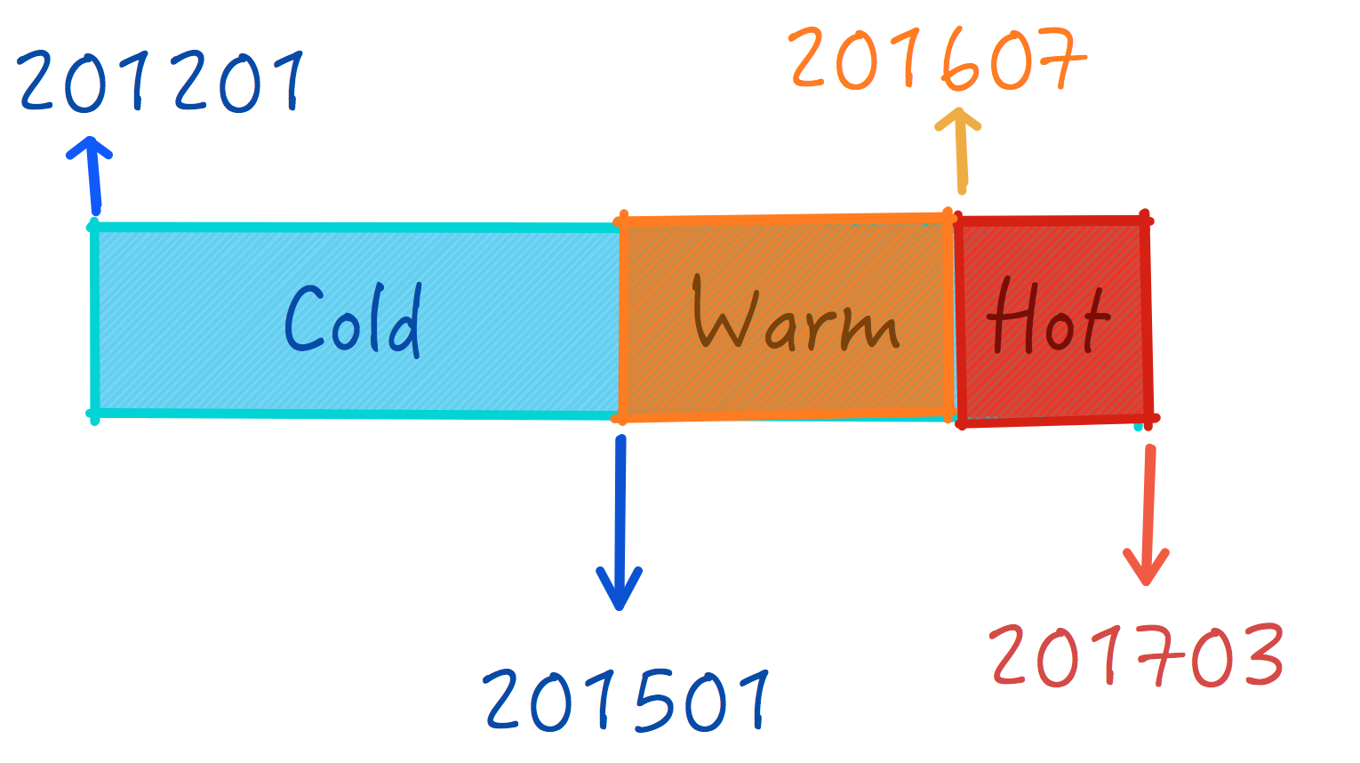
Stage Split Points Example
Property Name | Value
hbase.normalizer.nonuniform.months.hot | 8
hbase.normalizer.nonuniform.months.warm | 18
hbase.normalizer.nonuniform.months.cold | 36

Slide 19
Min Number of Regions
Implementations:
SimpleMinNumberRegionPlanner
StagedMinNumberRegionPlanner:
It can handle a non-uniform number of regions per stage.
It will adjust the # of regions to an different interval per stage.
The number of regions needs to be decided based on the data density & access patterns different per stage.
For each stage (hot, warm, cold) it will adjust dynamically the number of regions per table based on:.

Slide 20
Stage min & max factor properties
Properties defined in HBase Service Advanced Configuration Snippet (Safety Valve) for hbase-site.xml
Property Name | Description | Default Value
hbase.normalizer.nonuniform.hot.min.factor | Lower limit factor used to calculate the number of regions in the hot stage. | 1
hbase.normalizer.nonuniform.hot.max.factor | Upper limit factor used to calculate the number of regions in the hot stage. | 2
hbase.normalizer.nonuniform.warm.min.factor | Lower limit factor used to calculate the number of regions in the warm stage. | 1
hbase.normalizer.nonuniform.warm.max.factor | Upper limit factor used to calculate the number of regions in the hot stage | 2
hbase.normalizer.nonuniform.cold.min.factor | Lower limit factor used to calculate the number of regions in the cold stage | 1
hbase.normalizer.nonuniform.cold.max.factor | Upper limit factor used to calculate the number of regions in the cold stage | 2

Slide 21
Split & Merge logic
Criteria to adjust the number of regions to the intervals per stage:
If the number of regions with a stage < min #Regions it will split the regions with SIZE (MB) > Average Size.
If the number of regions with a stage (Hot) > max #Regions it will merge contiguous regions (Ri, Rj) when the (Size of Region i +Size of Region j) < Average Size of all regions in that area.
If the number of regions is within the interval of that stage it will normalize regions by size:
Split those regions bigger than N times than the average. N is a hbase.normalizer.nonuniform.split.factor
Merge contiguous regions (Ri, Rj) when the (Size of Region i +Size of Region j) < Average Size of all regions in that stage
Property Name | Description | Default Value
hbase.normalizer.nonuniform.split.factor | Factor used to split those regions with size N times over the average size for the stage interval. | 2

Slide 22
Region Manager Tool
Debug and Trouble Shooting

Slide 23
How to Debug ?
log4j.rootLogger=INFO, stdout, file log4j.appender.stdout=org.apache.log4j.ConsoleAppender log4j.appender.stdout.layout=org.apache.log4j.PatternLayout # Pattern to output the caller's file name and line number. log4j.appender.stdout.layout.ConversionPattern=%d{yy/MM/dd HH:mm:ss} %5p [%t] (%F:%L) %c{2}: %m%n log4j.appender.file=org.apache.log4j.RollingFileAppender log4j.appender.file.File=../log/region-tool.log log4j.appender.file.layout=org.apache.log4j.PatternLayout log4j.appender.file.layout.ConversionPattern=%d{yy/MM/dd HH:mm:ss} %5p [%t] (%F:%L) %c{2}: %m%n log4j.appender.file.MaxFileSize=100MB log4j.appender.file.MaxBackupIndex=5 log4j.appender.file.append=true log4j.logger.admin=DEBUG log4j.logger.org.apache.hadoop=WARN log4j.logger.org.apache.zookeeper=ERROR log4j.logger.org.apache.hadoop.hbase=WARN
Use the argument –report
./region-tool.sh -tablename testtable –report
Review the logs
Implementation based in Apache Commons Logging / Log4j
Default log configuration at resources/tool-log4j.properties
Default path at TOOL_HOME_DIR/log/
Increase trace level

Slide 24
Packaging & Installation

Slide 25
Compilation & Packaging
Maven file included with the project.
$ cd [HBase-Extensions-project]
$ mvn package
2 JAR file at [HBase-Extensions-project]/target
hbase-extensions-0.1-hbase1.2-cdh5.8.4.jar
hbase-extensions-0.1-hbase1.2-cdh5.8.4-jar-with-dependencies.jar

Slide 26
Installation
Copy the jar file:
Edge Nodes: hbase-extensions-0.1-hbase1.2-cdh5.8.4.jar
External Nodes without Gateway Role:use the jar including the dependencies
Update the environment dependencies in the shell scripts:
export JAVA_HOME = /usr/java/jdk1.7.0_67-cloudera
export CDH_VERSION = cdh5.8.4

