Slide 1
20210702

Slide 2
Dataset – Training data construction
2-class classification
Using diagnosis as label
Yes or no
Proportion
Yes:no = 1:4
Using pre-diabetes as label
One is Normal, the other one combines pre-diabetes and diabetes.
(pre-)diabetes：normal = 2:1
3-class classification
Using pre-diabetes as label
Normal，pre-diabetes，diabetes
比例接近1:1:1
The amount of data
Diagnosis
Training：979 subjects, each subject contains 4 training samples.
Test：200 subjects.
Pre-diabetes
Training：959 subjects, each subject provides 4 training samples.
Test：200 subjects.

Slide 3
Encoder-decoder Transformer

Slide 4
Model structure
2013
2014
Input
Encoder：images from 2010 and 2011
Decoder：images of any two consecutive years (e.g. 2012, 2013)
Output
The output of decoder is the prediction of the following year（e.g. 2012，2013 --> 2013, 2014）
Results of 3-class classification
Partial to one category
Linear
Encoder
Decoder
CNN
CNN
2010
2011
2012
2013
 | acc | kappa
Pre-diabetes | 0.4117 | 0.1099
2015
2016

Slide 5
Encoder Transformer

Slide 6
Transformer with encoder only
2016 prediction
Adjust the former Transformer
Instead of encoder-decoder structure, choose encoder only.
Train CNN and encoder at the same time
MLP
module
Encoder
 | acc | kappa
Pre-diabetes | 0.57 | ~0.10
CNN
2010
2011
2015

Slide 7
Verification
In order to verify whether the Transformer is useful for short sequence data
On image classification test
Crop one image to 2x2 patches (i.e. sequence length is 4）
Result
Can achieve a good classification result.

Slide 8
Input form test
Use image feature difference as input for time series model
E.g., Using the feature difference of year 2011 and 2010 as the input to the time point of sequence model.
2012 and 2011 as the second input
…
The final sequence length is 5
Using Transformer with encoder only model to train
Result
Still not working
No prediction ability

Slide 9
Increasing the amount of training data
Based on Transformer with encoder
Using two images centered on Macular as inputs
Limited by GPU memory, using two images only not all four images
Result
No significant improvement

Slide 10
Other sequence model
CNN
RNN

Slide 11
CNN
Using the image feature differences of the last two years as input to predict the next year
ResNet for feature extraction
MLP for classification

Slide 12
RNN
Using GRU model
Input is the same as Transformer with encoder only model
Result
No significant difference with Transformer
But easy to train and easy to converge
For test, the prediction is forward to one category, kappa is almost zero

Slide 13
Conclusion
From all models above, GRU is more suitable for the task
But the prediction results of all models are almost in one category with small kappa, which seems useless and meaningless
One assumption is the label does not correspond to data

Slide 14
A new label tag
Label based on Glu
Three categories: decrease，noChange，increase
Year 2016 label is based on the Glu difference of 2016 and 2015 and threshold
Decrease: noChange: increase = 4：5：1
Using GRU model to train
Compared with the previous label tag
The best performance is acc: 0.58，kappa：0.225

Slide 15
Feature extractor study
Using the encoder of trained AE as feature extractor instead of pretrained ResNet

Slide 16
Autoencoder
Using autoencoder to reconstruct the images to learn the feature of the lingtou dataset
Training images: 18w+
Final L1 loss is 0.015
Using the encoder as the feature extractor for sequence model
Result
Three categories acc: 0.6150; kappa: 0.2480
Original
acc：0.58, kappa: 0.225
Compared with ResNet, the improvement is not significant but better

Slide 17
Other label tag?
The suggestion from Prof. Ge
Changing the classification to regression, using a new score to indicate the diabetic risk.
i.e., indicating the risk score by the image changing
E.g., something like Framingham Risk Score, which may consider the gender, Glu, age etc.

Slide 18
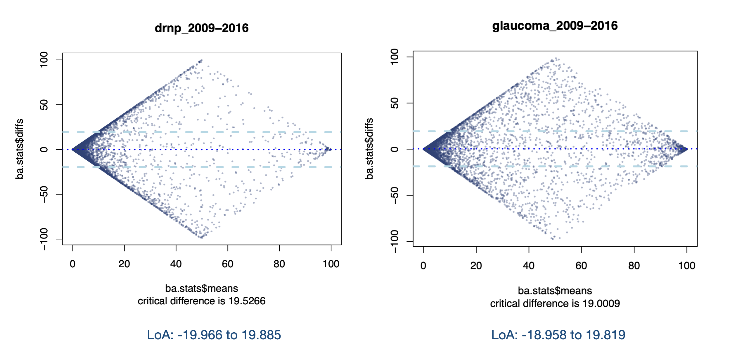
The robustness of deep learning model
Some consistent result:
DR:0.86
DRNP:0.92
GLA:0.91

