Slide 1
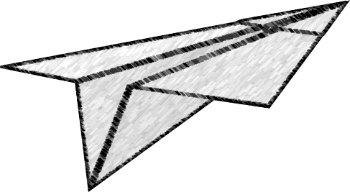
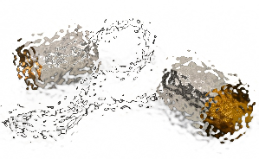
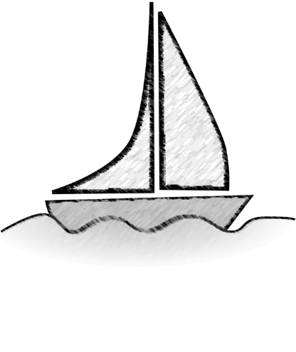
The Oracle Problem Honest reporting in P2P networks, when everyone has an incentive to lie, and you don’t even know how many people there really are.
Paul Sztorc
QCON London
March 8, 2017

Slide 2
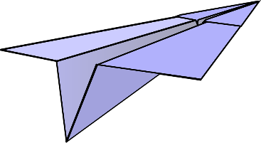

Goal / Overview
Goal: Take a problem, and contrast the traditional approach from the blockchain approach.
Overview:
Thesis / Takeaways
The P2P Oracle Problem
Three Categories of Design Failure
Conclusion
Notes:
You do not necessarily need to understand // how it *is* solved in the blockchain context, to fully appreciate the differences, just as someone building a boat doesn’t need to know everything about building an airplane. But I’m hoping … instead, you just need to grasp
-- comparable to like those boats that can also drive on land, or those planes that can land on the water. In that I think they will have their place, but it will be very niche.

Slide 3
Message / Takeaways
Blockchain = Less trust = everything is harder.
Programmers vs. Contract-Authors : Dev objective is to enable the user to do more, contracts are about forcing the user to opt-into less. Oracle can fail as a result of actions that users are allowed to take:
…too easy for user to assume two identities / make bribe.
…too easy for the service to be “too” popular.
…too easy for rivals to enter and ‘steal’ the service.
In the blockchain world, code is built upon a foundation of incentives.

Slide 4
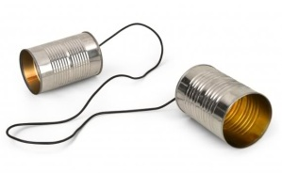

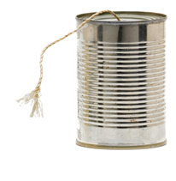
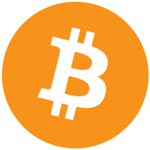
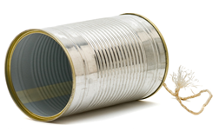
What is the Oracle Problem?
What the heck is my exchange rate these days, anyway?
It’s £1000/BTC. …hello? Hello?!
Blockchain is ignorant of ‘real world’ data.
Needs to be told this data, by an “oracle”.

Slide 5



An Example: Betting on Brexit
Much earlier, in the past…
We will remain.
We will leave.
500 quid?
Fine.
?
Beatrix
Arthur
Now, in the present, we know that the outcome was = “Leave”. They settle up. Our purpose: automate this process via computer. They put money into a box, but…
Notes:
Concrete – independent of Bitcoin
Arthur says Remain (Beatrix says Leave).
The outcome was “Leave”.
How does the compute know who to pay? (If it wants to pay 500 quid worth of BTC, how does it know how much to pay?)

Slide 6
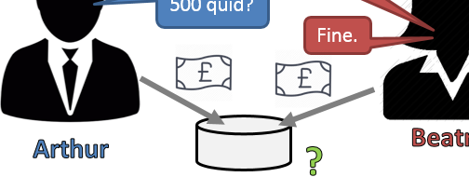
What is the Oracle Problem?
Stated Clearly: Guarantee the box is worth X to Arthur (|a), and Y to Beatrix (|b). And we want to make this guarantee, when they are putting in the money.
What the heck is my exchange rate these days, anyway?
It’s £1000/BTC. …hello? Hello?!
The Blockchain is ignorant of ‘real world’ data.

Slide 7
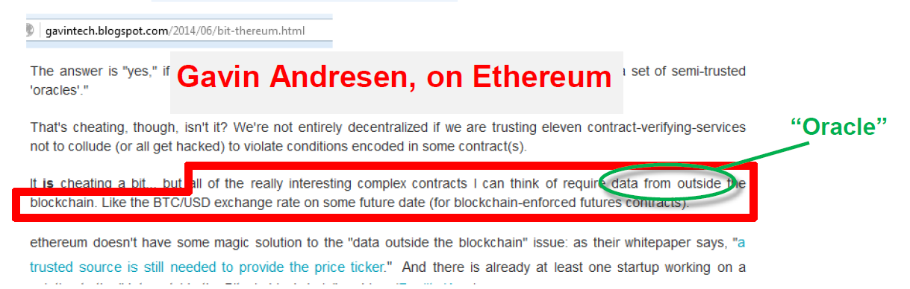
Why solve this problem?
Cool = “something useful/valuable” happens, conditional on events in the real world – finance, insurance, IoT, ….
We want “smart contracts” (ie, self-executing). We don’t want to bother the courts with this – we want automation.
Notes:
I, personally: Prediction Markets (Hivemind), conditional payments.
Generally, “something useful/valuable” happens, conditional on events in the real world – finance, insurance, IoT.
Gavin’s notice – chief scientist of the Bitcoin foundation at this time.
In order to accomplish this, we’ll need to know what happened in the real world.
We want “smart contracts” (ie, self-executing). We don’t want to bother the courts with this – we want automation. To the extent that people are involved at all, we don’t want to have to hire them. We just want them to behave in a selfish lazy – hands off.

Slide 8
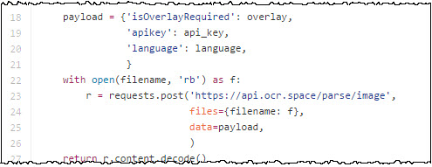
In Non-Blockchain World, Solution is Easy
Some free service that OCRs images and gives you JSON.
Notes:
This is an example of an API. I just grabbed it from Google Image search, but apparently it leads to a free service that will accept images and OCR them for you, and send the text back to you in JSON format.
Breaks all of our rules!

Slide 9
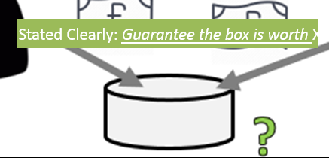
Reminder: Blockchain Features
Good | Bad
Automatic. Immune to tampering. Censor-resistant. | No inherent identities. Every user must be able to validate entire history. Total consensus on the unique valid history, down the last byte.

Slide 10
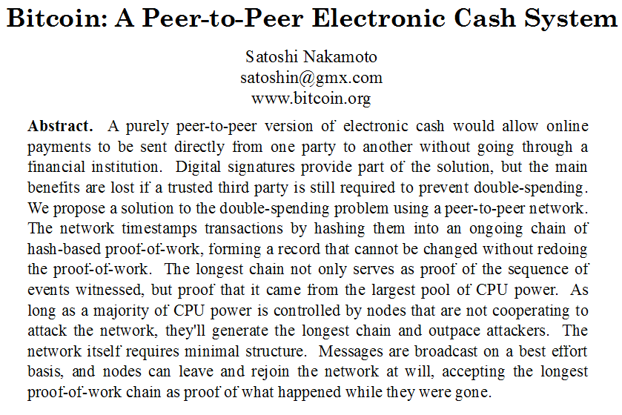


Every Node Must Be Able to Verify Entire Blockchain History, At All Times
Time
Different answer reported, at different time.
Or, Google goes out of business.
Or, policy changes / great firewall.
Notes:
AskJeeves is up here mostly as a joke, throwback. But think of what you might use today to answer a question. In 2005, you might rely on NYTimes.com, but then Twitter is invented in 2006. Will Google be on top forever? What fate will befall CNN.com? What if someone that you don’t like purchases, for example, the Financial Times?
Many tech companies, and internet resources, have died over the internet’s history. But a worse concern is that a better one will be born.
→ You can prove what Google said today, by just “Googling it” today and comparing. But you can’t use that to prove what Google said yesterday. If there’s a dispute about what Google said yesterday,

Slide 11
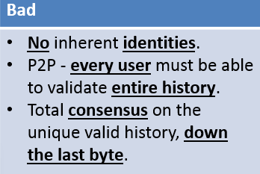
Every Node Must Be Able to Verify Entire Blockchain History, At All Times
You CAN prove “What Google said today”. You just Google-it-today, yourself, and check x’==x.
You CANNOT prove “What Google said yesterday”, because you would need to time-travel to yesterday in order to Google it then, and verify it.
Also: Great Firewall of China, User-Specific results, sign-in, time of day → all this interferes with the requirement of total “all bytes” consensus.
Time
Different answer reported, at different time.
Or, Google goes out of business.
Or, policy changes / great firewall.
Notes:
AskJeeves is up here mostly as a joke, throwback. But think of what you might use today to answer a question. In 2005, you might rely on NYTimes.com, but then Twitter is invented in 2006. Will Google be on top forever? What fate will befall CNN.com? What if someone that you don’t like purchases, for example, the Financial Times?
Many tech companies, and internet resources, have died over the internet’s history. But a worse concern is that a better one will be born.
→ You can prove what Google said today, by just “Googling it” today and comparing. But you can’t use that to prove what Google said yesterday. If there’s a dispute about what Google said yesterday,

Slide 12
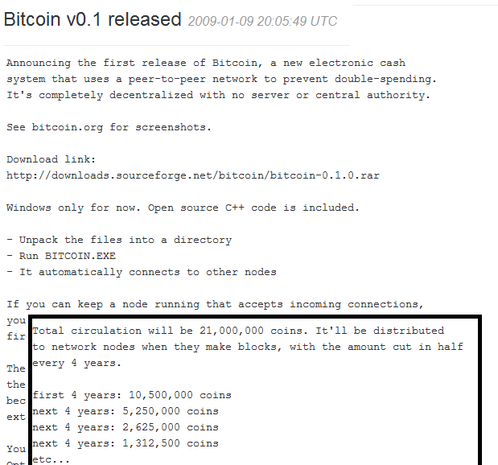
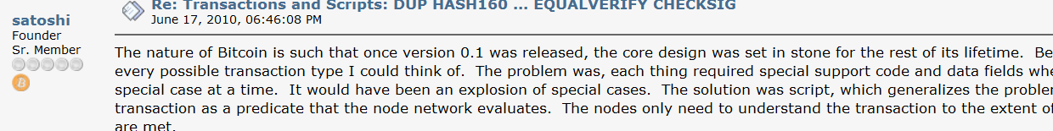
Satoshi Planned for 100+ Years
Final BTC: Year ~2140
Notes:
Big difference between this, and for example Hyperledger. Hyperledger has people you can call, Hyperledger has a mailing address, etc.

Slide 13
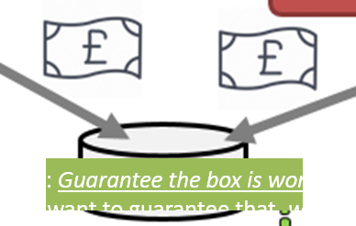
Part 2 – Trying to solve the problem.
Limited to this example, for clarity:

Slide 14
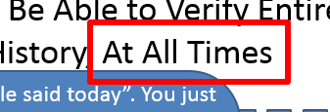
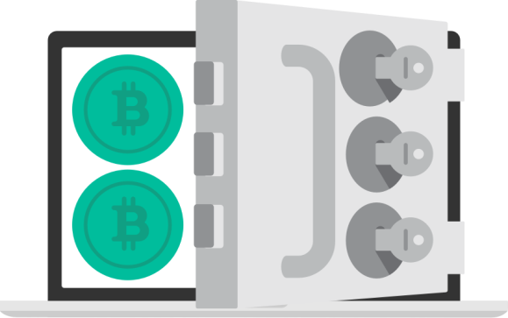


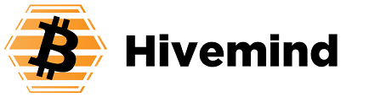
Must be self-contained -- We’ll need Escrow, and “Reports” – but how?
A] One TTP reporter.
B] Competing Reporters
C] Pseudo-corporation.
(small sample of attempts)
Multi-signature (2010)
DataFeed Subscription (2014)
(2014)
(2015)

Slide 15



[A] Multisignature
2 of 3. If there is a dispute, Charles “reporter” will break the tie.
(Unspoken: because Charles will always resolve correctly, there will, in practice, be no disputes, and thus, no need to bother Charles.)
Arthur
Beatrix
Charles

Slide 16
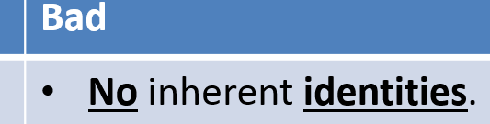
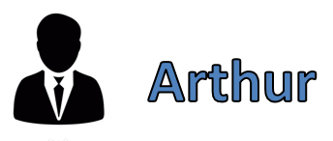
[A] Multisignature
2 of 3. If there is a dispute, Charles will break the tie.
(Unspoken: because Charles will always resolve correctly, there will, in practice, be no disputes, and thus, no need to bother Charles.)
Arthur
Beatrix
Charles

Slide 17
[A] Multisignature
2 of 3. If there is a dispute, Charles will break the tie.
(Unspoken: because Charles will always resolve correctly, there will, in practice, be no disputes, and thus, no need to bother Charles.)
Arthur
Bribe.
Arthur can offer Charles up to 1000 quid.
Beatrix
Charles

Slide 18
[A] Multisignature
Charlies “theft” decision is worth 1000 quid. This is inherent to the oracle problem -- an opportunity cost of theft equal, at least, to the amount of money controlled by the oracle.
The multisignature “solution” is to transfer that burden from Arthur (its origin) to Charlie, and simply hope that Charlie and Arthur cannot coordinate.
(The oracle problem is → how we manage this cost.)
2 of 3. If there is a dispute, Charles will break the tie.
(Unspoken: because Charles will always resolve correctly, there will, in practice, be no disputes, and thus, no need to bother Charles.)
Arthur
Bribe.
Arthur can offer Charles up to 1000 quid.
Beatrix
Charles

Slide 19
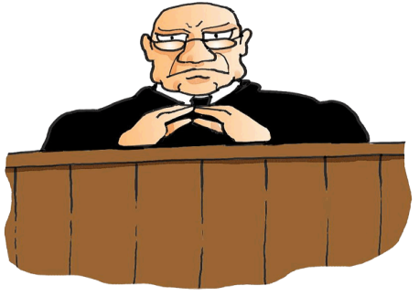

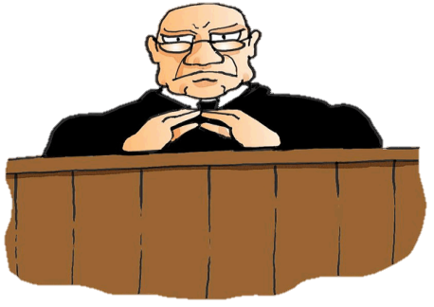

[B] “Competing” Reporters
User Chooses One
Reporter 1
User(s)
Reporter 2
Reporter 3
Give up on identity: abstracts the identities into roles (users and reporters).
Reporters collect fees on an ongoing basis (per report, per …).
User can choose their reporter: competitive marketplace provides incentive to get-and-keep a good reputation. Bad reputation = no longer chosen = loses ongoing fees.
Notes:
Counterparty, Princeton Paper, (Prediction Market Genius) Robin Hanson

Slide 20
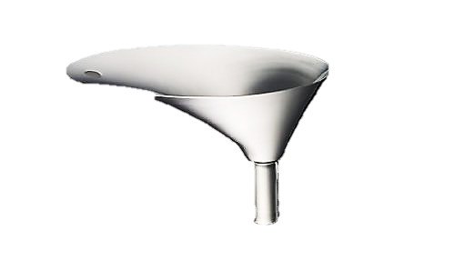
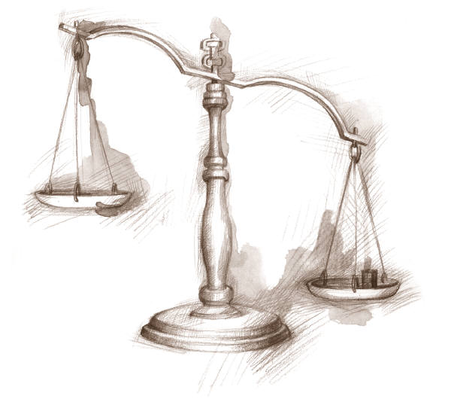
Competing Reporters: The Assumption
2: Payoffs in Future
1: Attack Payoff Today
Conform
Attack
TIME | Today | + 1 Day | + 2 Days | + 3 Days | + 4 Days | + 5 Days | + 6 Days
3: Time-Discounting (NPV “Funnel”, Concern for the future)
ALWAYS
Notes:
Start with the table: two rows.

Slide 21
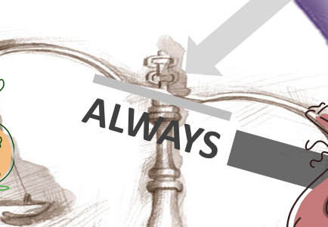
Triple Uncertainty
 | The Attack Payoff Today (we want low) can skyrocket: As a market becomes unexpectedly popular. Marketing / Hedged-”Chandelier Trades” by Reporters themselves. No reliable way of estimating market’s future popularity.
 | The Future Payoffs (we want high) can collapse on news/rumors : About reporter-industry-competitiveness (more people joining the industry, higher-quality offerings). Econ theory -> “No Rent”. About the future of the protocol (more popular alternative coming out, critical vulnerability found).
 | The reporter’s concern for the future (we want high) can decrease: With capricious Reporter preferences (we cannot guarantee to Traders that Reporters have psychologically stable preferences). Reporter hacked / faux-hacked / diagnosed with terminal illness. With Reporter retirement-plans (“I’ve been doing this for a while, and I just don’t want to do it anymore”). Reporter dies -> ?
Notes:
Triple Integral Lava – Don’t touch!
More uncertainty = swelling like a balloon.
All 3 are far too volatile. No way of changing a market, in response to these parameters.

Slide 22
Triple Uncertainty
← opportunity cost of theft equal to the amount of the losing bet.
(potentially large, if many users)
← A fee we extract, based on the utility of the service.
(better, we *are* compensated for honesty, this time)
A new psychological parameter, specific to this solution-attempt.
(unreliable)
Net result: better, but too uncertain.
 | The Attack Payoff Today (we want low) can skyrocket: As a market becomes unexpectedly popular. Marketing / Hedged-”Chandelier Trades” by Reporters themselves. No reliable way of estimating market’s future popularity.
 | The Future Payoffs (we want high) can collapse on news/rumors : About reporter-industry-competitiveness (more people joining the industry, higher-quality offerings). Econ theory -> “No Rent”. About the future of the protocol (more popular alternative coming out, critical vulnerability found).
 | The reporter’s concern for the future (we want high) can decrease: With capricious Reporter preferences (we cannot guarantee to Traders that Reporters have psychologically stable preferences). Reporter hacked / faux-hacked / diagnosed with terminal illness. With Reporter retirement-plans (“I’ve been doing this for a while, and I just don’t want to do it anymore”). Reporter dies -> ?
Notes:
Triple Integral Lava – Don’t touch!
More uncertainty = swelling like a balloon.
All 3 are far too volatile. No way of changing a market, in response to these parameters.

Slide 23
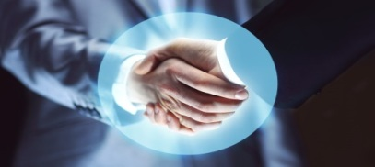
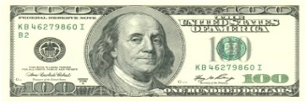
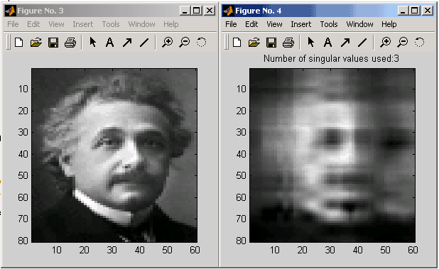
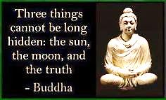
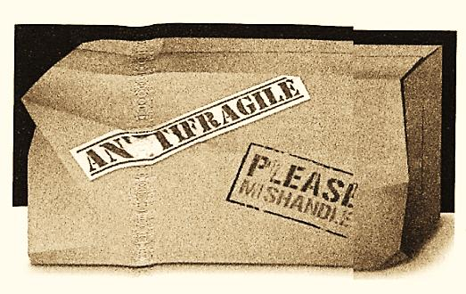
[C] Pseudo-corporation
1) Make Reputation itself Tradeable
Pseudo-corporation which exists to prove its consistency within and across time.
Collects $ to power the mechanism.
TRUST
2) SVD Cross-Validation
Statistical technique: seeks importance.
Gleans truth, measures conformity.
3) Strategic Use of Time
Funds can be ‘locked’ across time.
Yet info-search-costs constantly fall.
Net effect: time penalizes attackers only.
4) “Talebian” Robustness
“Fail quickly and safely” (instead of “we never fail”).
Bad Voters, Voter-Cartels, and Monopolist Voters can each help (not hurt), up to a certain (high) point.

Slide 24
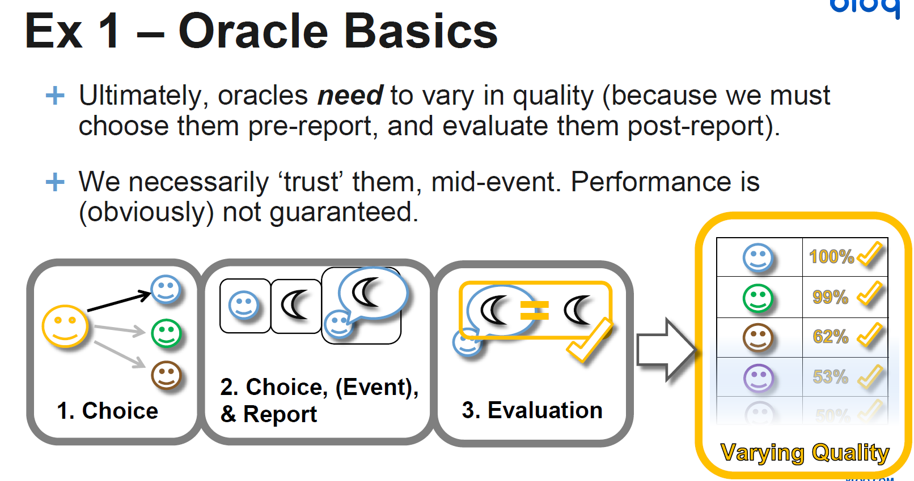
Corporation Model Breaks Sometimes
Multiple oracles
Notes:
Each reporter gets their own evaluation.

Slide 25
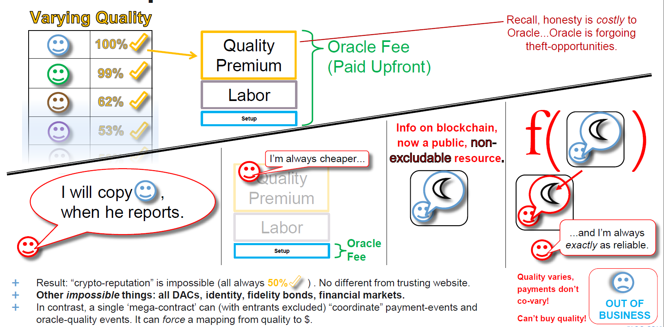
To Purchase Quality, Need pseduo-“©”

Slide 26
To Purchase Quality, Need pseduo-“©”
In this case, we successfully spread the opportunity cost of theft widely over many people, and over a long time period. Problem is we ensured that the maximum reward these people could receive was zero.
In turn, the “shares” of the Honest Corporation were worth NPV(0) = 0, meaning that it is trivial to purchase all the shares and attack.

Slide 27
Takeaways
Blockchain = Less trust = everything is harder.
Programmers vs. Contract-Authors : Dev objective is to enable the user to do more, contracts are about forcing the user to opt-into less. Oracle can fail as a result of actions that users are allowed to take:
…too easy for user to assume two identities / make bribe.
…too easy for the service to be “too” popular.
…too easy for rivals to enter and ‘steal’ the service.
In the blockchain world, code is built upon a foundation of incentives.
Notes:
Google

Slide 28

Conclusion
I hope that you’ve learned a little about the P2P Oracle, and why it is so much more difficult than the API call.
And, in turn, about blockchain.
Thank you for your attention.

Slide 29
Appendix

Slide 30
Scope: Some widely known info.
Universe of Knowledge
Search Costs /
Diffusion Costs:
low
high
Everyone knows.
No one knows.
A few experts know.
Already too difficult
Ability to Convey:
low
high
To move from brains, to the blockchain.
Function of fees, …
High volume of bets, “passionate” contention.
Not contentious – no one cares.
Notes:
First, notice that there is a spectrum of knowledge-availability. Some things everyone knows, some things view people know, some things are completely unknown.
Second, notice that, even if we agree that we know something, that doesn’t yet mean the blockchain has consensus on it. Unless we build a simulated human brain into the blockchain, it will need some way of deciding what information to trust and what to discard.
Spectrum I above, → teach it to a computer (Spectrum II – costs/benefits of different mappings from
From ?? → information (venn diagram) ; from information → consensus

Slide 31
Three Fundamental Problems
Opportunity Cost of Honesty – Imagine that payment M is conditional on an event, and that event either must happen or not happen (ie, we live in only one reality), then there will be one “winner” and one “loser” to the payment. The loser always has an incentive not to cooperate, and, in fact, to pay
No Identities / “Nothing at Stake” / Free Resurrection – Classic Internet Negative Reputation Problem, in the real world you can punish / imprison / assassinate people who misbehave. On the internet, you cannot.
Principal-Agent Problem – The decision-maker (agent) will not care as much about the decision as the people who are affected by it (principals), unless they are the same person. In a 1v1 dispute, this gets frustrating as it seemingly leads either to corruption or to neglect.

Slide 32
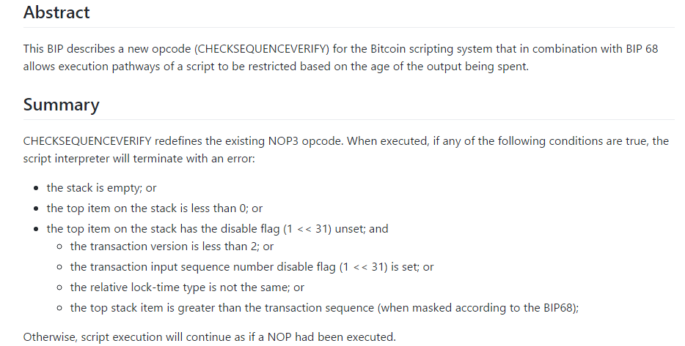
Bitcoin Upgrade
Upgrade, by adding errors?!

