Slide 1
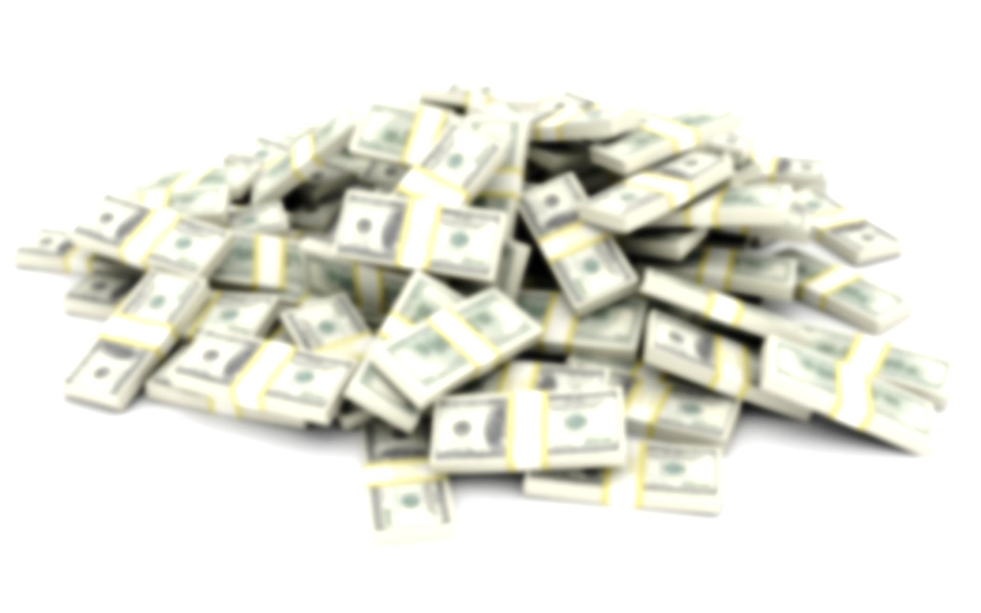
Hivemind is Valuable
v0.3 – 7/31/2014
Paul Sztorc
BitcoinHivemind.com

Slide 2
This Deck: Private, Not Public, Value
Public (Not the focus here):
Second Scientific Revolution / Utopia.
P2P Financial Derivative-Portfolios
Can prove true-unorthodox-beliefs (and converse).
Prevent CEOs/Politicians from lying.
Recreational speculation (sports, gambling, “fun”, etc).
(All ultra-cheap, no arbitrary limits, software-efficient).
Private: What return is available to owners (investors, volunteer-programmers)?
Notes:
Gambling is fun, fun to watch markets.

Slide 3
Overview
“What produces the return?” (4 slides)
Not the alt-coin itself (giving that away).
Instead, Trading Volumes (fees).
Collected by Branch-owners.
Robustness to Competition (1 slide).
Possibilities (3 slides).
“Can it be done?” (1 slide).
Conclusion Slide: Current Needs

Slide 4
[1] Where’s that return coming from?
Truthcoin has TWO coins – “Cash” and “Reputation”.
Use Coin 2 (“Reputation”) to reward contributors, and provide Return.
(Give 100% of “Cash” to Bitcoin-owners).
It’s the “best bad idea”.
Greatest marketing possible.
Only unique solution (non-arbitrary).
Sidechains may force this anyway.
Kind of “scammy” not to do this.
Can do this in two phases (“testing phase” and “launch phase”).
Notes:
Would unfairly challenge Bitcoin’s network effect.

Slide 5
[1] Truthcoin Graphic
Main
Sports
Owners
(“Reputation”)
Branches
Decisions
Markets
Owners (“Cash”)
Authorship
Trades
Authorship
Notes:
Hazy lines are Scaled Decisions, Boxes are Binaries. Note that Scaled Decisions span an entire Dimension, whereas Binaries just Partition-from-Null.
Multidimensional Markets have more than one Decision.

Slide 6
[1] Branches
Free Option to own future branches:
-Trust / Network Effect
-Uniqueness (consensus & digital scarcity)
Football
Sports
Sports (Non-Football)
Main (Non-Sports, Non-Finance)
Main
Main (Non-Sports)
Finance
Time
Notes:
Why ownership would be maintained (stored trust, non arbitrary, reason-for-doing)
(Free) option to continue owning.

Slide 7
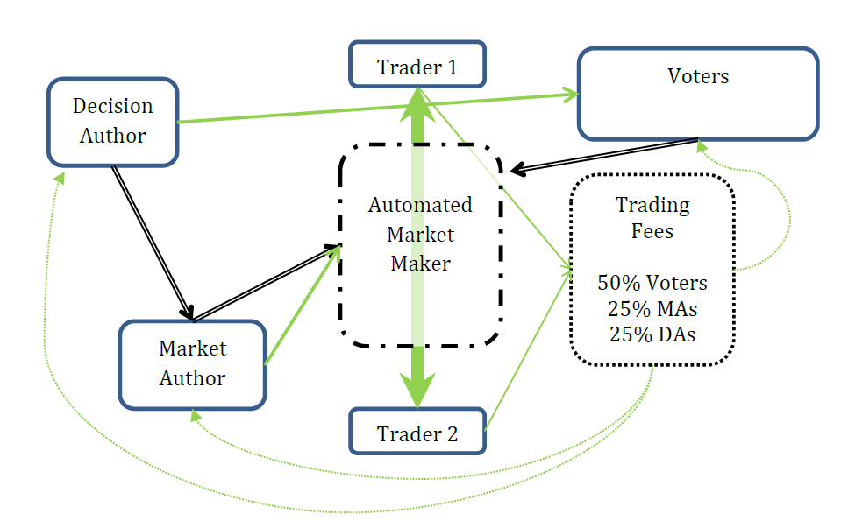
[1] What fraction of Trading Volume?
(Figure 5 Adapted from Whitepaper).
Trading Fee itself is set by Author (more later).
Notes:
Factors influencing transactions fees: competition, risk-return for Authors. Authors want to maximize Trading Fees.

Slide 8
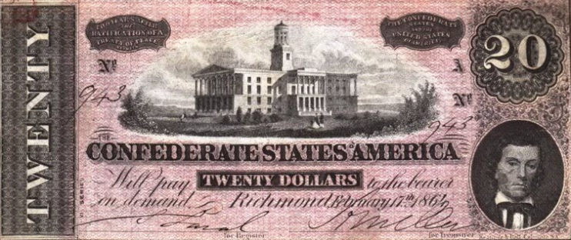
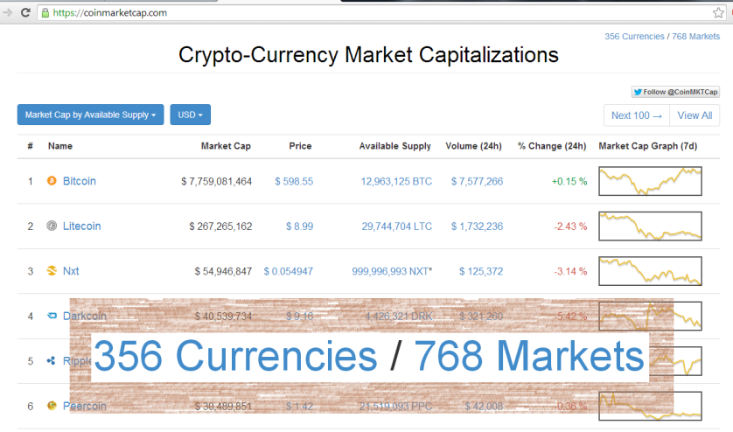
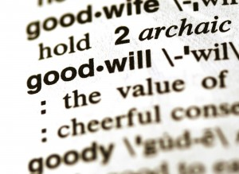
[2] Competition (Lack Thereof)
Tech Network-Effects
Money (once established, near-unbreakable).
Competitors Must Prove Non-Fraud (uniqueness / digital-scarcity problem).
Fight drives profits down (still >0?).
Main competitor: Legal prediction markets (not happening).
Notes:
Confederate Money
Github Comments

Slide 9
[3] Beyond Prediction
Application | Sample Market
1. “BitUSD” (Save in Dollars/Gold, xfer these as you would Bitcoin) | TRU/USD Exchange Rate on Date D.
2. PMs denominated in USD (P2P Exchange, Financial Portfolios) | TRU/USD Exchange Rate on Date D X Hillary Clinton to win US President in Nov 2016.
3. Public Goods | Lighthouse with specifications X built with Schelling Indicator: S by Date D.
4. Insurance | Natural Disaster X of Magnitude M to occur on or before Date D.
5. Gambling | Sports Team X to win on Date D.
Notes:
Even better – hedge (option to see portfolio value increase)
Buying and Selling BTC is a real pain
Use a prediction market instead – same return
Can even “bet” in USD inside the 100% cryptocurrency software.
Warning: Scaled claims require a bounded range. – see NN Taleb. (use of log may help).
More details in my 3_Applications paper.
Non-moral-hazard only. Requires fully collateralized (will have limited applications).

Slide 10
[3] Valuation Possibilities
Worst Case
Medium Case
Possibility | Yearly Trading Volume (in 2013-USD) | 5 Basis Points (.05%), 3 Years @ 45% (1.5x) | 50 Basis Points (.5%), 10 Years @ 30% (3x)
InTrade | 23.8 million | $ 8,925 | $ 178,500
Unreg Sports Betting (USA) | 300 billion | 112.5 million | 2.25 billion
NYSE (on just 251 trading days) | 27.6 trillion | 10.35 billion | 207 billion
(1/2) * Trading Fee * Trading Volume * NPV-Multiplier
Ignores superiorities to each of these existing institutions (see notes).
Figures are for US numbers only (Truthcoin would be global).
Ignores revenues from other branches.
Ignores Listing Fees paid by Authors (because also ignores Voting Work).
Notes:
Project may fail for any number of reasons:
Technical
Managerial
design-failure
market disinterest, etc.
This was an election year, however, InTrade was also closed to US bettors late November 2012). It closed completely in early 2013.
InTrade was inferior to Truthcoin in several ways
counterparty risk
no-return-on-deposits
higher fees
limited who it took money from
restricted what markets could be created
no multidimensional markets
no MSRs
http://www.newrepublic.com/article/politics/90371/intrade-and-jon-huntsman-president-odds-republican-nomination
Data
Personal InTrade dataset
http://reason.com/archives/2013/11/25/the-death-of-intrade
http://fivethirtyeight.com/features/even-without-intrade-billions-will-be-bet-on-2016-race/
Sports Gambling
http://www.sportsonearth.com/article/81295462/sports-gambling-in-us-could-be-legal-if-new-jersey-fights-courts#!3OEG0
Counterparty risk greatly hinders Bitcoin gambling options, rife with fraud/theft.
http://www.cnbc.com/id/48780316
More opportunities:
[ market | Fed Policy ]
[ Stock price | CEO status ]
P2P
No middle man
lower fees
fund availability 24/7/365
instant transfers
no frozen accounts, etc.
Voting Work is required for non-competition (deal with it).

Slide 11
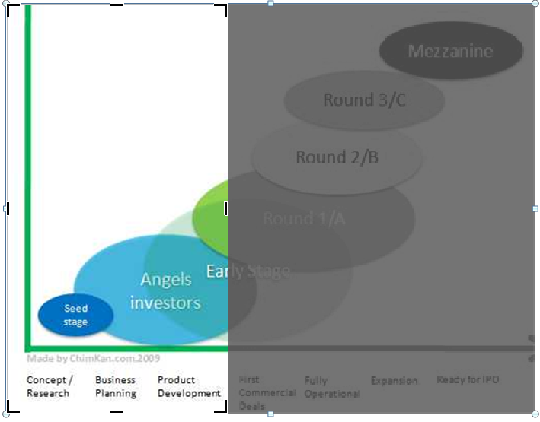
[3] Dilution It’s all yours!
Blockchain: Once programmed, immutable. In future, even illegal to try.
Scalability: No need for more employees/lawyers/office space/customer service.
Notes:
Blockchain design, (and regulatory project-life uncertainty), requires instant-IPO.
Exception: open-source tools (making it easier to visualize and trade in markets, manage money, vote on Decisions, etc).

