Slide 1

Blockchain Prediction Markets
“Outcomes”
v2 – 10/15/2014 Paul Sztorc
Notes:
Climbed to the top of yCombinator, while I was on vacation like in early May or something.

Slide 2
This Presentation
Applications
Outcomes
Trading
Bitcoin
Notes:
Three Rectangles This presentation is on Determining-the-Outcomes
“What everyone wants to know.”
“What I get emails about constantly.”

Slide 3
Talk Outline – 26 Slides
The Outcome Problem (Slides 4 – 8)
The Goal, stated clearly.
Competing Arbiters? Not even close to good enough.
The Assumption.
How can we do better? (Slides 9 – 13)
Consistency – brought to you by SVD.
Reputation – brought to you by financial econ.
Hivemind Overview (14-19)
The Big Graphic.
Scalability via “Branching”.
The 51% ownership attack.
Going Beyond (19-26)
Auditing Branches (Two-Wave SVD)
Vetoing Bad Votes
Semi-Trusted “Branch Insurance”
Notes:
Prediction Market NPV Backward Induction

Slide 4
The Outcome Problem
Goal: Guarantee to Traders that their ‘event derivatives’ will eventually be worth their promised value.
Resources:
Reports from users, aggregated (“votes”).
Some $ to pay the reporters (“voters”).
Problems:
Completely self-determined ( reliable data must be only a function of the reports ). Decentralization = no “special users”.
Laziness: (No one will vote unless they have to).
‘Virtual Voters’ likely pseudonymous, can’t be sued, shamed, or whacked. No 9 month waiting period.
Special Problems:
Half of all trades will be ‘losers’: these traders have an inherent reason-to-lie.
“Retiring users” have an inherent reason-to-lie.
“The Powers That Be” / Crazy “Joker” types.
Notes:
We’ve got to tie reality to these prices. Chicken-and-egg. Overcome their laziness.

Slide 5
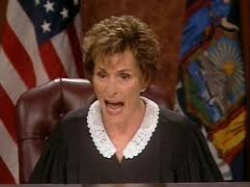

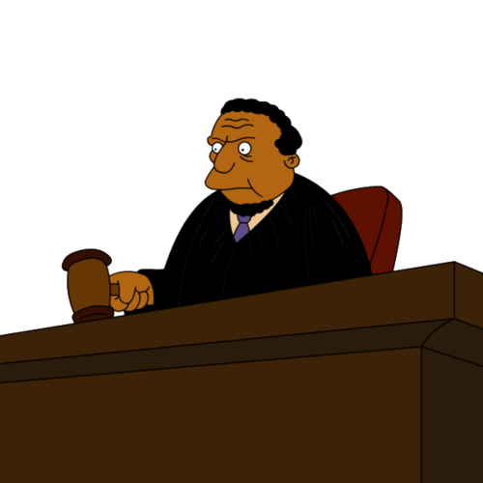
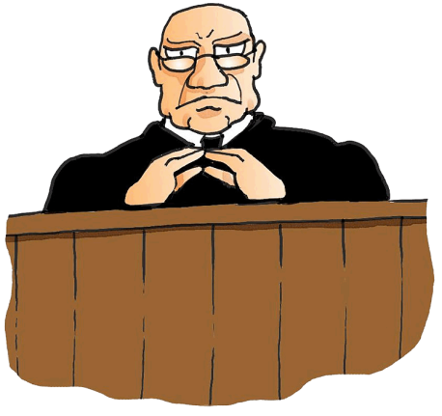
Existing Proposal (Which Won’t Work): Competing Arbiters / Price-Feed-Providers
?
Judge 1
Trader
Judge 2
Judge 3
Some user assumes role of ‘arbiter’ (may pay registration
fee, ‘fidelity bond’, or may be free, may involve off-chain marketing/legal …).
Arbiters collect fees on an ongoing basis per judgment, resolution, audit, or per day, feed, subscriber, etc.
Trader can choose arbiter: competitive marketplace provides incentive to keep good reputation. “Bad” agent = no longer chosen = loses ongoing fees.
(I don’t own these images).
Notes:
Counterparty, Princeton Paper, (Prediction Market Genius) Robin Hanson

Slide 6
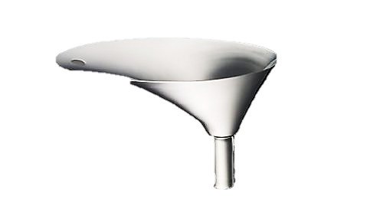
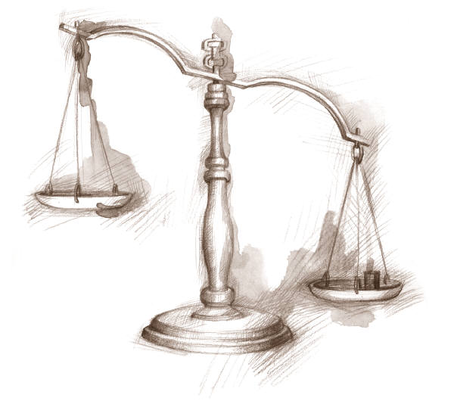
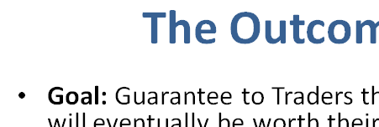
The Competing Arbiters Assumption
2: Payoffs in Future
1: Attack Payoff Today
Conform
Attack
TIME | Today | + 1 Day | + 2 Days | + 3 Days | + 4 Days | + 5 Days | + 6 Days
3: Time-Discounting (NPV “Funnel”, Concern for the future)
ALWAYS
Notes:
Start with the table: two rows
Attack: Mitt Romney, buy things which were supposed to be worthless, profit tremendously

Slide 7
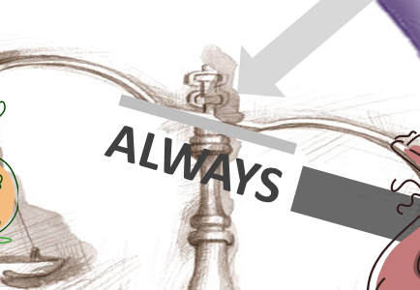
Triple Uncertainty
 | The Attack Payoff Today (we want low) can skyrocket: As a market becomes unexpectedly popular. Marketing / Hedged-”Chandelier Trades” by Arbiters themselves. No reliable way of estimating market’s future popularity.
 | The Future Payoffs (we want high) can collapse on news/rumors : About judge-industry-competitiveness (more people joining the industry, higher-quality offerings). Econ theory -> “No Rent”. About the future of the protocol (more popular alternative coming out, critical vulnerability found).
 | The arbiter’s concern for the future (we want high) can decrease: With capricious Arbiter preferences (we cannot guarantee to Traders that Arbiters have psychologically stable preferences). Arbiter hacked / faux-hacked / diagnosed with terminal illness. With Arbiter retirement-plans (“I’ve been doing this for a while, and I just don’t want to do it anymore”). Arbiter dies -> ?
Notes:
Triple Integral Lava – Don’t touch!
More uncertainty = swelling like a balloon.
All 3 are far too volatile. No way of changing a market, in response to these parameters.

Slide 8
Will anything work? Don’t be discouraged…

Slide 9
…real people do it all the time!
Our reality is completely self-determined.
And real people are:
Liars who constantly misrepresent themselves.
Hypocrites who aren’t self-aware enough to have a reputation to lose (politicians: no shame).
Lazy (not voting on important things unless they have to). Threshold for “public consciousness”.
Yet, we still think we “know” some facts (“Was Mitt Romney elected president in 2012?”, ‘Google-able’ facts)
Notice: After the fact = Much easier.

Slide 10
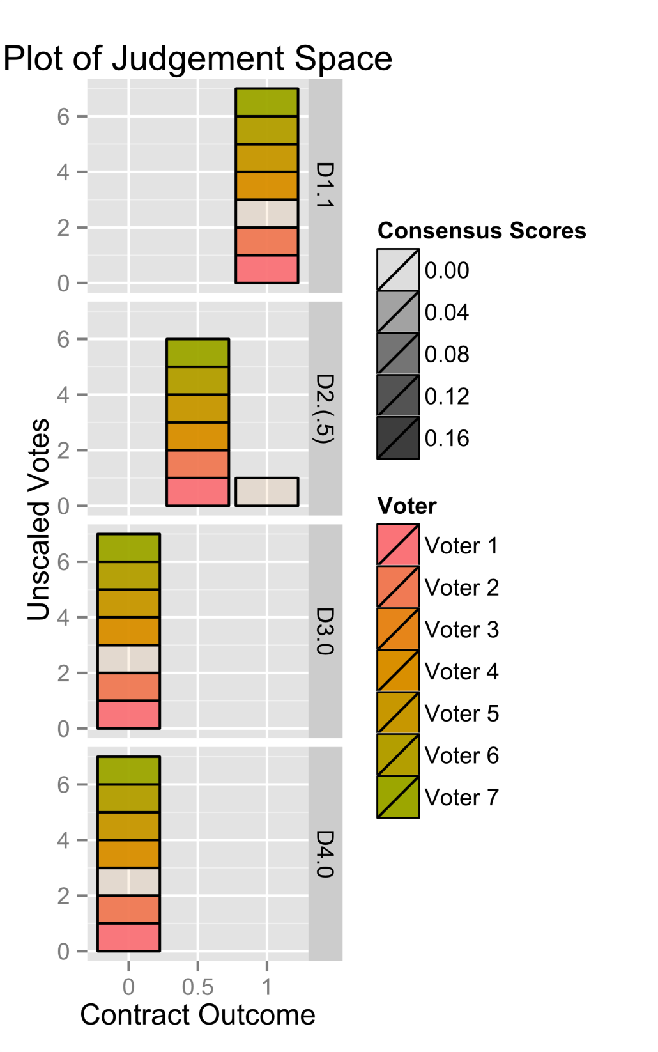
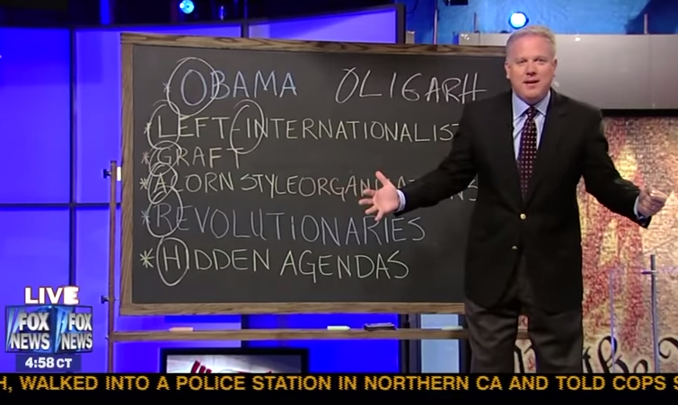
How Do We Do It?
Experience “reports” on many things from many people in real-time (‘Ballot’).
Constantly evaluate logical consistency of the person.
“I’m unreliable.”
Notes:
…there are many techniques for doing this.

Slide 11
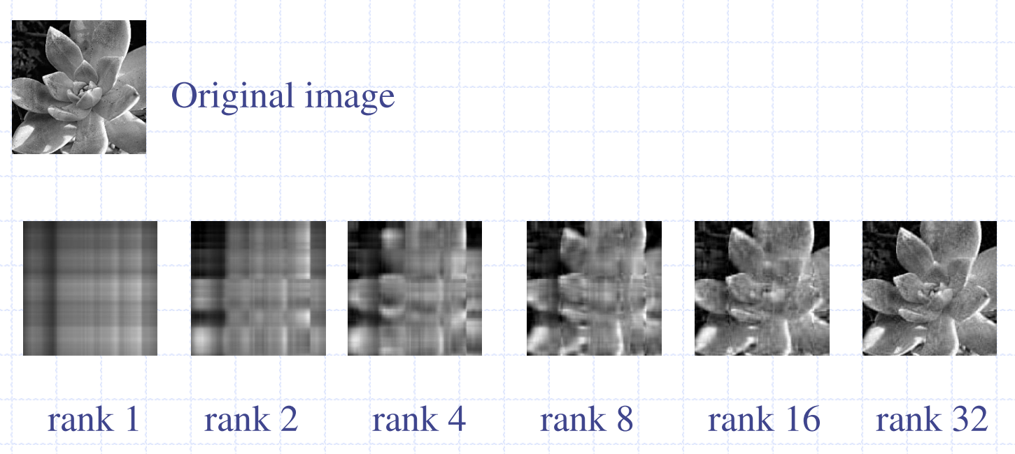
Singular Value Decomposition
http://www.youtube.com/watch?v=pAiVb7gWUrM
Point = Build index of disagreement with an abstract ‘most-representative ballot’ (not known in advance to any single voter). Cotinuous.
http://www8.tfe.umu.se/courses/systemteknik/Media_signal_processing/04/presentations/MSP_P3-3.pdf
Notes:
I’m familiar with this one – There might be a better way. The first term as “canonical truth”, and I don’t use that (directly), but I do use “how close everyone was too that”. Some Sweedish University

Slide 12
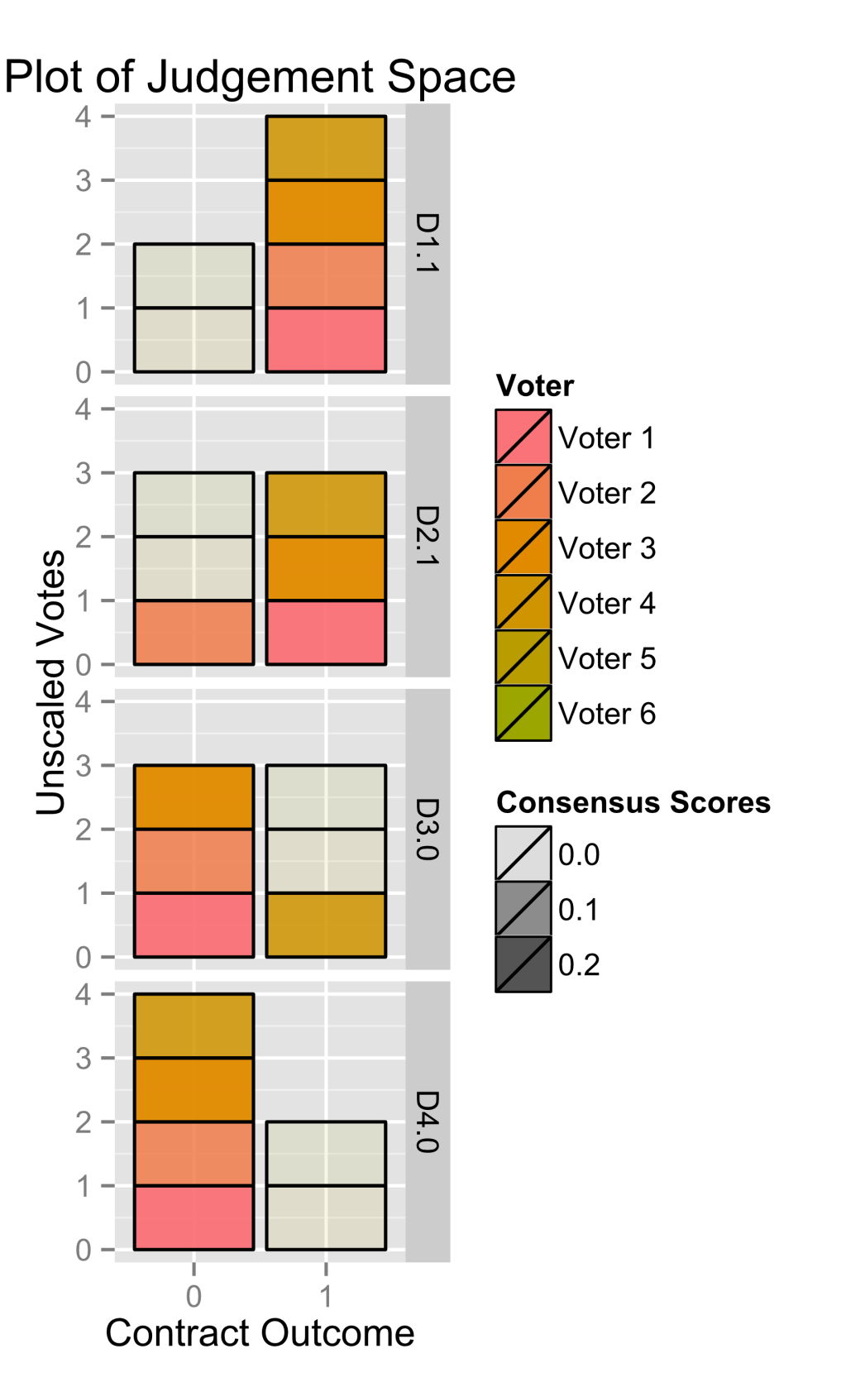
Example 2:
 | D1 | D2 | D3 | D4
Voter 1 | 1 | 1 | 0 | 0
Voter 2 | 1 | 0 | 0 | 0
Voter 3 | 1 | 1 | 0 | 0
Voter 4 | 1 | 1 | 1 | 0
Voter 5 | 0 | 0 | 1 | 1
Voter 6 | 0 | 0 | 1 | 1
Total | 4 - 2 | 3 - 3 | 3 - 3 | 2 - 4
Demo: http://forum.truthcoin.info/index.php/topic,134.0.html

Slide 13
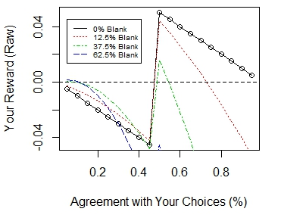
As others disagree with you, you benefit (up to a point)!
Result: Cannot trust rival voters…no cartels or “voting pools”.

Slide 14
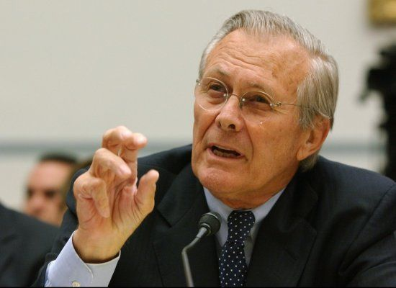
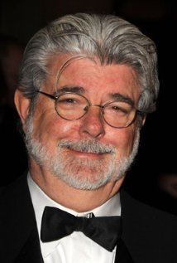
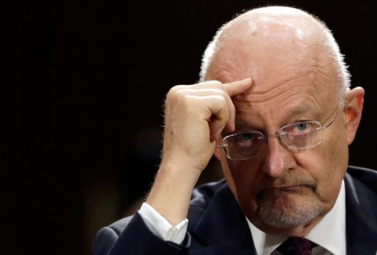

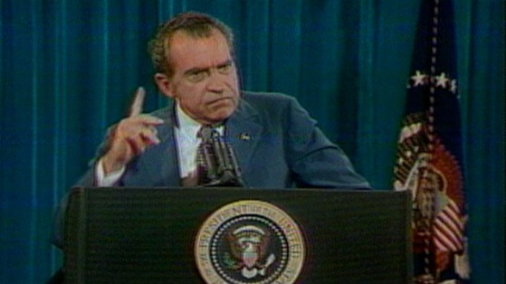
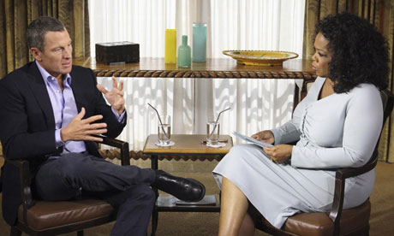
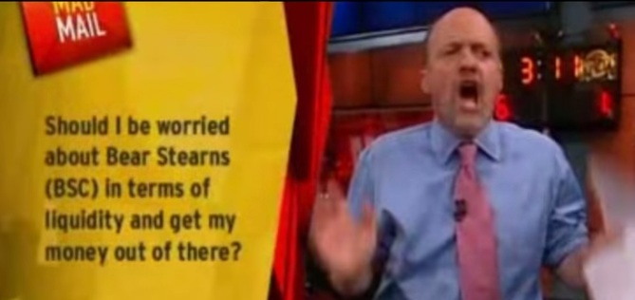
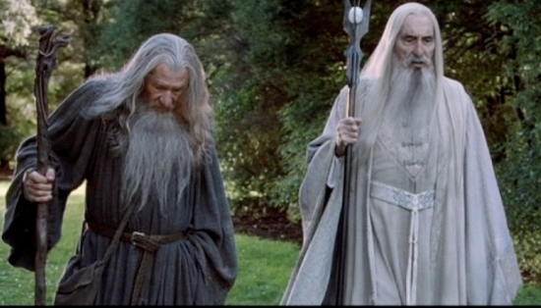
Consistency #2: Time After someone lets you down, then stop trusting them! (Reputation)
Notes:
We give people a certain amount of trust, just, “as a fellow human being”. What they do might originally seem normal, and acceptable. Until a certain point in time…then we decide not to trust them for a while. Lance Armstrong - Doping Donald Rumsfeld – WMDs in Iraq “we know where they are” Richard Nixon – I am not a crook
James Clapper - "Does the NSA collect any type of data at all on millions or hundreds of millions of Americans?" He responded, "No, sir." Wyden asked "It does not?" and Clapper said "Not wittingly. There are cases where they could inadvertently, perhaps, collect, but not wittingly.“ OJ Simpson – If the glove don’t fit. Jim Cramer – Should I sell Bear Stearns - March 11, 2008 - $62 at the time. 6 days later the company was brought out by JP Morgan for $2 per share. Note that the caller is asking NOT about the share price, but about the assets held by BSC. However, J Cramer DID recommend “buy BSC” within the previous 10 days and across the preceding several months. The image conveniently has the BSC stock symbol (probably a mistake by the producers) and the “no” face was just too much to pass up. http://www.youtube.com/watch?v=olxxgobf6Z4
Saruman and Gandalf

Slide 15
How to ‘tie’ people to a permanent reputation (as they are so-tied in real life)?
Allow them to become owners in an abstract corporation.
Must ‘buy in’ (prevents Sybil attacks).
Positive selection effect (only those who want to do this can buy).
Financial Asset
No ‘retirement attack’ (retirees can simply sell).
All users earn dividends on all future resolutions.
Penalize bad behavior by reducing ownership.
Non-conformity (measured via SVD-consensus)
Laziness (failure to vote on-time, every-time).
smooths cash flows
Notes:
Would be nice if we could have people keep reporting on the same thing. That’s possible, but it’s a little inconvenient (waiting until 2017 or 2018 until “certain” enough to resolve your Hillary 2016 contract)
Doesn’t stop “tech disaster”, but tech is what we can improve, human nature we can’t.

Slide 16
Hivemind Graphic: Two Coin Types
Main
Sports
Owners
(“Reputation”)
Branches
Decisions
Markets
Owners (“Cash”) (“Bitcoin”)
Authorship
Trades
Authorship
Notes:
Hazy lines are Scaled Decisions, Boxes are Binaries. Note that Scaled Decisions span an entire Dimension, whereas Binaries just Partition-from-Null.
Multidimensional Markets have more than one Decision.

Slide 17
Scalability = “Branching”
Free Option to own future branches:
-Trust / Network Effect
-Uniqueness (consensus & digital scarcity)
Football
Sports
Sports (Non-Football)
Main (Non-Sports, Non-Finance)
Main
Main (Non-Sports)
Finance
Time
Notes:
“Can this Scale if Everyone must Vote on Everything?” No.
Why ownership would be maintained (stored trust, non arbitrary, reason-for-doing)
(Free) option to continue owning.

Slide 18
The 51% Voter-Attack is Much Harder
YOU (individually) need 50% (a mere “coalition of >50%” will not work, as you can’t trust them).
Now you must ‘buy up’ the marketcap of the entire Branch (not just pay off one person).
Requires additional investment (all of which is lost post-attack).
Opportunity cost of attack is tied to the profitability of the Branch (previously, lots of ‘luck’ re: gaining rep, chancing to referee a popular market).
Attackers LOSE the reputation you bought (ie the opportunity cost of selling).
Previously, you lost only your established reputation.
Previously, your ‘investment’ was low.
Strong resistance to the (otherwise fatal) “exit scam”.

Slide 19
Going Beyond 50%
What if Attack exceeds Conform and
someone buys up >51% of the VoteCoins?
Could execute same ‘lie attack’, only worse (51/100th cheaper)!
To SVD, we add:
[1] The Audit, [2] The Miner Veto, and [3] The Miner Override.

Slide 20

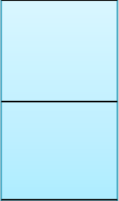
[1] Audit
Real-World Logic: When people can’t agree on something, they do not go with “51%”, instead they say something like “we really aren’t sure”.
“Two Wave SVD”
Wave Two: On all the ‘Certain Decisions’ which survived Round 1.
1
SVD(
)
1
0.8
SVD(
)
0
0.2
The Uncertain Decisions become “Auditable”
0
Wave One: Catches largest outliers immediately (preserves every incentive we just described).
Branch Parameters include a ‘Certainty Threshold’ (φ=80% here)

Slide 21
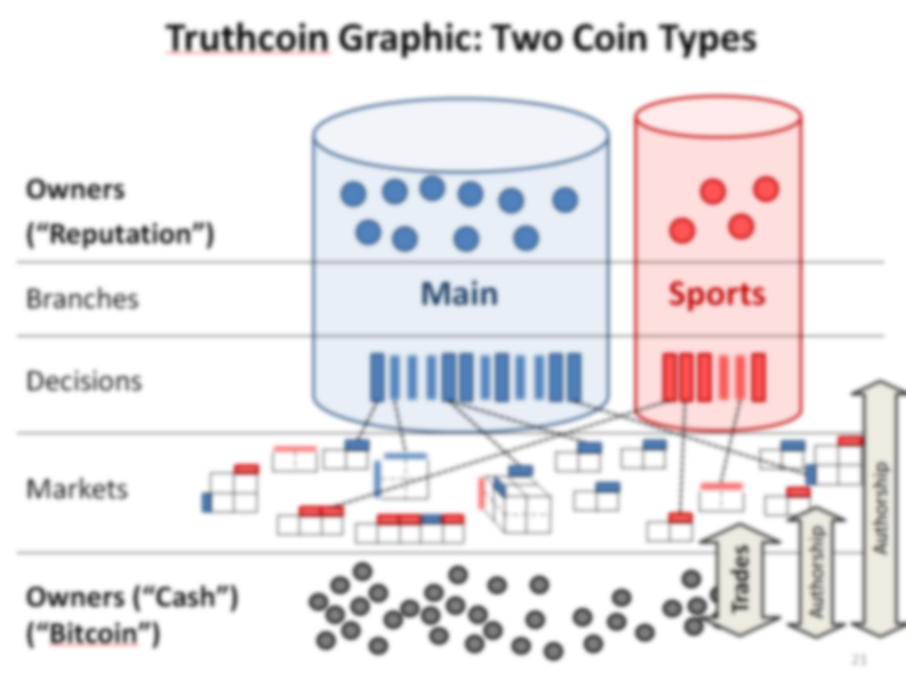
Per Audit Period (6 Months or so), anyone can cast a vote with their available cash (cash not invested in a market).
These votes are on the top 5 most representative Ballots from each ‘Auditable Ballot’ (not on the Auditable Decisions themselves, this substantially reduces the workload of the auditors).
More general: Vote on Ballots from multiple Branches and Time Periods.
You always get your cash back (no penalty for not voting).
Winners in SVD get the half Trading Fees for that round (the other half go to the winning Branch VTC owners), proportional to their agreement (as usual).
Cash Branch
Result: By ‘sticking it out’, an honest minority of Voters can earn a superior return (50% instead of <50% [by definition, they are a minority]).

Slide 22
[2] Miner Veto
So far, we have a situation where:
Voters would like to collaborate and attack, but fear being double-crossed by double-agent Voters.
Honest Voters have recourse for ‘sticking it out’ (not only overall, but especially on a Decision-by-Decision basis).
Therefore, Voters are unlikely to trust each others (even if they can prove they are a majority).
Let’s amplify Voter mistrust by making life even more inconvenient for liar-Voters, by using a Miner Veto.
Those planning to attack are…
Victory
More Uncertainties
…Just Pretending
…Really Attacking

Slide 23
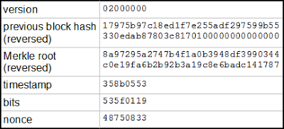
Preventing the >φ Attack
Miner Veto Opportunity
>φ
Cast Vote
Unseal Vote
<φ
Miner Veto Opportunity
Ballots
Become
Auditable
>φ
SVD 2
Veto Opportunity
Ends: Resolved!
Unseal Vote
SVD 1
Cast Vote
<φ
Miner Veto Opportunity
Ballots
Become
Auditable
Audit
Opportunity
Veto Opportunity
Ends: Resolved!
50% “Ballot Veto”
Ballot / Audit Ignored
Try again next period
(Miners can already hard-fork, this is simply a failsafe).
(And/Or) 95% “Branch-Veto”
Branch’s future Decisions can be moved to a different Branch (by their Author).
+
Ballot Veto(s) | BA-i3s3…, BA-30f4…
Audit Veto(s) | A-jji7b…
Branch Veto(s) | B-35o5…, B-u987…
Not necessarily in block header, just pointing out that these are “signature-less inclusions”

Slide 24
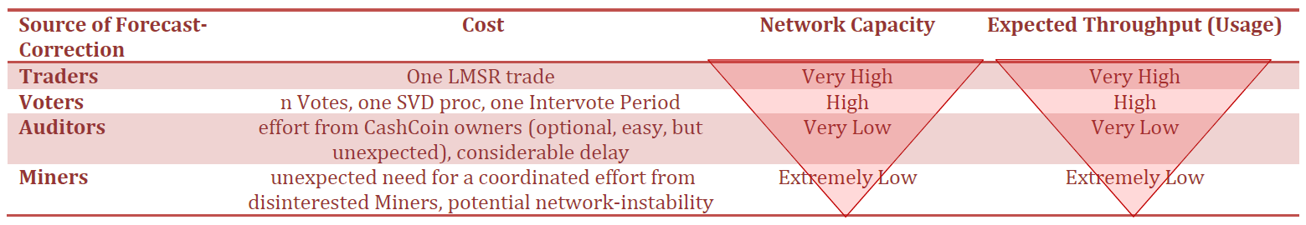
[3] Miner Override
We need to stop anyone from owing 51% of something…sound familiar?
Outsource the task of Voting completely to Miners.
High instability, extra special effort required, but Miners should always find it to be worthwhile, even profitable. (Comparable to reacting to a software bug / hard fork).
Costs everyone big…attackers most of all.

Slide 25
Can it get EVEN BETTER??

Slide 26
Branch Insurance Reintroducing “Trust”
Football
Branch: | “Regular” | “Insurance”
Owners | Many | One
Trusted | No | Yes
Specialized | By Topic | By Owner
Decisions | “DJIA close on Date X?” “Super Bowl winner in X?” | “Will Finance-Branch ever Misjudge?” “Will Sports-Branch ever Misjudge?”
Sports
Sports (Non-Football)
Main (Non-Sports, Non-Finance)
Main
Main (Non-Sports)
Insurance Group C
Insurance Group B
Finance
Competing
Insurers
Insurance Group A
Notes:
Too complicated to explain the Tau Range.

Slide 27
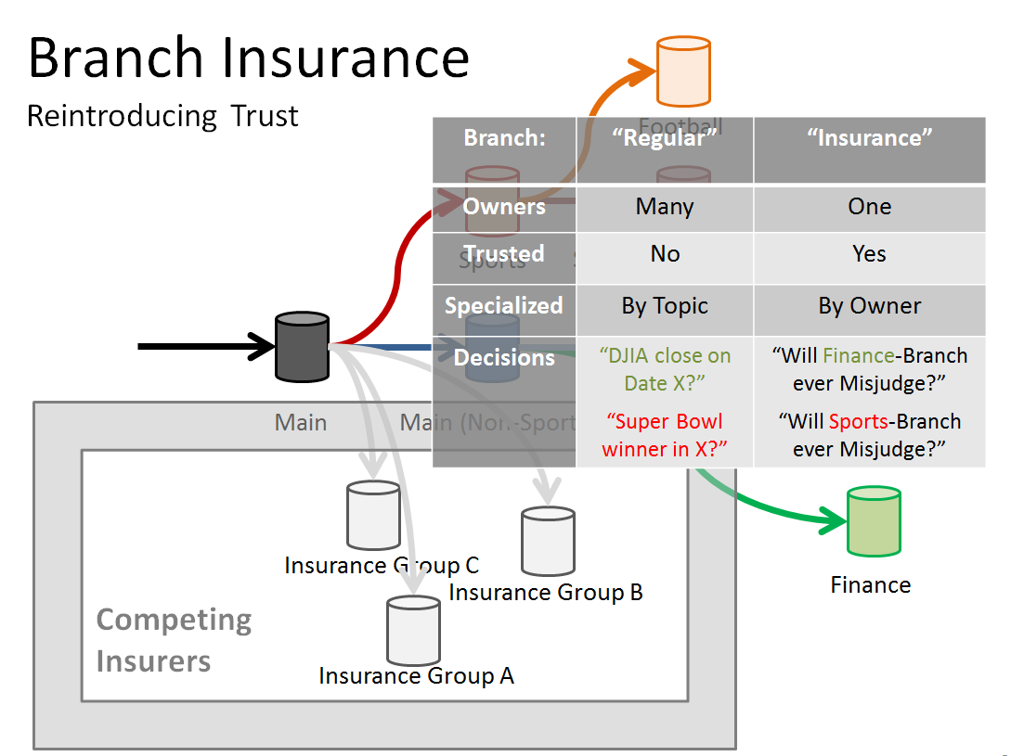
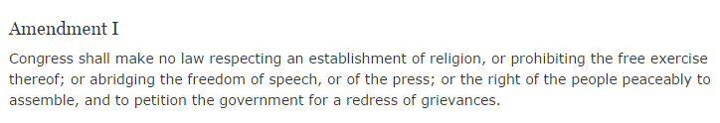
New Business Opportunities
With Guarantees Enforced by Legal System (?)
abridging the freedom of speech
Walmart Assurance
Law Firm X
Consulting Firm Y

Slide 28
Current Status / Plans
See forum.truthcoin.info, github.com/psztorc/Truthcoin
Currently no organization / investors / foundation.
Currently are several “volunteer-versions”, each with pros/cons, at various states of being.
Release these versions for testing.
Wait for sidechains/treechains (?).
…or replace Bitcoin *gasp*?
Preserve ownership of the ‘VoteCoins’
value-add.
network-effect.
valuable-component.
Give ‘CashCoins’ to Bitcoin users to preserve econ network.
Notes:
No reason to continually update this.

Slide 29
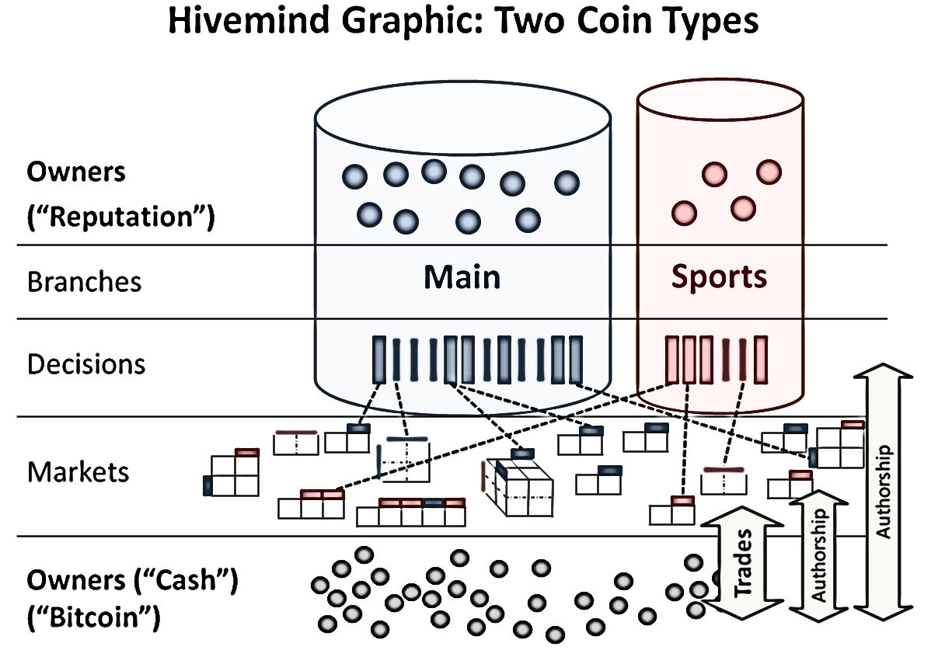
Thank You!

Slide 30
The Trading Slide
Permanent Liquidity – Market Scoring Rules
No order books needed
Only one trader / trade needed.
One tx (“signed update”)
Info Prize (donations)
Trading at near-instant speed (within 10-minute blocks)
Notes:
It is possible, in economic science, to build a market where one always has someone to trade against, even if the market has a total of one trader.

Slide 31
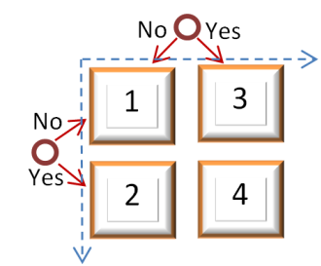
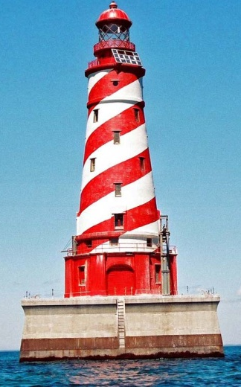
The Applications Slide
Multidimensional Markets
Optimal Advice (“futarchy”)
Boost econ growth (CEOs)
Financing Public Goods
Smart Contracts
(With Selling Disabled) = “Lockbox”
Public Goods without Coercion (T-DAC)
Focus On: the result, not the computation.
Notes:
Hal Finney Use Buying or the Info Prize

Slide 32
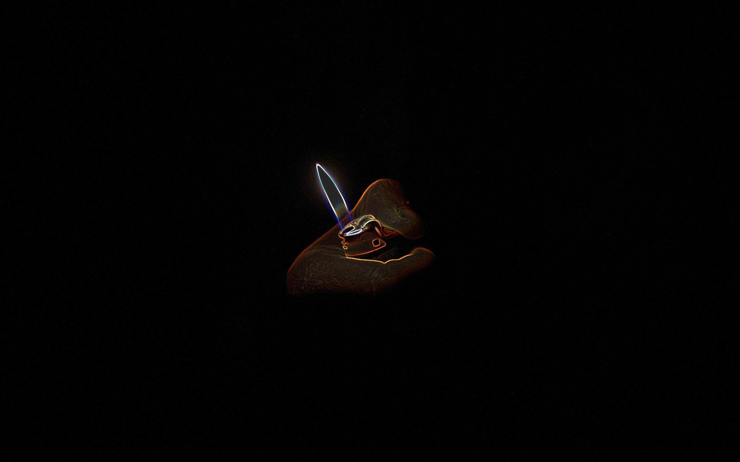
Truthcoin
Notes:
Climbed to the top of yCombinator, while I was on vacation like in early May or something.

