Slide 1
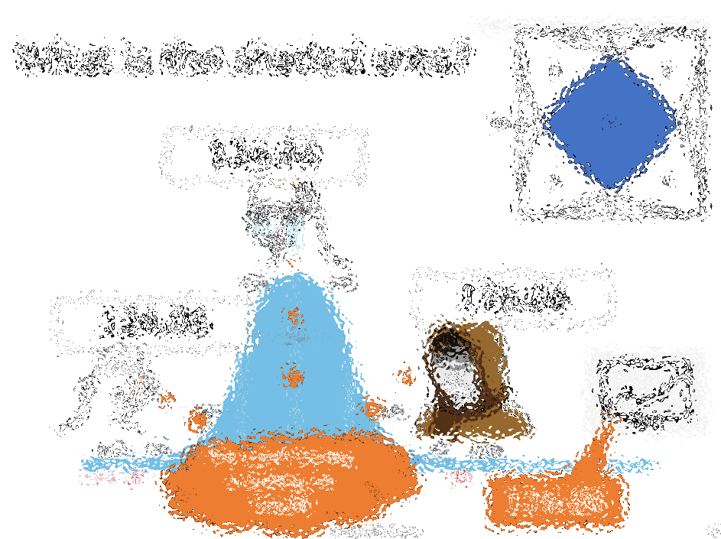
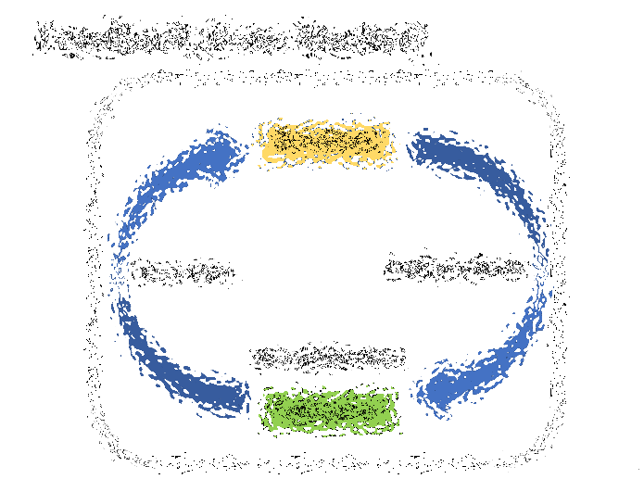
Bitcoin Prediction Markets
Bitcoin Asia
May 9, 2024
Hong Kong
Paul Sztorc
BitcoinHivemind.com LayerTwoLabs.com

Slide 2
Civilization Tech
Writing
The Printing Press
The Internet
The Blockchain
PredictIon Markets

Slide 3
Information…
Writing
Save info
Spread info
The Printing Press
The Internet
Sort & immortalize info
The Blockchain
Unite info
PredictIon Markets

Slide 4
Agenda
About me
Seeing the Future -- What are Prediction Markets
Getting Advice – Multi-dimensional Prediction Markets
A Bitcoin L2 Specializing in Prediction Markets

Slide 5
About Me
Joined in 2012
Yale Econ Department
Code for prediction markets – 2013
“truthcoin” white paper – 2014
Renamed BitcoinHivemind.com
…
Notes:
Hello, my name is Paul Sztorc. I have a relatively mainstream background – public school in Connecticut for 12 years, private engineering college in Ohio, where I studied economics and statistics. I then worked a kind of pre-doctoral research statistician job at Yale for 2 years for a man named William Nordhaus, who just won the economics Nobel Prize a few months ago. So my economic training is quite mainstream.
Despite all of that, I fell in love with Bitcoin in 2012. I’ve published Bitcoin research on my blog “truthcoin.info” since 2014. I presented at many Bitcoin conferences, especially the scaling conferences, as well as Building on Bitcoin (last summer) and TABConf earlier this year.

Slide 6
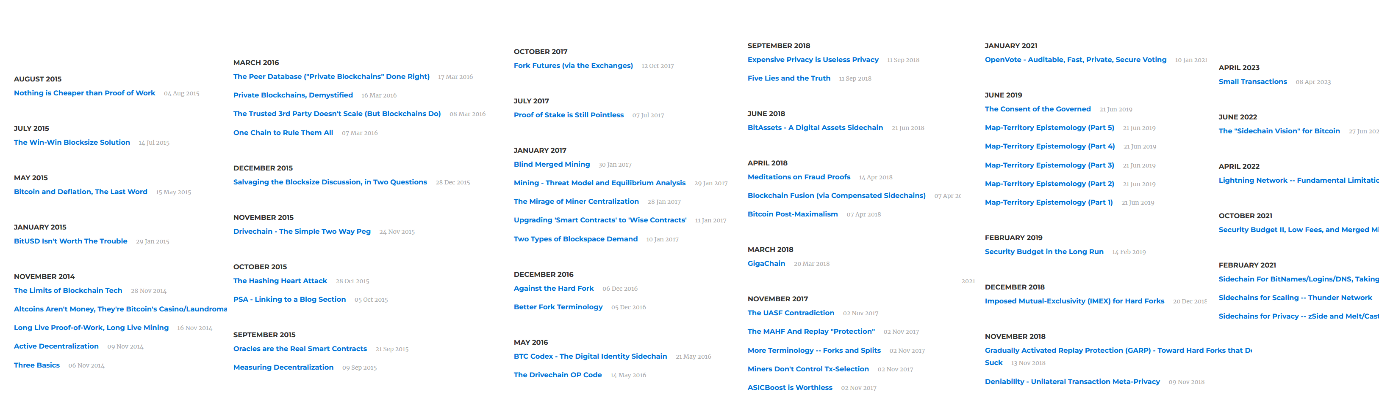
Paul’s 1000+ Pages About Bitcoin
Bitcoin Blog -- truthcoin.info

Slide 7
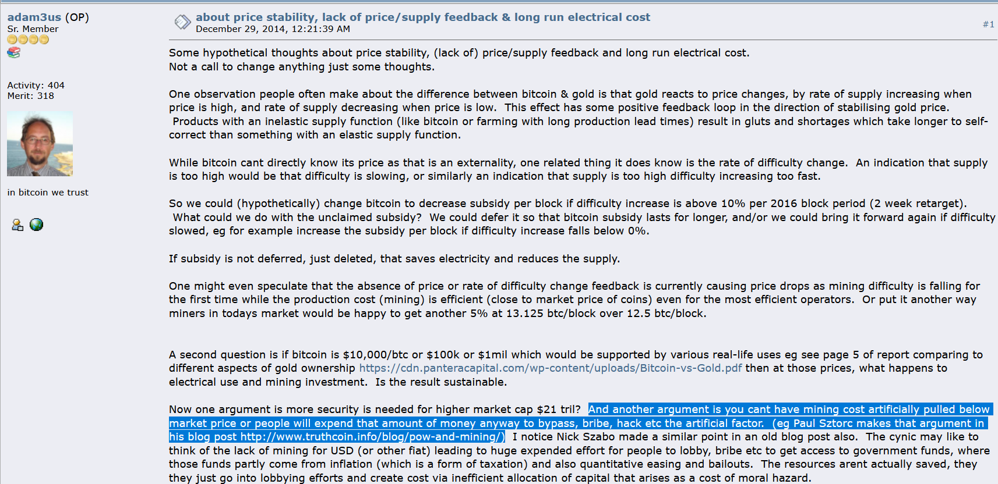
My Big Break
Adam Back links to my blog – Dec 2014

Slide 8
Since Then
Technical Talks
Scaling Bitcoin 1 2 & 3 -- Program Committee for #4
TabConf every year – keynoted in 2018
Bitcoin Wednesday – all around the globe (Toronto, Chicago, Amsterdam, etc)
BitDevs – Summer 2014 (NYC), Austin (May 2018), Miami (covid), etc
Consensus Construct (2017, 2019); American Banker ; Qcon London (2017)
Bitcoin Miami 2019/2021/2022/2023 & Amsterdam & Asia
Countless Podcasts – see truthcoin.info/rss/
Drivechain – Nov 2015 -- BIPs 300/301 – drivechain.info
Dec 2022 -- Raised $3M to start LayerTwo Labs & help Bitcoiners dominate the world.
We have WORKING zCash sidechain, Ethereum sidechain, largeblock-scaling L2 sidechain “Thunder”, Namecoin sidechain, Bit-Asset sidechain. With GUI for all operating systems.
Try it yourself! – LayerTwoLabs.com/download

Slide 9
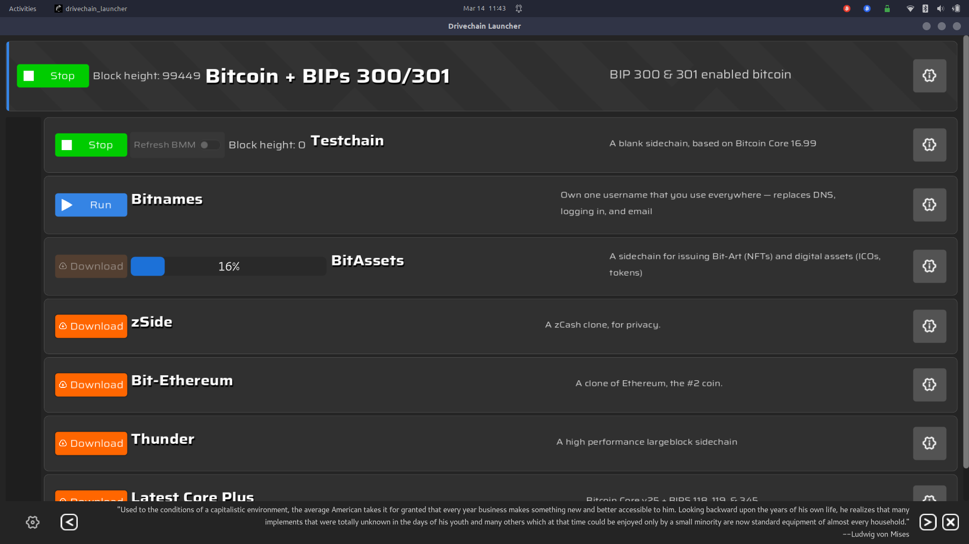
Drivechain Screenshot
But – if it succeeds – if this idea takes off, then people all around the world, will turn to this Bitcoin L2 for answers to all of life’s important questions.

Slide 10
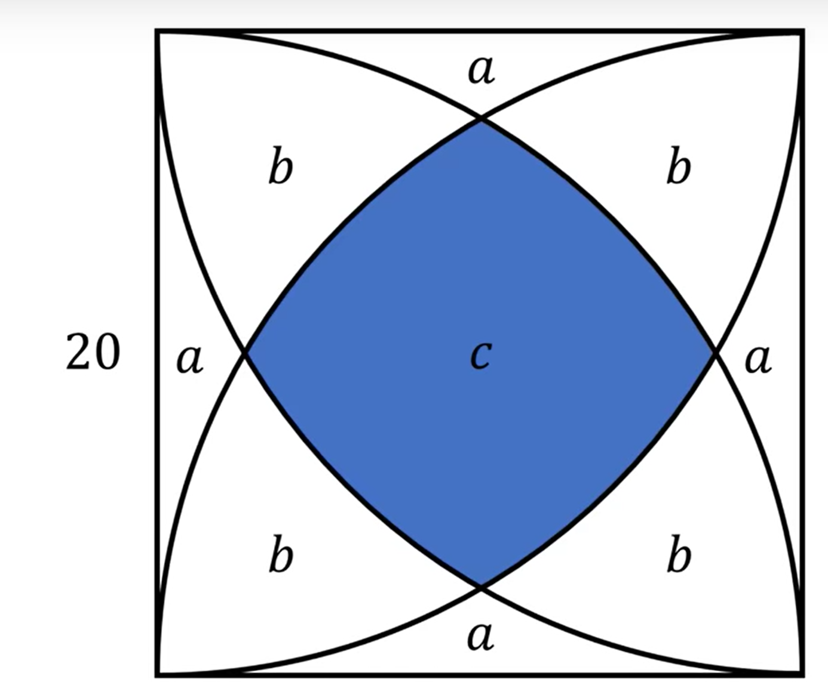
What is the shaded area?

Slide 11
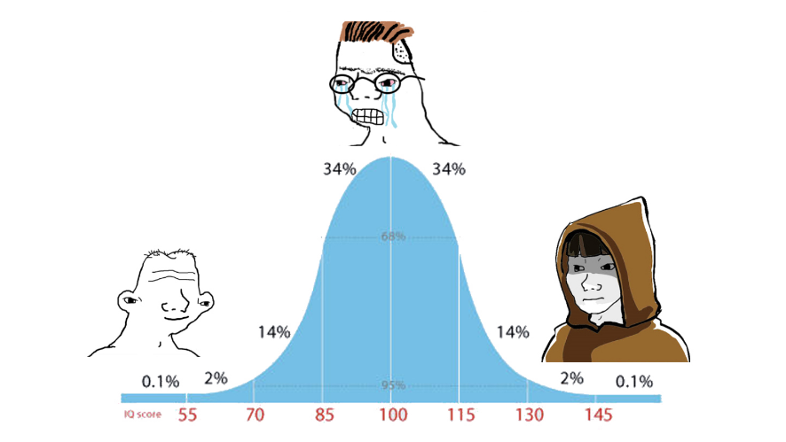
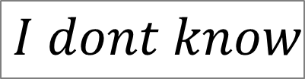

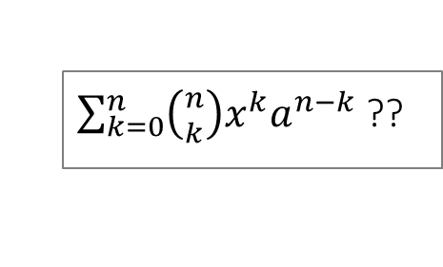
What is the shaded area?
$\sum_{k=0}^{n}{\left({n \atop k}\right)x^{k}a^{n−k}}$??
$$I dont know$$
$$I dont know$$

Slide 12
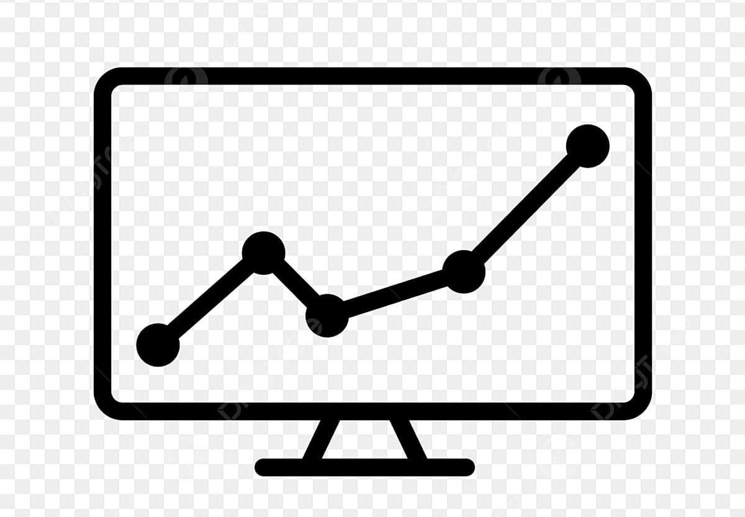
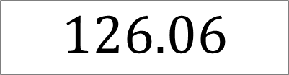
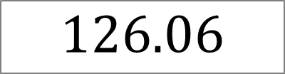
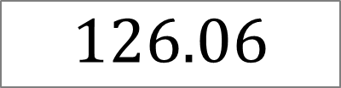
What is the shaded area?
$$126.06$$
$$126.06$$
$$126.06$$
126.06

Slide 13
What is the shaded area?
$$126.06$$
$$126.06$$
$$126.06$$
The smart money is betting on 126.06
The smart money is betting on 126.06
The smart money is betting on 126.06
126.06

Slide 14
Controversial Questions
Is the earth getting warmer?
If we fire our CEO next year, would the stock price increase or decrease?
If David Bailey mints an ordinal next year, what would it be worth?
Will Trump win the 2024 USA election?
Should Trump win the next USA election?

Slide 15
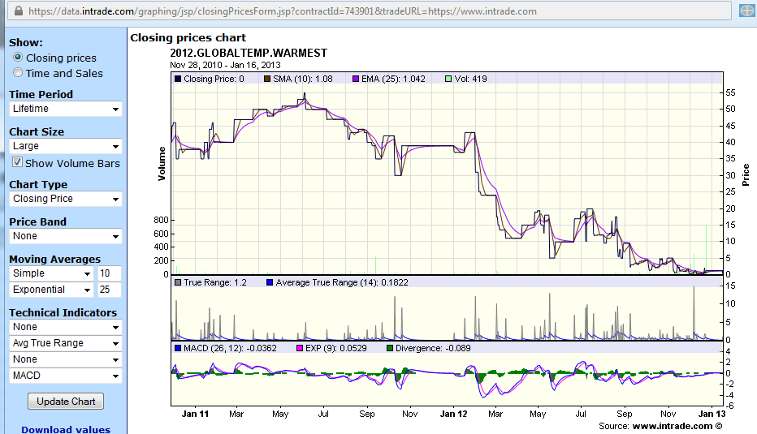
Event Derivative (InTrade.com) - 2012 global warming (also called a “prediction market”)
Worth $100 if 2012 is the warmest year on record.
Ran from Jan 2011 to End of 2012

Slide 16
Controversial Questions
Is the earth getting warmer?
If we fire our CEO next year, would the stock price increase or decrease?
If David Bailey mints an ordinal next year, what would it be worth?
Will Trump win the 2024 USA election?
Should Trump win the next USA election?

Slide 17
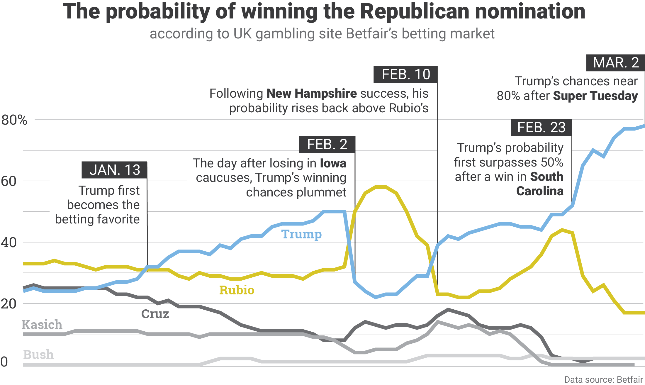
Betting on who will win
Graphic from NationalJournal.com

Slide 18
Betting on who will win
No
Graphic from NationalJournal.com

Slide 19
Controversial Questions
Is the earth getting warmer?
If we fire our CEO next year, would the stock price increase or decrease?
If David Bailey mints an ordinal next year, what would it be worth?
Will Trump win the 2024 USA election?
Should Trump win the next USA election?

Slide 20
The Voter’s Values
What will the Unemployment Rate be?
How much will the government spend, and on what?
What will the country’s GDP be?
How much will everyone earn ($)?
What will CO2 emissions be?
How many people will die? Will there be any dangerous wars? (If there are, will we win those?)
Trump wins 2024 election = 55% likely
Unemployment Rate in 2026 = likely to be 15%

Slide 21
Nine Slides on Multivariate Betting

Slide 22
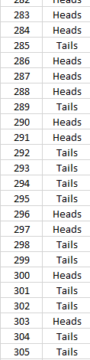
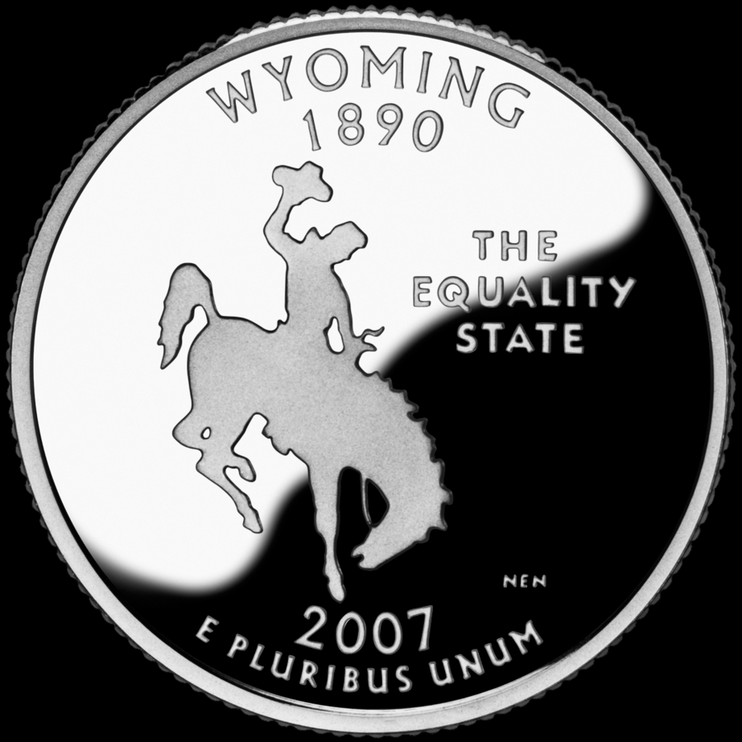
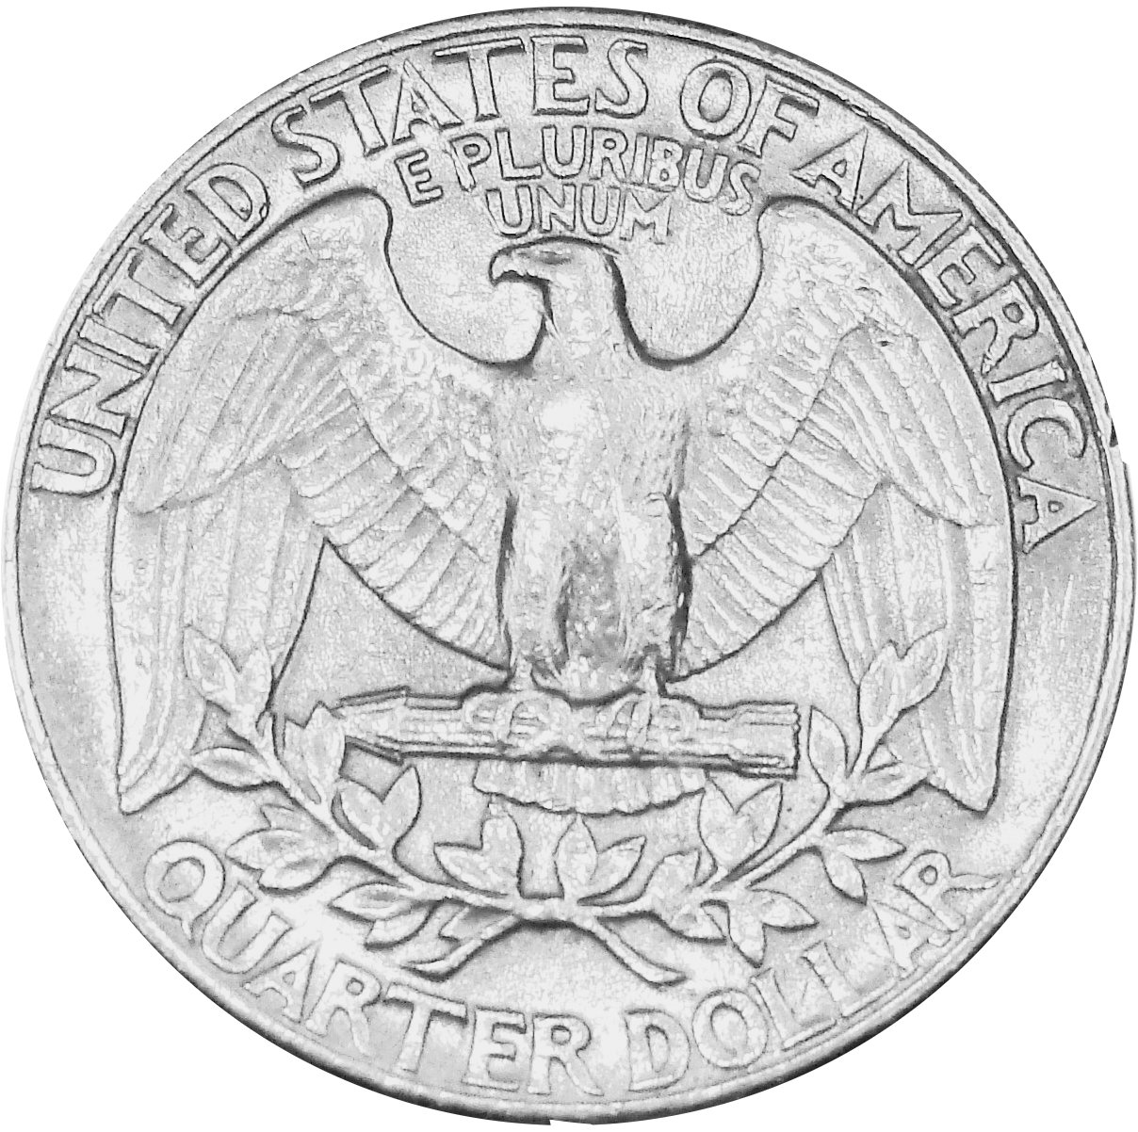
(1/9) Probability -- Review
Some future event (coin flip).
Heads has 50% likelihood.
Tails has 50% likelihood.
H | .50
T | .50
Coin Flip #303
1.00
Total probabilities add up to 100%.
Notes:
I need to explain conditional probability, in order to continue explaining this project. So I will now do that across nine slides. But the first two are super-easy, and four of them are really just one slide, broken into four pieces. So, this “math part” will be over soon, don’t worry.
Here, on the left I have a column of coin-flip events. We’re describing the behavior of the three-hundred-and-third coin flip. We don’t know what will happen on that flip, but we can nonetheless fill in the probabilities in this table. Heads and Tails are equally likely so its 50-50.

Slide 23
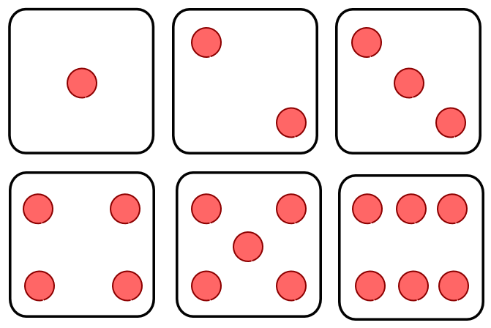
(2/9) Probability -- Review
Some future event (dice roll).
(1) | 1/6
(2) | 1/6
(3) | 1/6
(4) | 1/6
(5) | 1/6
(6) | 1/6
Each outcome has one-sixth likelihood.
Dice Roll #1190
1.00
Notes:
Now, this slide is the same as the previous one. But it has a dice roll instead of a coin toss. Each side of the dice is equally likely to come up, each has one-sixth probability.

Slide 24
(3/9) – Two Random Events, Taken Together
Dice Roll #1190
Coin Flip #303
 | (1) | (2) | (3) | (4) | (5) | (6)
H | 1/12 | 1/12 | 1/12 | 1/12 | 1/12 | 1/12
T | 1/12 | 1/12 | 1/12 | 1/12 | 1/12 | 1/12
“margin”
.50 | .50
.50
.50
1/6 | 1/6 | 1/6 | 1/6 | 1/6 | 1/6
1.00
Rolling a two AND flipping a tails.
“margin”
Rolling a two.
Flipping a tails.
Notes:
Now here we go, three of seven… This example, is the previous two examples, smushed together. We have the coin flip in green along the left vertical edge of the table. We have the dice roll across the top horizonal edge. I’ve circled some probabilities in red. The probability that two will be rolled, is one-sixth. The probably that a tail will be flipped, is one-half. Those are called marginal probabilities because they’re written in the margin, so to speak. The probability that BOTH a two will be rolled, and a tail will be flipped, is shown here as one-twelfth.

Slide 25
(4/9) -- Conditional Probability Taught Quickly
Coin Flip #304
 | H | T
H | .25 | .25
T | .25 | .25
Coin Flip #305
Two coins.
Coin Flip #304
 | H | T
H | ? | ?
T | ? | ?
The same event
(#304 x #304)
(not realistic)!
Coin Flip #304
 | 1 | 2 | 3 | 4 | 5 | 6
1 | ? | ? | ? | ? | ? | ?
2 | ? | ? | ? | ? | ? | ?
3 | ? | ? | ? | ? | ? | ?
4 | ? | ? | ? | ? | ? | ?
5 | ? | ? | ? | ? | ? | ?
6 | ? | ? | ? | ? | ? | ?
The same dice.
Notes:
Now, we’ll talk about relationships among events. Let me draw a contrast between these two blue tables here. Both are about unknown future coin flips. The top table considers coinflip three-zero-four, in blue across the top. And it considers flip number three-ohh-five, in red across the left side. Each cell will occur with probability point two five, which is what I have indicated here. The second table does something extremely unrealistic, and only useful for teaching purposes. It plots coin-flip #304 against itself. Again, in the real world, this would never happen. But, if it did happen, what probabilities would we write in this table?

Slide 26
(5/9) -- Conditional Probability Taught Quickly
Coin Flip #304
 | H | T
H | .25 | .25
T | .25 | .25
Coin Flip #305
Two coins.
Coin Flip #304
 | H | T
H | .50 | 0
T | 0 | .50
The same event
(#304 x #304)
(not realistic)!
Coin Flip #304
 | 1 | 2 | 3 | 4 | 5 | 6
1 | ? | ? | ? | ? | ? | ?
2 | ? | ? | ? | ? | ? | ?
3 | ? | ? | ? | ? | ? | ?
4 | ? | ? | ? | ? | ? | ?
5 | ? | ? | ? | ? | ? | ?
6 | ? | ? | ? | ? | ? | ?
The same dice.
Notes:
Here’s the answer. Coin flip three-zero-four, can either be heads or tails. But it has to be one or the other. So we zero out everything that’s impossible.

Slide 27
(6/8) -- Conditional Probability Taught Quickly
Coin Flip #304
 | H | T
H | .25 | .25
T | .25 | .25
Coin Flip #305
Two coins.
Coin Flip #304
 | H | T
H | .50 | 0
T | 0 | .50
The same event
(#304 x #304)
(not realistic)!
Coin Flip #304
Dice Roll #4011
 | 1 | 2 | 3 | 4 | 5 | 6
1 | ? | ? | ? | ? | ? | ?
2 | ? | ? | ? | ? | ? | ?
3 | ? | ? | ? | ? | ? | ?
4 | ? | ? | ? | ? | ? | ?
5 | ? | ? | ? | ? | ? | ?
6 | ? | ? | ? | ? | ? | ?
The same dice roll
(again, unrealistic!).
Dice Roll #4011
Notes:
Almost done teaching conditional probability. This time with dice instead of coins.
Same dice roll, #4011. We don’t know what it is.

Slide 28
(7/9) -- Conditional Probability Taught Quickly
Coin Flip #304
 | H | T
H | .25 | .25
T | .25 | .25
Coin Flip #305
Two coins.
Coin Flip #304
 | H | T
H | .50 | 0
T | 0 | .50
The same event
(#304 x #304)
(not realistic)!
Coin Flip #304
Dice Roll #4011
 | 1 | 2 | 3 | 4 | 5 | 6
1 | (1/6) | 0 | 0 | 0 | 0 | 0
2 | 0 | (1/6) | 0 | 0 | 0 | 0
3 | 0 | 0 | (1/6) | 0 | 0 | 0
4 | 0 | 0 | 0 | (1/6) | 0 | 0
5 | 0 | 0 | 0 | 0 | (1/6) | 0
6 | 0 | 0 | 0 | 0 | 0 | (1/6)
The same dice roll
(again, unrealistic!).
Dice Roll #4011
Notes:
It’s one-sixth, across the diagonal, and the rest zeros.

Slide 29
(8/9) “Clumping” = Related
Coin Flip #304
 | H | T
H | .50 | 0
T | 0 | .50
Coin Flip #304
Will Candidate X be Elected?
 | Yes | No
Yes | .50 | 0
No | 0 | .50
Will American Voters Earn Higher Incomes?

Slide 30
(9/9) Synthesis – Just Four Different Event-Derivative Markets
Will Candidate X be Elected?
 | Yes | No
Yes | .50 | 0
No | 0 | .50
Will American Voters Earn Higher Incomes?

Slide 31
Basic Arithmetic
“Good Economy” in 2024
( <5% Unemployment )?
“Good Economy” (Conditional Likelihood)
Yes
No
Someone Else
0.0005 | 0.0005 | 0.001
.42 | .19 | .61
.23 | .15 | .38
.00 | .009 | .009
.6505 | .3495
50%
31%
39%
100%
Nov 2024 Election Winner
Biden
Trump
Elon Musk

Slide 32
Voter Sees on Election Morning (For Example):
Average, over years 2024-2028… | Biden | Trump
Total Government Spending ($/person) | $12,568 | $10,407
Total Money Earned by all Citizens ($ billions) | $16,427 | $17,009
Total Deaths, all causes (thousands of people) | 2,917 | 2,901
better
Slightly better
basically the same

Slide 33
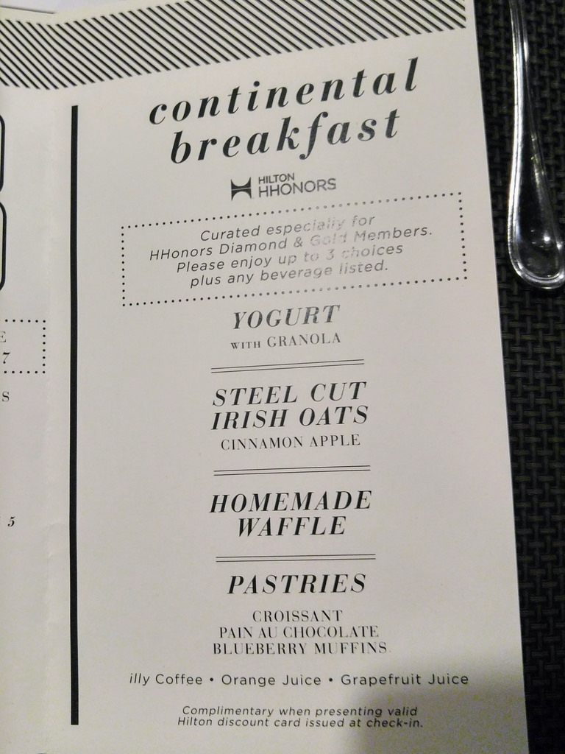

Slide 34
It also works for…
Which CEO would most increase our stock price?
Which FED Policy would most increase nGDP?
Which laws would most increase local land values?
Which policies would most decrease violent crime?
Which hardfork to BTC would most increase the USD/BTC price? (if any)
Works better on “the big questions” – more people, more disagreement, more information to unite.

Slide 35
Rot From Above: Who controls what?
Informed or otherwise…
CEO / President / Senator / Editor-in-Chief
Group Opinion
C-Suite / Cabinet /
Coordinators / Reviewers
Managers / Directors /
Aides / Researchers
Shareholders /
Voters / Colleagues
Staff / Research Assistants
Result
Satisfaction of: Customers / Citizens / Readers
Notes:
Ownership and Control = efficiency

Slide 36

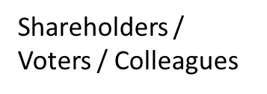
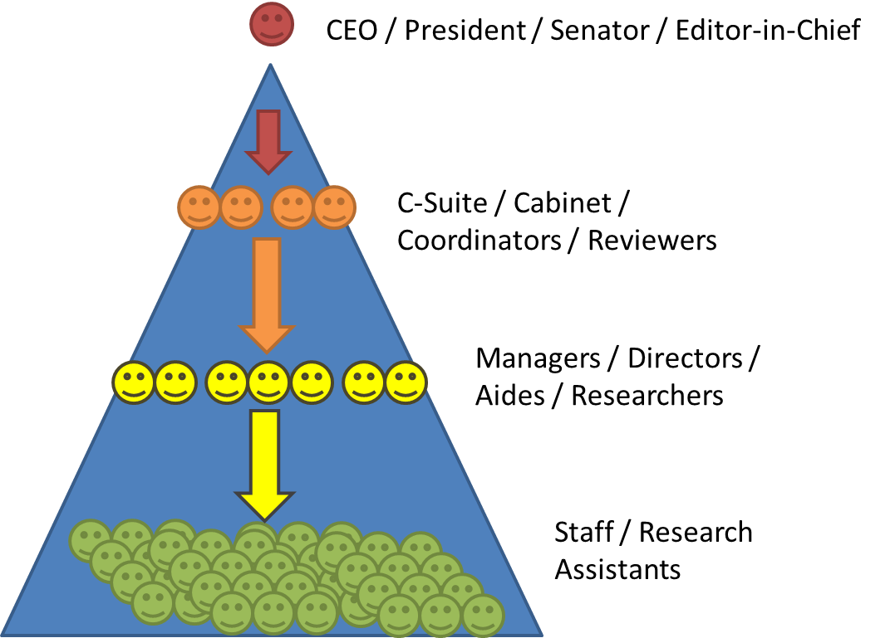
Ownership and Control: The Weakest Link
How to we combine the many preferences of this group into one request?
Do we each have to monitor the leader’s work? If not, who do we trust (and why)?
If I don’t like this leader, how do I find out if others agree? How do we fire the leader?
Bad
Can easily…
…make requests.
…observe work/results.
…fire insubordinates.
Good
Notes:
I don’t see it that way.

Slide 37
What does this have to do with Bitcoin?
The whole process can be on a special L2 of Bitcoin
This includes:
The creation of Questions and Markets
The P2P Oracle algorithm that allows the blockchain to determine what-actually-happened (ie, whether Trump won or not)
Market Scoring rules so that markets never run out of liquidity
Trades
Ambitious project!
BitcoinHivemind.com

Slide 38
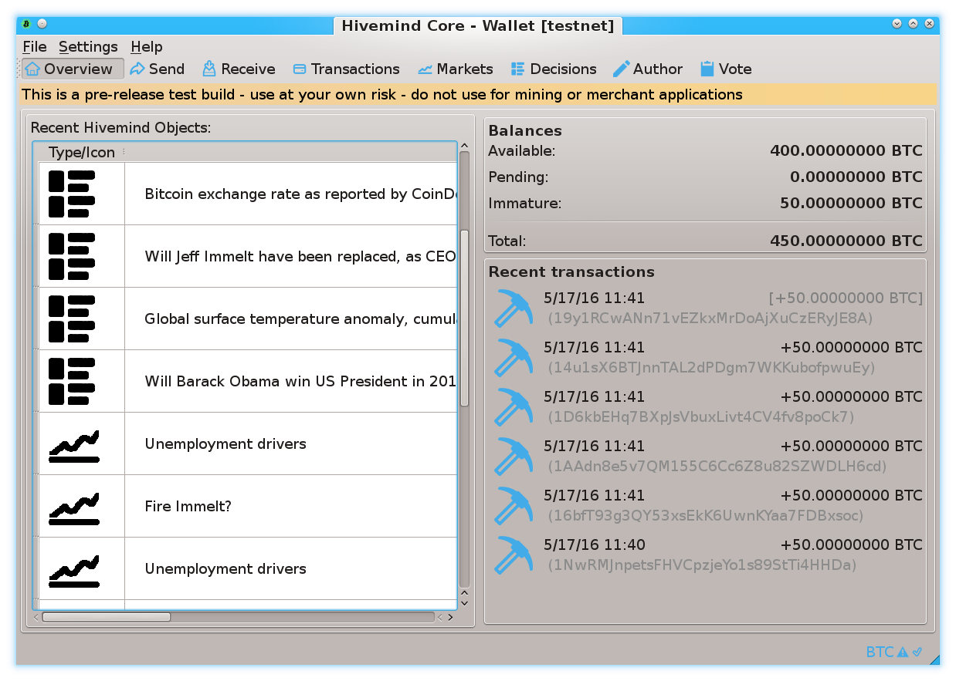

Slide 39
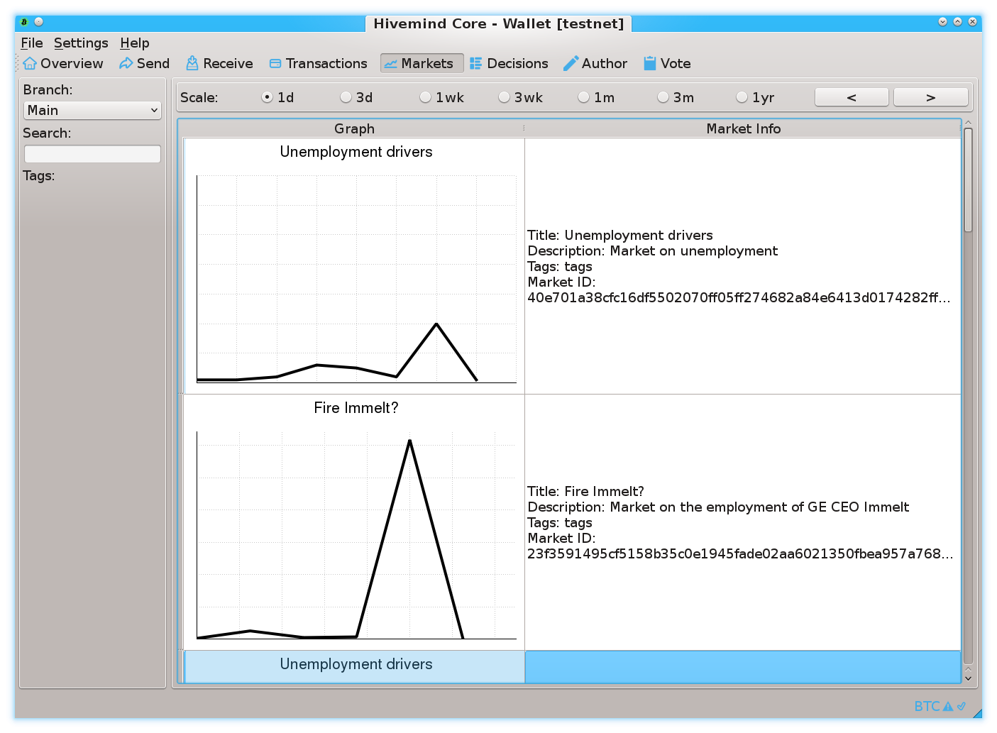

Slide 40
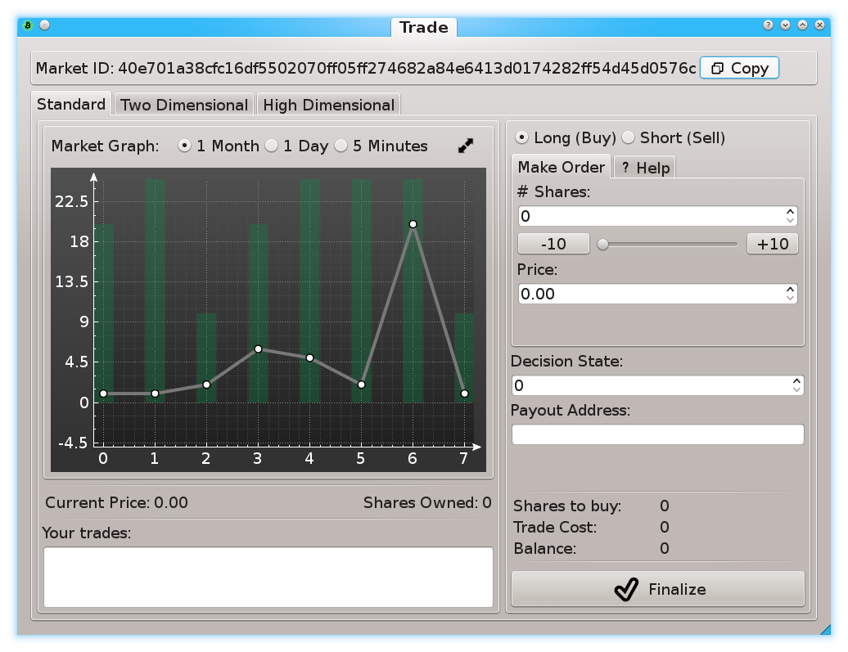

Slide 41
Final Slide – External Links
Paul Sztorc, CEO LayerTwo Labs
@truthcoin on Twitter
@psztorc on Telegram
LayerTwoLabs.com
Drivechain.info
T.me/DcInsiders – Drivechain Telegram Group
BitcoinHivemind.com – Bitcoin Prediction Markets
Thank You!

Slide 42
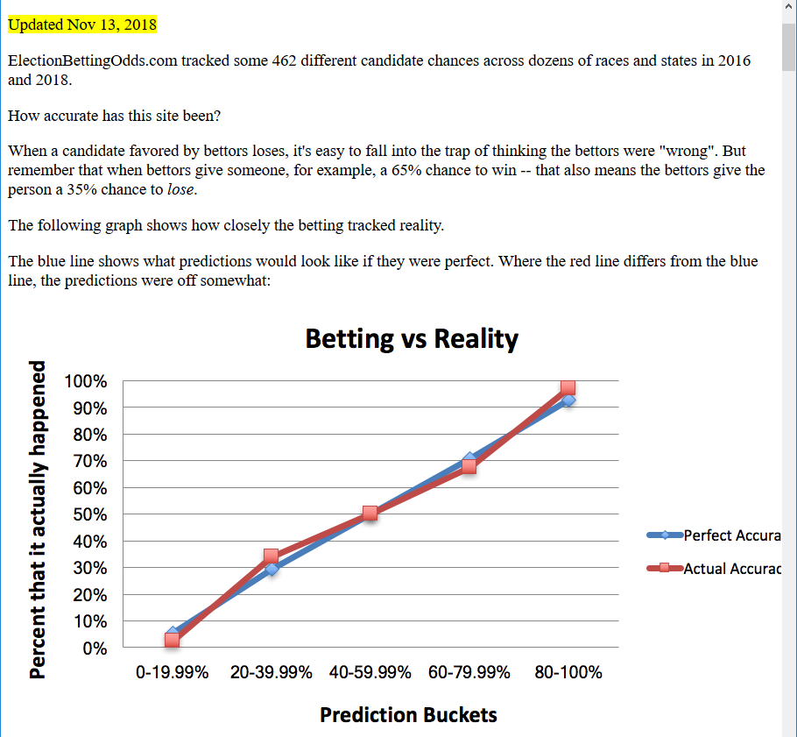

Slide 43
“Ramp it up” Lowbrow → Highbrow
Sports (SuperBowl, March Madness)
E-Sports
Arts (Oscars, Tonys).

Slide 44
Last Slide: Here, Rhetoric Is Irrelevant
As this idea becomes influential, politicians will start competing on these metrics.
But in order for their numbers to go up, they’ll need to actually hit the target in reality.
For example: Politician could announce that they want everyone to die, and plan to kill everyone, but unless traders believe that the politician can follow through with this plan, the ‘deaths’ numbers won’t budget an inch.
Layperson already knows that politicians are liars. (Will prefer this.)

