Slide 1
JCL – Java Component Library
JCL & BitcoinJ
A bit of history of JCL & BitcoinJ evolution
JCL-Script is added:
JCL-Base
JCL-Net
JCL-Script
JCL
Extension from BitcoinJ
The core of BNA is refactored as JCL
JCL-Net
BNA and HeaderSV projects are refactored to use JCL
JCL-Net
JCL-Base is added:
JCL-Base
JCL-Net
MASTER Branch
JCL-Base
JCL-Net
Extension from BitcoinJ
BitcoinJ
BitcoinJ-sv forked from original B¡bitcoinJ
Changes from Hardfork in 2018 added
Changes to make it Genesis compatible
MASTER Branch
Stripped off the domain clases, dependency to JCL added

Slide 2
JCL – Java Component Library
JCL releases
A multi-module library, different modules are implement/added on demand.
Used now by BNA, HeaderSV
JCL-Base
JCL-Net
JCL-Script
Not used at the moment in a real Project.
It’s expected to be used from now moving forward, replacing the Script from BitcoinJ.
Used now by BNA, HeaderSV

Slide 3
JCL – Java Component Library
JCL programming paradigm
All modules share a common paradigm so developing seems similar in all of them.
JCL-Base
TxOutput txOutput = TxOutput.builder()
.value(Coin.valueOf(10))
.scriptBytes(new byte[10])
.build();
JCL-Net
P2P p2p = P2P.builder("testing").build(); p2p.EVENTS.PEERS.CONNECTED.forEach(System.out::println); p2p.EVENTS.PEERS.DISCONNECTED.forEach(System.out::println);
p2p.start();
…
p2p.stop();
JCL-Script
String scriptContent = "2 2 ADD 4 EQUALS”;
Script script = Script.builder(scriptContent).build();
ScriptContext scriptContext = ScriptContext.builder().build()
ScriptInterpreter interpreter = ScriptInterpreter.builder("testing").build();
ScriptResult scriptResult = interpreter.execute(scriptContext, script);

Slide 4
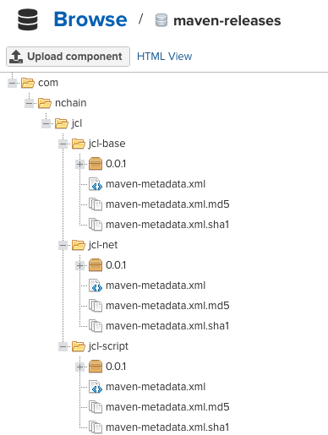
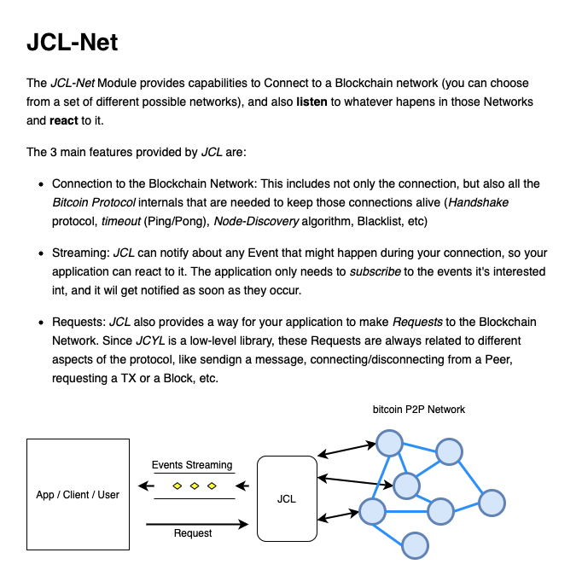
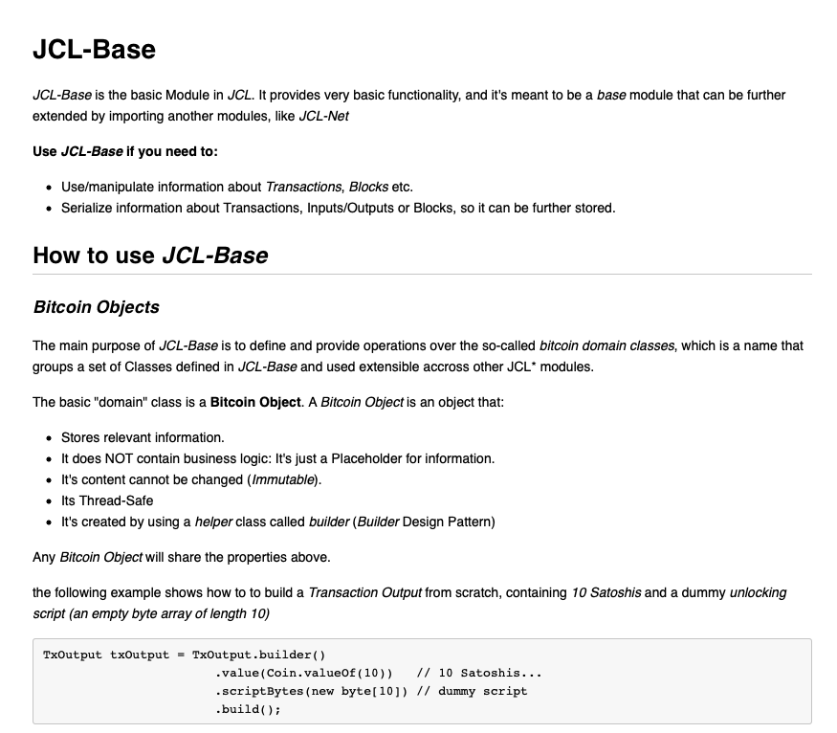
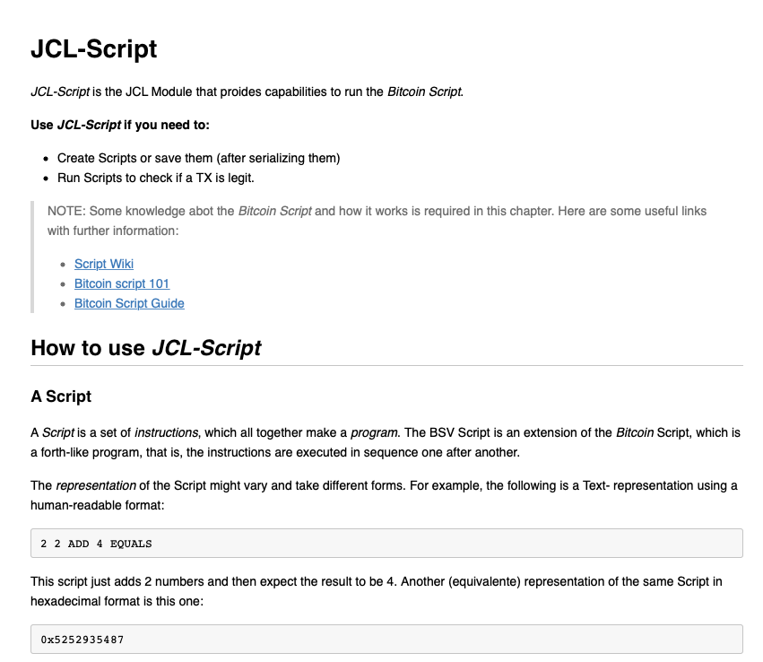
JCL – Java Component Library
JCL releases
The JCL Modules are published in the nChain Nexus repository
Each Module is published along with documentation

