Slide 1
1
2
3
4
5
6
7
8
9
10
ATCGATCGATCG
ATCGATCGATCG
ATCGATCGATCG
ATCGATCGATCG
ATCGATCGATCG
ATCGATCGATCG
ATCGATCGATCG
ATCGATCGATCG
ATCGATCGATCG
ATCGATCGATCG
ATCGATCGATCG

Slide 2
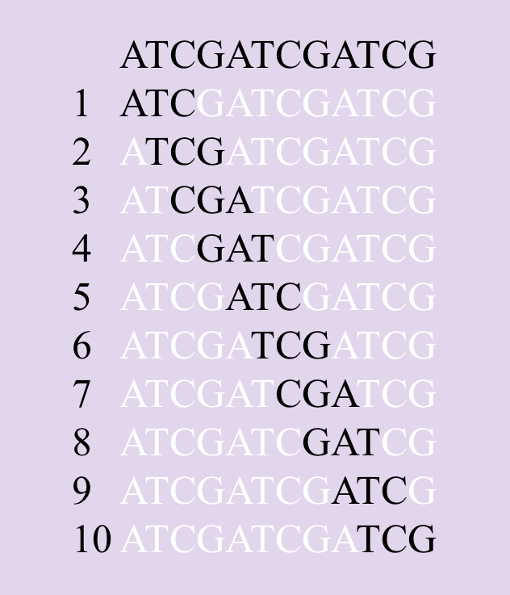
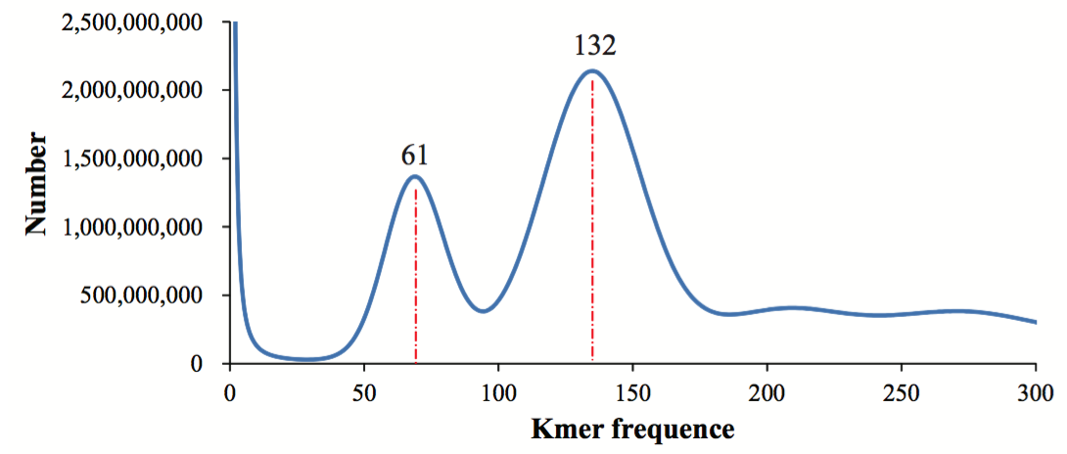
(a)
(b)
(a) For a 12 bp reads, and the k-mer size is 3, so there are total 11 k-mers (12 -3 + 1). Notably, there are theoretically12⁴ k-mers for a 12bp sequence with kmer size as 3.
(b) K-mer analysis of G. montanum Illumina sequences. The heterozygous peak depth is 66 and its corresponding homozygous peak depth is 132. The estimated genome size of G. montanum was calculated as (total number of k-mers) / (homozygous peak) = 543,136,841,648/132 = 4.11 Gb.

Slide 3
(b) K-mer analysis of G. montanum Illumina sequences. The heterozygous peak depth is 66 and its corresponding homozygous peak depth is 132. The estimated genome size of G. montanum was calculated as (total number of k-mers) / (homozygous peak) = 543,136,841,648/132 = 4.11 Gb.

Slide 4
For a 12 bp reads, and the k-mer size is 3, so there are total 10 k-mers (12 -3 + 1). Notably, there are theoretically12⁴ k-mers for a 12bp sequence with kmer size as 3.

