Slide 1
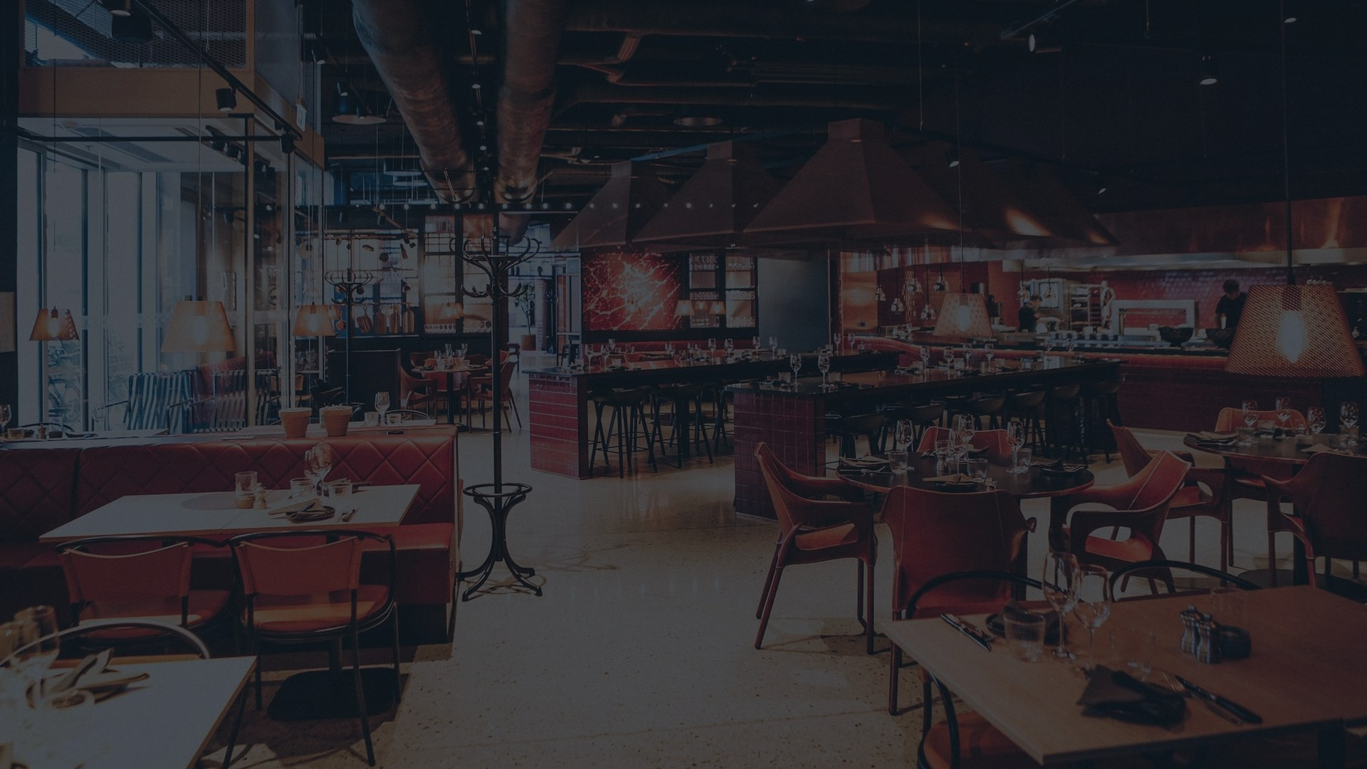
BitePerk
Never miss another booking.
VocoTable — the AI phone host for Australian restaurants.
Made in Sydney · Answers 24/7 · Free first week
Notes:
One line: VocoTable answers your restaurant's phone 24/7 in an Australian voice and books the tables you're missing.

Slide 2
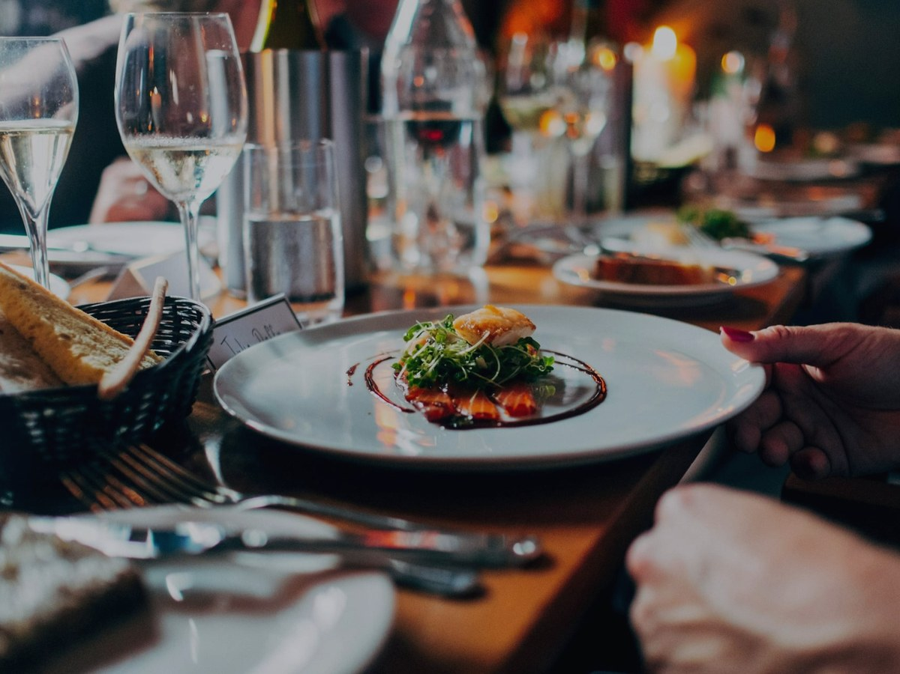
The most expensive
sound in hospitality
is a
ringing phone nobody answers.
•
Friday 7pm — every hand is on the floor
•
10pm — tomorrow's function call rings out
•
The caller doesn't leave a message. They book next door.
Notes:
Ask: on a busy night, who answers your phone? Let them answer — that's the pitch.

Slide 3

Meet Bella.
Your AI phone host — on every call, every hour.
✓
Answers instantly
No voicemail. No hold music. Ever.
✓
Books the table
Straight into your diary — no double-ups.
✓
Sounds local
Warm Australian voice. Suburbs said right.
“Hello! Thanks for calling — how can I help?”
✓
Never guesses
Unsure? She takes a message — your team calls back.
Notes:
Personalise: when someone calls Darbar Cafe, Bella answers as YOUR host — your menu, your rules.

Slide 4
Always on. Instantly there.
24/7
<1 sec
100%
Every call answered
To pick up, every time
Of bookings in your dashboard
Every call transcribed. Every booking visible. You stay in control.
Notes:
Let the numbers land. Pause here.

Slide 5
Nothing changes for your customers.
1
2
3
Keep your number
Bella answers
You see everything
Customers call exactly as they do today.
Books, answers questions, or takes a message.
Live bookings and transcripts in your dashboard.
Setup is a five-minute call forward. No hardware. No apps. Nothing to learn.
Notes:
Reassure: their number stays; customers only notice the phone always gets answered.

Slide 6
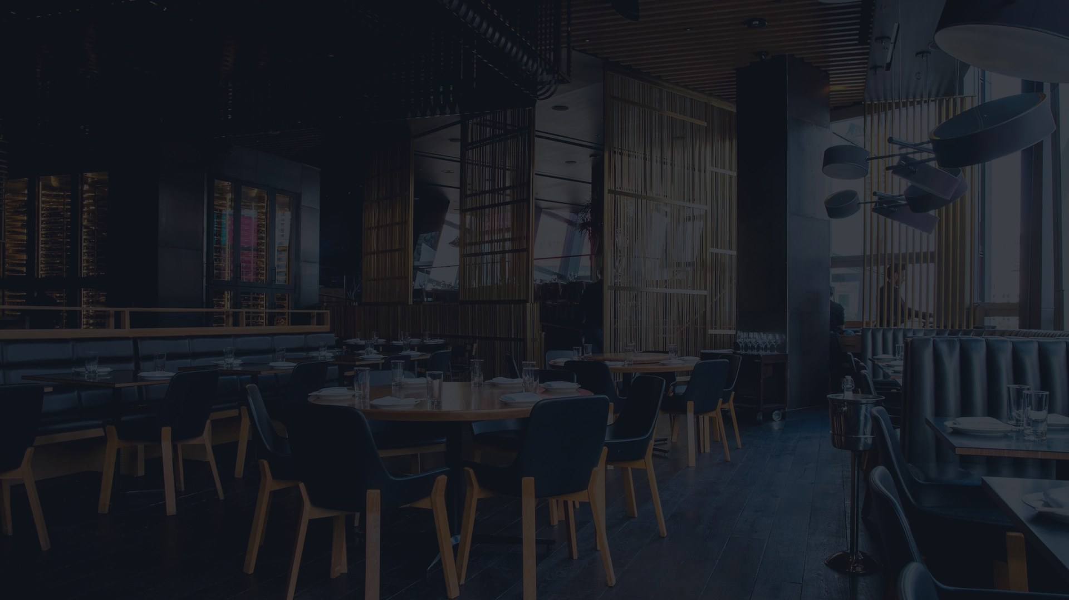
V O C O T A B L E — L I V E D E M O
Don't take our word for it.
Call Bella right now, from your own phone.
(02) 7501 1140
“A table for six tonight at 7:30” “Do you take groups of twenty?” “When do you close on Sundays?”
She answers in under a second. Try to trip her up.
Notes:
THE moment. Hand them the phone. Stay quiet while they listen.

Slide 7
Your venue. Your rules.
✓
Your number — or a new one
✓
Every call — or just missed ones
Keep your line, add a booking line, or run both.
Bella covers everything, or only when your team can't reach the phone.
✓
Your greeting, your rules
✓
Start small, grow later
Group sizes, sittings, specials — Bella follows your house style.
Begin with bookings. Add takeaway orders when ready.
Notes:
Owner in control: Voco adapts to their business, never the other way around.

Slide 8
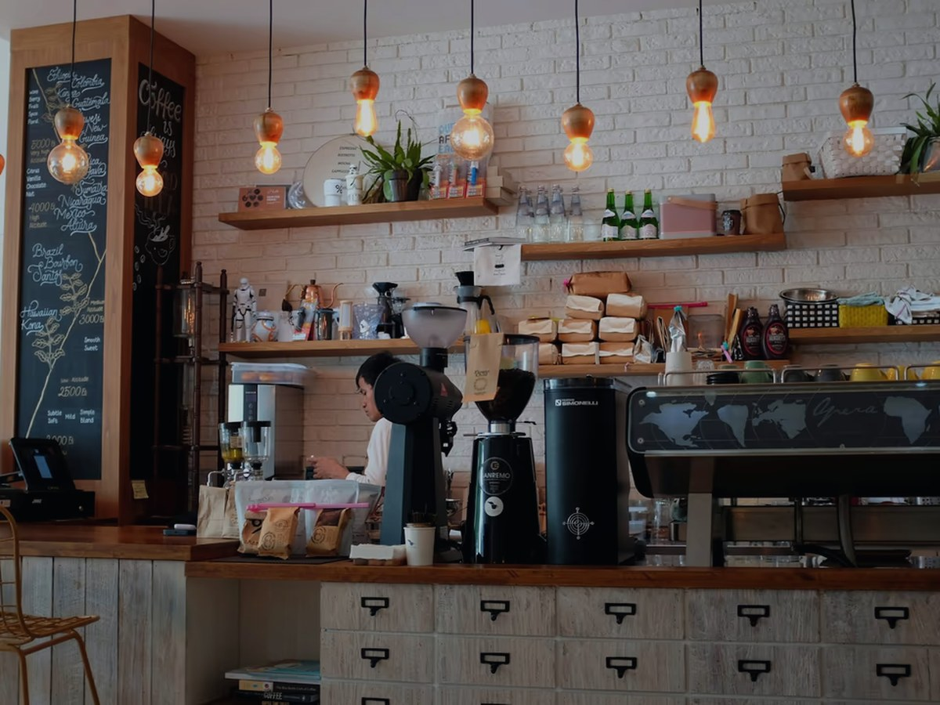
Built in Sydney.
Yours stays yours.
Australian data residency
Calls processed and stored here. Privacy Act compliant.
Sydney support, real humans
People who've answered restaurant phones. 7 days.
No lock-in, ever
Month to month. Leave any time — your data comes with you.
Flat monthly plan · free first week · no per-call fees
Notes:
Price question → flat monthly plan, free week, tailored on the setup call. Never discuss infra costs.

Slide 9
One agent, growing with you.
VocoTable
Bookings — every call answered
LIVE
VocoOrder
Takeaway orders straight to your POS
LIVE
VocoConcierge
Waitlists, confirmations, no-show recovery
IN DEVELOPMENT
VocoDrive
Drive-thru voice for the morning rush
CONCEPT
Same Bella. Same dashboard. One bill.
Notes:
Start with bookings; switch on more later.

Slide 10
Live in days, not months.
DAY 1
DAY 2
DAY 3
We chat
You test
Go live
15 minutes — your hours, menu basics, booking rules.
Call Bella set up as YOUR venue. Tweak until it's right.
Forward the phone. Watch the bookings arrive.
Free first week · month to month · your data stays yours
Notes:
Low risk: free week, no lock-in, days not months.

Slide 11
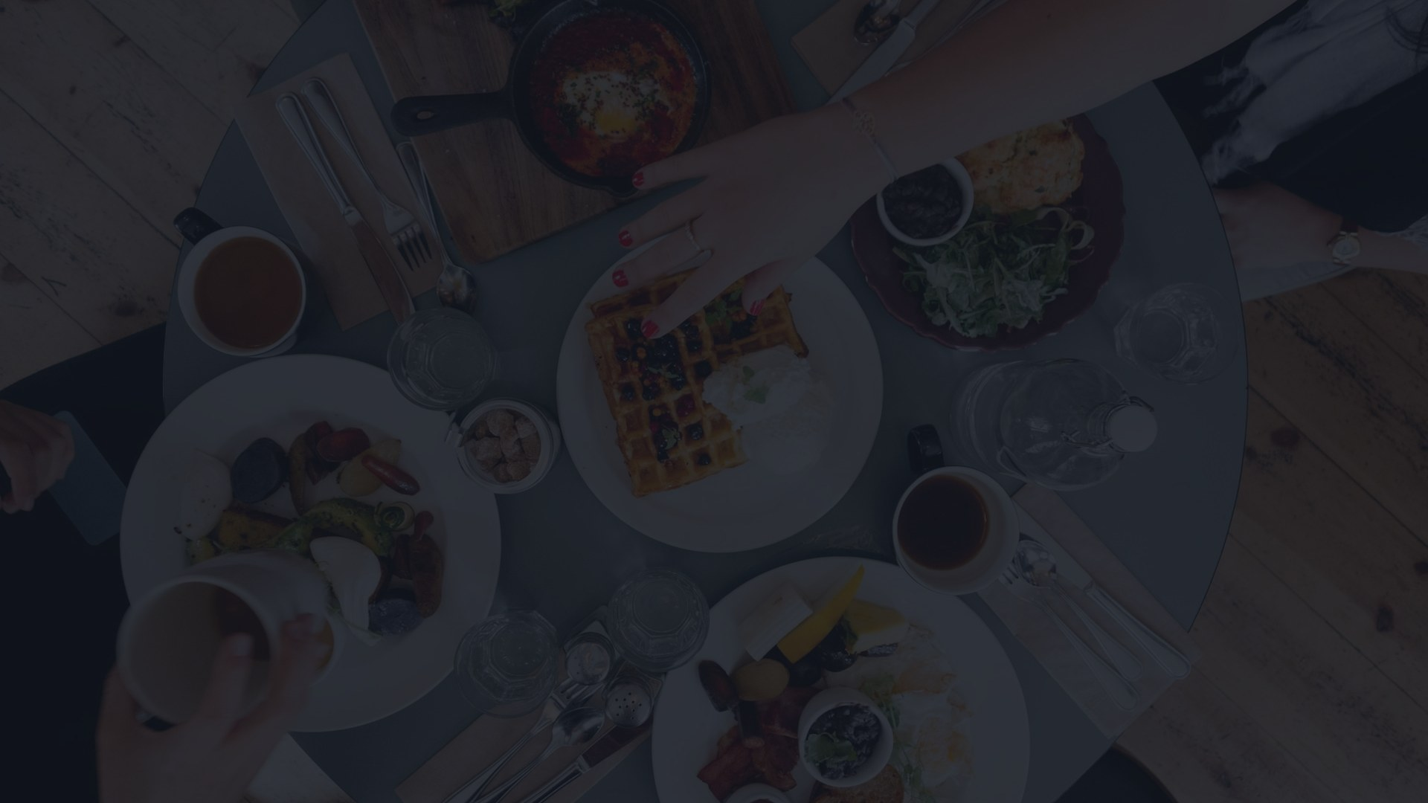
Let's get your phone answered.
Book a free 15-minute setup call. Hear Bella answering as your venue this week.
Sam · BitePerk sam@biteperk.com.au · (02) 5504 1140 · biteperk.com.au
Notes:
Close on the spot: propose the 15-minute setup call and get a time before you leave.

