Slide 1
Powerpoint for Windows : PDF pasted as PDF in Mac Powerpoint

Slide 2
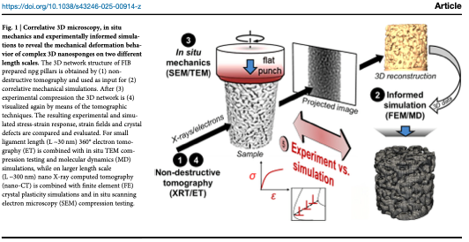
Powerpoint for Windows: PDF pasted as TIFF on Mac

Slide 3
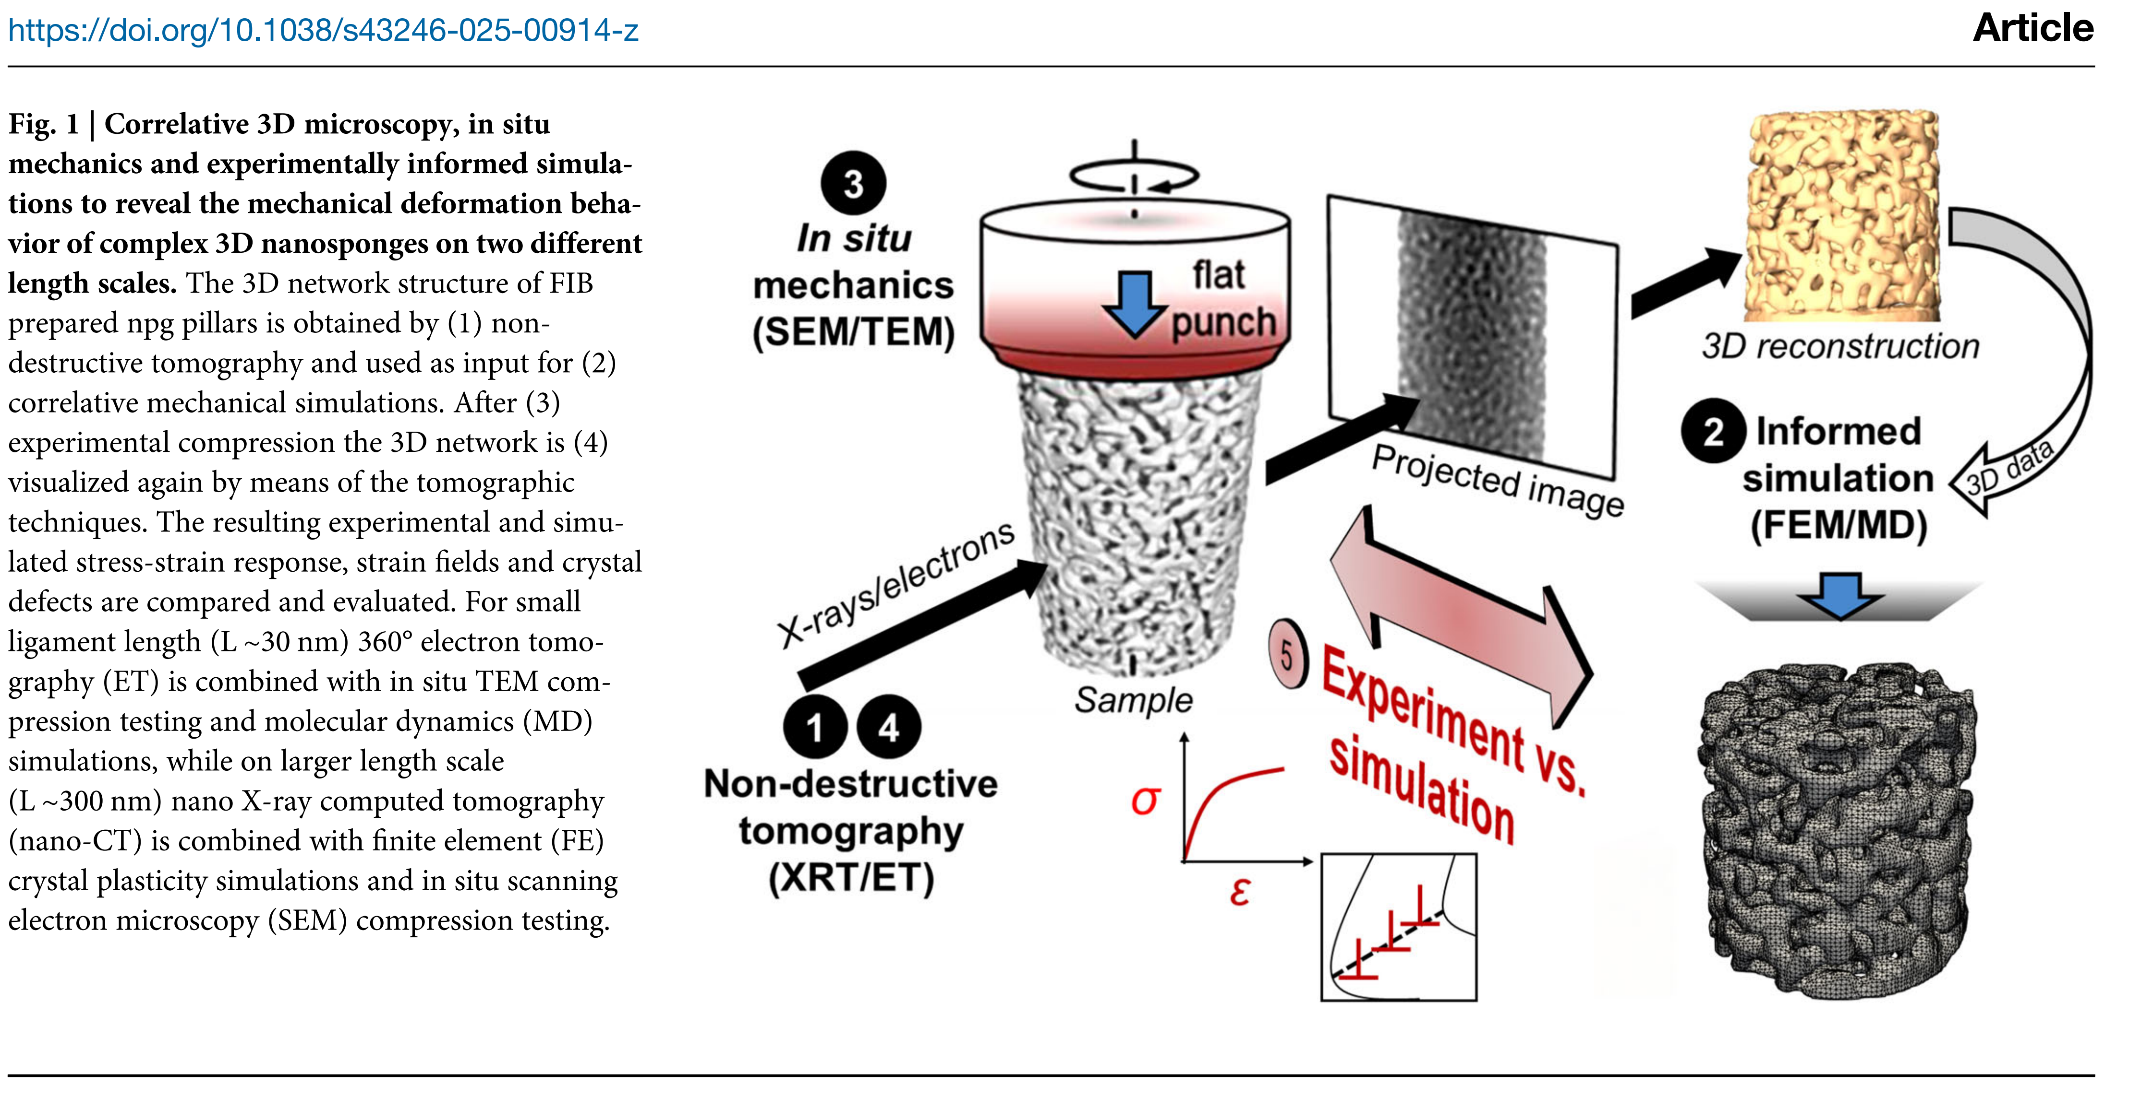
Powerpoint for Windows: PDF pasted with hiresclip on Mac

