Slide 1
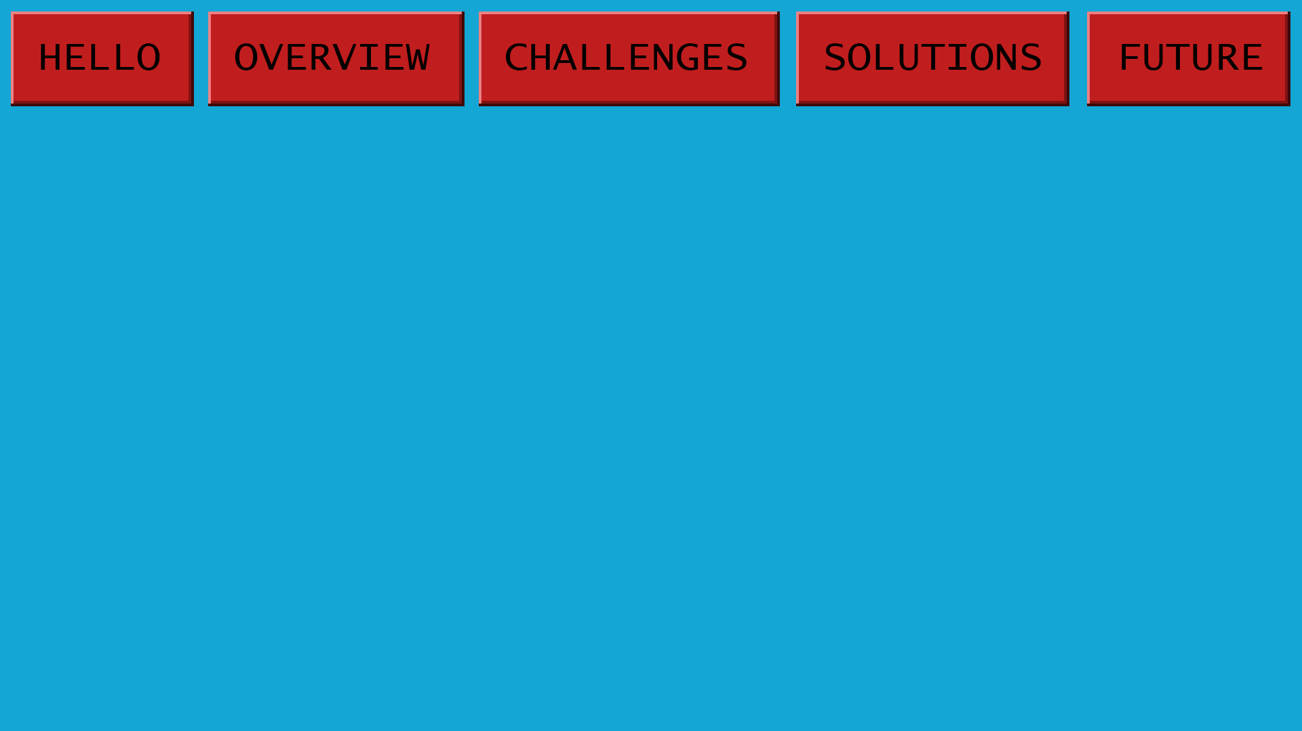
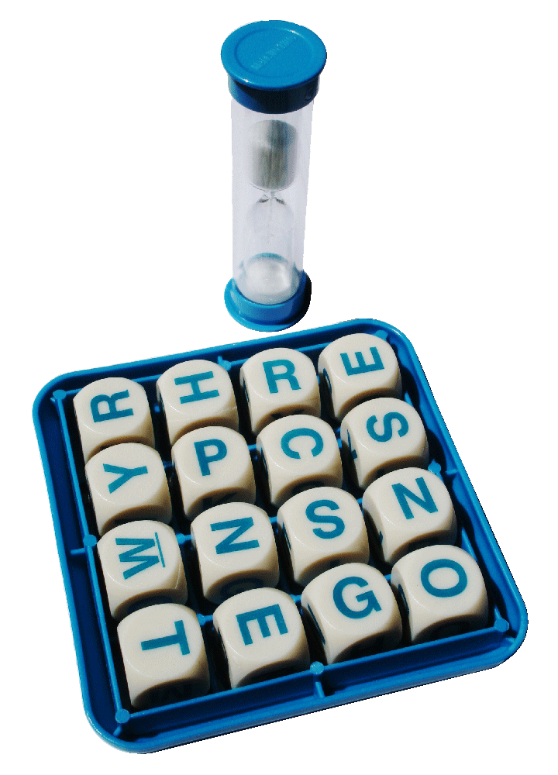
BOGGLE
By
Bertrand Joseph-Paré
&
Norbert Rozmarynowski

Slide 2
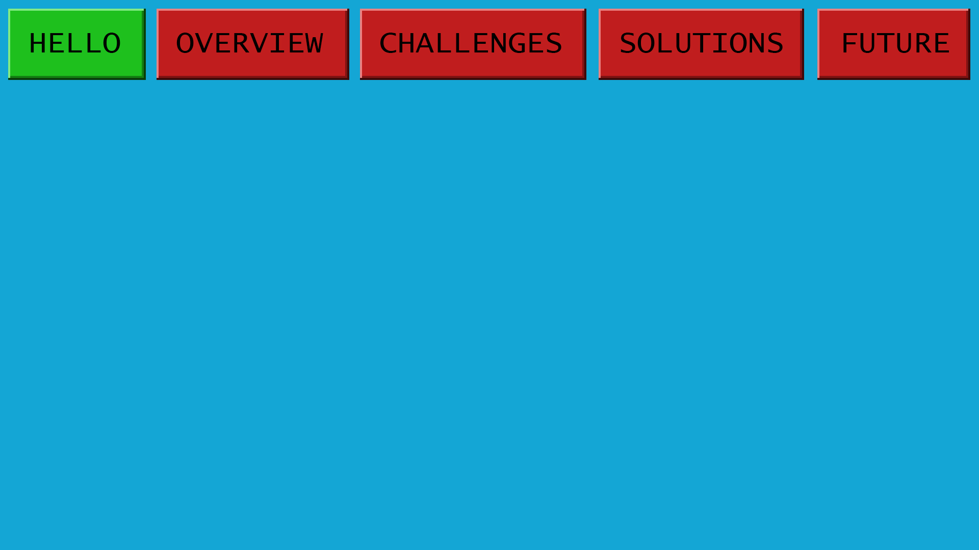
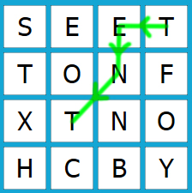
How to play Boggle?
4x4 grid of dice
2 minutes to find maximum words
To be valid, a word must
  Be formed from consecutive tiles
  Not be a proper name
  Not use same tile twice
  Be at least three letters
Here’s “TENT.”
Can you find…
“NOSE” “BOY” “STONE”
“BONNETS” “BONES”

Slide 3
How to play Boggle? (continued)
Scoring based on word length
  3-4 letters > 1 point
  5 letters > 2 points
  6 letters > 3 points
  7 letters > 5 points
  8 letters or more > 11 points
  Built for gameplay, not a solver
Here’s “TENT.”
Can you find…
“NOSE” “BOY” “STONE”
“BONNETS” “SONNET”

Slide 4
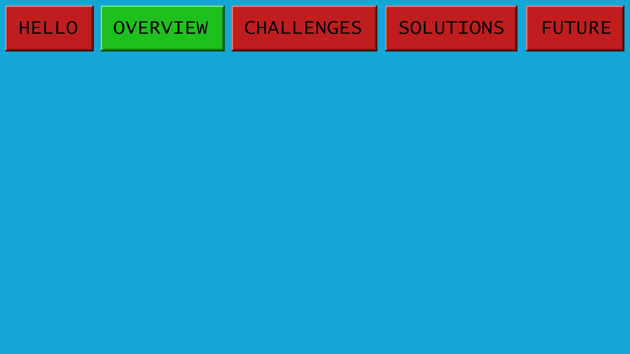
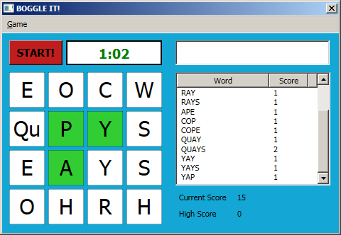
Features
Tile Highlights
  Visualize word as it’s typed
Communicate with player
  Not in dictionary? Red!
  Time’s up? Red!
Remember high scores
  Replay same game

Slide 5
Features (continued)
Click mode
  Play using only keyboard
  Play using only mouse
Timer colors
  Orange at 0:30
  Red at 0:10
  Visual cue – hurry!

Slide 6
Functions
Running tally of score
  Visualize word as it’s typed
High scores
  Show high score of
  Time’s up? Red!
Replay game
  Compete against your friends!
“Qu” tile support
  Q would be useless
  Counts as 2 letters when scoring

Slide 7
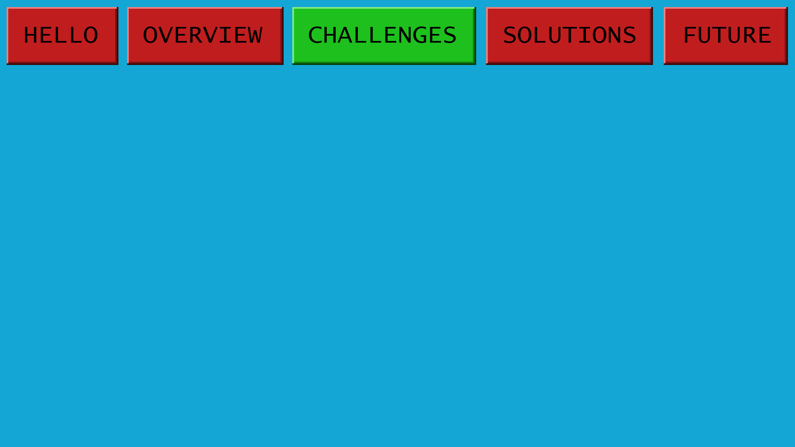
Challenges
UI Design
  Clean UI without distracting graphics
Dictionary
  Which one?
  Will this slow down the game?
“Qu” tile support
  As in the board game
  Q would be useless
  Counts as 2 letters when scoring

Slide 8
Challenges (part two)
Database
  Saving Tables
    Users can replay previous tables and try to beat high scores
      Recording Scores
Challenges
  Saving game to the database when timer ends
  Relationship between Boards and Scores

Slide 9
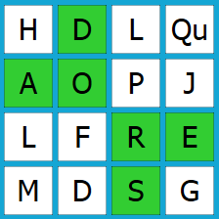
Challenges (part three)
Highlight feature
  Serves two roles
    Validate presence of word in board
    Help user visualize word
Issue One: Word may appear multiple times
Issue Two: Nested statements
  if { if { foreach {} for { foreach { if { for { if { if { (if{})x8 } } } } } } } } foreach {}
Issue Three: Programming “Adjacent”

Slide 10
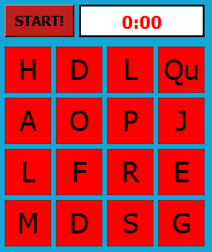
Challenges (part four)
Timers
  Finding the right timer
Fire events at certain times
  30sec: timer becomes orange
  10sec: timer becomes red
  Time’s up?
    Disable all inputs
    All tiles red (visual cue)
    Send score to database

Slide 11
Solutions
Highlight feature
  Serves two roles
    Validate presence of word in board
    Help user visualize word
Issue One: Word may appear multiple times
Issue Two: Nested statements
  if { if { foreach {} for { foreach { if { for { if { if { (if{})x8 } } } } } } } } foreach {}
Issue Three: Programming “Adjacent”

Slide 12
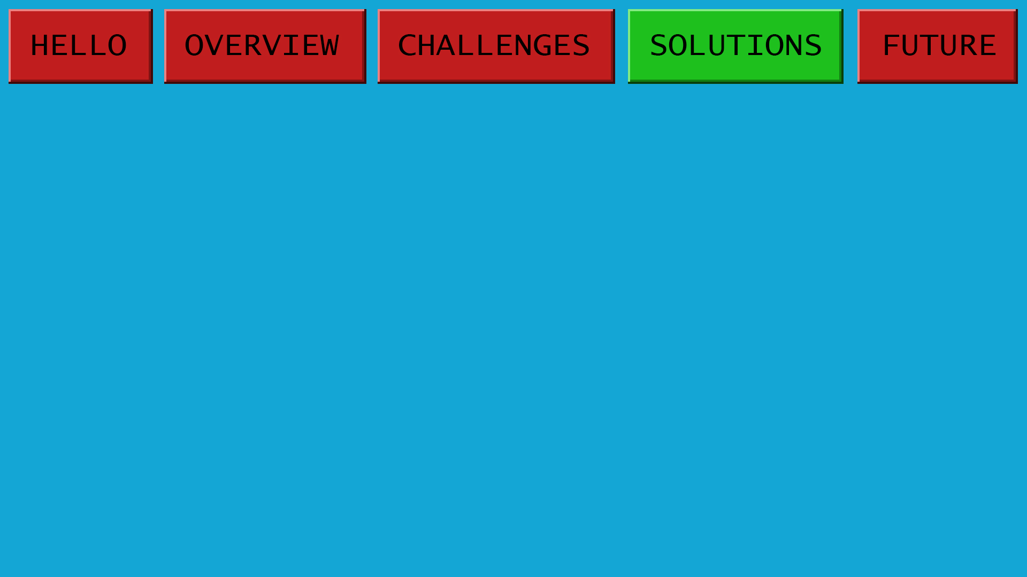
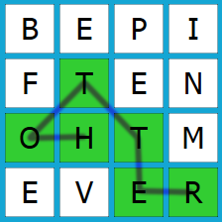
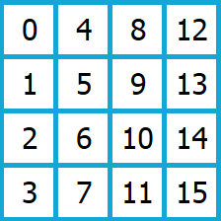
Solutions (the fun part)
The highlight function
  Problem: String occurs multiple times in board
  Solution: Track each one!
Each occurrence of the word is tracked
  Array positions correspond to tiles as numbered
Only displays first match
List<int[]> ListOfWordsFoundAsYouType = new List<int[]>();
int[] WordFound = { 99, 99, 1, 99, 99, 2, 0, 99, 99, 99, 3, 4, 99, 99, 99, 5, };
ListOfWordsFoundAsYouType.Add(WordFound);

Slide 13
Solutions (part three)
Programming adjacent
if (k <= 11) //CHECKS RIGHT
if (k % 4 < 3) //CHECKS DOWN
if (k >= 4) //CHECKS LEFT
if (k % 4 > 0) //CHECKS UP
if ((k >= 4) && (k % 4 > 0)) //CHECKS LEFT UP
if ((k >= 4) && (k % 4 < 3)) //CHECKS LEFT DOWN
if ((k <= 11) && (k % 4 > 0)) //CHECKS RIGHT UP
if ((k <= 11) && (k % 4 < 3)) //CHECKS RIGHT DOWN

Slide 14
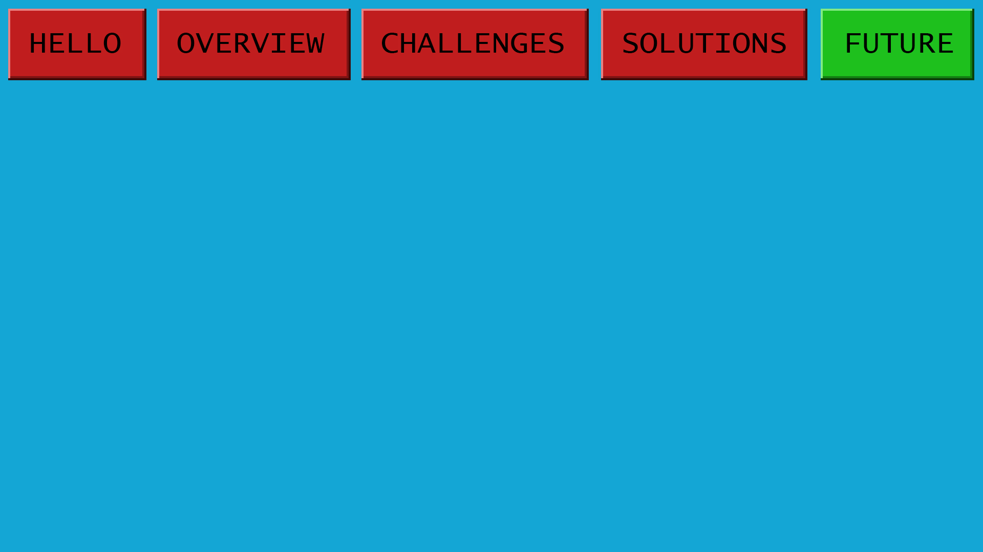
What’s Next?
Phone App
  Click-only mode eases transition
Multi-language
  Allow user to import own dictionary
Scrabble Scoring
  Alternate scoring from Scrabble game
  Hard-to-use letters worth more points
Package for distribution

Slide 15
Summary
All features implemented
  Zero compromise!
Bug free
  We hope.
Ready to play!
  Just ask us for a copy!

