Slide 1
Linear Algebra
A gentle introduction
Linear Algebra has become as basic and as applicable
as calculus, and fortunately it is easier.
--Gilbert Strang, MIT

Slide 2
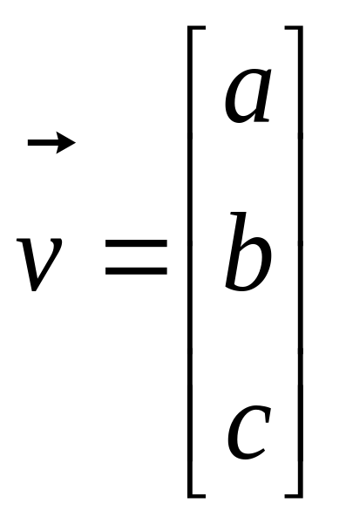
What is a Vector ?
Think of a vector as a directed line segment in N-dimensions! (has “length” and “direction”)
Basic idea: convert geometry in higher dimensions into algebra!
  Once you define a “nice” basis along each dimension: x-, y-, z-axis …
  Vector becomes a 1 x N matrix!
  v = [a b c]^{T}
  Geometry starts to become linear algebra on vectors like v!
y
v
x
Notes:
From 2D to 3D
In 2D,(a,b) is the point, combined with origin, [a,b]’is a direction.
upgrade to 3D, [a b c]’also can decide a direction
2. Emphasize the transpose and column vector

Slide 3
Vector Addition: A+B
A+B
A
A+B = C
(use the head-to-tail method to combine vectors)
B
C
B
A

Slide 4
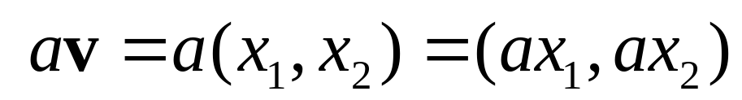
Scalar Product: av
av
v
Change only the length (“scaling”), but keep direction fixed.
Sneak peek: matrix operation (Av) can change length,
direction and also dimensionality!
Notes:
A scalar is just a number, no direction included.
So scalar product does not change direction.

Slide 5
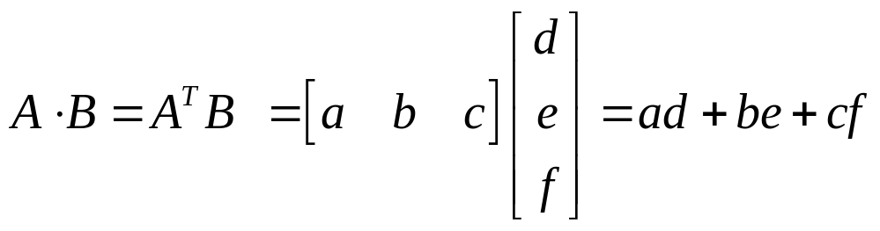
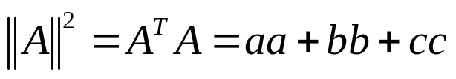

Vectors: Dot Product
Think of the dot product as a matrix multiplication
The magnitude is the dot product of a vector with itself
The dot product is also related to the angle between the two vectors

Slide 6
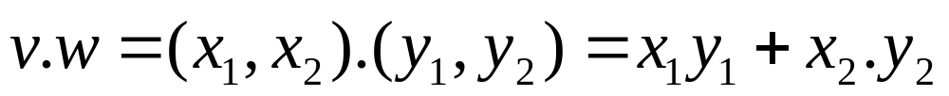
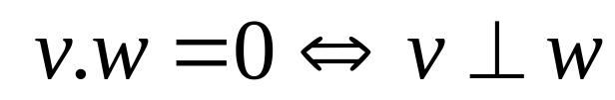
Inner (dot) Product: v.w or w^{T}v
v
α
w
The inner product is a SCALAR!
If vectors v, w are “columns”, then dot product is w^{T}v
Notes:
Do the operation first
Example: [a1 a2].[b1 b2]=??
[a1 a2 a3].[b1 b2 b3]=
Show m*n n*b trick to emphasize the result of dot product is scalar

Slide 7
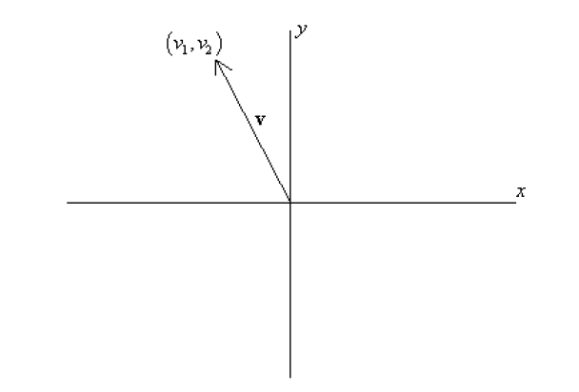
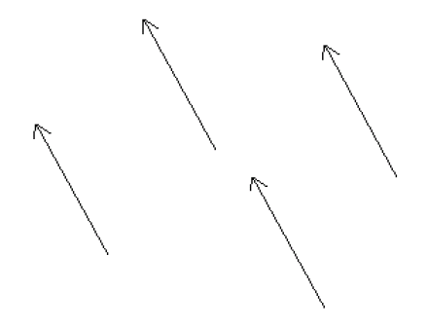
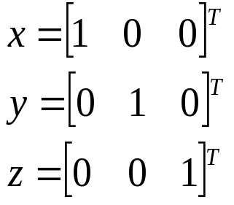
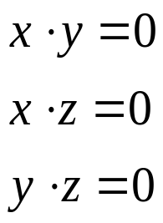
Bases & Orthonormal Bases
Basis (or axes): frame of reference
vs
Basis: a space is totally defined by a set of vectors – any point is a linear combination of the basis
Ortho-Normal: orthogonal + normal
[Sneak peek:
Orthogonal: dot product is zero
Normal: magnitude is one ]

Slide 8

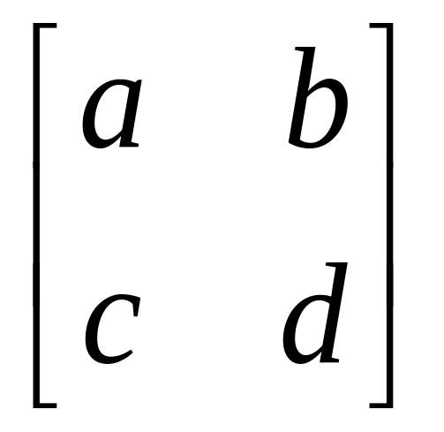
What is a Matrix?
A matrix is a set of elements, organized into rows and columns
rows
columns

Slide 9
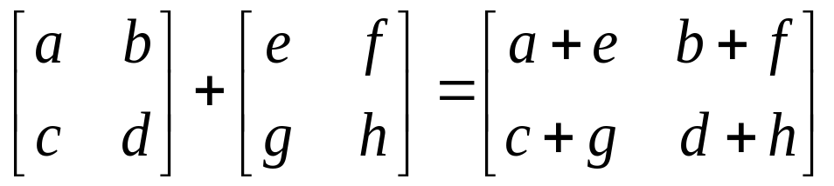
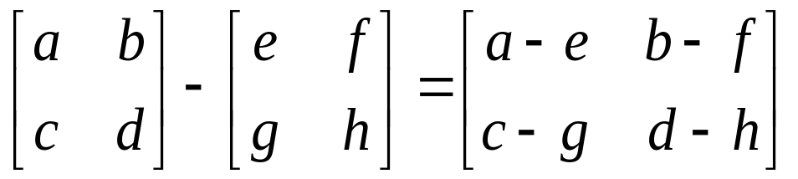
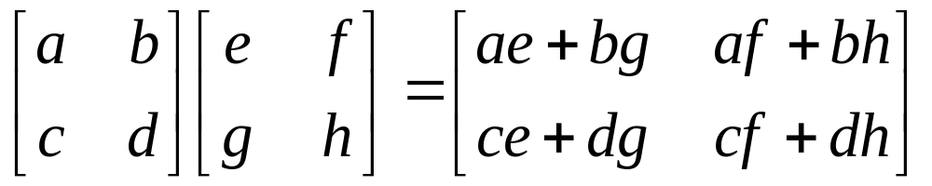
Basic Matrix Operations
Addition, Subtraction, Multiplication: creating new matrices (or functions)
Just add elements
Just subtract elements
Multiply each row by each column
Notes:
Addition and subtraction must be done in same dimension
Do multiplication together

Slide 10

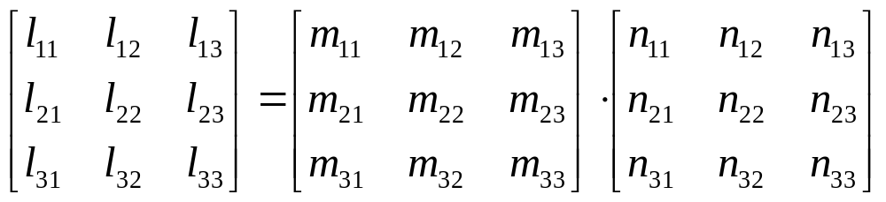
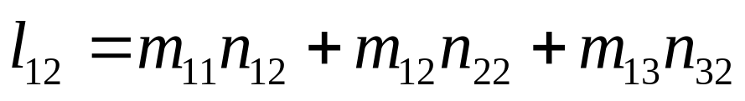
Matrix Times Matrix

Slide 11
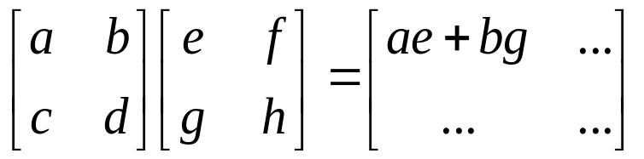
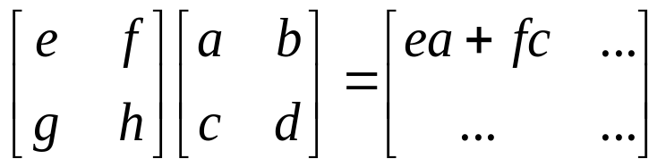
Multiplication
Is AB = BA? Maybe, but maybe not!
Matrix multiplication AB: apply transformation B first, and then again transform using A!
Heads up: multiplication is NOT commutative!
Note: If A and B both represent either pure “rotation” or “scaling” they can be interchanged (i.e. AB = BA)

Slide 12
Matrix operating on vectors
Matrix is like a function that transforms the vectors on a plane
Matrix operating on a general point => transforms x- and y-components
System of linear equations: matrix is just the bunch of coeffs !
x’ = ax + by
y’ = cx + dy
⎡
a
b
⎤
⎡
x
⎤
⎡
x
'
⎤
=
⎢
⎥
⎢
⎥
⎢
⎥
⎣
c
d
⎦
⎣
y
⎦
⎣
y
'
⎦

Slide 13
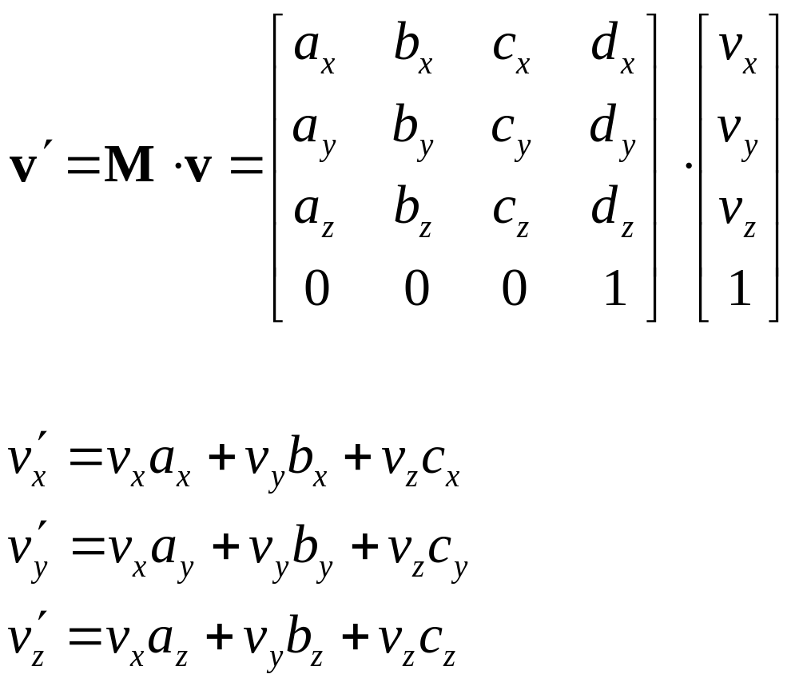
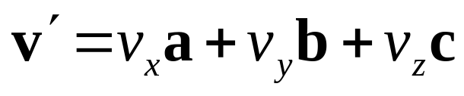
Direction Vector Dot Matrix

Slide 14
Matrices: Scaling, Rotation, Identity
Pure scaling, no rotation => “diagonal matrix” (note: x-, y-axes could be scaled differently!)
Pure rotation, no stretching => “orthogonal matrix” O
Identity (“do nothing”) matrix = unit scaling, no rotation!
r₁ 0
0 r₂
[0,1]^{T}
[0,r₂]^{T}
scaling
[1,0]^{T}
[r₁,0]^{T}
cosθ -sinθ
sinθ cosθ
[0,1]^{T}
[-sinθ, cosθ]^{T}
rotation
[cosθ, sinθ]^{T}
θ
[1,0]^{T}

Slide 15

Scaling
P’
P
a.k.a: dilation (r >1),
contraction (r <1)
r 0
0 r

Slide 16
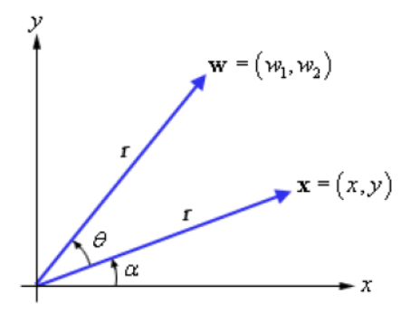
Rotation
P
P’
cosθ -sinθ
sinθ cosθ

Slide 17

2D Translation
P’
t
P
P’
ty
t
P
y
x
tx

Slide 18
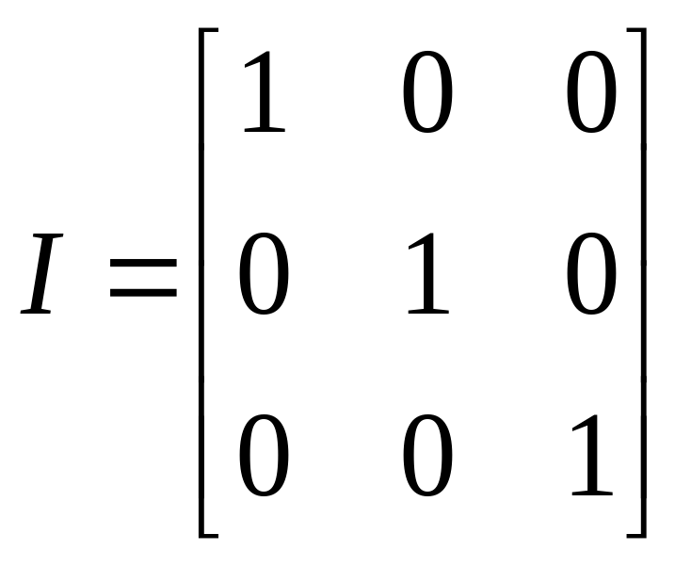
Inverse of a Matrix
Identity matrix:
AI = A
Inverse exists only for square matrices that are non-singular
  Maps N-d space to another N-d space bijectively
Some matrices have an inverse, such that:
AA⁻¹ = I
Inversion is tricky:
(ABC)⁻¹ = C⁻¹B⁻¹A⁻¹
Derived from non-commutativity property

Slide 19
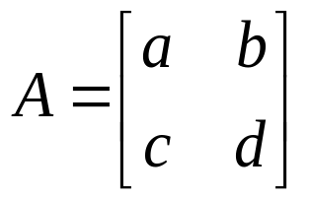
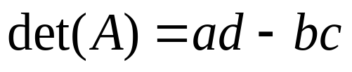
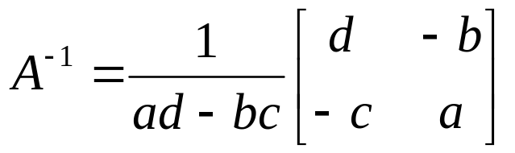
Determinant of a Matrix
Used for inversion
If det(A) = 0, then A has no inverse
http://www.euclideanspace.com/maths/algebra/matrix/functions/inverse/threeD/index.htm

Slide 20
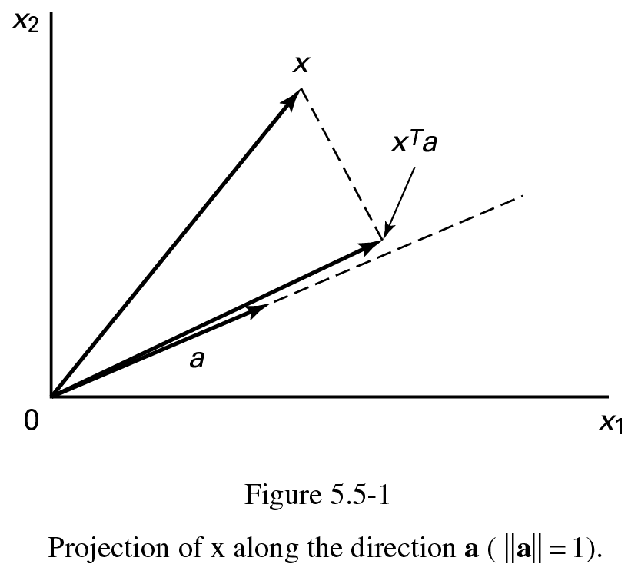
Projection: Using Inner Products (I)
p = a (a^{T}x)
||a|| = a^{T}a = 1

Slide 21
Homogeneous Coordinates
Represent coordinates as (x,y,h)
Actual coordinates drawn will be (x/h,y/h)

Slide 22
Homogeneous Coordinates
The transformation matrices become 3x3 matrices, and we have a translation matrix!
x’
y’
1
1 0 t_{x}
0 1 t_{y}
0 0 1
x
y
1
=
New point Transformation Original point
Exercise: Try composite translation.

Slide 23
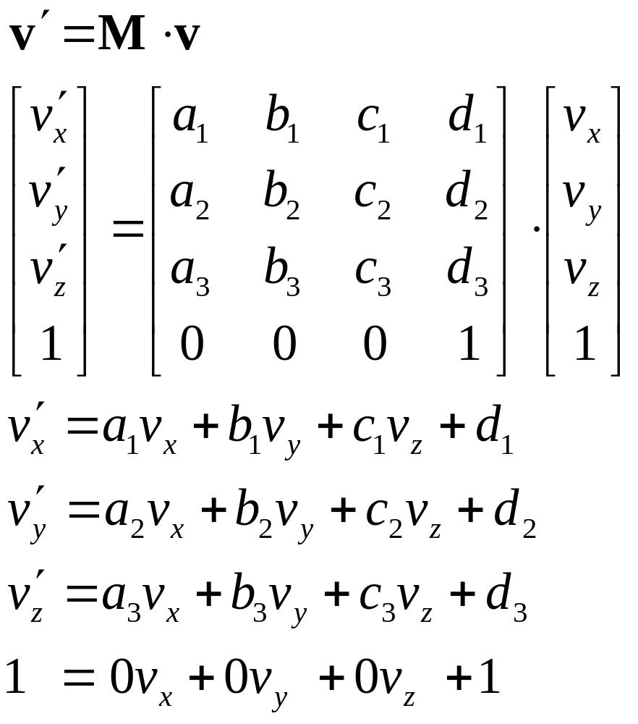
Homogeneous Transformations

Slide 24
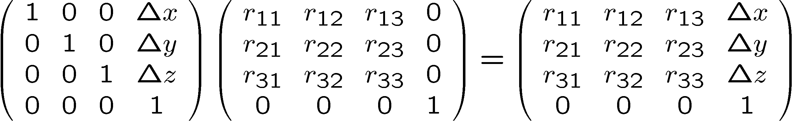
Order of Transformations
Note that matrix on the right is the first applied
Mathematically, the following are equivalent
p’ = ABCp = A(B(Cp))
Note many references use column matrices to represent points. In terms of column matrices
p^{’T} = p^{T}C^{T}B^{T}A^{T}
T
R
M

Slide 25
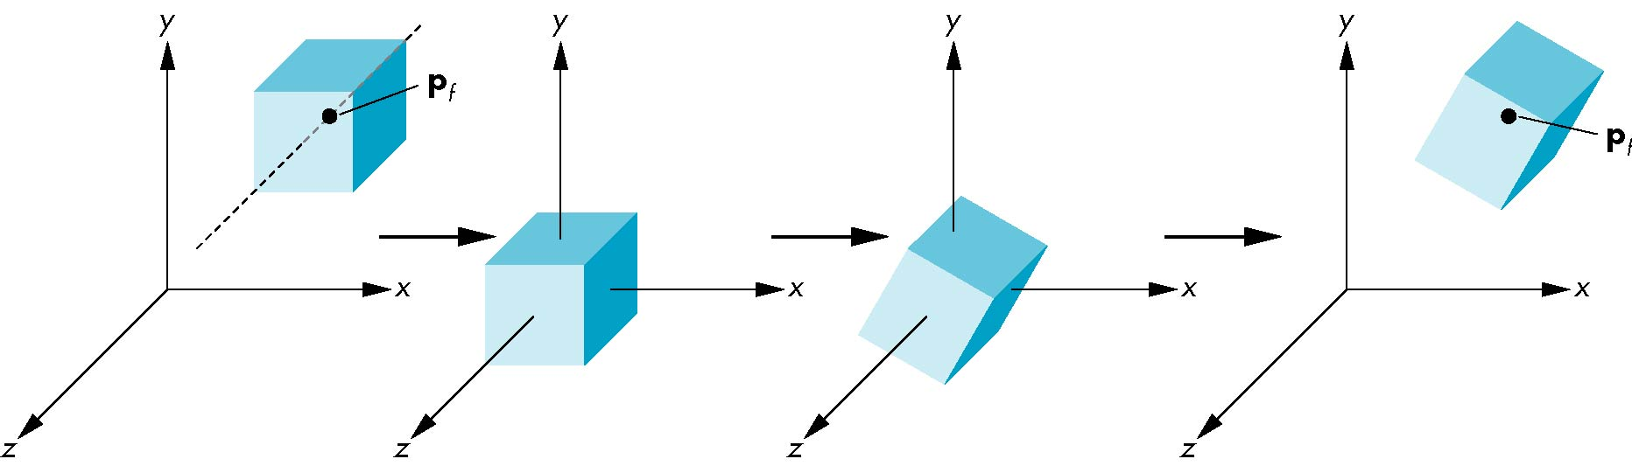
Rotation About a Fixed Point other than the Origin
Move fixed point to origin
Rotate
Move fixed point back
M = T(p_{f}) R(θ) T(-p_{f})

Slide 26
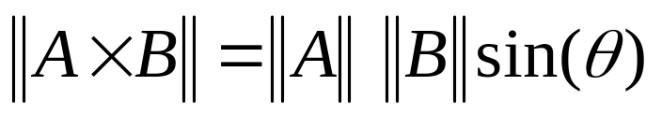
Vectors: Cross Product
The cross product of vectors A and B is a vector C which is perpendicular to A and B
The magnitude of C is proportional to the sin of the angle between A and B
The direction of C follows the right hand rule if we are working in a right-handed coordinate system
A×B
B
A

Slide 27
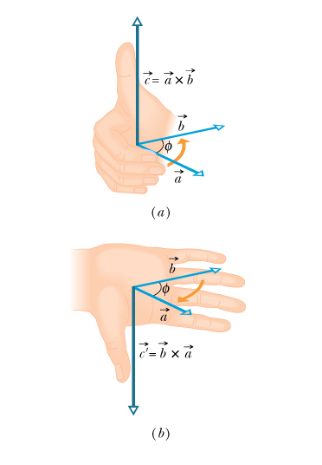
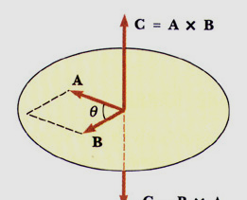
MAGNITUDE OF THE CROSS PRODUCT

Slide 28
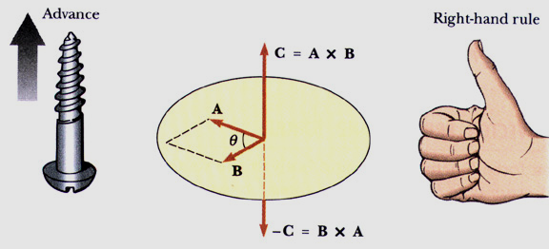
DIRECTION OF THE CROSS PRODUCT
The right hand rule determines the direction of the cross product

Slide 29
For more details
Prof. Gilbert Strang’s course videos:
http://ocw.mit.edu/OcwWeb/Mathematics/18-06Spring-2005/VideoLectures/index.htm
Esp. the lectures on eigenvalues/eigenvectors, singular value decomposition & applications of both. (second half of course)
Online Linear Algebra Tutorials:
http://tutorial.math.lamar.edu/AllBrowsers/2318/2318.asp

