Slide 1

OAuth 2.0 Flow & Redirect URI Hijacking Attack Simulation
Security Analysis & Demonstration
Focus: Authentication Vulnerability
Submitted by: Yashfaa (BITf24MO27)
Information Security

Slide 2
The Problem
Modern Login is Broken (If Done Wrong)
Users log in via Google / GitHub
Apps rely on OAuth 2.0
Developers assume it's secure by default
Reality: Bad implementation = major risk
One mistake → attacker gets access

Slide 3
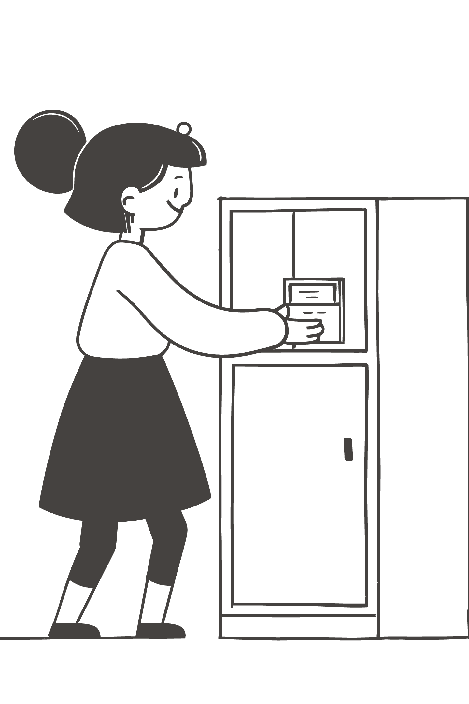
What is OAuth 2.0?
Simple Idea, Powerful Impact
Authorization framework
No password sharing
Uses tokens instead of credentials
Goal: Secure + Convenient authentication
But: Security depends on correct implementation

Slide 4

OAuth Flow (Core Logic)
How Login Actually Works
01
02
03
User clicks login
App redirects to Auth Server
User authenticates
04
05
Server sends authorization code
App exchanges code for access token
Critical Point: Redirect URI

Slide 5

The Vulnerability
Redirect URI Hijacking
App fails to validate redirect URI
Attacker modifies redirect link
Authorization code sent to attacker
Result:
Account takeover
Data exposure
Session compromise

Slide 6
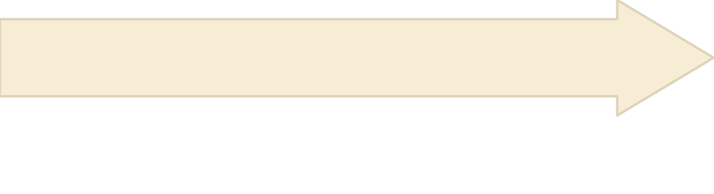
Attack Simulation (Vulnerable System)
What Goes Wrong
Auth code sent to attacker
System accepts it blindly
User enters malicious URI: attacker.com
No validation = No security

Slide 7
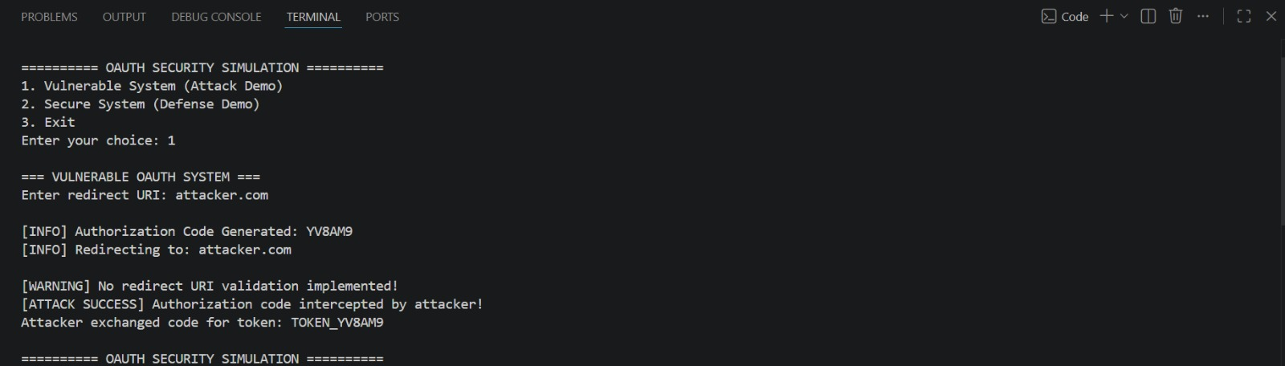
DEMO Of ATTACK SIMULATION
(VELNURABLE System)

Slide 8

Impact of the Attack
Why This Matters
Unauthorized login access
Sensitive data leakage
Full account control
This is not theoretical
It happens in real-world apps

Slide 9

Secure System Design
Fixing the Weakness
Implement Redirect URI Whitelisting
Only trusted domains allowed
Reject unknown URIs
Control where data goes

Slide 10



Defense Mechanism
How Protection Works
Compare input URI with whitelist
If valid → proceed
If invalid → block request
Result: Authorization code stays safe

Slide 11
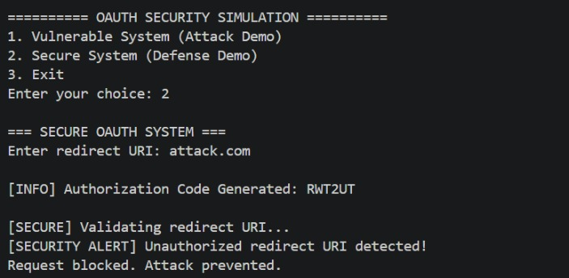
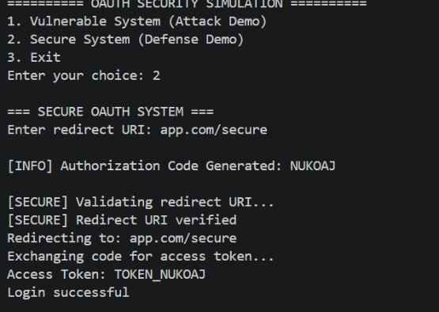
DEMO Of
Project
Security Simulation (Attack prevented) Security Simulation (Login Successful)

Slide 12
Results & Security
Comparison
Vulnerable System
No URI validation
attacker.com accepted
Attack successful
Secure System
Whitelist validation
attacker.com blocked
Attack prevented
Final Result Proper redirect URI validation successfully stopped authorization code interception.

