Slide 1
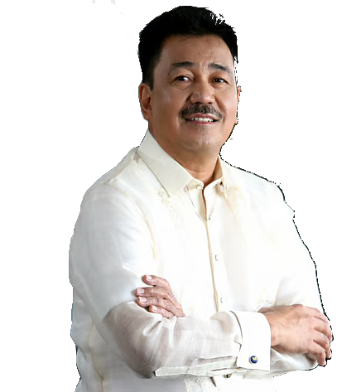

Happy
Birthday!
DR. J. PROSPERO “POPOY” E. DE VERA III
Chairperson, CHED
Greetings from
TUP family

