Slide 1
Cit Master Project
11.01.2018 – Meeting 4

Slide 2
Overview
Introduction
Frontend
Backend

Slide 3
Introduction

Slide 4
Frontend

Slide 5
Backend

Slide 6
OpenStack
Bitflow - Agent
Bitflow - Agent
MySQL - DB
Bitflow - Backend
Backend - Agent - API
Backend - Mgmt
Backend - API
Bitflow - Frontend

Slide 7
Technologies
JavaEE 8
Swagger for API definition
Wildfly 11.0 as application server

Slide 8
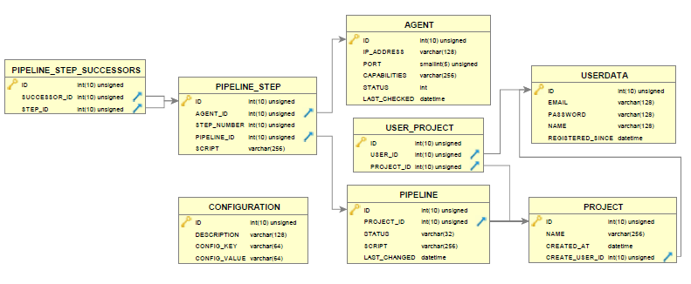

Slide 9
Next Steps
Adjusting DB and API
Implementing API methods
Including authentication

