Slide 1
Chapter 11
Machine learning
Xiu-jun GONG (Ph. D)
School of Computer Science and Technology, Tianjin University
gongxj@tju.edu.cn
http://cs.tju.edu.cn/faculties/gongxj/course/ai/

Slide 2
Outline
What is machine learning
Tasks of Machine Learning
The Types of Machine Learning
Performance Assessment
Summary

Slide 3
What is the “machine learning”
machine learning is concerned with the design and development of algorithms and techniques that allow computers to "learn“
  Acquiring knowledge
  Mastering skill
  Improving system’s performance
  Theorizing, posting hypothesis, discovering the law
The major focus of machine learning research is to extract information from data automatically, by computational and statistical methods.

Slide 4

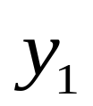

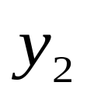
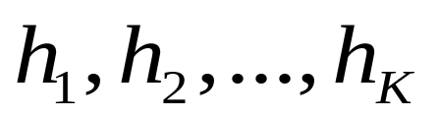
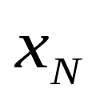
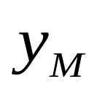
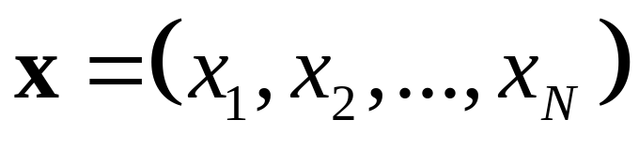
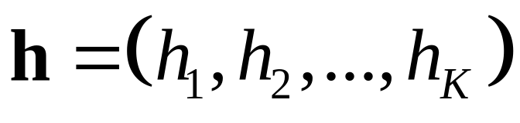
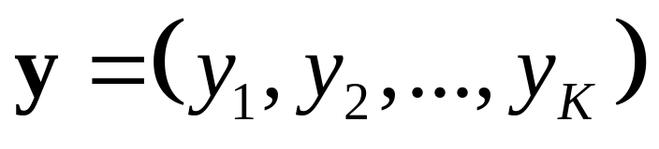
A Generic System
System
…
…
Input Variables:
Hidden Variables:
Output Variables:

Slide 5
Another View of Machine Learning
Machine Learning aims to discover the relationships between the variables of a system (input, output and hidden) from direct samples of the system
The study involves many fields:
  Statistics, mathematics, theoretical computer science, physics, neuroscience, etc

Slide 6
Learning model: Simon’s model
环境
知识库
学习环节
执行环节
圆圈代表信息/知识的集合
Environment ——外界提供的信息/知识
Knowledge Base——系统具有的知识
方框代表环节
Learning——由环境提供的信息生成知识库中的知识
Performing——利用知识库的知识完成某种任务，并把执行中获得的信息反馈给学习环节，进而改进知识库。

Slide 7
Defining the Learning Task
Improve on task, T, with respect to
performance metric, P, based on experience, E.
T: Playing checkers
P: Percentage of games won against an arbitrary opponent
E: Playing practice games against itself
T: Recognizing hand-written words
P: Percentage of words correctly classified
E: Database of human-labeled images of handwritten words
T: Driving on four-lane highways using vision sensors
P: Average distance traveled before a human-judged error
E: A sequence of images and steering commands recorded while
observing a human driver.
T: Categorize email messages as spam or legitimate.
P: Percentage of email messages correctly classified.
E: Database of emails, some with human-given labels

Slide 8
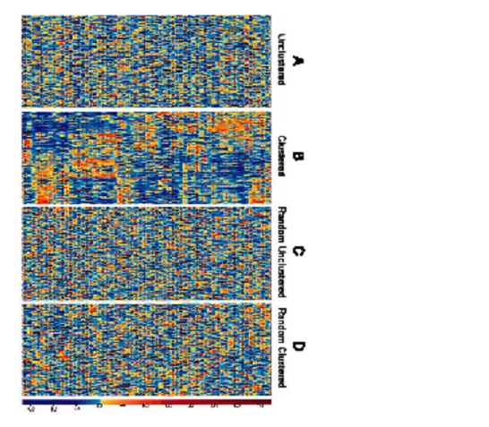
Formulating the Learning Problem
Data matrix: X
n lines = patterns (data points, examples): samples, patients, documents, images, …
m columns = features: (attributes, input variables): genes, proteins, words, pixels, …
m attributes
Output
n instance
A11,A12,…,A1m
A21,A22,…,A2m
…
…
An1,An2,…,Anm
---C1
---C2
---…
---…
---Cn
Colon cancer, Alon et al 1999

Slide 9
Supervised Learning
Generates a function that maps inputs to desired outputs
Classification & regression
Training & test
Algorithms
  Global model: BN, NN,SVM, Decision Tree
  Local model: KNN, CBR(Case-base reasoning)
m attributes
Output
n instance
A11,A12,…,A1m
A21,A22,…,A2m
…
…
An1,An2,…,Anm
---C1
---C2
---…
---…
---Cn
√
√
…
…
√
Training
Task
a1, a2, …, am
---?

Slide 10
Unsupervised learning
Models a set of inputs: labeled examples are not available.
Clustering & data compression
Cohension & divergence
Algorithms
  K-means, SOM, Bayesian, MST…
m attributes
Output
n instance
A11,A12,…,A1m
A21,A22,…,A2m
…
…
An1,An2,…,Anm
---C1
---C2
---…
---…
---Cn
X
X
…
…
X
Task

Slide 11
Semi-Supervised Learning
Combines both labeled and unlabeled examples to generate an appropriate function or classifier.
With large unlabeled sample, small labeled samples
Algorithms
  Co-training
  EM
  Latent variables
m attributes
Output
n instance
A11,A12,…,A1m
A21,A22,…,A2m
…
…
An1,An2,…,Anm
---C1
---?
---…
---…
---Cn
√
X
…
…
√
Task
a1, a2, …, am
---?

Slide 12
Other types
Reinforcement learning
  concerned with how an agent ought to take actions in an environment so as to maximize some notion of long-term reward
  find a policy that maps states of the world to the actions the agent ought to take in those states.
Multi-task learning
  Learns a problem together with other related problems at the same time, using a shared representation.

Slide 13
Learning Models(1)
A single Model: Motivation - build a single good model
  Linear models
  Kernel methods
  Neural networks
  Probabilistic models
  Decision trees

Slide 14
Learning Models (2)
An Ensemble of Models
  Motivation – a good single model is difficult to compute (impossible?), so build many and combine them. Combining many uncorrelated models produces better predictors...
  Boosting: Specific cost function
  Bagging: Bootstrap Sample: Uniform random sampling (with replacement)
  Active learning: Select samples for training actively

Slide 15
Linear models
f(x) = w • x +b = Σ_{j=1:n} w_{j} x_{j} +b
Linearity in the parameters, NOT in the input components.
f(x) = w • Φ(x) +b = Σ_{j} w_{j} φ_{j}(x) +b (Perceptron)
f(x) = Σ_{i=1:m} α_{i} k(x_{i},x) +b (Kernel method)

Slide 16
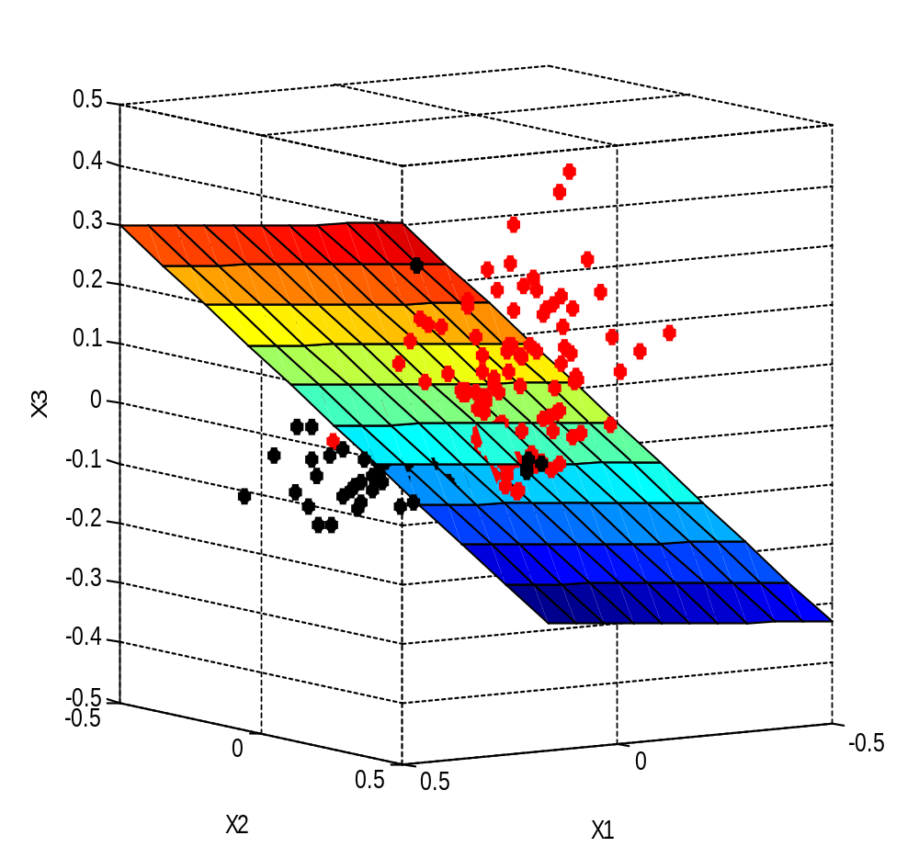
Linear Decision Boundary
hyperplane
x₂
x₃
x₁
x₂
x₁

Slide 17
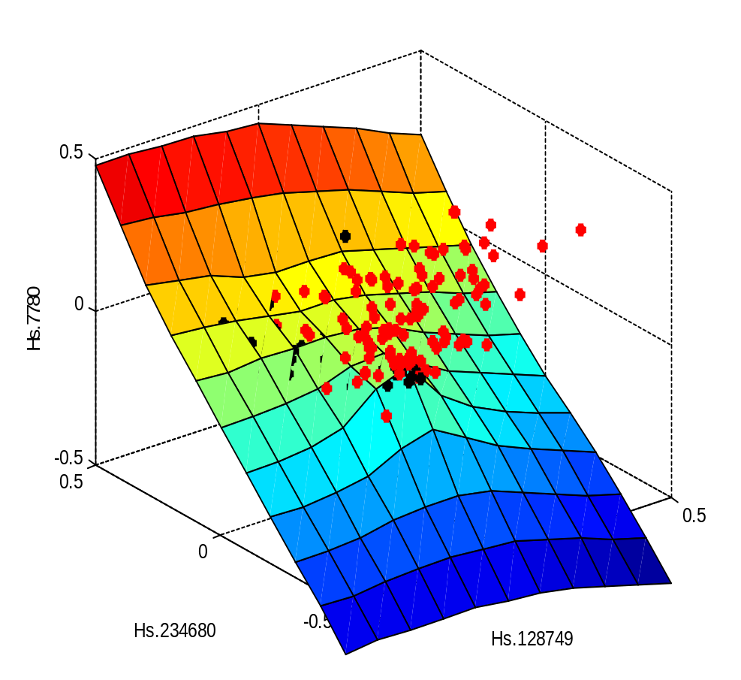
Non-linear Decision Boundary
x₂
x₃
x₂
x₁
x₁

Slide 18
Kernel Method
x₁
Potential functions, Aizerman et al 1964
k(x₁,x)
α₁
x₂
k(x₂,x)
α₂
Σ
α_{m}
x_{n}
k(x_{m},x)
b
f(x) = Σ_{i} α_{i} k(x_{i},x) + b
1
k(. ,. ) is a similarity measure or “kernel”.

Slide 19
What is a Kernel?
A kernel is:
a similarity measure
a dot product in some feature space: k(s, t) = Φ(s) • Φ(t)
But we do not need to know the Φ representation.
Examples:
k(s, t) = exp(-||s-t||²/σ²) Gaussian kernel
k(s, t) = (s • t)^{q} Polynomial kernel

Slide 20
Probabilistic models
Bayesian network
Latent semantic model
Time series model-HMM

Slide 21
Decision Trees
f₂
All the data
f₁
Choose f₂
At each step, choose the feature that “reduces entropy” most. Work towards “node purity”.
Choose f₁

Slide 22
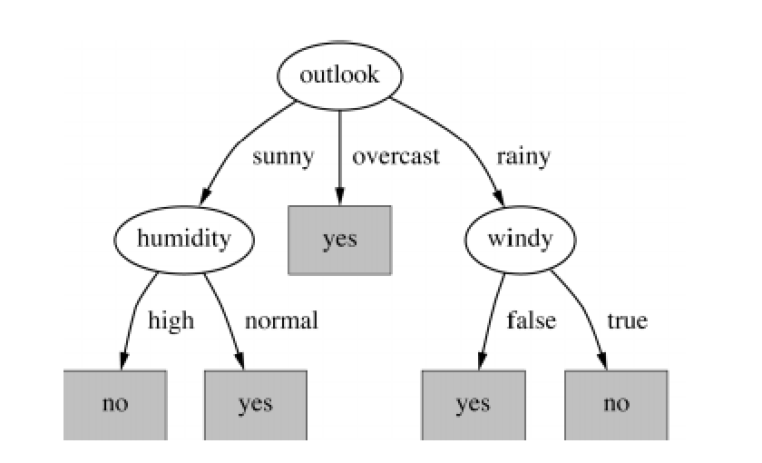
Decision Trees
CART (Breiman, 1984)
C4.5 (Quinlan, 1993)
J48

Slide 23
Boosting
  Main assumption:
  Combining many weak predictors to produce an ensemble predictor.
Each predictor is created by using a biased sample of the training data
  Instances (training examples) with high error are weighted higher than those with lower error
Difficult instances get more attention

Slide 24
Bagging
  Main assumption:
  Combining many unstable predictors to produce a ensemble (stable) predictor.
  Unstable Predictor: small changes in training data produce large changes in the model.
    e.g. Neural Nets, trees
    Stable: SVM, nearest Neighbor.
Each predictor in ensemble is created by taking a bootstrap sample of the data.
Bootstrap sample of N instances is obtained by drawing N example at random, with replacement.
Encourages predictors to have uncorrelated errors.

Slide 25
Active learning
Labeled Data
Unlabeled data
NBClassifier
Model
Data Pool
Selector
Learning incrementally
Classifying incrementally
Computing the evaluation function incrementally

Slide 26
Performance Assessment
Cost matrix
Predictions: F(x)
Class -1
Class +1
Total
Class +1 / Total
Truth:
y
Class -1
tn
fp
neg=tn+fp
False alarm = fp/neg
Class +1
fn
tp
pos=fn+tp
Hit rate = tp/pos
Total
rej=tn+fn
sel=fp+tp
m=tn+fp +fn+tp
Frac. selected = sel/m
Class+1
/Total
Precision = tp/sel
Compare F(x) = sign(f(x)) to the target y, and report:
  Error rate = (fn + fp)/m
  {Hit rate , False alarm rate} or {Hit rate , Precision} or {Hit rate , Frac.selected}
  Balanced error rate (BER) = (fn/pos + fp/neg)/2 = 1 – (sensitivity+specificity)/2
  F measure = 2 precision.recall/(precision+recall)
  Vary the decision threshold θ in F(x) = sign(f(x)+θ), and plot:
      ROC curve: Hit rate vs. False alarm rate
      Lift curve: Hit rate vs. Fraction selected
      Precision/recall curve: Hit rate vs. Precision

Slide 27
Challenges
training examples
Ada
NIPS 2003 & WCCI 2006
Sylva
10⁵
Gisette
Gina
10⁴
Dexter, Nova
10³
10²
Madelon
Arcene, Dorothea, Hiva
10
inputs
10
10²
10³
10⁴
10⁵

Slide 28
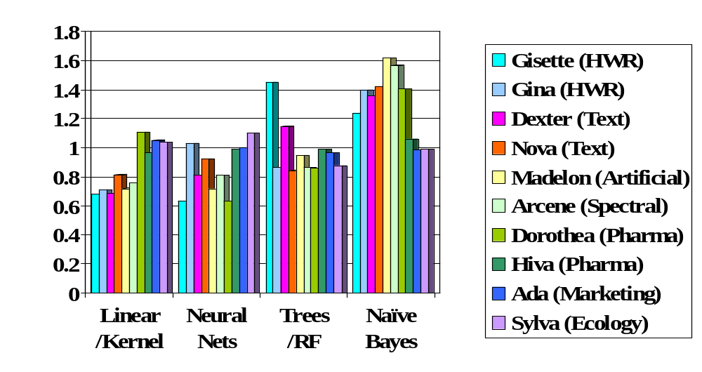
Challenge Winning Methods
BER/<BER>

Slide 29
Issues in Machine Learning
What algorithms are available for learning a concept? How well do they perform?
How much training data is sufficient to learn a concept with high confidence?
When is it useful to use prior knowledge?
Are some training examples more useful than others?
What are best tasks for a system to learn?
What is the best way for a system to represent its knowledge?

