Slide 1




Slide 2
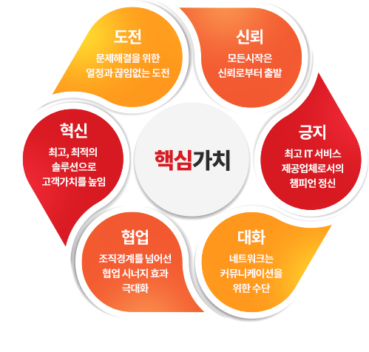



Slide 3

Enterprise
Network
Insight

Slide 4
E
N
I
Enterprise
Network
Insight
Enterprise
Network
Insight

Slide 5

E
Enterprise
Network
Insight

