Slide 1
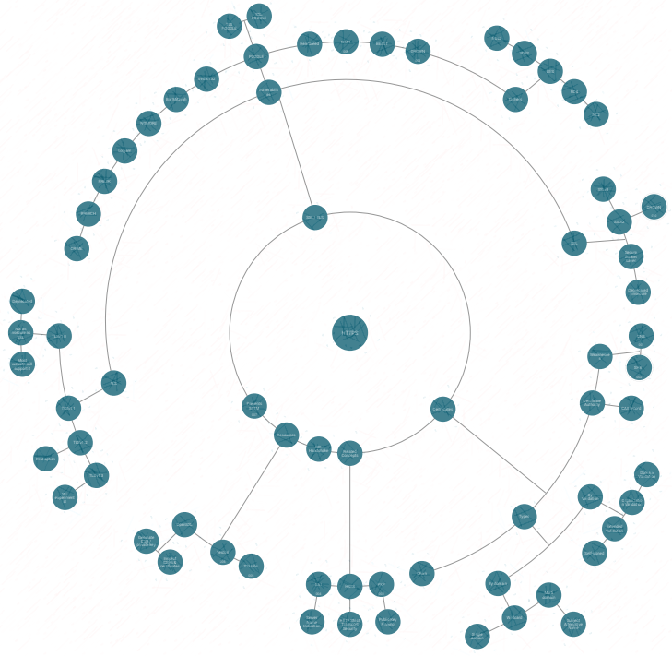
The magic behind https
https://github.com/bitnesswise/the-magic-behind-https · CC BY 4.0

Slide 2

In the beginning
1969 - Arpanet
1972 - Email
1983 - DNS
1993 - Internet
becomes browsable
Notes:
1969: Arpanet precursor to the modern internet, created by US Defense Department
1993: largely thanks to the NCSA Mosaic browser which supported text and images

Slide 3
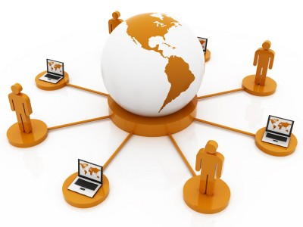



Happy people
Notes:
The 1993 milestone made people Happy:
- People could communicate with each other
- Access to an infinite amount of knowledge
- And access to an infinite amount of …. :-)

Slide 4
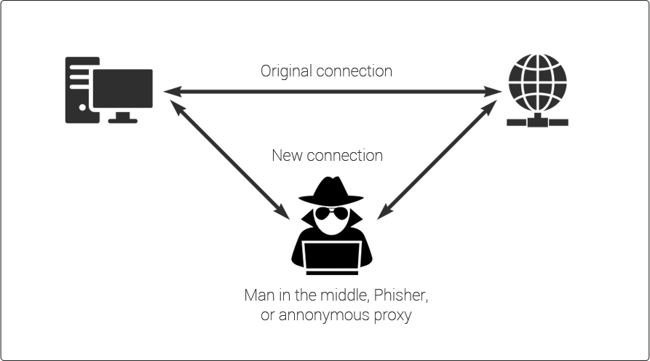
Bad people
Notes:
But then came the bad people
→ because nothing was encrypted, a mitm (man in the middle) attack became an issue.
(We will look at the details of the problems later (slide 7))

Slide 5

Sad people
Notes:
And that made the Happy people Sad

Slide 6

Enter SSL
1994, Mozilla created https for Netscape Navigator
1995, SSL 2.0 (SSLv2) was released to the public (followed by SSLv3 in 1996)

Slide 7
Why use (ssl) encrypted communication
No one can read your message
No one has changed your message
You are communicating with the intended person (server)
Notes:
This made the people happy again, because (see bullets)

Slide 8
(ssl) encrypted communication
TLS?
Notes:
We’ve been talking about SSL, but isn’t it called TLS? Or is that the same thing? Or different?

Slide 9
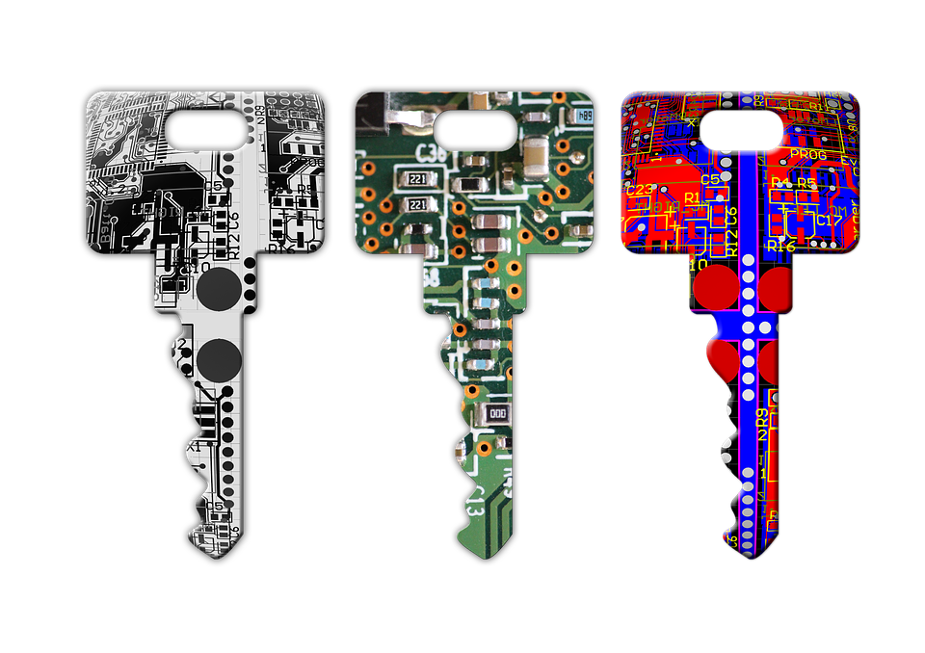
SSL / TLS
Secure Sockets Layer
Transport Layer Security
SSL is the predecessor of TLS and now deprecated

Slide 10
SSL / TLS
SSL Versions
  SSLv2
  SSLv3
  TLS1.0 (SSLv4)
  TLS1.1
  TLS1.2
  TLS1.3
Notes:
SSL protocol and all it’s version are now considered insecure
red=very insecure
orange=deprecated, not really secure
green=good

Slide 11
Small quantum deepdive
Protocol | Quantum Ready | Quantum Safe
TLS 1.2 | ❌ | ❌
TLS 1.3 | ✅ | ❌ (yet)
Notes:
This slide is here so you can briefly touch on the topic of quantum computers and the dangers they pose for today’s encryption, including https
At this point: just mention that TLS1.3 is Quantum Ready.
We will look at this table again later

Slide 12



TLS is used in/for
Used in combination with other protocols to form:
  HTTPS
  FTPS
  Secure Email
  OpenVPN
Notes:
Ftps is based on ftp, with ssl/tls added for encryption
(sftp=secure file transfer over ssh)

Slide 13

TLS Protocol
What does it really do?
It consists of two parts:
  TLS handshake layer
    This process is performed only once to establish a secure network connection for both parties.
  TLS record layer
    Gets data from the user applications, encrypts it, fragments it to an appropriate size (as determined by the cipher), and sends it to the network transport layer.

Slide 14
But before we begin ……..
Notes:
We do a small side-step into some encryption fundamentals first, in order to better understand the handshake explanation

Slide 15
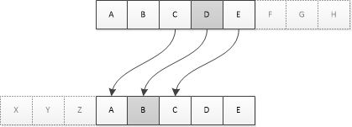
Cipher
An algorithm to encode or decode data
Secret key ensures the result is always different
Encoding + secret key = encrypting
Notes:
What is a cipher?
Stating that ‘Encoding + secret key = encrypting’ is too simplistic, but high-over it does illustrate the roles nicely

Slide 16

Two types of encryption
Symmetric
Asymmetric
Notes:
At least, two that are important in the current context

Slide 17
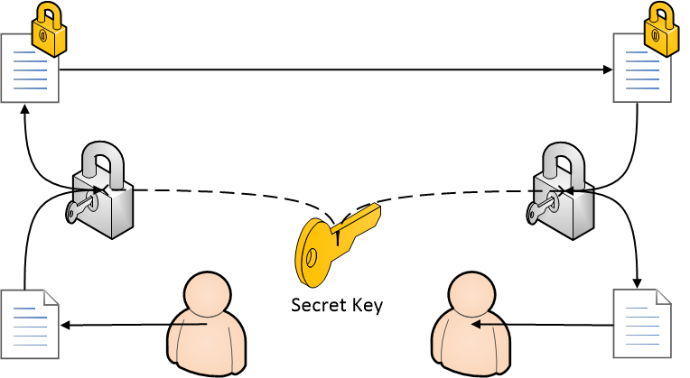
Symmetric encryption
Same key is used for encryption and decryption
PROs
  Speed
CONs
  Same (shared) key
  Cannot Authenticate

Slide 18

Asymmetric encryption
Public & private key
  Encryption with public key
  Decryption with private key
PROs
  Authenticity
  Integrity
CONs
  Slow / resource intensive
Notes:
Explain that it’s a matched set of cryptographic keys, where public key can be shared and used to encrypt messages.

Slide 19
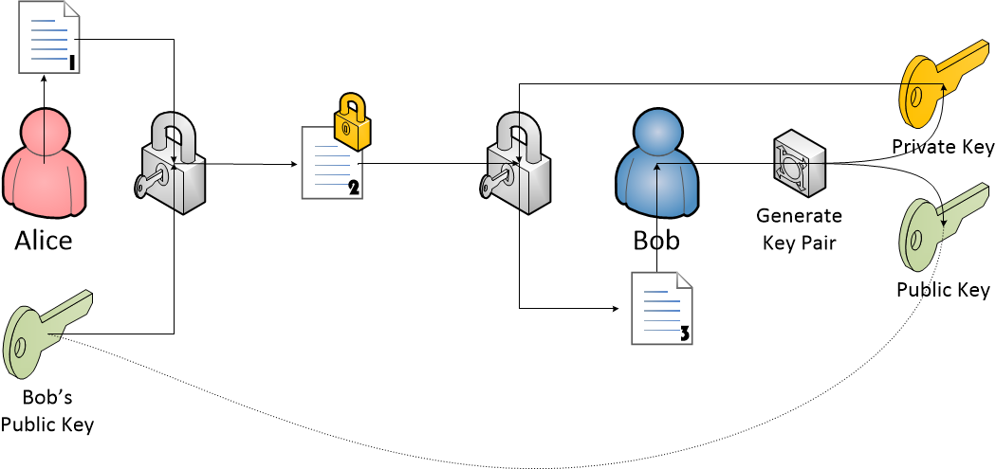
Asymmetric encryption
Notes:
Do a voice-over for this picture illustrating the classic case of Alice and Bob

Slide 20
Asymmetric encryption
Public & private key
  Encryption with public key
  Decryption with private key
PROs
  Authenticity
  Integrity
CONs
  Slow / resource intensive
Notes:
What happens when we encrypt with the private key, is that possible?
→ yes, that is possible, but then the usage changes
Encryption with public key: ensures confidentiality
Encryption with private key: for authentication

Slide 21
Here it comes, the handshake ….

Slide 22
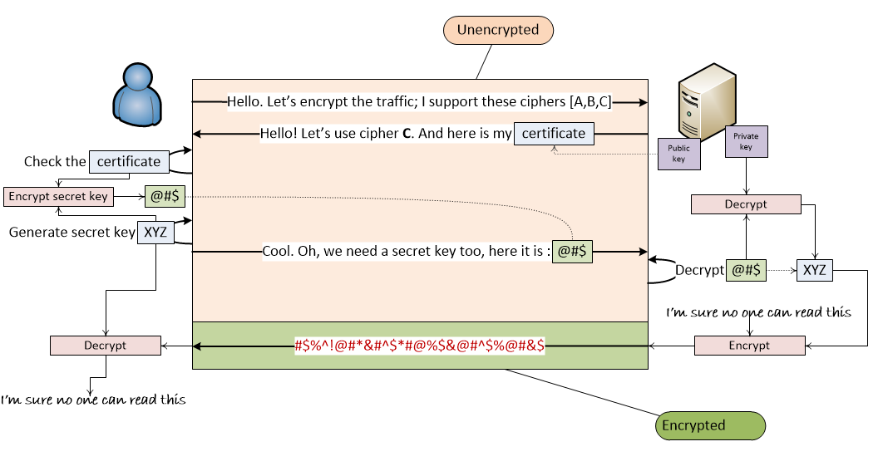
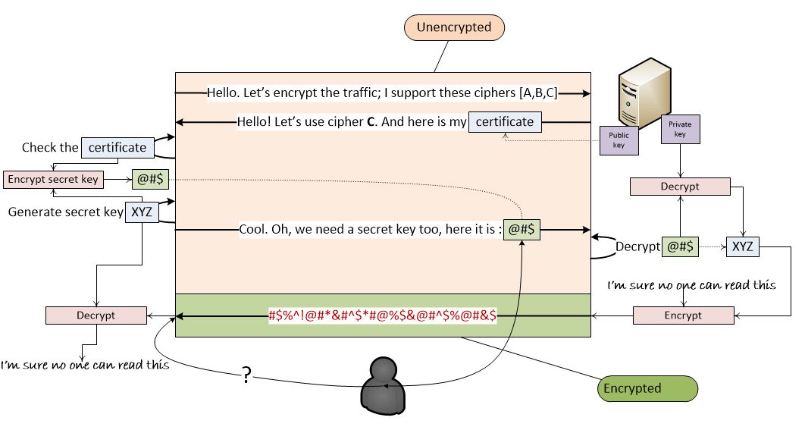
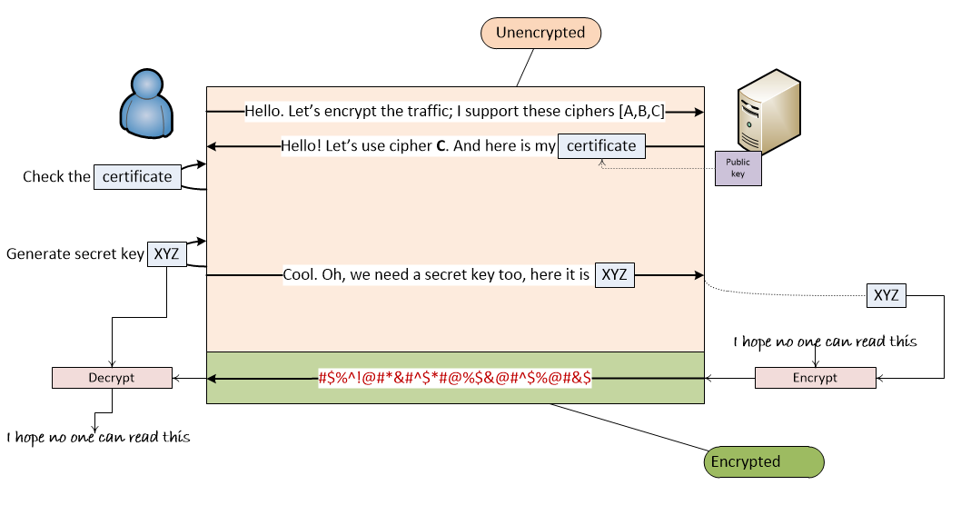
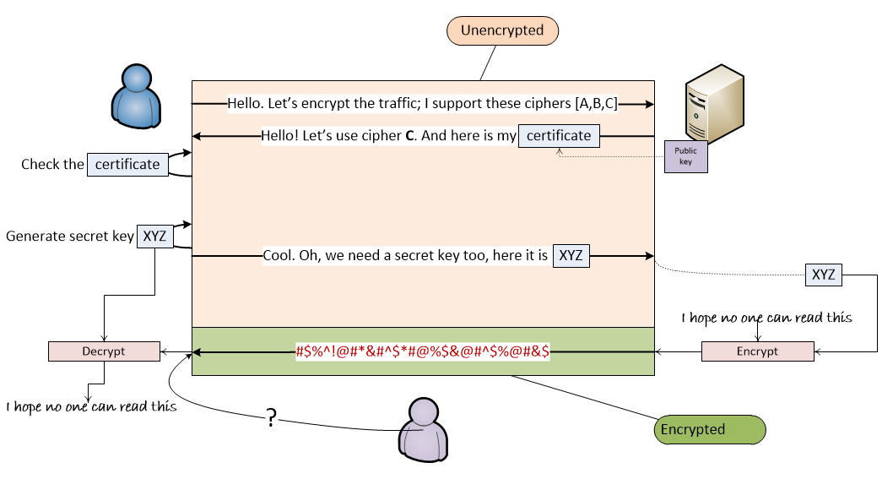
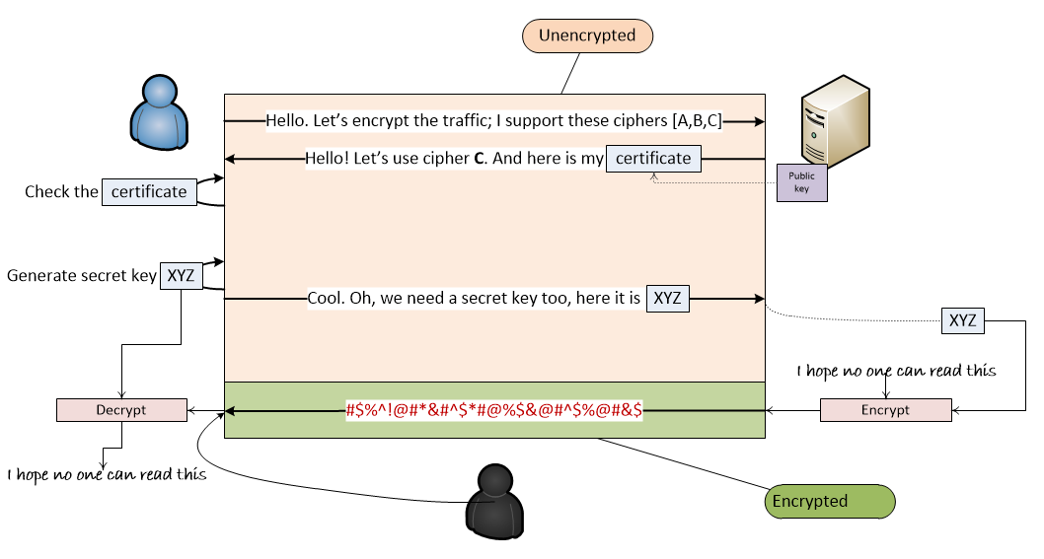
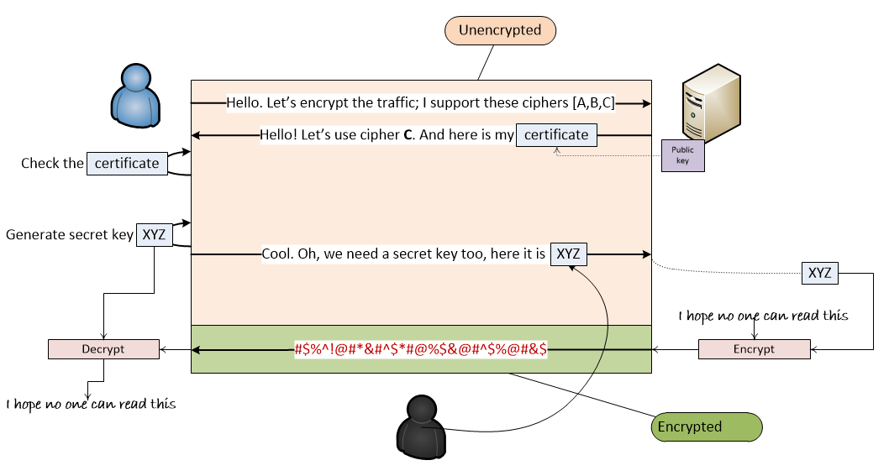

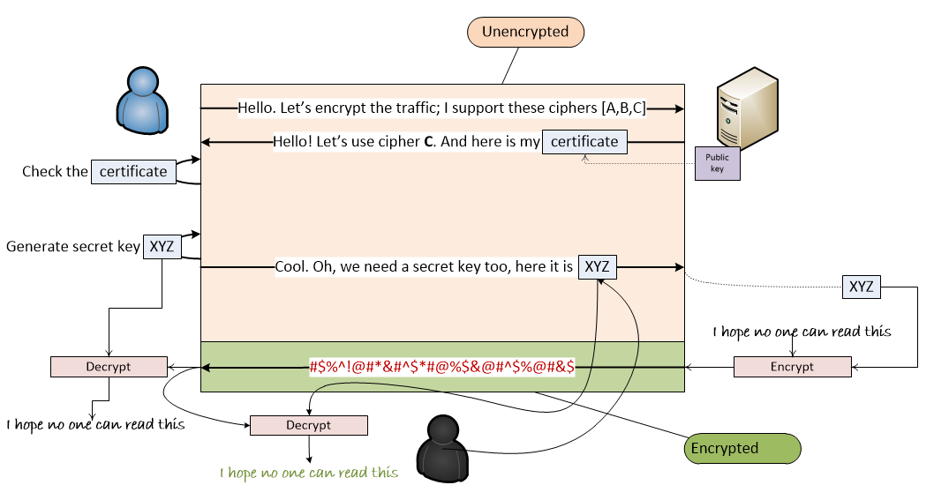
Notes:
The first image is not of a real TLS handshake.It is an example of a handshake where a malicious user can read what is being exchanged. By showing this problem, it will be easier to understand the actual handshake.
After that follows the actual TLS 1.2 handshake
1.2 is used because it is easier to understand then 1.3. TLS 1.3 is optimized (more efficient), but basically does the same things

Slide 23
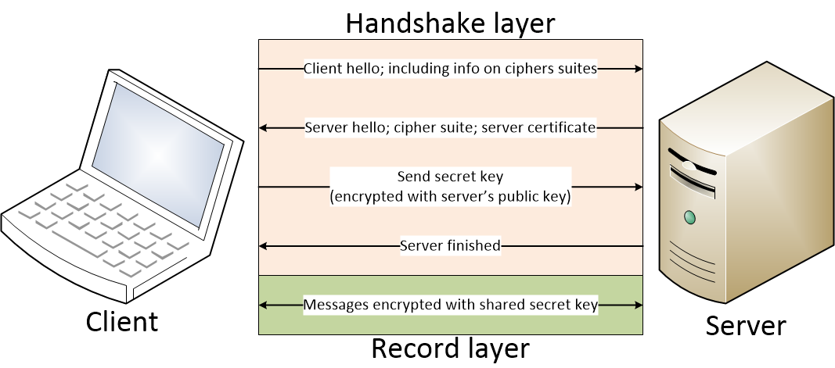
TLS Handshake (<=1.2)

Slide 24
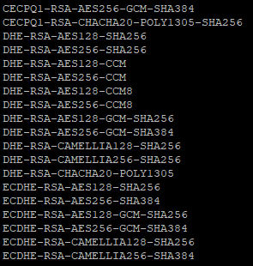
Cipher suite
The complete recipy for securing the connection
It determines:
  Security level
  Compatibility
  Performance

Slide 25
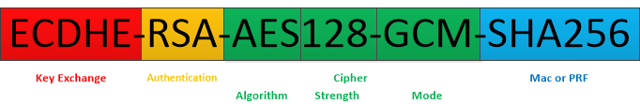
Ciphersuites
Key exchange : Key exchange algorithm (asymmetric)
Authentication : Authentication algorithm
Cipher - Symmetric encryption algorithm
MAC - The hash function to ensure message integrity

Slide 26
As promised: quantum re-dive
PQC
Protocol | Quantum Ready | Quantum Safe
TLS 1.2 | ❌ | ❌
TLS 1.3 | ✅ | ❌ (yet)
Notes:
Problem with TLS1.2 is that it depends on RSA, ECDH & ECDSA, which are not quantum safe
Symmetric key (p.e. AES) is not as vulnerable – we simply need to increase their length
TLS1.3 is quantum ready, but not yet quantum safe.
PQC = Post Quantum Cryptography

Slide 27
Encrypted parts of an https request
Breakdown of an http(s) request:
  https://www.domain.com/path/to/some/page.html
  IP
  Domain name (in header)
  Path
  Body
  Headers
Notes:
An http(s) request consists of these parts, if you look purely at the url and data that is sent on layer 7
Before proceeding, ask the audience which parts they think are encrypted

Slide 28
Encrypted parts of an https request
Breakdown of an https request:
  IP
  Domain name (in header)
  Path
  Body
  Request Headers
Notes:
Which parts are encrypted:
- red: not encrypted
- orange: depends
- green: is encrypted
Why it depends for the domain name is something we will see later!

Slide 29

So we can put whatever in the path?
Breakdown of an https request:
  IP
  Domain name (in header)
  Path
  Body
  Request Headers

Slide 30

So we can put whatever in the path? – NO!
Yes, the path is encrypted, but don’t put sensitive information in it because it can still ‘leak’ in various ways:
  Webserver Logs
  Browser History
  Bookmarks
  Printing
  Referrer Headers
  Analytics Tools

Slide 31

Certificates
Notes:
That concludes the first part.
Now we move on to Certifcates

Slide 32
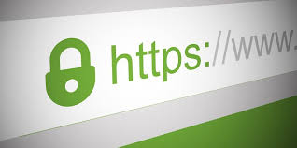
Certificates
What is a certificate?
What role do certificates play exactly?
And why are we still using SSL certificates if SSL is no longer safe?
How can we trust a certificate?

Slide 33
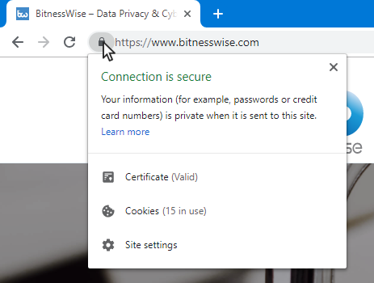
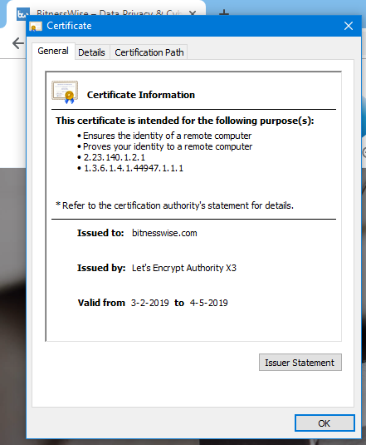
What is a certificate
Notes:
This answers the question from the perspective of what you see when you open it in your browser.
(but of course that doesn’t really answer the question)

Slide 34
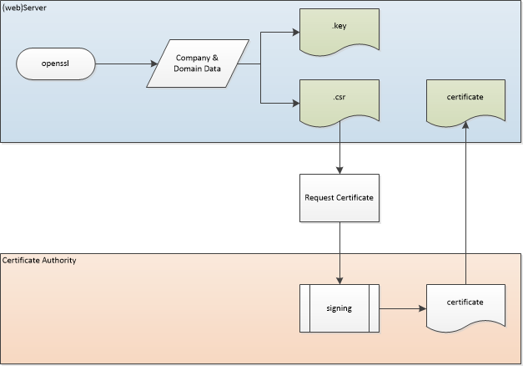
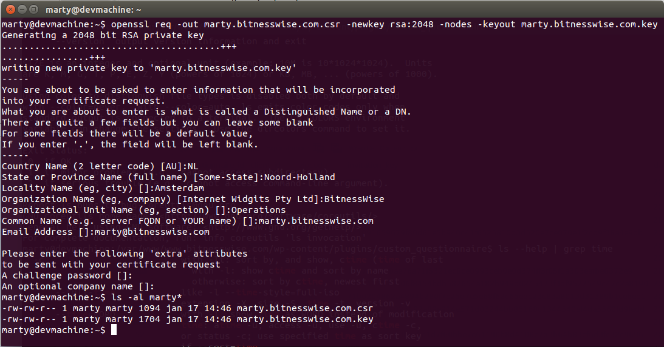
What is a certificate really
Notes:
What is a certificate really
The previous slide didn’t really answer the question; from here on we’re going to explain it with technical understanding.
Based on the information you give, a CSR (Certificate Signing Request) is generated along a private key. The public key is embedded in the CSR (and you can extract it if you want to).
The private key can optionally be protected by a passphase

Slide 35
What is a certificate really
A file that digitally binds a cryptographic key to company and domain data.
Format is according to X.509 standard
There are several commonly used filename extensions for X.509 certificates:
  .pem – (Privacy-enhanced Electronic Mail) Base64 encoded DER certificate, enclosed between "-----BEGIN CERTIFICATE-----" and "-----END CERTIFICATE-----"
  .cer, .crt, .der – usually in binary DER form, but Base64-encoded certificates are common too (see .pem above)
  .p7b, .p7c – PKCS#7 SignedData structure without data, just certificate(s) or CRL(s)
  .p12 – PKCS#12, may contain certificate(s) (public) and private keys (password protected)
  .pfx – PFX, predecessor of PKCS#12 (usually contains data in PKCS#12 format, e.g., with PFX files generated in IIS)
  (Unfortunately, some of these extensions are also used for other data such as private keys)

Slide 36
What role does it play in an https connection
The server authenticates itself (this works because a trusted CA has signed it)
  The client can validate that it’s talking to the correct server/domain
The initial encryption of the connection
Server vs Client
Notes:
The trust in the CA that signed it is something we will explain in more detail later
Server vs Client : not only servers have certificates, clients can also have them to prove to a server who they are (can be used as an extra factor for example to get access to a company portal)

Slide 37
SSL (??) Certificates
Certificates are not dependent on protocols. That is, you don’t need to use a TLS Certificate vs. an SSL Certificate. While many vendors tend to use the phrase “SSL/TLS Certificate”, it may be more accurate to call them “Certificates for use with SSL and TLS", since the protocols are determined by your server configuration, not the certificates themselves.
We’ll just use the terms Certificates or SSL Certificates
Notes:
Why do we call it ssl certificats – didn’t we say ssl was old and insecure?

Slide 38

How can we trust a certificate?
Certificate Authorities
Root Certificate Authority
Certificate Chain
Other validations
Notes:
We said we can trust a certificate because it is signed by a CA, but how does that trust really work?

Slide 39
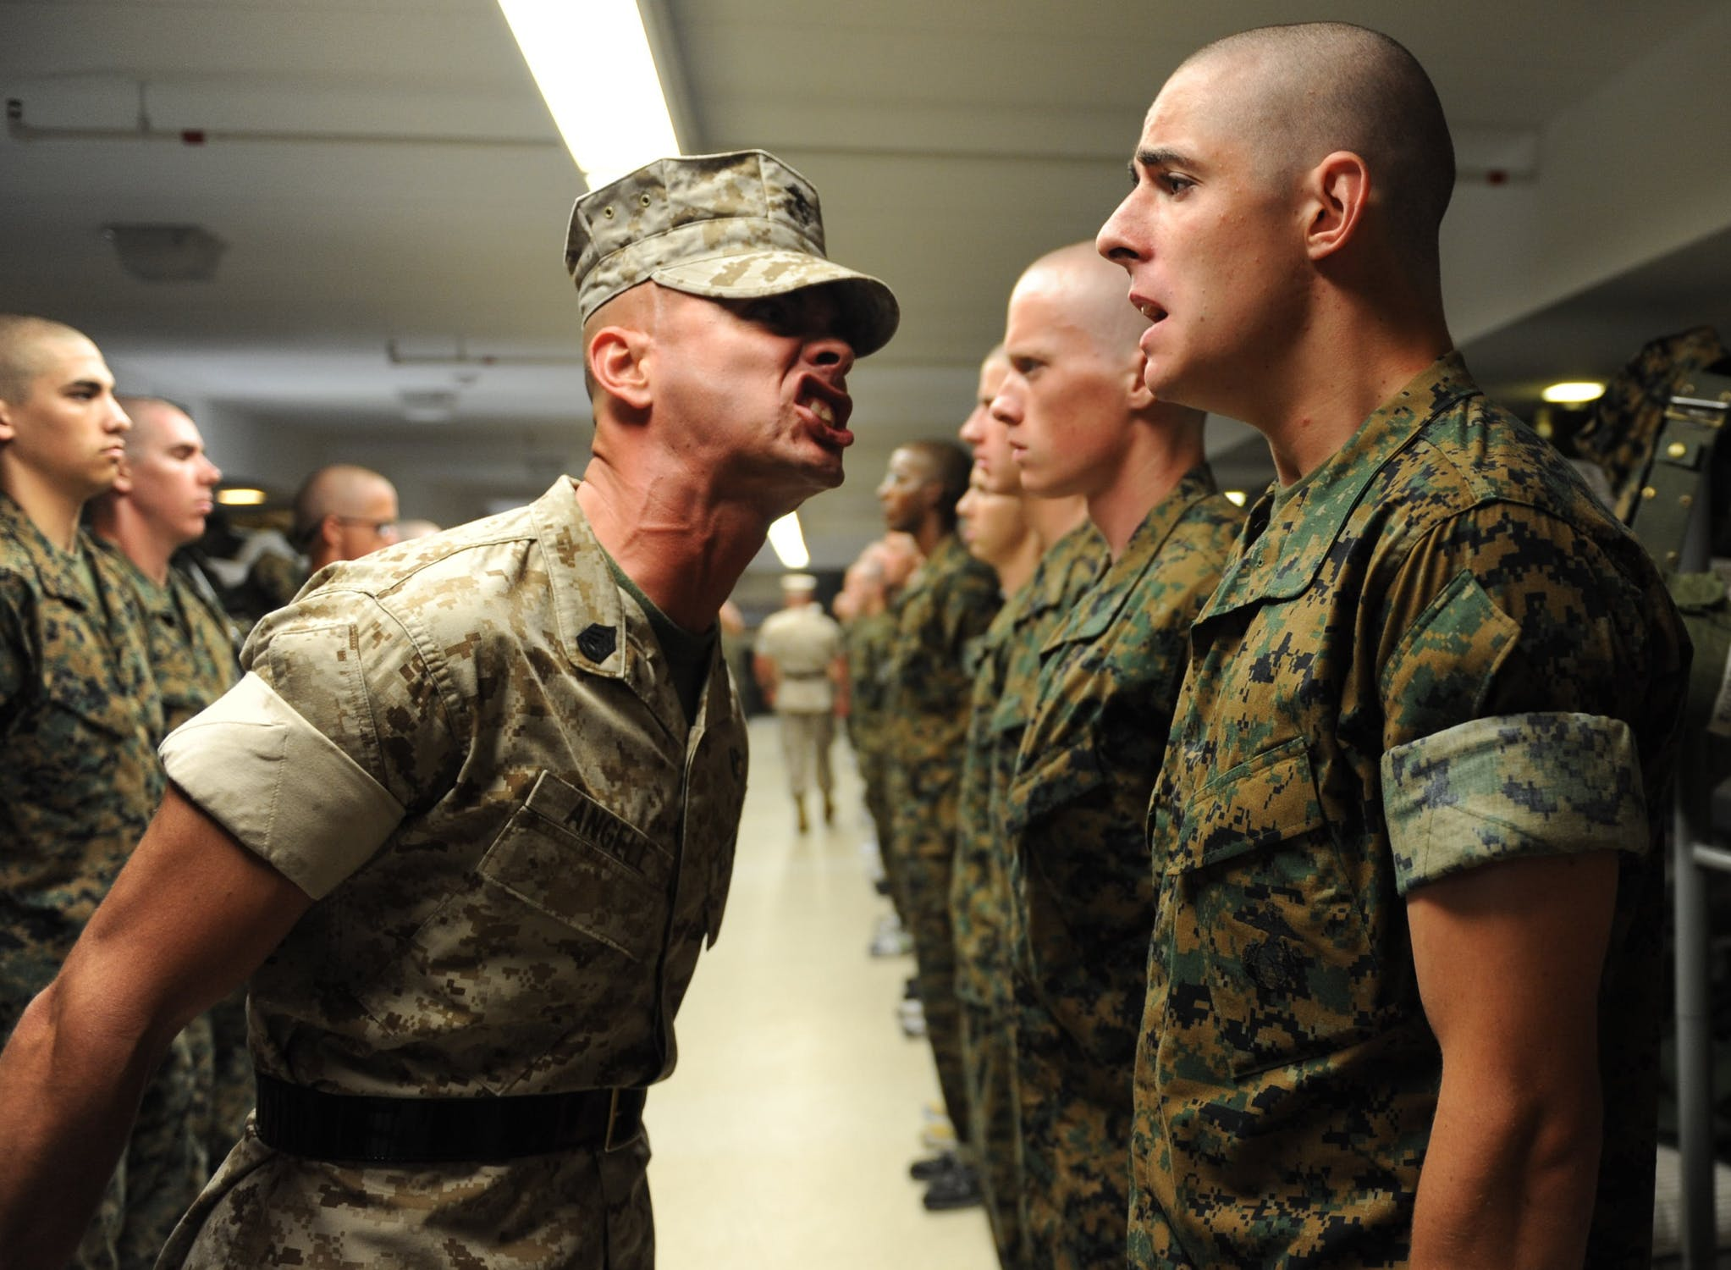
Certificate Authority
CA issues certificates
Acts as trusted 3rd party (trusted by both owner and user)
CA can also revoke a certificate

Slide 40

Root CA
A Root CA is a Certificate Authority that is implicitly trusted
They have a self-signed certificate which is pre-installed in the trust-store of the client

Slide 41
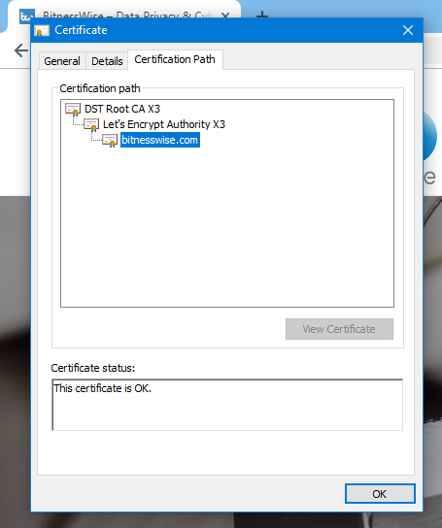
Certificate chains
Notes:
Example of a chain

Slide 42
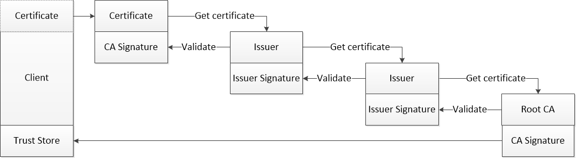
Certificate chains
Notes:
This visualizes how the trust works

Slide 43
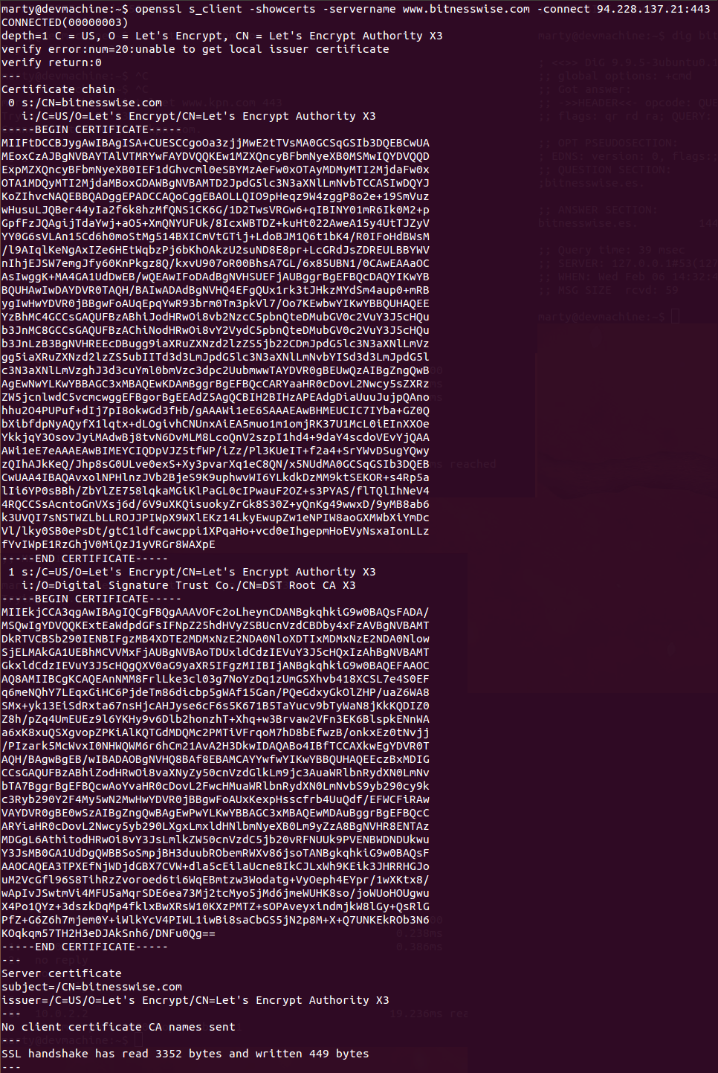
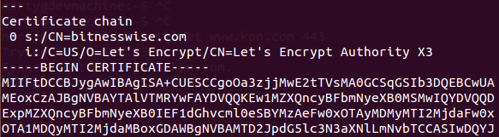
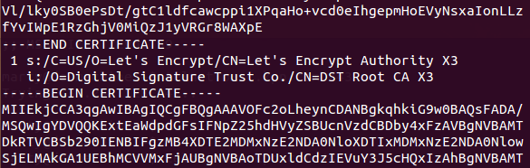
Certificate chains
Notes:
This is what it looks like when you use openssl.
The pics on the left are the most important parts from the pic on the right, but zoomed in

Slide 44
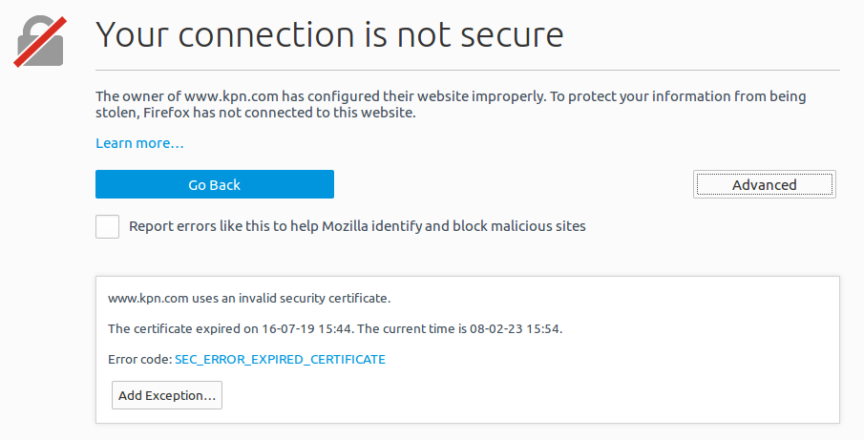
Certificate validations
Chain validation
Subject validation
Date validation
Notes:
We’re going to explain these 3 validation topics

Slide 45




Different type of certificates
By Validation:
  Self-signed Certificates
  Domain Validation (DV)
  Organization Validation (OV)
  Extended Validation (EV)
By domain:
  Single domain
  Multi domain
  Wildcard

Slide 46
Type of Certificates by validation
Domain validated (DV)
Organisation validated (OV)
Extended validation (EV)
Self-signed certificates

Slide 47
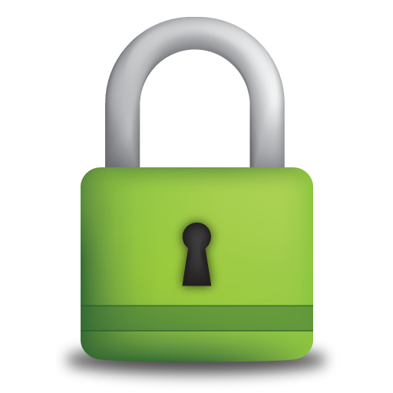
Domain Validated (DV) Certificates
No company information is vetted, only use of a domain
Letsencrypt
Pros: quick, cheap
Cons: clients can not be sure who is at the receiving end
Although: clients can not really see the difference….

Slide 48
Organisation Validated (OV) Certificates
Besides the right to use the domain, the CA also conducts vetting of the organisation
Pros: extra validation, enhanced trust
Cons: normal users don’t see the difference, more costly
and process takes longer

Slide 49
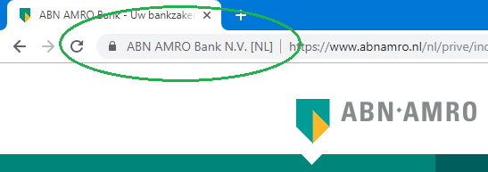
Extended Validation (EV) Certificates
Besides the right to use the domain, the CA also conducts an extensive vetting of the organisation
Pros: extra validation, enhanced trust, difference is visible
Cons: more expensive

Slide 50
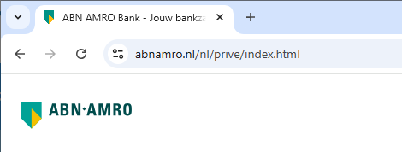
Extended Validation (EV) Certificates
Besides the right to use the domain, the CA also conducts an extensive vetting of the organisation
Pros: extra validation, enhanced trust, difference is visible
Cons: more expensive
Notes:
Difference is visible used to be an argument, but nowadays browsers don’t display it anymore.

Slide 51
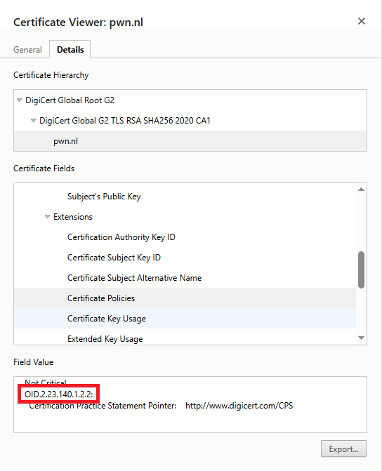
DV vs OV vs EV
Characteristic | DV | OV | EV
O= organisation | ❌ | ✅ | ✅
OU= org. unit | ❌ | optional | optional
Certificate Policies OID | 1.2.1 | 1.2.2 | 1.1
Organisation validation | ❌ | Standard | Strict, legal
Displayed in browser |  |  | (org name in older browsers)
Notes:
OID stands for Object Identifier.
The number highlighted indicates this is an OV certificate:
- 2.23.140.1.2.1 → Domain Validated (DV)
- 2.23.140.1.2.2 → Organization Validated (OV)
- 2.23.140.1.1 → Extended Validation (EV) certificate policy

Slide 52
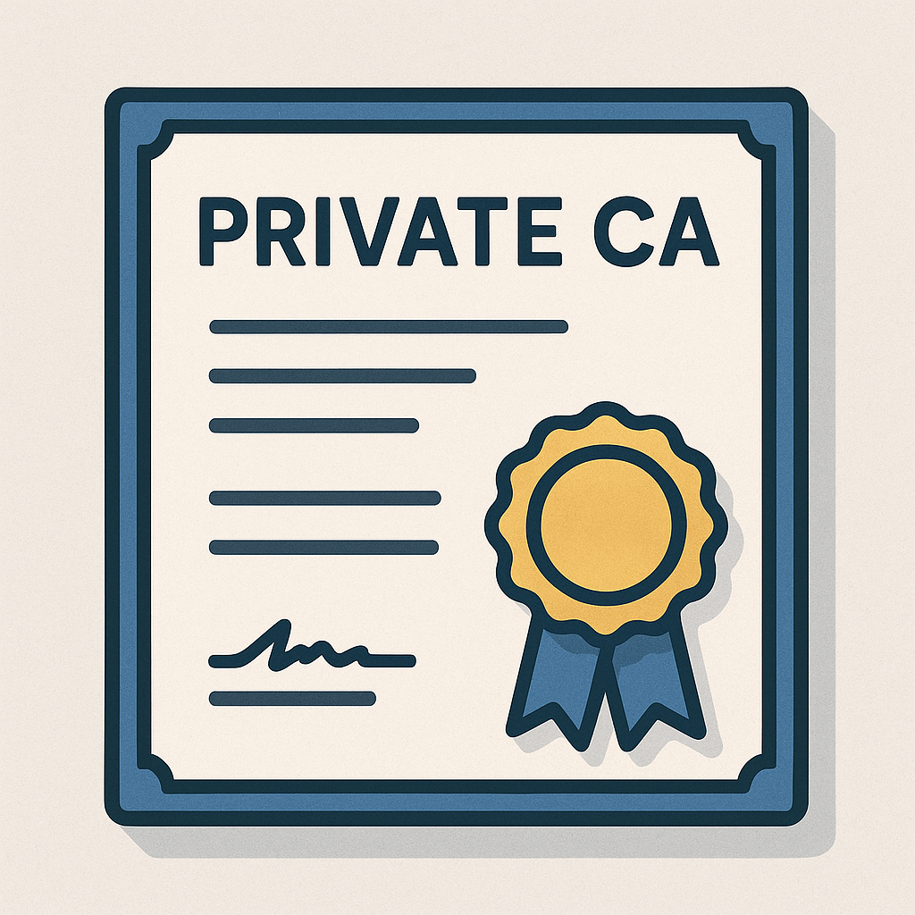
Trusting a CA – private CAs
Companies can have their own CA
By default not trusted by any device
Cheaper
Sometimes only possibility (because they don’t have internet access)
Can define own standards (validity period, etc.)

Slide 53
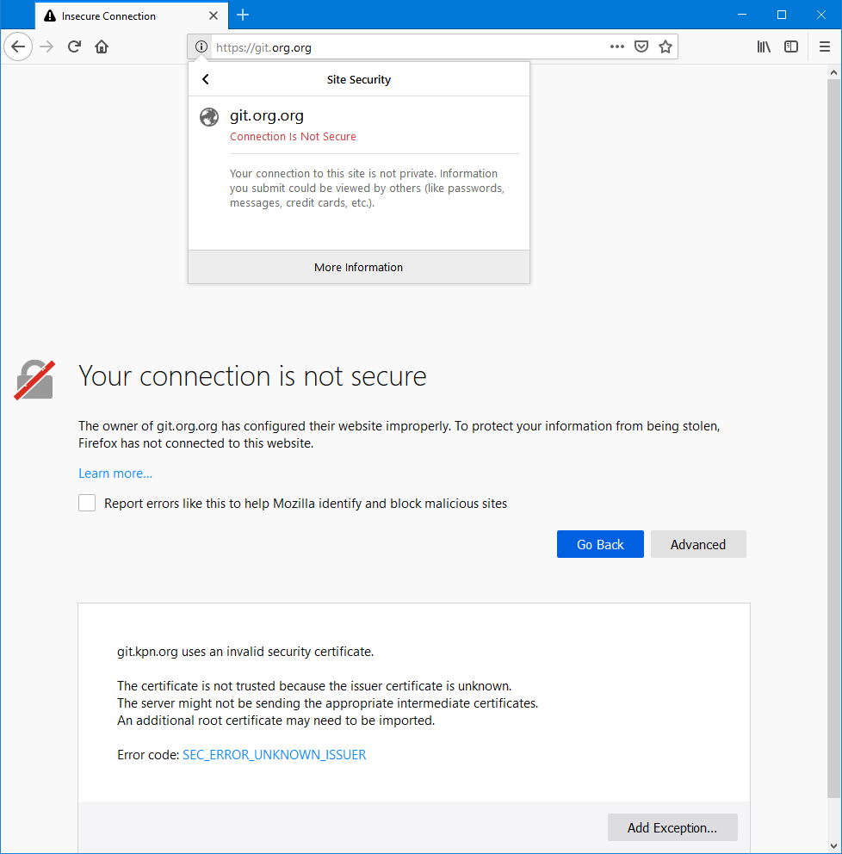
Trusting a CA – private CAs
Notes:
Private CAs are not trusted out of the box and this is the error you will see (more or less, depending on your browser) when it’s not trusted yet.
How to trust it? The next slides will explain that

Slide 54
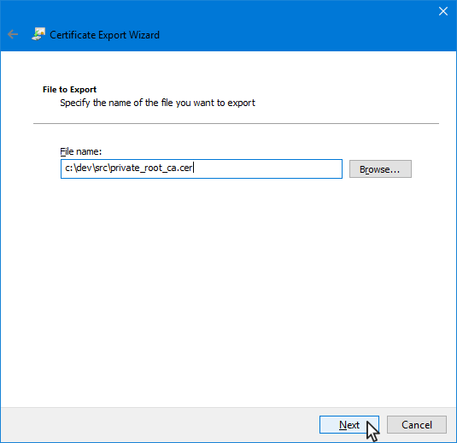
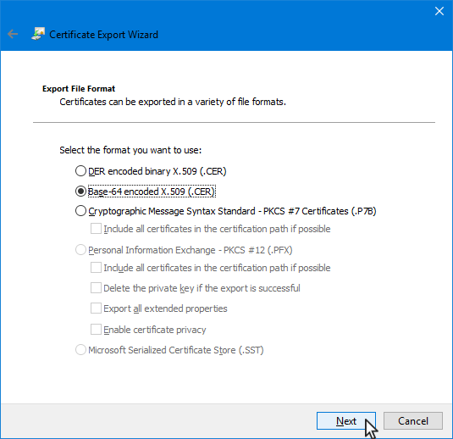
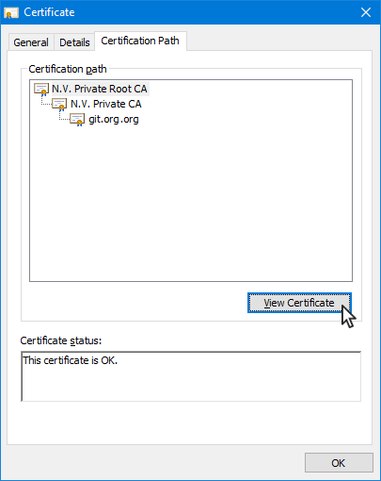
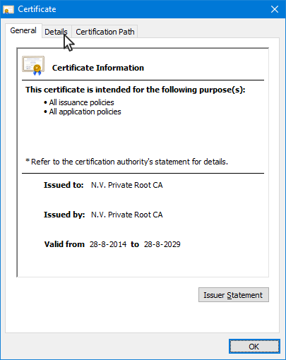
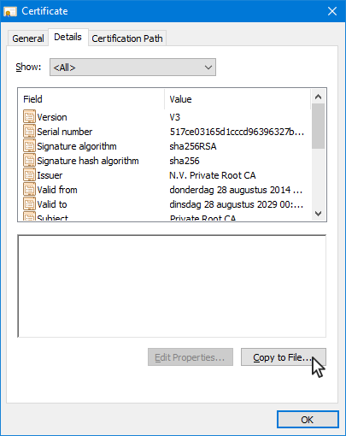
Trusting a CA – saving the certificate

Slide 55
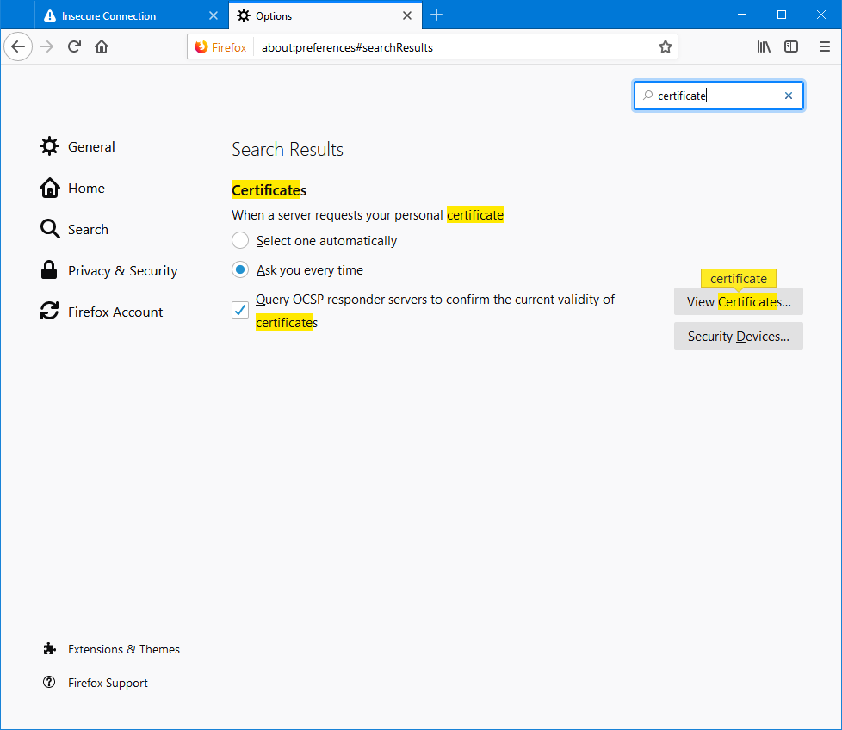
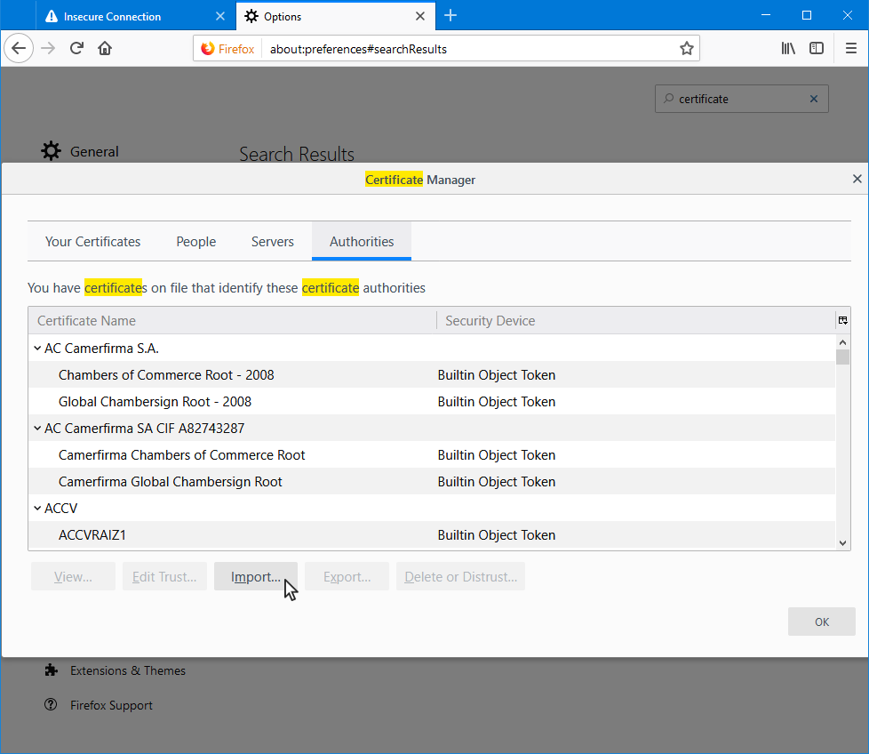
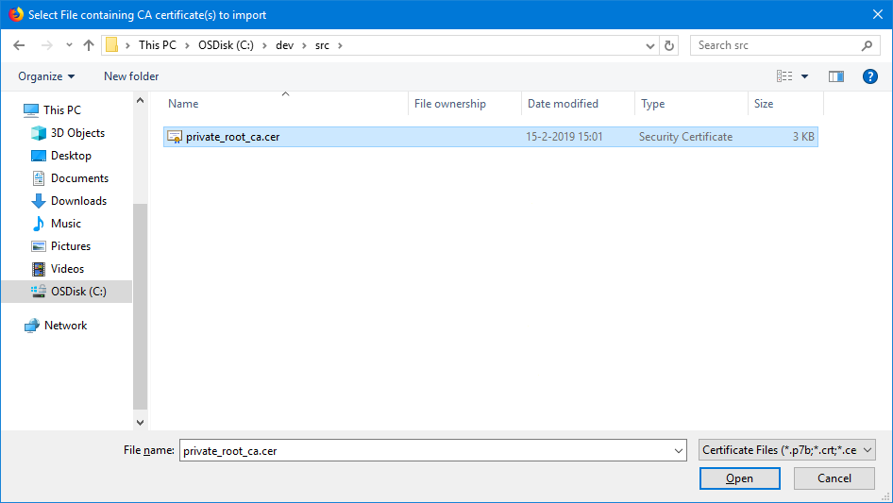
Trusting a CA – adding to truststore

Slide 56
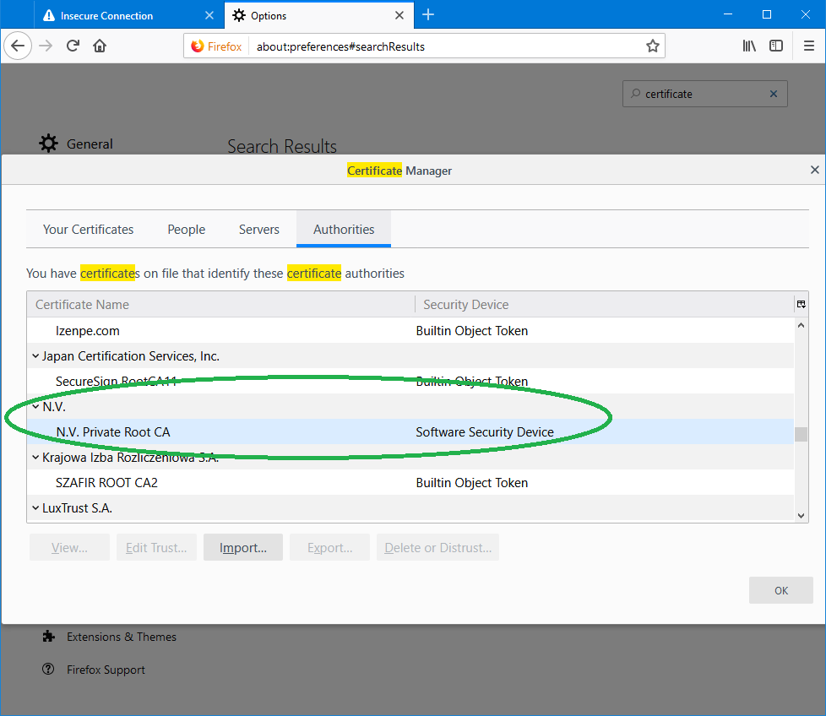
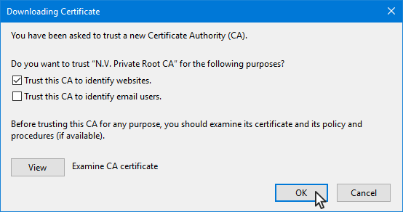
Trusting a CA – adding to truststore

Slide 57
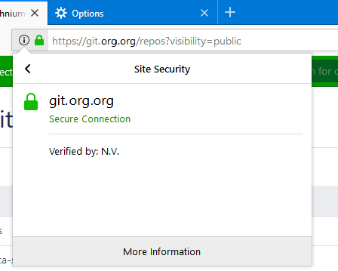
Trusting a CA – adding to truststore

Slide 58
Type of Certificates by domain
Single domain
Multi domain
Wildcard

Slide 59
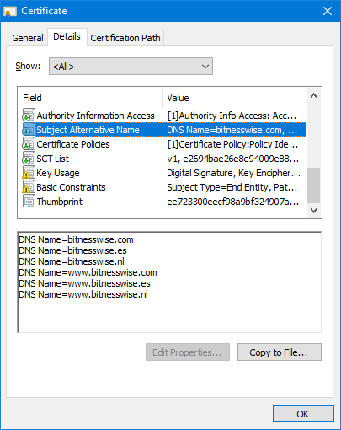
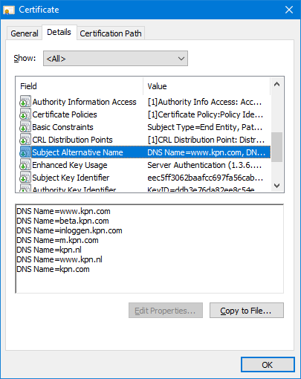
Multi domain
SANs
Subject Alternative Names
Pros: same website can be served under
different domain names with same
certificate
But beware ..
Notes:
You should really only use a SAN when the same website can be accessed with multiple domains. You should not use it out of convenience to serve different things with 1 certificate. The picture shows bad usage (this is an old example, they don’t do it anymore)

Slide 60
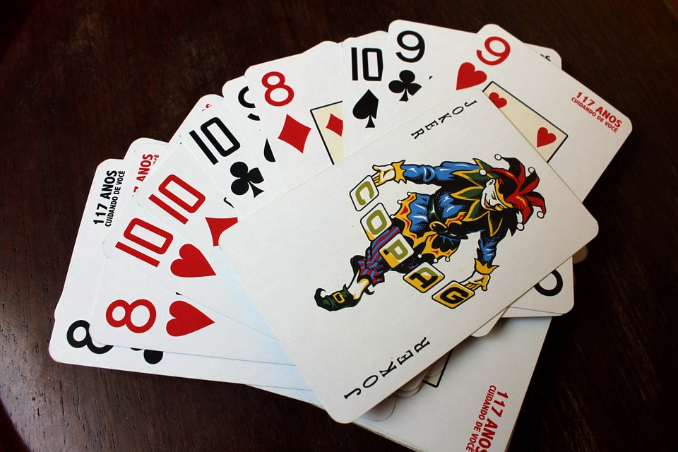
Wildcard Certificates
PROs : will work for any subdomain (convenience)
CONs : weakest link

Slide 61
Almost there……….

Slide 62
Related concepts / technologies
ETS
Server Name Indication
HTTP Strict Transport Security
Public Key Pinning
OCSP (Stapling)
CAA Record
Some vulnerabilities
Notes:
To finish this, we want to touch on some subjects that are closely related to https

Slide 63

ETS / eTLS
  Enterprise Transport Security
  Exra Terrible Security
  Weakened version of TLSv1.3, developed by ETSI
  Removes Forward Secrecy

Slide 64
Server Name Indication
Extension of TLS Protocol
Hostname included in TLS handshake
To enable multiple certificates on same IP
Not every client supports this (by default)

Slide 65
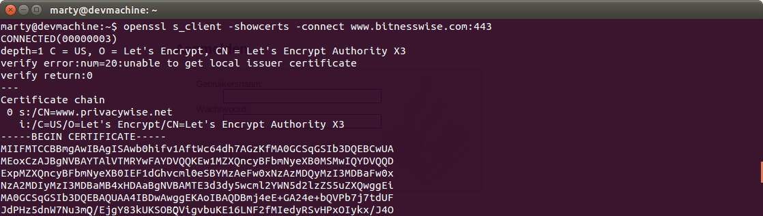

Server Name Indication

Slide 66
Encrypted SNI
Remember:
  Domain name (in header)
Expands on TLSv1.3
https://tools.ietf.org/html/draft-rescorla-tls-esni-00
Notes:
This is a reference to the slide where we showed which part of a request are encrypted.
Remember we said it depends for the Domain Name and that later we would explain why? This is the slide that explains it.
HTTP headers are encrypted, so the domain name in those headers are too
But SNI is/was unencrypted, so that request exposed the domain you were requesting
Encrypted SNI fixes that.

Slide 67



Question!
Notes:
A question to see if they’ve been paying attention. If they have, they might be able to solve it.
Why is there a mismatch even though the servername has been indicated?
Because of Subject Alternative Names. The .nl domain name must be a SAN of this certificate (and is of course, if you look at the complete certificate)

Slide 68

HTTP Strict Transport Security (HSTS)
A web security policy that prevents websites being loaded over (plain) HTTP
  First visit is needed
    Unless preloaded
  Can include subdomains
  Always has a TTL
Zero Tolerancy Mode
Beware : requires tight management of certificates

Slide 69


HTTP Public Key Pinning (HPKP)
Pinning is the process of associating a host with their expected public key (or those of any intermediate certificate)

Slide 70

HTTP Public Key Pinning (HPKP)
Pinning is the process of associating a host with their expected public key (or those of any intermediate certificate)

Slide 71
HTTP Public Key Pinning (HPKP)
Pinning is the process of associating a host with their expected public key (or those of any intermediate certificate)
Even more dangerous!
Alternatives : Certificate transparency logs and CAA records
(Expect-CT)
Deprecated by Google late 2017
Notes:
Pinning is still quite popular in mobile applications though!

Slide 72
OCSP (en CRL)
Level |  | Purpose | Used by
CRL | Certificate Revocation List | List of all certificates that have been revoked by the CA | Issued by the CA and sometimes downloaded by clients
OCSP | Online Certificate Status Protcol | A real-time status check for a single certificate (good / revoked / unknown) | Used by browsers or servers

Slide 73

OCSP Stapling
Aspect | Without stapling | With OCSP stapling
Who does the request? | Browser | Server
Speed | Slow (extra request) | Fast (in handshake)
Privacy | CA knows which websites you’re visiting | Privacy friendly
Browser support | All modern browsers | All modern browsers
Current status | Still used, but partly replaced by CRLite/CRLsets | Recommended

Slide 74

CAA Record
DNS Record to let know which CA can issue certificates
Optional Incident Reporting
https://sslmate.com/caa/
Cons:
  Depends on all CAs to honour this
  Depends on CA
Notes:
CAA = Certificate Authority Authorization
CAA records can include an “iodef” (Incident Object Description Exchange Format) tag.
This lets you specify an email or URL where a CA should report problems — like if someone tries to get a certificate for your domain without permission.

Slide 75










Vulnerabilities
BEAST (CVE-2011-3389)
CRIME (CVE-2012-4929)
BREACH (CVE-2013-3587)
Heartbleed (CVE-2014-0160)
POODLE (CVE-2014-3566 & CVE-2014-8730)
FREAK (CVE-2015-0204)
Bar Mitzvah (CVE-2015-2808)
Logjam (CVE-2015-4000)
DROWN (CVE-2016-0800)
SWEET32 (CVE-2016-2183)
Notes:
No need for a voice over. It’s just meant as a funny last slide

Slide 76


Slide 77
Resources
Openssl
  Generate csr / private key
  Inspect CSRs & certificates
Testssl
  https://github.com/drwetter/testssl.sh
SSLlabs
  https://www.ssllabs.com/ssltest/
Mindmap
  https://github.com/bitnesswise/https-mindmap

Slide 78
License & Attribution
This presentation is licensed under the Creative Commons Attribution 4.0 International License (CC BY 4.0).
You are free to use, share, and adapt this presentation, including for commercial purposes.
Original source: https://github.com/bitnesswise/https-presentation
Please:
Keep the original source attributions intact
Credit the original author
Indicate if you have made changes
You are not required to publish or share your adaptations.
© 2026 Martijn Korse / BitnessWise
CC BY 4.0 License

