Slide 1

Project Nightcrawler
Daniel Chyan, Katherine Li, Katherine Pogrebniak, Alice Zhang
Faster, Cheaper, Smarter Travel

Slide 2
Problem
No comprehensive comparison between all modes of transportation

Slide 3
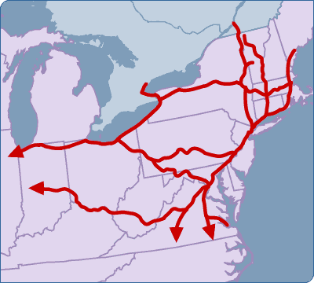
Purpose
Compare across modes of transportation to find you the cheapest and fastest routes!
Connect multiple modes of transportation to services routes that require at least one transfer across modes of transportation

Slide 4
Examples of Target Audience
College students on a budget
Businessmen who value their time
Travelers unfamiliar with the area

Slide 5
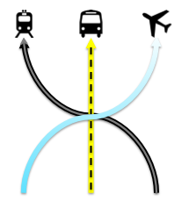

Our Logo

Slide 6











Travel Providers

Slide 7
Cities that we serve
New York
Albany
Amherst
Baltimore
Binghamton
Boston
Buffalo
Buffalo Airport
Burlington
New Brunswick
New Haven
Fair Haven
Harrisburg
Harford
Rochester
Salisbury
Watertown
Worcester
Belfast
Bridgeport
Philadelphia
Secaucus
State College
Storrs
Syracuse
Washington, DC
Allentown
Altoona
Atlantic City
Bangor
Bar Harbor
Bedford
Block Island
Bradford
Cumberland
Dubois
Saranac Lake
Westerly
Princeton
Berlin
Concord
Providence
Easton
Endicott
Erie
Franklin
Hagerstown
Hanover
Hyannis
Islip
Ithaca
Jamestown
Johnstown
Keene
Lancaster
Latrobe
Manchester
Trenton
Williamsport
Princeton Junction
Newark
Martha’s Vineyard
Massena
Nantucket
Newburgh
Stewart Field
Ogdensburg
Plattsburgh
Portland
Poughkeepsie
Presque Isle
Provincetown
Reading
Rockland
Rutland
Utica
Windsor Locks
Amsterdam
Brattleboro
Newark Airport

Slide 8
Functionality
Drop down menu for cities in the northeast
Enter time and date preferences
Sort results by cheapest prices, fastest elapsed time, by arrival time or by departure time
Links to book reservations
Maps to display routes

Slide 9
Demo
Notes:
Drop down city menu – auto-complete
Date calendar
How you can put in a time or not
Show different optimization mechanisms
Show multileg and how it works
Show link
Show map
Show overall price and elapsed time

Slide 10
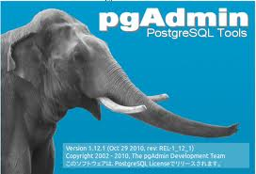






Back-end

Slide 11

Scraping
POST Requests
GET Requests
Regular Expressions

Slide 12





Front-end

Slide 13
Future Directions
Include more travel service providers (such as Bolt Bus and MTA North)
Improve the speed of the algorithm
Expand to other regions of the country
Compare to cost of driving

Slide 14
Challenges
Beautiful Soup
AWS Deployment
Message passing between front end and back end

