Slide 1

CanJS Meetup #6 – can.Component
Overview
Hello World
APIs

Slide 2
overview

Slide 3
can.Component
Create widgets that combine a view and a view-model on custom tags.
.

Slide 4
can.Component.extend(p)
can.Component.extend({
tag:"tabs",
template: "<ul>…</ul><content>…",
scope: {
active: false
},
helpers: {}
events: {
inserted: function(){...}
}
})
Notes:
Create a control
Has a view model that you make changes to
Those changes are reflected in some template
You still need to listen to events, especially DOM mutation events

Slide 5
can.Component
<tabs>
{{#each foodTypes}}
<panel title='{title}'>
{{content}}
</panel>
{{/each}}
</tabs>

Slide 6
can.Component
var foodTypes= new can.List([
{title: "Fruits", content: "oranges, apples"},
{title: "Breads", content: "pasta, cereal"},
{title: "Sweets", content: "ice cream, candy"}
]);
$("#out").html( can.view("app",{
foodTypes: foodTypes
}));

Slide 7
Why
Benefits of custom elements
User defined content
Friendly for designers
Initialization in one place
Easy to build the right way
View + View Model
Flexible
Internal can.Control

Slide 8
can.Component
View Model
TabsViewModel = can.Map.extend({
addPanel: function(){…}
removePanel: function(){…}
});
template = can.stache("<ul>{{#panels}}...")
<tabs>
{{#each foodTypes}}
<panel title='{title}'>{{content}}</panel>
{{/each}}
</tabs>
+
View
=
Element

Slide 9
Hello World

Slide 10
Define API
can.Component.extend({
tag: String,
template: String | renderer,
helpers: {name: handler([arg…], opts)},
scope: Object |
can.Map |
scope (attrs,parentScope, el),
events:
{"eventDescribe": handler(el, event)},
});
Notes:
tag
- can.view.tag
- dashed
- non-dashed must be registered

Slide 11
Instantiate API
< TAG [ATTR-NAME="{KEY}|ATTR-VALUE"] >
<custom-tag property="value"
property="{value}"
property="{{value}}">
</custom-tag>
Notes:
tag
- can.view.tag
- dashed
- non-dashed must be registered
template
- define user / shadow / composite
instantiate className , id, no others
camel case

Slide 12
tag
Specifies the tag name on which instances of the component will be created.
can.Component.extend({
tag: "foo-bar"
});
Notes:
Use hypens, they automatically have custom elements setup.

Slide 13
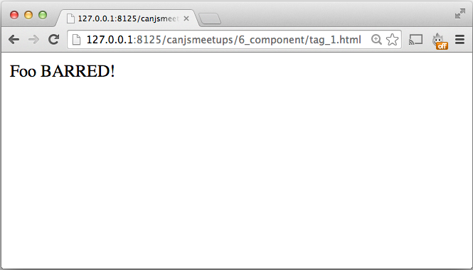
Notes:
tag_1 – shows defining component before compiling and rendering the view
tag-2 – shows defining after compiling, before rendering with hyphen
tag_3 – shows defining after compiling, before rendering without hyphens

Slide 14
template*
Specifies a template whose contents are rendered directly within a component’s element.
can.Component.extend({
tag: "my-modal",
template: can.stache(
"<div class='background'></div>"+
"<div class='modal-container'>"+
"<h3>{{title}}</h3>"+
"<div class='modal-contents'><content></content></div>"+
"</div>"),
});
Notes:
string -> can.Mustache template
can pass your own renderer … rendered with the “scope”
combined with source

Slide 15
template: String | renderer
can.Component.extend({
template: "<div>…</div>",
template: can.stache("<div>…</div>"),
template: can.mustache("<div>…</div>"),
template: can.view("my-view")
});
Notes:
Almost every widget that operates on a value needs to expose four common APIs to make it generally useful:

Slide 16
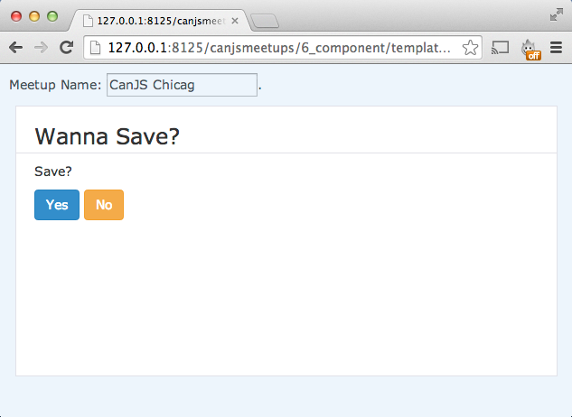

Slide 17
<content>DEFAULT</content>
Light / User DOM
Shadow DOM
<my-modal title="Wanna Save?">
<p>Save?</p>
<button>Yes</button>
<button>No</button>
</my-modal>
<div class='background'></div>
<div class='modal-container'>
<h3>{{title}}</h3>
<content>empty</content>
</div>
Composed DOM
<my-modal title="Wanna Save?">
<div class='background'></div>
<div class='modal-container'>
<h3>{{title}}</h3>
<p>Save?</p>
<button>Yes</button>
<button>No</button>
</div>
</my-modal>
Notes:
string -> can.Mustache template
can pass your own renderer … rendered with the “scope”
combined with source

Slide 18
<content>DEFAULT</content>
Light / User DOM
Shadow DOM
<my-modal title="Wanna Save?">
</my-modal>
<div class='background'></div>
<div class='modal-container'>
<h3>{{title}}</h3>
<content>empty</content>
</div>
Composed DOM
<my-modal title="Wanna Save?">
<div class='background'></div>
<div class='modal-container'>
<h3>{{title}}</h3>
empty
</div>
</my-modal>
Notes:
string -> can.Mustache template
can pass your own renderer … rendered with the “scope”
combined with source

Slide 19
can.view.Scope
Create a linked list of contexts representing a hierarchical lookup path.
new can.view.Scope(context, [parentScope]) //-> scope

Slide 20
Template:
{{#siblings}}
<li>{{.}} {{name.last}}</li>
{{/siblings}}
Data:
{
name: {first: "Justin", last: "Meyer"},
siblings: ["Kim", "Logan"]
}
Result:
<li>Kim Meyer</li> <li>Logan Meyer</li>

Slide 21
first
data
name
"Justin"
last
"Meyer"
siblings
0
"Kim"
"Logan"
1
Scope
<ul>
{{#siblings}}
<li>{{.}} {{name.last}}</li>
{{/siblings}}
</ul>
data.siblings.0
data.siblings.1
data
data
<ul>
<li>
<li>Logan Meyer</li>
</ul>
Kim
Meyer
</li>

Slide 22
can.view.Scope example
var data = new can.Map({
greeting: "Howdy",
person: {name: "stranger"}
});
var baseScope = new can.view.Scope( data );
var topScope = new can.view.Scope(
data.attr("person"),
baseScope );
var greeting = topScope.compute("greeting"),
name = topScope.compute("name")
greeting() //-> "Howdy"
name() //-> "stranger"
Notes:
For example, with jQueryUI

Slide 23
scope*
Specifies the component’s view model and a can.Map used to render the template.
can.Component.extend({
scope: Object |
can.Map |
scopeHandler(attrs, parentScope, el)
});
Notes:
string -> can.Mustache template
can pass your own renderer … rendered with the “scope”
combined with source

Slide 24
scope: function(attrs, parentScope, el)
can.Component.extend({
tag: "add-data",
scope: function(){
return new can.Map({
name: "CanJS"
});
}
});
Notes:
Almost every widget that operates on a value needs to expose four common APIs to make it generally useful:

Slide 25
scope: can.Map
var AddDataViewModel = can.Map.extend({
count: 0,
add: function(){
this.attr("count",
this.attr("count")+1);
}
});
can.Component.extend({
tag: "counter",
scope: AddDataViewModel
});
Notes:
Almost every widget that operates on a value needs to expose four common APIs to make it generally useful:

Slide 26
scope: Object
can.Component.extend({
tag: "counter",
scope: {
count: 0,
add: function(){
this.attr("count",
this.attr("count")+1);
}
}
});
Notes:
Almost every widget that operates on a value needs to expose four common APIs to make it generally useful:

Slide 27
scope.method( context, scope )
can.Component.extend({
tag: "counter",
scope: {
count: 0,
numbers: [1,2,3,4,5],
add: function(context, scope){
this.attr("count",
this.attr("count")+context);
} ,
prettyCount: function(context, scope){…}
}
});
Notes:
Almost every widget that operates on a value needs to expose four common APIs to make it generally useful:

Slide 28
Instantiate API
< TAG [ATTR-NAME="{KEY}|ATTR-VALUE"] >
<custom-tag property="value"
property="{value}"
property="{{value}}">
</custom-tag>
ATTR-NAME !== "id" | "class"
Notes:
tag
- can.view.tag
- dashed
- non-dashed must be registered
template
- define user / shadow / composite
instantiate className , id, no others
camel case

Slide 29
Instantiate Attributes
Cross bind to attribute
Cross bind to attribute
Attribute live to key value in scope
Cross bind to key value in scope
property="value"
property="{{key}}"
property="{key}"
Notes:
this is with stache

Slide 30
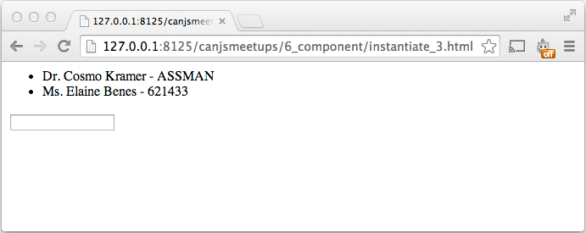
Cross bound + Camelized
Sets plateName on the scope.
Updating plateName updates the value pointed at by key.
plate-name="{key}"
Notes:
this is with stache

Slide 31
Secret Instantiate API
new Component( el,tagData );
var app = $("my-app")[0]
new MyApp(app, {
scope: new can.view.Scope({}),
options: new can.view.Options({}),
subtemplate: can.stache(app.innerHTML)
});
Notes:
tag
- can.view.tag
- dashed
- non-dashed must be registered
template
- define user / shadow / composite
instantiate className , id, no others
camel case

Slide 32
signatures
can.compute( getterSetter [, context] )
can.compute( initialValue [, settings] )
can.compute( initialValue,
setter(newVal,oldVal) )
can.compute( object, propertyName
[, eventName] )

Slide 33
can.compute( getterSetter [, context] )
var person = new can.Map({
first: 'Justin', last: 'Meyer'
});
var fullName = can.compute(function(){
return this.attr('first')+' '+
this.attr('last');
},person);
fullName() //-> "Justin Meyer"
Notes:
Almost every widget that operates on a value needs to expose four common APIs to make it generally useful:

Slide 34
can.compute( initialValue [, settings] )
var input = $("input#age");
var age = can.compute(input.val(),{
get: function(){
return input.val();
},
set: function(newVal){
input.val(newVal);
},
on: function(updated){
input.bind("change", updated);
},
off: function(updated){
input.unbind("change", updated);
}
});
age() //-> "31"
Notes:
api_video_play.html

Slide 35
can.compute( initialValue,
setter(newVal,oldVal) )
var age =
can.compute(6, function(newVal, oldVal){
if(!isNaN(+newVal)){
return +newVal;
} else {
return oldVal;
}
});
age() //-> 6
Notes:
Almost every widget that operates on a value needs to expose four common APIs to make it generally useful:

Slide 36
can.compute( object, propertyName
[, eventName] )
var input = document.getElementById('age');
var age = can.compute(input,"value","change");
age() //-> 31
var person = new can.Map({age: 31});
var age = can.compute(person,"age");
age() //-> 31
Notes:
api_video_position.html

Slide 37
IRUL

Slide 38
IRUL (“I rule”)
Initialize widget with a value
Read current value of the widget
Update the widget’s value
Listen for changes to widget’s value
Notes:
Almost every widget that operates on a value needs to expose four common APIs to make it generally useful:

Slide 39
IRUL (“I rule”)
Initialize widget with a value
$("#slider").slider({value: 5})
Read current value of the widget
$("#slider").slider("value") //-> 5
Update the widget’s value
$("#slider").slider("value",10)
Listen for changes to widget’s value
$("#slider").on("slidechange",handler)
Notes:
For example, with jQueryUI

Slide 40
Cross Binding
$("#slider").slider({
value: fullPercent()
});
fullPercent.bind("change",function(ev, newValue){
$("#slider").slider("value", newValue);
});
$("#slider").on("slide slidechange",function(){
fullPercent( $("#slider").slider("value") );
});
Notes:
irul_jqui_slider.html

Slide 41
IRUL (“I rule”)
Initialize widget with a value
new Slider({value: compute})
Read current value of the widget
compute() //-> 5
Update the widget’s value
compute(10)
Listen for changes to widget’s value
compute.bind("change",handler)
Notes:
For example, with jQueryUI

Slide 42
Cross Binding
new Slider("#slider",{
value: glass.compute('fullRatio')
})
Notes:
irul_compute_slider.html

Slide 43
can.compute & can.Map

Slide 44
map.compute
var obs = new can.Map({
first: "Justin", last: "Meyer"
});
first = obs.compute("first")
first() //-> "Justin"
first("Nate")
obs.attr("first") //-> "Nate"

Slide 45
method: compute
Person = can.Map.extend({
fullName: can.compute(function(){
return this.attr("first")+
" "+this.attr("last")
})
})
me = new Person(
{first: "Josh", last: "Marchan"}
)
me.attr("fullName") //-> "Josh Marchan"

Slide 46
method:compute
Person = can.Map.extend({
fullName: can.compute(function(newVal){
if(arguments.length){
var split = newVal.split(" ");
this.attr({
first: split[0],
last:split[1]
});
} else {
return this.attr("first")+
" "+this.attr("last")
}
})
});
me = new Person(
{first: "Josh", last: "Marchan"}
)
me.attr("fullName", "Justin Meyer")

Slide 47
can.compute & views

Slide 48
Live bound
var me = new can.Map({
first: "Andy", last: "Kant"
})
var fullName = can.compute(function(newVal){
return me.attr("first") +" "+ me.attr("last");
})
Full Name: <label>{{fullName}}</label>
Notes:
computes are live-bound
mustache_live.html

Slide 49
Live Functions
var me = new can.Map({
first: "Andy", last: "Kant"
})
var fullName = function(newVal){
return me.attr("first") +" "+ me.attr("last");
}
Full Name: <label>{{fullName}}</label>
Notes:
functions are automatically converted to a compute by canjs.
mustache_live_2.html

Slide 50
can-value
var fullName = can.compute(function(newVal){
if(arguments.length) {
var parts = newVal.split(" ");
me.attr({
first: parts[0],
last:parts[1]
});
} else {
return me.attr("first")+" "+ me.attr("last");
}
});
<input can-value="fullName" />
Notes:
getter-setter computes can be used with can-value
mustache_can-value.html

Slide 51
helpers
<h2>There are {{modules.length}} CanJS
{{plural "Module" modules.length}}.</h2>
can.Mustache.registerHelper(
"plural",
function(name, count){
if( typeof count === "function" ) {
count = count();
}
return count != 1 ? name+"s" : name;
});
Notes:
helpers passed observables pass computes
mustache_helpers_2.html

Slide 52
element helpers
<input type="text" {{value me.last}}/>
can.Mustache.registerHelper(
"value", function(value){
return function(el){
el.onchange = function(){ value(el.value) }
value.bind("change", function(ev, newValue){
el.value = newValue
});
el.value = value();
}
});
Notes:
The reason is so you can do fun element helpers that listen to when an observable changes.
Make sure you unbind from the compute when the element is removed from the page.
mustache_helpers_3.html

Slide 53
custom attributes
<input type="text" my-value="me.last"/>
can.view.attr("my-value", function(el, attrData){
var attrValue = el.getAttribute("my-value"),
value = attrData.scope.compute(attrValue);
el.onchange = function(){
value(el.value)
};
value.bind("change", function(ev, newValue){
el.value = newValue
});
el.value = value();
})
Notes:
When 2.1 lands, you can register custom element callbacks. These get called back with the scope. Scope has a compute method
that creates a get/set compute based upon a mustache key.
You could implement something close to can-value like above.
Make sure you unbind from the compute when the element is removed from the page.
mustache_attributes.html

Slide 54
attributes on components
<my-list items="selectedModules"></my-list>
selectedModules: function(){
var list = new can.List(),
type = this.attr("type");
this.attr("modules").each(function(mod){
if(type == "all" || … ) {
list.push(mod)
}
});
return list;
}
Notes:
mustache_component.html

