Slide 1

CanJS Meetup #2 – can.Map and can.List
Observable Overview
can.Map
can.List
ATM
@justinbmeyer
Notes:
I am Justin Meyer
Welcome to the first CanJS meetup!
Today we are going to talk:
a bit about the goals for these meetups.
Give an introduction to CanJS 2.0 while we build TodoMVC with CanJS.
Finally, we’ll end with QA and an open forum for questions.

Slide 2
Observer Pattern
A pattern in which an object, called the subject, maintains a list of its dependents, called observers, and notifies them automatically of any state changes.
Notes:
The observer pattern is basically pub-sub / events, but when state changes.
The subject in this definition we call Observables. Observables contain that state.

Slide 3
Observer Pattern
Observer
notify
Observable
notify
Observer

Slide 4
new can.Map(data)
var person = new can.Map({name:'josh'});
person.attr('name') //-> 'josh'
person.bind('name',function(ev,newVal,oldVal){
newVal //-> 'Justin'
oldVal //-> 'josh'
});
person.attr('name','Justin');
Notes:
Lets take a look at CanJS’s observables …
can.Map, which makes objects observable

Slide 5
new can.List(data)
var hobbies = new can.List(['JS']);
hobbies.attr(0) //-> 'JS'
hobbies.bind('add',function(ev,items,index){
items //-> ['bball','hip hop']
index //-> 1
});
hobbies.push('bball','hip hop');
Notes:
can.List makes Array’s observable

Slide 6
can.compute(data)
var age = can.compute(30);
age(); //-> 30
age.bind('change',function(ev,newVal,oldVal){
newVal //-> 31
oldVal //-> 30
});
age(31);
Notes:
And can.compute can make other values observable

Slide 7
can.compute(getter)
var info = can.compute(function(){
return person.attr("name")+" is "+age()+
" and likes: "+hobbies.join(', ')
});
info() //-> "Justin is 31 and likes
// JS, bball, hip hop"
info.bind('change',function(ev,newVal,oldVal){
newVal //-> "Justin is 31 and likes
// JS, bball"
});
hobbies.pop();
Notes:
And can make values derived from other observables observable.

Slide 8
De-coupling widgets
Digital Clock
Analog Clock
notify
notify
Timer
STOP
START
Notes:
An example use case of an observable might be a Timer observable that’s time property is
used to update a Digital clock and calendar.
Show Demo

Slide 9
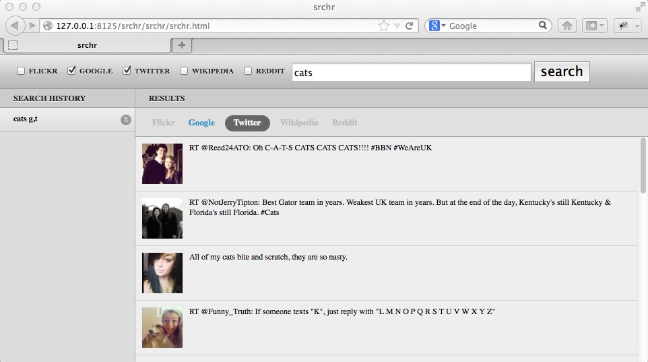

Slide 12
// in search.js
formSubmitted: function(){
var searchData = this.element.formParams();
history.add( searchData )
searchResults.update( searchData )
}

Slide 13
// in search.js
formSubmitted: function(){
var searchData = this.element.formParams();
history.add( searchData )
searchResults.update( searchData )
}

Slide 14
// in search.js
formSubmitted: function(){
var searchData = this.element.formParams();
history.add( searchData )
searchResults.update( searchData )
}
// in history.js
historyItemClicked: function(){
var searchData = this.element.data('search');
searchForm.add( searchData )
searchResults.update( searchData )
}

Slide 15
// in history.js
historyItemClicked: function(){
var searchData = this.element.data('search');
searchForm.add( searchData )
searchResults.update( searchData )
}

Slide 16
// in history.js
historyItemClicked: function(){
var searchData = this.element.data('search');
searchForm.add( searchData )
searchResults.update( searchData )
}

Slide 17
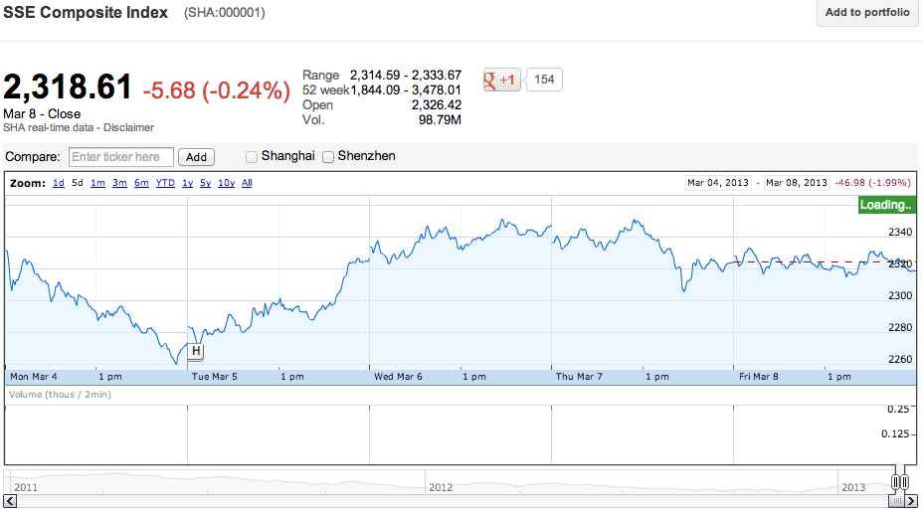

Slide 28
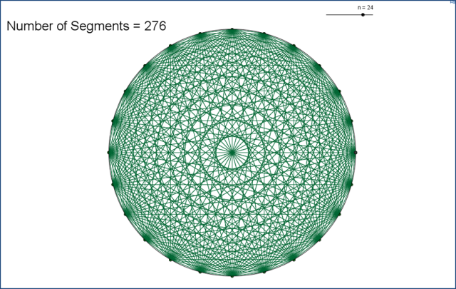

Slide 30
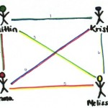

Slide 31
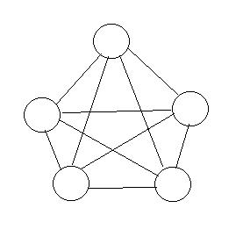

Slide 32
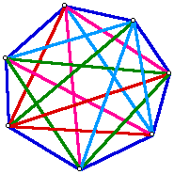

Slide 33
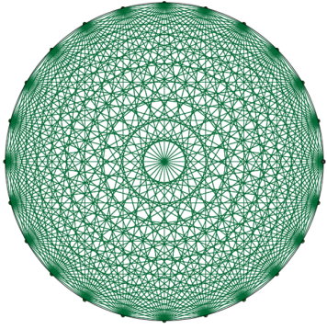

Slide 34
n ( n – 1 ) / 2

Slide 44
{
ticker: "SSE",
startTime: 1350709200000, // Oct 20, 2012
endTime: 1350795600000 // Oct 21, 2012
}

Slide 47
{
query: "cats",
types: ["Google", "Twitter"]
}

Slide 48
{
query: "cats",
types: ["Google", "Twitter"]
}

Slide 49
Search
{
query: "cats",
types: ["Google", "Twitter"]
}

Slide 50
new can.Map( [props] )
map.attr( key, value )
map.removeAttr( attrName )
map.bind( eventType, handler )
map.unbind( eventType[, handler] )
map.each( callback( item, propName ) )
map.serialize( callback( item, propName ) )
map.compute( attrName )
can.Map.extend( staticProps, protoProps )
COMPUTE-ATTR: can.compute( getter )
DEFAULT-ATTR: value
can.Map.keys( map )
can.Map API

Slide 51
Creating a can.Map
var obs = new can.Map({
name: 'Alexis'
});
Notes:
Not passing an object is the same as passing an empty object

Slide 52
Getting property values
obs.attr('name'); // 'Alexis'
obs.attr(); // { name: 'Alexis' }

Slide 53
Setting property values
obs = new can.Map({name: 'Alexis'});
obs.attr('name', 'Justin');
obs.attr('name') //-> "Justin"
obs.attr({age: 30});
obs.attr() //-> {name:"Justin",age:30}
obs.attr({age: 31}, true)
obs.attr() //-> {age:31}

Slide 54
Removing properties
obs.removeAttr('age');
obs.attr(); // {}

Slide 55
Listening to changes
obs.bind('change',
function(ev, attr, how, newVal, oldVal) {
/*
ev – The event object
attr – Which property changed
how – 'add', 'remove' or 'set'
newVal – value after change
oldVal – value before change
*/
});

Slide 56
Listening to changes
obs.bind('name',
function(ev, newVal, oldVal) {
// listening to a single property change
});

Slide 57
Helpers
var obs = new can.Map({
first: "Justin", last: "Meyer"
});
obs.each(function(value, propName){
});
obs.serialize() //->{first:"Justin",last:…}
c = obs.compute("first")
c() //-> "Justin"
can.Map.keys(obs) //-> ["first","last"]

Slide 58
Extending can.Map
Person = can.Map.extend({
fullName: function(){
return this.attr("first")+
" "+this.attr("last")
}
})
me = new Person(
{first: "Justin", last: "Meyer"}
)
me.fullName() //-> "Justin Meyer"

Slide 59
Compute Values
Person = can.Map.extend({
fullName: can.compute(function(){
return this.attr("first")+
" "+this.attr("last")
})
})
me = new Person(
{first: "Josh", last: "Marchan"}
)
me.attr("fullName") //-> "Josh Marchan"

Slide 60
Default Values
Person = can.Map.extend({
first: "Andy",
last: "Kant",
fullName: can.compute(function(){
return this.attr("first")+
" "+this.attr("last")
})
})
me = new Person()
me.attr("fullName") //-> "Andy Kant"

Slide 61
new can.List( [array] )
new can.List( deferred )
list.attr( key, value )
list.replace( array|deferred )
list.bind( eventType, handler )
list.unbind( eventType[, handler] )
list.each( callback( item, propName ) )
list.serialize( callback( item, propName ) )
.concat, .forEach, .join, .pop, .push,
.reverse, .shift, .slice, .sort, .splice,
.unshift
can.List.extend( staticProps, protoProps )
Map: Map
can.List API

Slide 62
Creating a can.List
var people = new can.List(['Alex', 'Bill']);

Slide 63
Creating a can.List
var def = $.Deferred()
var hobbies = new can.List(def);
hobbies.attr("length") //-> 0
def.resolve(["JS","Party rocking"])
hobbies.attr("length") //-> 2

Slide 64
Reading and writing attributes
var people = new can.List(['Alex', 'Bill']);
// set an element:
people.attr(0, 'Adam');
// get an element:
people.attr(0); // 'Adam’
// get all elements:
people.attr(); // ['Adam', 'Bill’]

Slide 65
Writing values
// extend the array:
people.attr(4, 'Charlie');
people.attr(); // ['Adam', 'Bill', undefined, undefined, 'Charlie']
// merge the elements:
people.attr(['Alice', 'Bob', 'Eve']);
people.attr(); // ['Alice', 'Bob', 'Eve', undefined, 'Charlie']
// set the elements:
people.attr(['Alice', 'Bob', 'Eve'], true );
people.attr(); // ['Alice', 'Bob', 'Eve']

Slide 66
Replacing values
people.replace(["Kathrine","Eric"])
people.attr("length") //-> 2
var def = $.Deferred();
people.replace( def );
people.attr("length") //-> 2
def.resolve(["Laura"])
people.attr("length") //-> 1

Slide 67
Array Methods
var people = new can.List(["Lizzy","Abby"])
people.push("Hank")
people.shift()
people.splice(0,2,"Kathrine")

Slide 68
Listening to events
var list = new can.List(["a","b","c"])
list.bind('change',
function(ev,index,how,newVals,oldVals) {
index //-> 1
how //-> "add"
newVals //-> ["X","Y"]
});
list.splice(1,0,["X","Y"])

Slide 69
Listening to events
var list = new can.List(["a","b","c"])
list.bind('change',
function(ev,index,how,newVals,oldVals) {
index //-> 1
how //-> "remove"
oldVals //-> ["b"]
});
list.splice(1,1)

Slide 70
Listening to events
var list = new can.List(["a","b","c"])
list.bind('change', function(ev, index, how, newVal, oldVal) {
index //-> 0
how //-> "set"
newVal //-> "A"
oldVal //-> "a"
});
list.attr(0,"A")

Slide 71
Listening to events
var list = new can.List(["a","b","c"])
list.bind('add',
function(ev,index,newVals) {
index //-> 1
newVals //-> ["X","Y"]
});
list.splice(1,0,["X","Y"])

Slide 72
Listening to events
var list = new can.List(["a","b","c"])
list.bind('remove',
function(ev,index,oldVals) {
index //-> 1
oldVals //-> ["b"]
});
list.splice(1,1)

Slide 73
Listening to events
var list = new can.List(["a","b","c"])
list.bind('length', function(ev,length) {
length //-> 2
});
list.splice(1,1)

Slide 74
Extending can.List
Numbers = can.List.extend({
sum: function(){
var sum = 0;
this.each(function(val){ sum += val })
return sum;
}
})
nums = new Numbers([1,2,3])
nums.sum() //-> 6

Slide 75
can.List’s Map property
var People = can.List.extend({
Map: Person
},{})
var people = new People([
{first: "Tom", last: "Greever"}
])
people.attr("0.fullName") //-> "Tom Greever"

Slide 76
Nested Properties
wife = new can.Map({
name: { first: "Payal", last: "Shah" }
})
wife.bind("change”,
function(ev,attr,how,newVal,oldVal){
attr //-> "name.first"
how //-> "set"
newVal //-> "Meyer"
oldVal //-> "Shah"
})
wife.attr("name.last","Meyer")

Slide 77
Batch Updating
If you have lots of changes to make to observes, you can batch them together to help performance – especially of those observes are live-bound to the DOM.

Slide 78
Batch Updating
me = new can.Map({
first: "Justin", last: "Meyer"
})
me.bind("first", function(ev){
ev.batchNum //-> 5
}).bind("last",function(ev){
ev.batchNum //-> 6
})
me.attr("first","Brian")
.attr("last","Moschel")

Slide 79
Batch Updating
me = new can.Map({ … })
me.bind("first", function(ev){
ev.batchNum //-> 5
}).bind("last", function(ev){
ev.batchNum //-> 5
})
can.batch.start()
me.attr("first","Brian")
.attr("last","Moschel")
can.batch.stop()

Slide 80
Batch Updating
me = new can.Map({
first: "Justin", last: "Meyer"
})
me.bind("first", function(ev){
ev.batchNum //-> 5
}).bind("last",function(ev){
ev.batchNum //-> 5
})
me.attr({first:"Brian",last:"Moschel"})

Slide 81


Slide 82



TRANSACTION
Reading
Card
chooseDeposit
chooseWithdraw /
currentTransaction
invalid
Picking Account
[ card ]
[ exit ]
[ chooseAccount ]
Reading
Pin
Withdraw Info
Deposit Info
[ card.verify ]
[ amount ]
ready
CARD
[ execute ]
unverified
executing
[ executed ]
[ verify ]
executed
Successful
Transaction
verified
[ removeTransaction ]
[ exit ]
Choosing
Transaction
Printing
Receipt
[ exit ]

Slide 83
Transaction
chooseDeposit
chooseWithdraw /
currentTransaction
Reading
Card
invalid
Picking Account
card
exit
chooseAccount
Reading
Pin
Withdraw Info
Deposit Info
card.verify
amount
ready
Card / Verifying Card
execute
unverified
executing
verify
executed
executed
Successful
Transaction
verified
Choosing
Transaction
removeTransaction
exit
Printing
Receipt
exit

