Slide 1

CanJS Meetup #3 – can.compute
Overview
Signatures
IRUL
Computes & Maps
Computes & Views

Slide 2
overview

Slide 3
can.compute
A computed method that represents some value. When this value is turned into a can.compute it can be read, updated, and listened to for changes. These are very powerful, especially when consumed by low level widgets.

Slide 4
Static Values
var age = can.compute(30);
age(); //-> 30
age.bind('change',function(ev,newVal,oldVal){
newVal //-> 31
oldVal //-> 30
});
age(31);
Notes:
And can.compute can make other values observable

Slide 5
Derived Values
var age = can.compute(31);
var person = new can.Map({name: 'Justin'});
var hobbies = new can.List(['JS', 'bball']);
var info = can.compute(function(){
return person.attr("name")+" is "+age()+
" and likes: "+hobbies.join(', ')
});
Notes:
Given the compute from the previous slide.
And two other observables.
I can create a derived compute, info that provides a string value for a composite value.
continued on next slide

Slide 6
Derived Values
var info = can.compute(function(){
return person.attr("name")+" is "+age()+
" and likes: "+hobbies.join(', ')
});
info() //-> "Justin is 31 and likes
// JS, bball"
info.bind('change',function(ev,newVal,oldVal){
newVal //-> "Justin is 31 and likes
// JS, bball"
});
hobbies.pop();
Notes:
overview_derived.html

Slide 7
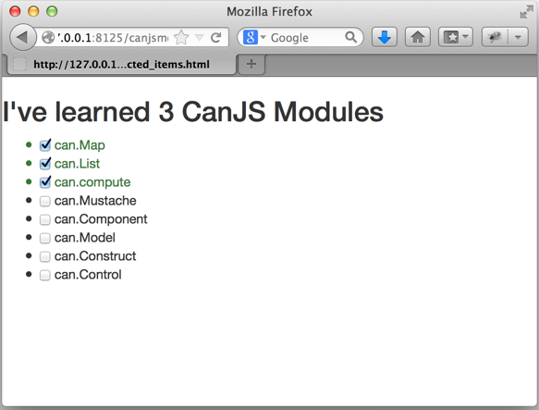
Notes:
overview_derived.html

Slide 8
Translated Values
var glass = new can.Map({ fullRatio: 0.5 });
var fullPercent = can.compute(function(newVal) {
if( arguments.length ) {
project.attr('fullRatio', newVal / 100);
} else {
return project.attr('fullRatio') * 100;
}
});
fullPercent(); // 50
fullPercent(75);
fullPercent(); // 75
glass.attr('fullRatio'); // .75
glass.attr('fullRatio', 1);
fullPercent(); // 100

Slide 9
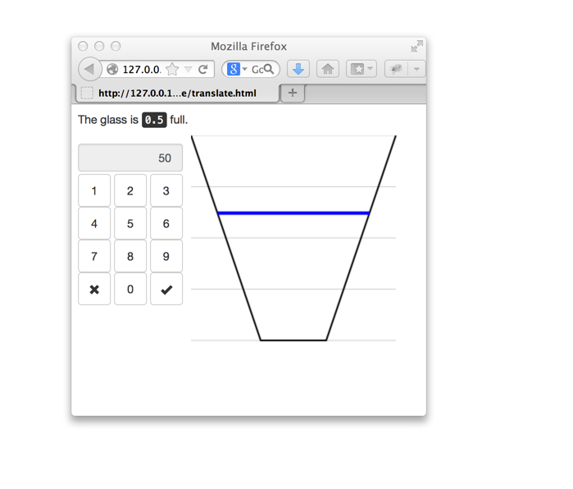
Notes:
overview_translate.html

Slide 10
signatures
can.compute( getterSetter [, context] )
can.compute( initialValue [, settings] )
can.compute( initialValue,
setter(newVal,oldVal) )
can.compute( object, propertyName
[, eventName] )

Slide 11
can.compute( getterSetter [, context] )
var person = new can.Map({
first: 'Justin', last: 'Meyer'
});
var fullName = can.compute(function(){
return this.attr('first')+' '+
this.attr('last');
},person);
fullName() //-> "Justin Meyer"
Notes:
Almost every widget that operates on a value needs to expose four common APIs to make it generally useful:

Slide 12
can.compute( initialValue [, settings] )
var input = $("input#age");
var age = can.compute(input.val(),{
get: function(){
return input.val();
},
set: function(newVal){
input.val(newVal);
},
on: function(updated){
input.bind("change", updated);
},
off: function(updated){
input.unbind("change", updated);
}
});
age() //-> "31"
Notes:
api_video_play.html

Slide 13
can.compute( initialValue,
setter(newVal,oldVal) )
var age =
can.compute(6, function(newVal, oldVal){
if(!isNaN(+newVal)){
return +newVal;
} else {
return oldVal;
}
});
age() //-> 6
Notes:
Almost every widget that operates on a value needs to expose four common APIs to make it generally useful:

Slide 14
can.compute( object, propertyName
[, eventName] )
var input = document.getElementById('age');
var age = can.compute(input,"value","change");
age() //-> 31
var person = new can.Map({age: 31});
var age = can.compute(person,"age");
age() //-> 31
Notes:
api_video_position.html

Slide 15
IRUL

Slide 16
IRUL (“I rule”)
Initialize widget with a value
Read current value of the widget
Update the widget’s value
Listen for changes to widget’s value
Notes:
Almost every widget that operates on a value needs to expose four common APIs to make it generally useful:

Slide 17
IRUL (“I rule”)
Initialize widget with a value
$("#slider").slider({value: 5})
Read current value of the widget
$("#slider").slider("value") //-> 5
Update the widget’s value
$("#slider").slider("value",10)
Listen for changes to widget’s value
$("#slider").on("slidechange",handler)
Notes:
For example, with jQueryUI

Slide 18
Cross Binding
$("#slider").slider({
value: fullPercent()
});
fullPercent.bind("change",function(ev, newValue){
$("#slider").slider("value", newValue);
});
$("#slider").on("slide slidechange",function(){
fullPercent( $("#slider").slider("value") );
});
Notes:
irul_jqui_slider.html

Slide 19
IRUL (“I rule”)
Initialize widget with a value
new Slider({value: compute})
Read current value of the widget
compute() //-> 5
Update the widget’s value
compute(10)
Listen for changes to widget’s value
compute.bind("change",handler)
Notes:
For example, with jQueryUI

Slide 20
Cross Binding
new Slider("#slider",{
value: glass.compute('fullRatio')
})
Notes:
irul_compute_slider.html

Slide 21
can.compute & can.Map

Slide 22
map.compute
var obs = new can.Map({
first: "Justin", last: "Meyer"
});
first = obs.compute("first")
first() //-> "Justin"
first("Nate")
obs.attr("first") //-> "Nate"

Slide 23
method: compute
Person = can.Map.extend({
fullName: can.compute(function(){
return this.attr("first")+
" "+this.attr("last")
})
})
me = new Person(
{first: "Josh", last: "Marchan"}
)
me.attr("fullName") //-> "Josh Marchan"

Slide 24
method:compute
Person = can.Map.extend({
fullName: can.compute(function(newVal){
if(arguments.length){
var split = newVal.split(" ");
this.attr({
first: split[0],
last:split[1]
});
} else {
return this.attr("first")+
" "+this.attr("last")
}
})
});
me = new Person(
{first: "Josh", last: "Marchan"}
)
me.attr("fullName", "Justin Meyer")

Slide 25
can.compute & views

Slide 26
Live bound
var me = new can.Map({
first: "Andy", last: "Kant"
})
var fullName = can.compute(function(newVal){
return me.attr("first") +" "+ me.attr("last");
})
Full Name: <label>{{fullName}}</label>
Notes:
computes are live-bound
mustache_live.html

Slide 27
Live Functions
var me = new can.Map({
first: "Andy", last: "Kant"
})
var fullName = function(newVal){
return me.attr("first") +" "+ me.attr("last");
}
Full Name: <label>{{fullName}}</label>
Notes:
functions are automatically converted to a compute by canjs.
mustache_live_2.html

Slide 28
can-value
var fullName = can.compute(function(newVal){
if(arguments.length) {
var parts = newVal.split(" ");
me.attr({
first: parts[0],
last:parts[1]
});
} else {
return me.attr("first")+" "+ me.attr("last");
}
});
<input can-value="fullName" />
Notes:
getter-setter computes can be used with can-value
mustache_can-value.html

Slide 29
helpers
<h2>There are {{modules.length}} CanJS
{{plural "Module" modules.length}}.</h2>
can.Mustache.registerHelper(
"plural",
function(name, count){
if( typeof count === "function" ) {
count = count();
}
return count != 1 ? name+"s" : name;
});
Notes:
helpers passed observables pass computes
mustache_helpers_2.html

Slide 30
element helpers
<input type="text" {{value me.last}}/>
can.Mustache.registerHelper(
"value", function(value){
return function(el){
el.onchange = function(){ value(el.value) }
value.bind("change", function(ev, newValue){
el.value = newValue
});
el.value = value();
}
});
Notes:
The reason is so you can do fun element helpers that listen to when an observable changes.
Make sure you unbind from the compute when the element is removed from the page.
mustache_helpers_3.html

Slide 31
custom attributes
<input type="text" my-value="me.last"/>
can.view.attr("my-value", function(el, attrData){
var attrValue = el.getAttribute("my-value"),
value = attrData.scope.compute(attrValue);
el.onchange = function(){
value(el.value)
};
value.bind("change", function(ev, newValue){
el.value = newValue
});
el.value = value();
})
Notes:
When 2.1 lands, you can register custom element callbacks. These get called back with the scope. Scope has a compute method
that creates a get/set compute based upon a mustache key.
You could implement something close to can-value like above.
Make sure you unbind from the compute when the element is removed from the page.
mustache_attributes.html

Slide 32
attributes on components
<my-list items="selectedModules"></my-list>
selectedModules: function(){
var list = new can.List(),
type = this.attr("type");
this.attr("modules").each(function(mod){
if(type == "all" || … ) {
list.push(mod)
}
});
return list;
}
Notes:
mustache_component.html

