Slide 1

CanJS Meetup #6 – can.route
Overview
API
Examples

Slide 2
overview

Slide 3
can.route
Connects a can.Map instance to the URL by translating changes in the URL to changes on the can.Map and vice versa.
.
Notes:
can.route connects a can.Map instance to the url and the url

Slide 4
can.Component.extend(p)
can.Component.extend({
tag:"tabs",
template: "<ul>…</ul><content>…",
scope: {
active: false
},
helpers: {}
events: {
inserted: function(){...}
}
})
Notes:
Create a control
Has a view model that you make changes to
Those changes are reflected in some template
You still need to listen to events, especially DOM mutation events

Slide 5
can.Component
<tabs>
{{#each foodTypes}}
<panel title='{title}'>
{{content}}
</panel>
{{/each}}
</tabs>

Slide 6
can.Component
var foodTypes= new can.List([
{title: "Fruits", content: "oranges, apples"},
{title: "Breads", content: "pasta, cereal"},
{title: "Sweets", content: "ice cream, candy"}
]);
$("#out").html( can.view("app",{
foodTypes: foodTypes
}));

Slide 7
Why
Benefits of custom elements
Initialization in one place
User defined content
Friendly for designers
Easy to build the right way
View + View Model
Flexible
Internal can.Control

Slide 8
can.Component
<tabs>
<panel title='Frameworks'>
CanJS, JavaScriptMVC, others
</panel>
<panel title='Libraries'>
jQuery, Underscore, etc
</panel>
</tabs>

Slide 9
can.Component
View Model
TabsViewModel = can.Map.extend({
addPanel: function(){…}
removePanel: function(){…}
});
template = can.stache("<ul>{{#panels}}...")
<tabs>
{{#each foodTypes}}
<panel title='{title}'>{{content}}</panel>
{{/each}}
</tabs>
+
View
=
Element

Slide 10
Hello World

Slide 11
Define API
can.Component.extend({
tag: String,
template: String | renderer,
helpers: {name: handler([arg…], opts)},
scope: Object |
can.Map |
scope (attrs,parentScope, el),
events: {"eventDescribe": handler(el, event)},
});
Notes:
tag
- can.view.tag
- dashed
- non-dashed must be registered

Slide 12
Instantiate API
< TAG [ATTR-NAME="{KEY}|ATTR-VALUE"] >
<custom-tag property="value"
property="{value}"
property="{{value}}">
</custom-tag>
Notes:
tag
- can.view.tag
- dashed
- non-dashed must be registered
template
- define user / shadow / composite
instantiate className , id, no others
camel case

Slide 13
tag
Specifies the tag name on which instances of the component will be created.
can.Component.extend({
tag: "foo-bar"
});
Notes:
Use hypens, they automatically have custom elements setup.

Slide 14
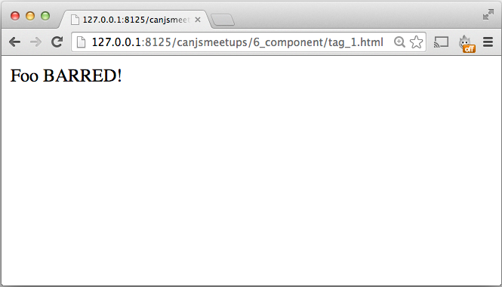
Notes:
tag_1 – shows defining component before compiling and rendering the view
tag-2 – shows defining after compiling, before rendering with hyphen
tag_3 – shows defining after compiling, before rendering without hyphens

Slide 15
[template]
Specifies a template whose contents are rendered directly within a component’s element.
can.Component.extend({
tag: "my-modal",
template: can.stache(
"<div class='background'></div>"+
"<div class='modal-container'>"+
"<h3>{{title}}</h3>"+
"<div class='modal-contents'><content></content></div>"+
"</div>"),
});
Notes:
string -> can.Mustache template
can pass your own renderer … rendered with the “scope”
combined with source

Slide 16
template: String | renderer
can.Component.extend({
template: "<div>…</div>",
template: can.stache("<div>…</div>"),
template: can.mustache("<div>…</div>"),
template: can.view("my-view")
});
Notes:
Almost every widget that operates on a value needs to expose four common APIs to make it generally useful:

Slide 17
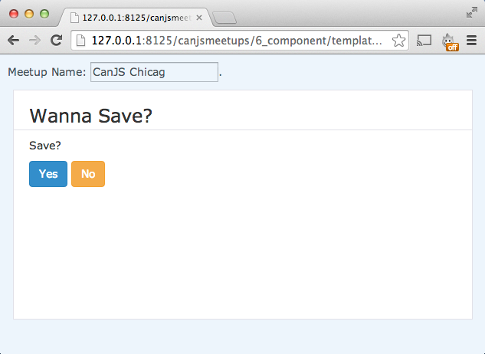

Slide 18
<content>DEFAULT</content>
Light / User DOM
Shadow DOM
<my-modal title="Wanna Save?">
<p>Save?</p>
<button>Yes</button>
<button>No</button>
</my-modal>
<div class='background'></div>
<div class='modal-container'>
<h3>{{title}}</h3>
<content>empty</content>
</div>
Composed DOM
<my-modal title="Wanna Save?">
<div class='background'></div>
<div class='modal-container'>
<h3>{{title}}</h3>
<p>Save?</p>
<button>Yes</button>
<button>No</button>
</div>
</my-modal>
Notes:
string -> can.Mustache template
can pass your own renderer … rendered with the “scope”
combined with source

Slide 19
<content>DEFAULT</content>
Light / User DOM
Shadow DOM
<my-modal title="Wanna Save?">
</my-modal>
<div class='background'></div>
<div class='modal-container'>
<h3>{{title}}</h3>
<content>empty</content>
</div>
Composed DOM
<my-modal title="Wanna Save?">
<div class='background'></div>
<div class='modal-container'>
<h3>{{title}}</h3>
empty
</div>
</my-modal>
Notes:
string -> can.Mustache template
can pass your own renderer … rendered with the “scope”
combined with source

Slide 20
can.view.Scope
Create a linked list of contexts representing a hierarchical lookup path.
new can.view.Scope(context, [parentScope]) //-> scope

Slide 21
Template:
{{#siblings}}
<li>{{.}} {{name.last}}</li>
{{/siblings}}
Data:
{
name: {first: "Justin", last: "Meyer"},
siblings: ["Kim", "Logan"]
}
Result:
<li>Kim Meyer</li> <li>Logan Meyer</li>

Slide 22
first
data
name
"Justin"
last
"Meyer"
siblings
0
"Kim"
"Logan"
1
Scope
<ul>
{{#siblings}}
<li>{{.}} {{name.last}}</li>
{{/siblings}}
</ul>
data.siblings.0
data.siblings.1
data
data
<ul>
<li>
<li>Logan Meyer</li>
</ul>
Kim
Meyer
</li>

Slide 23
can.view.Scope example
var data = new can.Map({
greeting: "Howdy",
person: {name: "stranger"}
});
var baseScope = new can.view.Scope( data );
var topScope = new can.view.Scope(
data.attr("person"),
baseScope );
var greeting = topScope.compute("greeting"),
name = topScope.compute("name")
greeting() //-> "Howdy"
name() //-> "stranger"
Notes:
For example, with jQueryUI

Slide 24
[scope]
Specifies the component’s view model and a can.Map used to render the template.
can.Component.extend({
scope: Object |
can.Map |
scopeHandler(attrs, parentScope, el)
});
Notes:
string -> can.Mustache template
can pass your own renderer … rendered with the “scope”
combined with source

Slide 25
scope: function(attrs, parentScope, el)
can.Component.extend({
tag: "add-data",
scope: function(){
return new can.Map({
name: "CanJS"
});
}
});
Notes:
Almost every widget that operates on a value needs to expose four common APIs to make it generally useful:

Slide 26
scope: can.Map
var CounterViewModel = can.Map.extend({
count: 0,
add: function(){
this.attr("count", this.attr("count")+1);
}
});
can.Component.extend({
tag: "counter",
scope: CounterViewModel
});
Notes:
Almost every widget that operates on a value needs to expose four common APIs to make it generally useful:

Slide 27
scope: Object
can.Component.extend({
tag: "counter",
scope: {
count: 0,
add: function(){
this.attr("count", this.attr("count")+1);
}
}
});
Notes:
Almost every widget that operates on a value needs to expose four common APIs to make it generally useful:

Slide 28
scope.method( context, scope )
can.Component.extend({
tag: "counter",
scope: {
count: 0,
numbers: [1,2,3,4,5],
add: function(context, scope){
this.attr("count", this.attr("count")+context);
} ,
prettyCount: function(context, scope){…}
}
});
Notes:
Almost every widget that operates on a value needs to expose four common APIs to make it generally useful:

Slide 29
Instantiate API
< TAG [ATTR-NAME="{KEY}|ATTR-VALUE"] >
<custom-tag property="value"
property="{value}"
property="{{value}}">
</custom-tag>
ATTR-NAME !== "id" | "class"
Notes:
tag
- can.view.tag
- dashed
- non-dashed must be registered
template
- define user / shadow / composite
instantiate className , id, no others
camel case

Slide 30
Instantiate Attributes
Cross bind to attribute
Cross bind to attribute
Attribute live to key value in scope
Cross bind to key value in scope
property="value"
property="{{key}}"
property="{key}"
Notes:
this is with stache

Slide 31
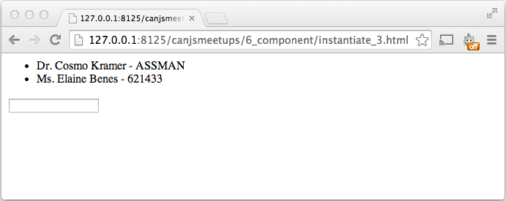
Camelized and Cross bound
Sets plateName on the scope.
Updating plateName updates the value pointed at by key.
plate-name="{key}"
Notes:
this is with stache

Slide 32
Secret Instantiate API
new Component( el,tagData );
var app = $("my-app")[0]
new MyApp(app, {
scope: new can.view.Scope({}),
options: new can.view.Options({}),
subtemplate: can.stache(app.innerHTML)
});
Notes:
tag
- can.view.tag
- dashed
- non-dashed must be registered
template
- define user / shadow / composite
instantiate className , id, no others
camel case

Slide 33
[events]
events: {
"[{context} ][selector ]eventName":
handler(context, event, [args])
}
"click": (el, ev)=>{},
"li click": (el, ev)=>{},
"{user.name} first": (name,ev,newV,oldV)=>{}
Notes:
this.element
this.scope
this is a control that looks like the component
in the future … it will be the element.

Slide 34
inserted: function(el, ev){ … }
can.Component.extend({
tag: "drivers",
template: can.view("drivers-stache"),
scope: {
drivers: new Driver.List()
},
events: {
inserted: function(){
this.scope.attr("drivers")
.replace( Driver.findAll() );
}
}
});
Notes:
Almost every widget that operates on a value needs to expose four common APIs to make it generally useful:

Slide 35
"{context} event": handler(el, ev, args)
can.Component.extend({
tag: "dmvs",
scope: {
zipCode: null,
dmvs: new Dmv.List()
},
events: {
inserted: function(){ ... },
"{dmvs} length": function(){
this.element.animate({opacity: 1},"slow");
}
}
});
Notes:
Almost every widget that operates on a value needs to expose four common APIs to make it generally useful:

Slide 36
[helpers]
helpers: {
name: helpers( [args…,] options)
}
options
.context
.scope
.fn
.inverse
.hash

Slide 37
helpers( [args…,] options)
can.Component.extend({
tag: "my-app",
scope: { editing: null },
helpers: {
isEditing: function(item, options){
if(this.attr("editing") === item) {
return options.fn();
} else {
return options.inverse();
}
}
}
});
Notes:
Almost every widget that operates on a value needs to expose four common APIs to make it generally useful:

Slide 38
demos

Slide 39
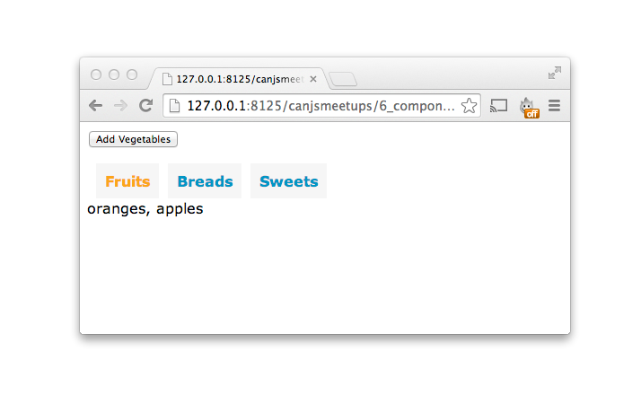
Tabs
Notes:
Almost every widget that operates on a value needs to expose four common APIs to make it generally useful:

Slide 40
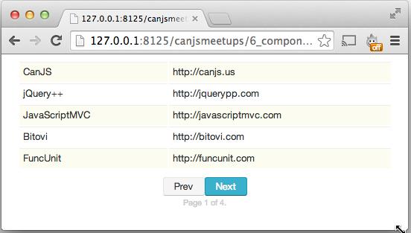
Paginate
Notes:
Almost every widget that operates on a value needs to expose four common APIs to make it generally useful:

Slide 41
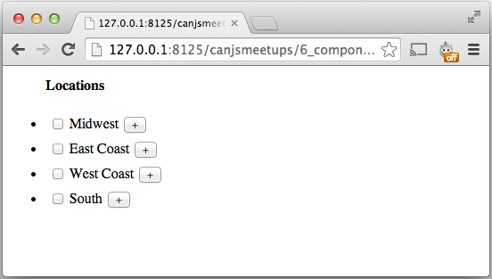
TreeCombo
Notes:
Almost every widget that operates on a value needs to expose four common APIs to make it generally useful:

