Slide 1

CanJS Meetup #6 – can.route
Overview
API
Examples

Slide 2
overview

Slide 3
can.route
Connects a can.Map instance to the URL by translating changes in the URL to changes on the can.Map and vice versa.
.
Notes:
can.route connects a can.Map instance to the url and the url

Slide 4
can.route(route,defaults)
location.hash //-> "#!"
can.route.attr() //-> {}
can.route.attr("page","recipes");
location.hash //-> "#!page=recipes"
location.hash = "#!page=recipes&id=1"
can.route.attr() //-> { page: "recipes",
id: "1" }
Notes:
JavaScript has 10 basic data types.
mutable

Slide 5
can.route(route,defaults)
can.route(":page/:id");
can.route.bind("id", function(ev, id){
if(can.route.attr('page') == "recipes"){
if( id ){
Recipe.findOne({id: id});
}e
}
});
location.hash = "#!recipes/1"
Notes:
JavaScript has 10 basic data types.
mutable

Slide 6
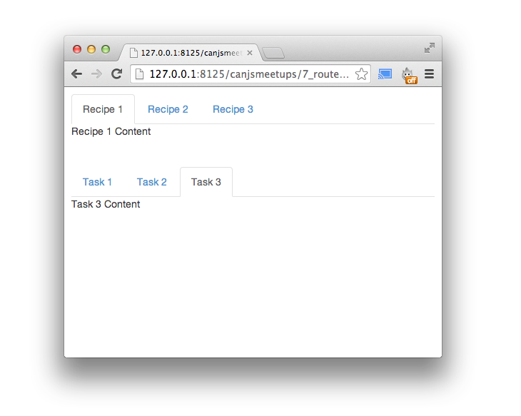
Why
Independence
State
Modularity
Less Code

Slide 7
URL
DOM
/#!
Routes
View
App State
{
pageNum: 1
};

Slide 8
URL
DOM
/#!
Routes
View
App State
{
pageNum: 1
};

Slide 9

URL
DOM
/#!
Routes
View
App State
{
pageNum: 1
};

Slide 10
URL
DOM
/#!
Routes
View
<button
can-click='paginate.next'
App State
{
pageNum: 1
};

Slide 11
URL
DOM
/#!
Routes
View
<button
can-click='paginate.next'
App State
// paginate
page : {
get : function(newVal) {
return this.attr('offset') /
… ;
}
},
{
pageNum: 1
};

Slide 12
URL
DOM
/#!
Routes
View
<button
can-click='paginate.next'
App State
// b-app scope:
page : {
get : function() {
return this.attr("paginate")
.attr("page");
}
},
{
pageNum: 1
};

Slide 13
URL
DOM
/#!
Routes
View
<button
can-click='paginate.next'
App State
{
pageNum: 1
};
<!—app-stache->:
<b-app page="{pageNum}">

Slide 14
URL
DOM
/#!
Routes
View
<button
can-click='paginate.next'
App State
{
pageNum: 2
};
<!—app-stache->:
<b-app page="{pageNum}">

Slide 15
URL
DOM
/#!
Routes
View
<button
can-click='paginate.next'
can.route(":pageNum");
App State
{
pageNum: 2
};
<!—app-stache->:
<b-app page="{pageNum}">

Slide 16
URL
DOM
/#!2
Routes
View
<button
can-click='paginate.next'
can.route(":pageNum");
App State
{
pageNum: 1
};
<!—app-stache->:
<b-app page="{pageNum}">

Slide 17

URL
DOM
/#!
<a href="#!2">next</a>
Routes
View
App State
{
pageNum: 1
};

Slide 18
URL
DOM
/#!2
<a href="#!2">next</a>
Routes
View
App State
{
pageNum: 1
};

Slide 19
URL
DOM
/#!2
<a href="#!2">next</a>
Routes
View
can.route(":pageNum");
App State
{
pageNum: 1
};

Slide 20
URL
DOM
/#!2
<a href="#!2">next</a>
Routes
View
can.route(":pageNum");
App State
{
pageNum: 2
};

Slide 21
URL
DOM
/#!2
<a href="#!2">next</a>
Routes
View
can.route(":pageNum");
App State
{
pageNum: 2
};
<!—app-stache->:
<b-app page="{pageNum}">

Slide 22
URL
DOM
/#!2
<a href="#!2">next</a>
Routes
View
can.route(":pageNum");
App State
// b-app scope:
page : {
set : function(newVal) {
this.attr("paginate")
.attr("page",newValue)
}
},
{
pageNum: 2
};

Slide 23
URL
DOM
/#!2
<a href="#!2">next</a>
Routes
View
can.route(":pageNum");
App State
// paginate
page : {
set: function(newVal) {
this.attr('offset',
(newVal - 1) *
this.attr('limit'));
}
},
{
pageNum: 2
};

Slide 24
URL
DOM
/#!2
<a href="#!2">next</a>
Routes
View
can.route(":pageNum");
{{#if paginate.canNext}}
App State
// paginate
page : {
set: function(newVal) {
this.attr('offset',
(newVal - 1) *
this.attr('limit'));
}
},
{
pageNum: 2
};

Slide 25
API

Slide 26
can.route.attr()
location.hash //-> "#!"
can.route.attr() //-> {}
can.route.attr("page","recipes");
location.hash //-> "#!page=recipes"
location.hash = "#!page=recipes&id=1"
can.route.attr() //-> { page: "recipes",
id: "1" }
Notes:
JavaScript has 10 basic data types.
mutable

Slide 27
can.route.bind
can.route.bind('change',
function(ev, attr, how, newVal, oldVal) {
/*
ev – The event object
attr – Which property changed
how – 'add', 'remove' or 'set'
newVal – value after change
oldVal – value before change
*/
});

Slide 28
Listening to changes
can.route.attr('genre', 'horror'); // how === "add”
can.route.attr('genre', 'drama'); // how === "set"
can.route.removeAttr('genre'); // how === "remove"

Slide 29
can.route.bind
can.route.bind('type',
function(ev, newVal, oldVal) {
/*
ev – The event object
newVal – value after change
oldVal – value before change
*/
});

Slide 30
can.route(str, [defaults])
Sets a “pretty” two way translation between the url and map instance.
can.route("",{
page: "home",
loc: "usa"
});
can.route(":page", {loc: "usa"});
can.route(":page/:loc");
location.hash = "#!";
can.route.attr() //-> {page: "home", loc: "usa"}
can.route.attr("loc","canada");
location.hash //-> "#!home/canada"

Slide 31
can.route.url( data, [merge])
Create a URL based on route data passed to it
can.route.url({ type: 'videos', id: 5 })
// #!type=videos&id=5
can.route(':type/:id');
can.route.url({ type: 'videos', id: 5 })
// #!videos/5
can.route.url({ type: 'videos', id: 5, isNew: false })
// #!videos/5&isNew=false

Slide 32
can.route.url( data, [merge])
can.route(':recipe/:task');
location.hash //-> #!recipe3/task1
can.route.url({ recipe: 'recipe2'})
//-> "#!recipe=recipe2"
can.route.url({ recipe: 'recipe2'},true)
//-> "#!recipe2/task1"

Slide 33
can.route.link(text, data, props, [merge])
Similar to can.route.url, but will make an entire anchor tag for you with the appropriate URL based on available route data
can.route(':type/:id');
can.route.link( "My video", {
type: "videos", id: 5
}, {
className: "new"
}, false );
// <a href="#!videos/5" class="new">My Video</a>

Slide 34
can.route.ready()
Sets up the two-way binding between the hash and the map instance and sets the maps initial values.

Slide 35
can.route.map(can.Map | can.map)
Assign the observable can.Map instance that is cross bound to the url.
var State = can.Map.extend({
getItem: function(){
return Item.findOne({id: this.attr("itemId")})
}
});
var state = new State();
can.route.map(state);
location.hash = "#!itemId=5"
can.route.ready();
state.attr() //-> {itemId: 5}
can.route.attr() //-> {itemId: 5}
can.route === state //-> false
state.getItem() //-> Deferred

Slide 36
can.route.map(can.Map | can.map)
Assign the observable can.Map instance that is cross bound to the url.
State = can.Map.extend({
define: {
item: {
get: function(old, set){
Item.findOne({id: this.attr("itemId")}, set);
}
}
}
});
can.route.map(State);
location.hash = "#!itemId=5"
can.route.ready();
can.route.bind("item",function(ev, item){ ... })

Slide 37
can.route.current(data)
Check if data represents the current route.
can.route.attr('id', 5) // location.hash -> "#!id=5"
can.route.current({id: 5}) //-> true
can.route.current({id: 5, type: 'videos'}) //-> false
can.route.attr('type', 'videos')
// location.hash -> #!id=5&type=videos
can.route.current({id: 5, type: 'videos'}) // -> true

Slide 38
can.route.deparam( url )
Check if data represents the current route.
can.route(":type/:id")
can.route.deparam("videos/5");
// -> {
id: 5,
route: ":type/:id",
type: "videos"
}

Slide 39
can.route.param( data )
Get a url path from given data.
can.route(":type/:id")
can.route.param({type: "video", id: 5})
// -> "video/5"
can.route
.param({type: "video",id: 5,isNew: false})
// -> "video/5&isNew=false"

Slide 40
demos

