Slide 1
Group 59
Scrabble Player Rating
Members :
Chaitanya Singh (B24CS1088)
Kinjal Choudhary (B24EE1035)
Meet Kiyada (B24EE1036)
Ankit Vaniya (B24CM1064)

Slide 2
Problem Statement
The Objective: Our primary goal is to develop a robust machine learning pipeline capable of predicting the Elo rating of human players in Scrabble games hosted on the Woogles.io platform.
The Importance of Skill Estimation: Accurate rating prediction is crucial for maintaining fair matchmaking systems, tracking player improvement over time, and identifying potential anomalies or 'sandbagging' in competitive play.
Predictive Context: Unlike many games where outcome is the only metric, Scrabble offers rich, turn-level data that reflects a player's strategic depth, vocabulary, and ability to manage resources (tiles).

Slide 3
Problem Statement
The Challenge of Identity vs. Performance: A major hurdle is balancing 'who the player is' (historical rating/nickname) with 'how they played in this specific game.' High-rated players occasionally play poorly, and vice versa.
Target Variable: The model specifically targets human_rating, which ranges significantly across the dataset, requiring high precision in regression.
Evaluation Metrics: We prioritize RMSE (Root Mean Squared Error) to penalize large outliers and MAE (Mean Absolute Error) for overall interpretability.
Validation Strategy: To ensure the model generalizes to new players and games, we employed 5-Fold Grouped Cross-Validation, grouping by game_id to prevent any data leakage between training and validation sets.

Slide 4
Dataset Description
Dataset Overview:72,773 games | 3 bots vs humans | BetterBot (Beginner) · STEEBot (Intermediate) · HastyBot (Advanced) 50,410 train / 22,363 test games
games.csv: Game metadata game_id · first · winner · created_at · game_duration_seconds time_control_name — ultrablitz / blitz / rapid / regular game_end_reason — STANDARD / RESIGNED / TIME / CONSECUTIVE_ZEROES lexicon — CSW21 / NWL20 / ECWL / NSWL20 rating_mode · initial_time_seconds · increment_seconds · max_overtime_minutes
turns.csv:Move-by-move data game_id · turn_number · nickname · rack · score · points location — board position (NA in test set) move — tiles played; -- Pass · -tiles Exchange · (tiles) remaining at end turn_type — Play / Exchange / Pass / Six-Zero Rule / Challenge
train.csv / test.csv: Per-player per-game game_id · nickname · score (final) · rating (pre-game, per lexicon+time control) ⚠ rating is NA for human players in test.csv — this is the prediction target

Slide 5
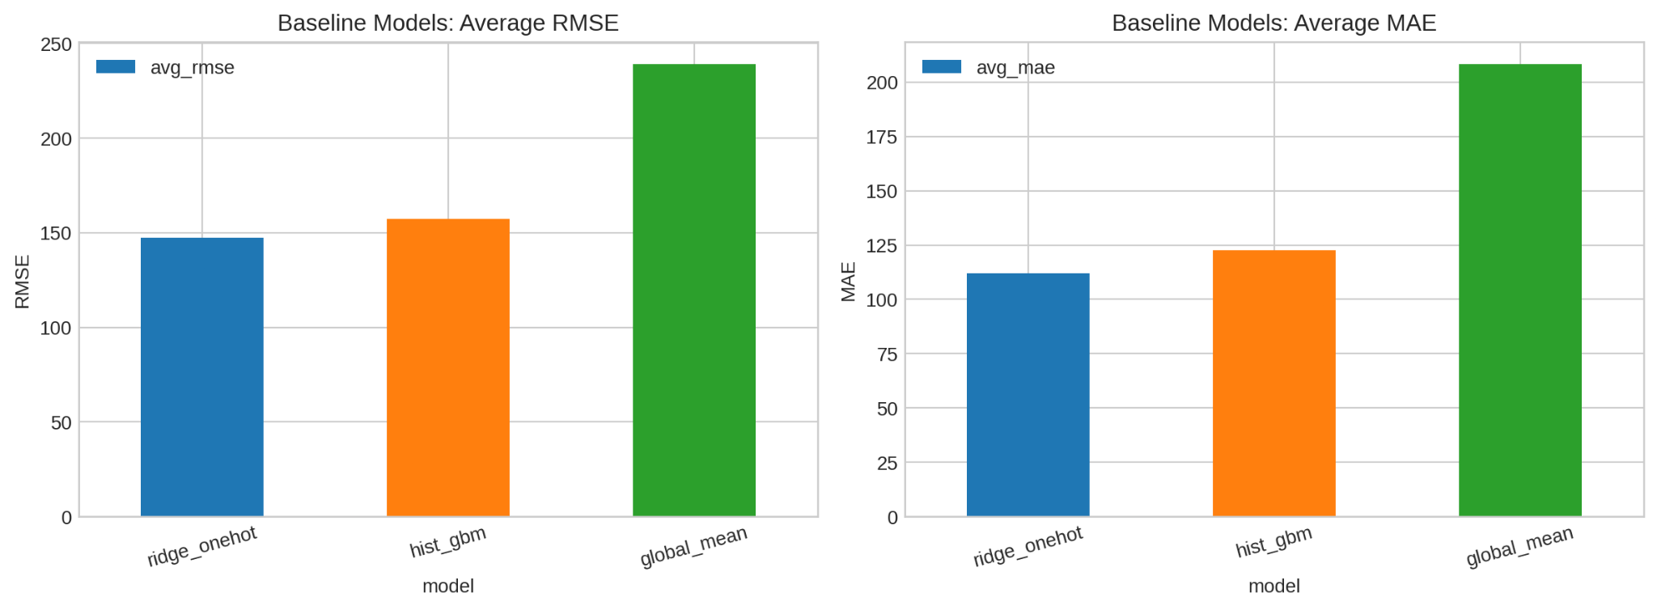
Baseline Model
Architecture
Approach: Our baseline, established in baseline_model.ipynb, evaluates three models: Global Mean, Ridge Regression, and HistGradientBoostingRegressor
Feature Selection: This model relies on game-level metadata and score-based features. Categorical variables such as bot, lexicon, and settings are handled via One-Hot Encoding.
Logic: It predicts player ratings using only game results and metadata, without considering move-by-move gameplay.
Interpretation: The baseline captures strong metadata signals but lacks turn-level insight, limiting its ability to evaluate move quality and making it dependent on outcome-driven patterns.

Slide 6
Final Model - The Blended Ensemble
The Architecture: We transitioned to a Weighted Ensemble named blend_ridge_hist.
Component A - Ridge Regression (65% Weight): Retains the baseline's ability to handle high-cardinality nicknames and linear trends efficiently.
Component B - Histogram Gradient Boosting (35% Weight): A non-linear tree-based model (HistGBM) that excels at finding complex interactions within the newly engineered turn-level features.
Why this works: The blend captures the stability of the player's history while adjusting the prediction based on the specific 'skill' demonstrated in the turn data.

Slide 7
Efforts: Turn-Level Feature Engineering
Aggregation Strategy: We transformed the granular turns.csv data into a 'per-player-per-game' summary.
Key Metrics Created:
Scoring Efficiency: Average points per turn and total game score.
Strategic Choices: Frequency of 'Exchange' moves (indicating tile management) and 'Pass' moves.
Game Tempo: Calculating moves per game and time management metrics.
Outcome: This added 34 additional dimensions of data that were previously ignored by the baseline model.

Slide 8
Methodology: Feature Engineering Pipeline
Preprocessing: We implemented a dual-path pipeline to handle the 43 numeric and 7 categorical features.
Scaling: Numeric features were processed using StandardScaler to ensure the Ridge component wasn't biased by feature magnitude.
Encoding: For the HistGBM component, we utilized Ordinal Encoding, which is more efficient for tree-based models than One-Hot Encoding.
Missing Data: We developed custom handling for cases where turn logs might be missing for specific games, ensuring the pipeline never crashes during inference.

Slide 9
Methodology: Model Selection & Tuning
Candidate Benchmarking: We didn't stop at Ridge and HistGBM. We benchmarked several popular algorithms including XGBoost and LightGBM.
Observations: Interestingly, while Boosting models are usually superior, the presence of player nicknames (high cardinality) made the linear Ridge model very competitive.
Hyperparameter Tuning: We tuned the regularization alpha for Ridge and the learning rate/max depth for the Boosting components to find the optimal 'sweet spot' for our ensemble weights.

Slide 10
Methodology: Ensuring Pipeline Robustness
Cold-Start Handling: One of our major efforts was ensuring the model could handle 'unseen' players in the test set. We used categorical mapping that defaults unknown nicknames to a global average.
Automated Merging: We built a dedicated merge_optional_features function that safely combines the turn-level aggregates with the game metadata, handling key mismatches and duplicate indices.
Inference Speed: Despite the complexity of the ensemble, the pipeline is optimized for rapid prediction, suitable for real-time rating updates.

Slide 11
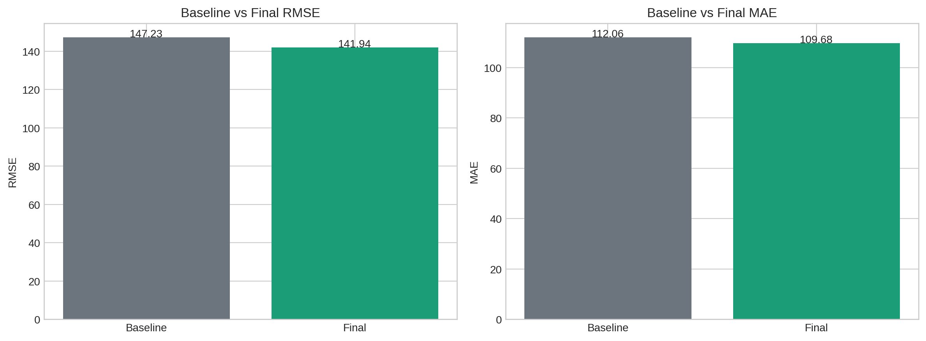
Results: Performance Comparison
Quantifiable Improvement:
Baseline(ridge_onehot) RMSE: 147.23
Final Ensemble RMSE: 141.94
Analysis:
By incorporating turn-level aggregates, we reduced the prediction error by approximately 3.6%.
Significance:
In the context of Elo ratings, a 5-point reduction in RMSE is significant, as it represents a much tighter fit to the player's actual skill level compared to just looking at their nickname.

Slide 12
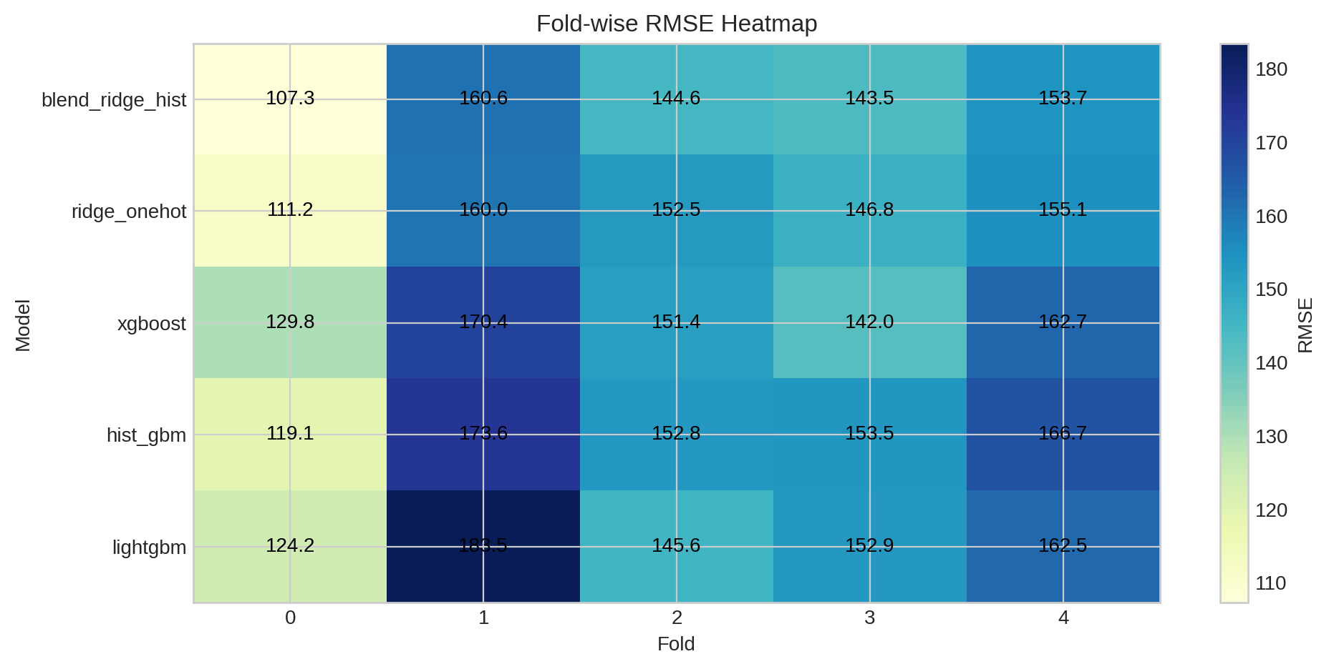
Results: Validation Stability Analysis
Consistency Across Folds: Our 5-Fold Grouped Cross-Validation shows moderate consistency with noticeable variation across folds.
Heatmap Insights:The final model (blend_ridge_hist) achieves RMSE values of 107.3, 160.6, 144.6, 143.5, and 153.7 across folds. Most folds (2–4) lie in the 140–155 range, while Fold 0 performs significantly better (~107) and Fold 1 is the most challenging (~160).
Interpretation:The model demonstrates strong average performance but non-trivial variability across folds, suggesting sensitivity to data splits. While it generalizes reasonably well, the variation indicates that performance depends on the underlying distribution of each fold, so overfitting cannot be completely ruled out.

Slide 13
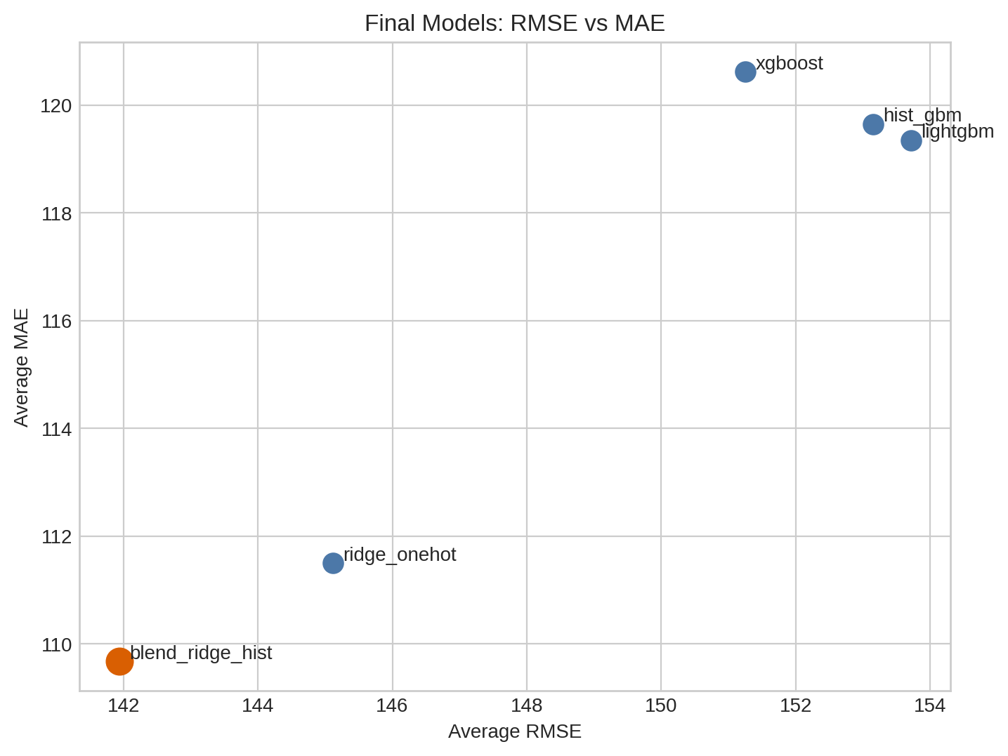
Results: Model Trade-offs & Insights
Ridge vs. Boosting: The Ridge model is excellent at capturing the 'who' (identity), while the Boosting model captures the 'how' (gameplay).
The Trade-off: Increasing the weight of the Boosting model improved performance on 'unseen' players but slightly degraded performance on 'known' veterans. The 0.65/0.35 split was chosen as the optimal balance for the overall dataset.
Error Bias: The model tends to be slightly more conservative, occasionally under-predicting the ratings of extreme outliers (very high or very low rated players).

Slide 14
Results: Final Validation Summary
Final Metrics:
RMSE: 141.9355
MAE: 109.6770
Submission Readiness: The model has been fully trained on the entire training set using the best parameters found during validation.
Conclusion: The integration of turn-level dynamics into a traditional metadata-based model successfully provides a more holistic view of player skill.

Slide 15
Work Division
Meet Kiyada
Chaitanya Singh
Kinjal Choudhary
Ankit Vaniya
Final model comparison, ensemble selection, notebook and report consolidation
Dataset understanding, validation design, leakage analysis, baseline evaluation support
Turn-level feature engineering, gameplay aggregation, feature documentation
Metadata feature engineering, baseline model development, baseline result analysis

Slide 16
Thank You

