Slide 1
Hospital Pricing & Network Affordability
What the same care costs across 3,236 hospitals — and what a health plan can do about it
Medicare hospital cost data · an AI-enabled analysis
Notes:
One-line hook: the same care, wildly different price. I'll give you the bottom line first, then the evidence. Data: public CMS Medicare hospital cost files (inpatient + outpatient), plus CMS ownership, rural/urban, location, and quality data. Audience note: keeping slides plain; happy to go as deep as you want on method.

Slide 2
THE BOTTOM LINE
The same care can cost up to 16× more — and the gap is mostly pricing, not better care
■ Wildly different prices. The same hospital treatment can cost up to 16× more at one hospital than another.
■ It's how they price, not what care costs. For-profit hospitals charge ~45% more — yet Medicare pays them slightly less. So it's a pricing choice, not higher costs.
■ Paying more doesn't buy better care. Price and hospital quality ratings have no relationship — and the most expensive hospitals tend to rate the worst.
■ The opportunity. Guide members to hospitals that are both cheaper and higher-quality (738 qualify).
■ The size. On for-profit hospitals alone, the overcharge is roughly $6–26 billion.
RECOMMENDATION: build the network around hospitals that are both affordable and high-quality — start where a cheaper, better option is already nearby.
Notes:
If you remember one slide, this is it — four findings build to one action, impact up front. Technical backing for each, in order: (1) within-DRG charge dispersion, p90/p10 median 3.67×, max ~16× (DRG 470). (2) For-profit premium +45% on submitted charge vs −9% on wage-index-adjusted Medicare payment — a falsification test isolating pricing from cost. (3) Spearman(cost index, CMS star) = −0.03. (4) Quality-gated steerage. (5) $25.8B excess premium, $12.9B at 50% recovery; I show 25/50/100% scenarios.

Slide 3
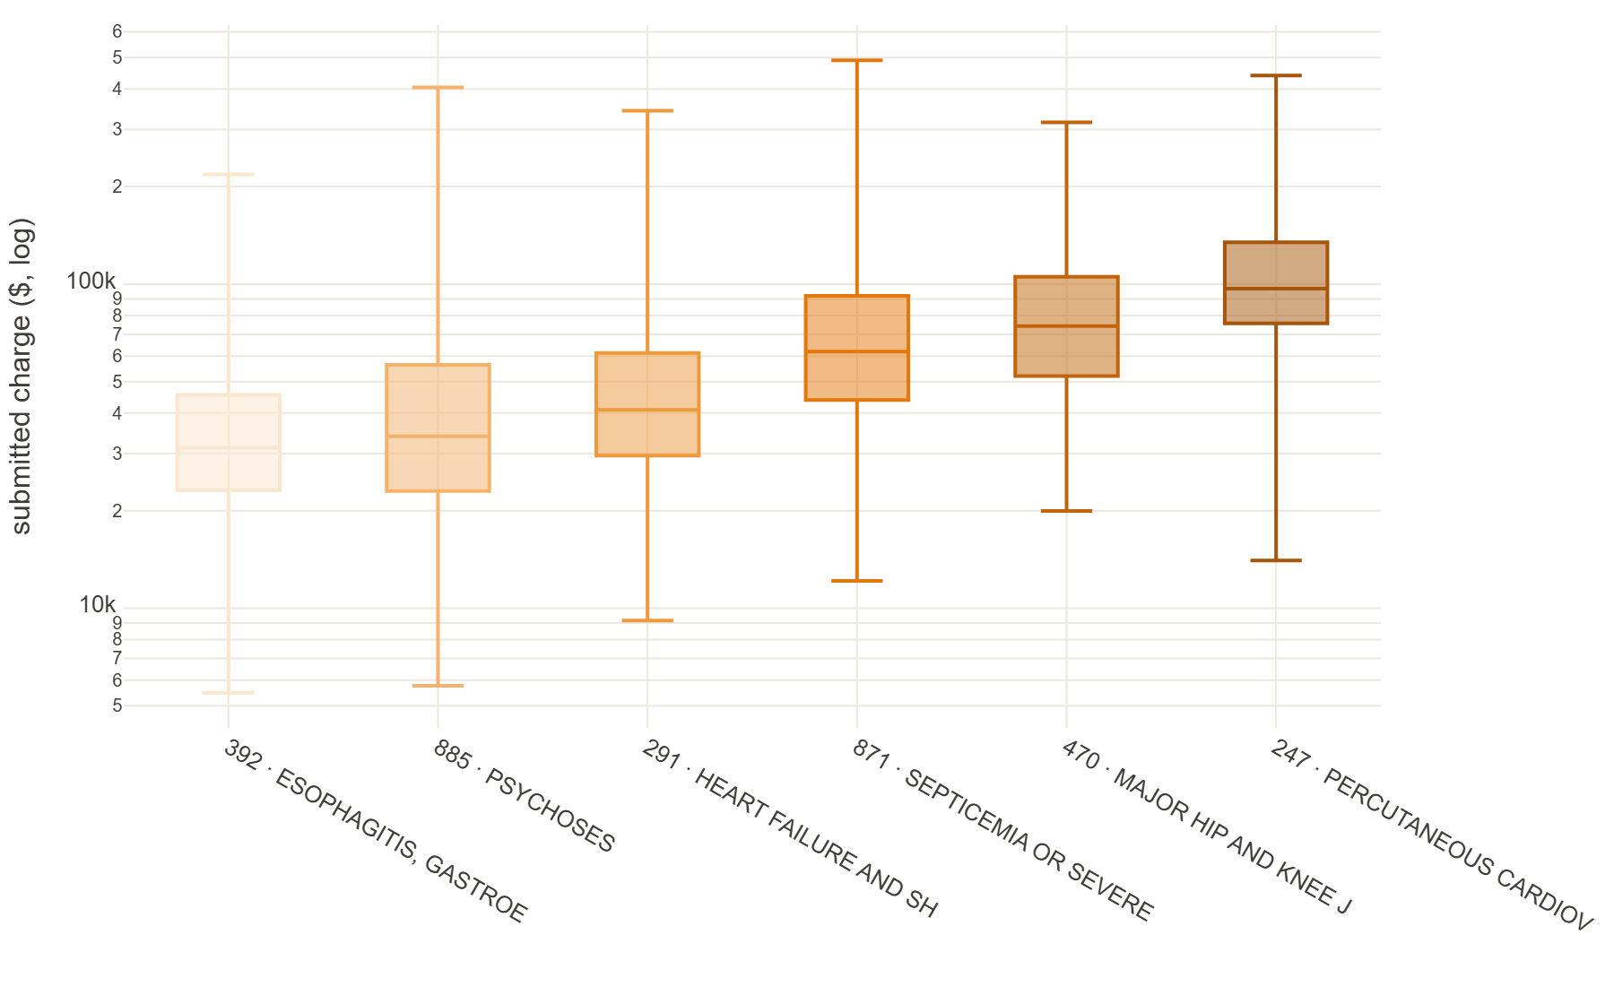
FINDING 1 · PRICE VARIES WILDLY
The same procedure, very different price
■ The question: which treatments vary most in price between hospitals?
■ For the same treatment, the priciest hospitals charge at least 3× more than the cheapest — true for 94% of common treatments.
■ The most extreme: a hip/knee replacement ran from about $20k to $316k — same surgery.
■ It's the hospital you walk into, not the care, that drives the difference.
Notes:
Insight Discovery, question 1 (cost variation across providers). Method: within-DRG dispersion so the procedure is held constant; median p90/p10 = 3.67×, 252/269 DRGs ≥3×. Worked example DRG 470 (major joint replacement), $19,972 → $315,717. Charges are skew-12.5, so everything uses medians/logs, never raw means. This is 'submitted charges' (the hospital's list price) — see the data slide for why that's the right signal for a %-of-charges payer.

Slide 4
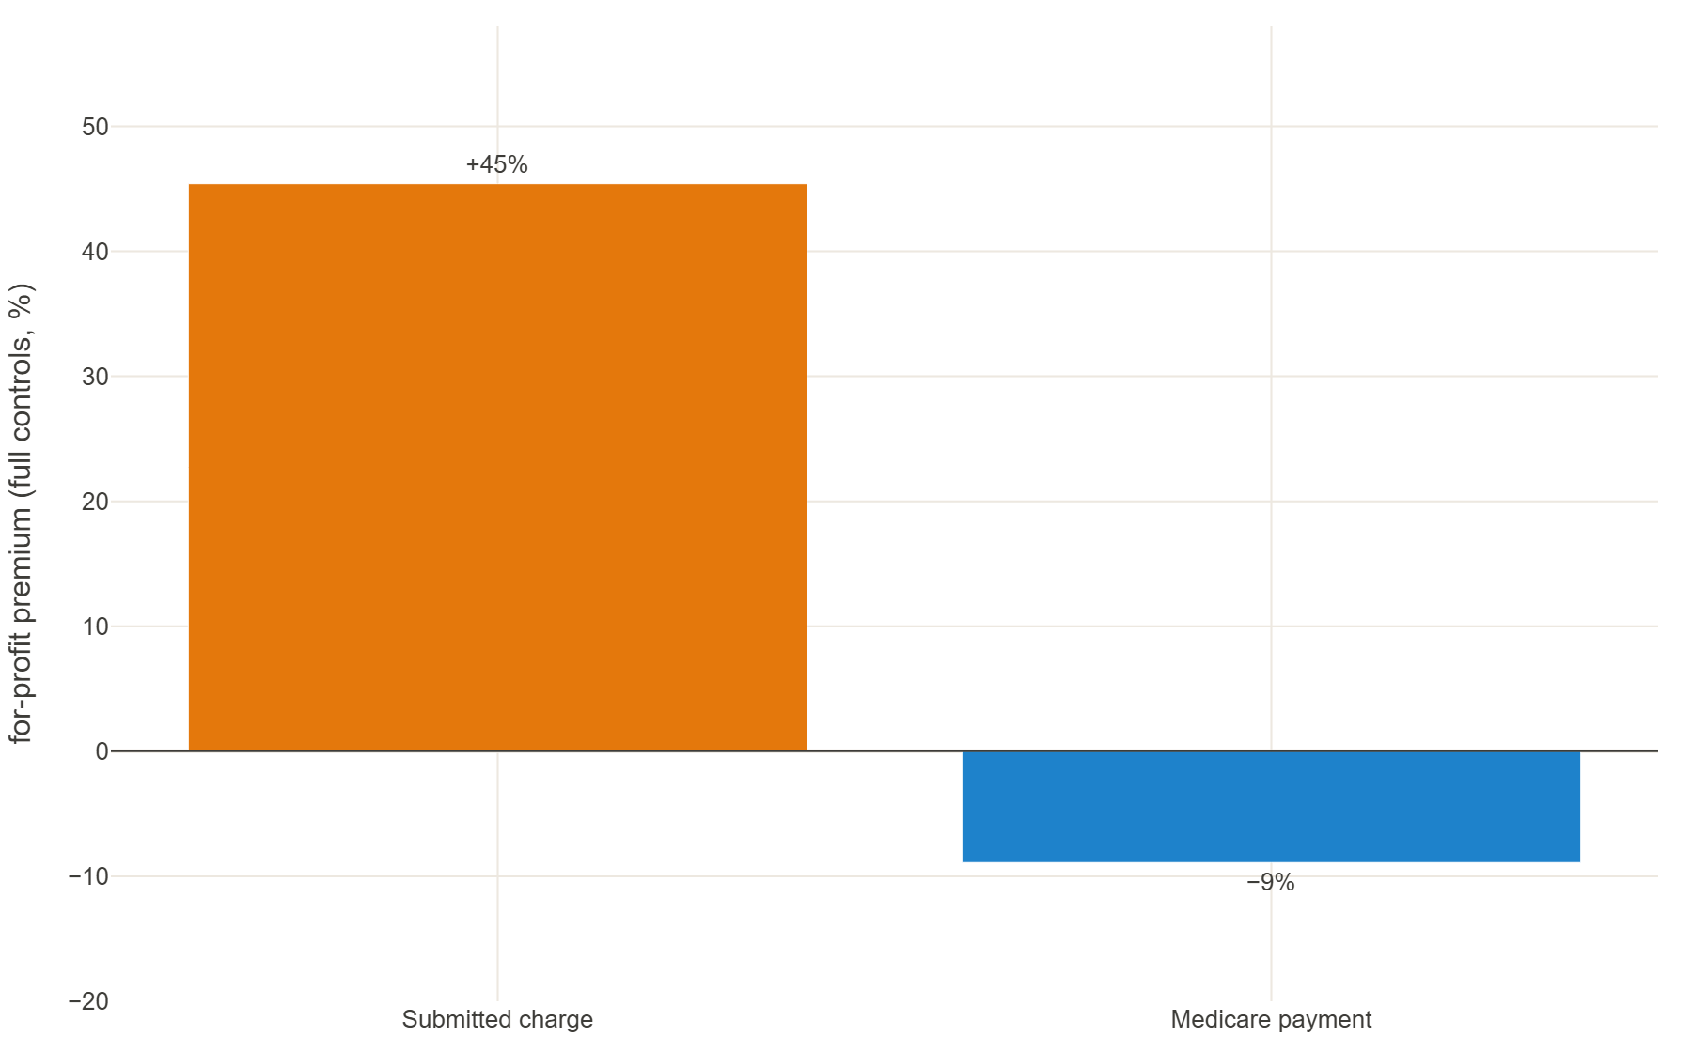
WHY — THE MECHANISM
It's a pricing choice, not a cost difference
■ For-profit hospitals charge about 45% more than others for comparable care — even after accounting for how sick patients are, where the hospital is, and what kind of hospital it is.
■ The tell: Medicare pays those same hospitals slightly LESS, not more.
■ Medicare's payment already adjusts for local labor costs — so 'things just cost more here' can't explain the gap.
■ This only hurts an insurer that pays a share of the hospital's list price.
Notes:
The acid test (falsification). Under identical controls the for-profit gap is +45% on submitted charge but −9% on formula-set Medicare payment. If it were genuine cost, the cost-based (wage-index-adjusted) Medicare payment would rise, not fall — so cost-of-living can't be the driver. Nested OLS on log charge; premium 62.5%→46.3% as controls are added. Pre-empts the obvious 'urban hospitals cost more' objection.

Slide 5
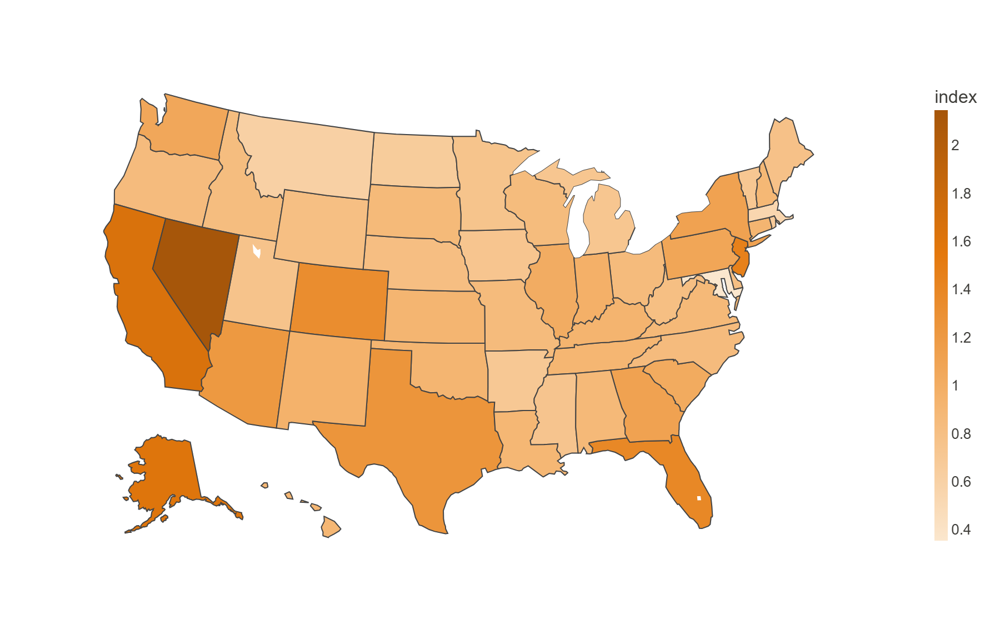
FINDING 2 · GEOGRAPHY
Where you are matters — a lot
■ The question: do prices follow a regional pattern?
■ Yes — the most expensive states charge about 6× more than the cheapest for the same care.
■ Maryland, which regulates hospital rates, is the cheapest; Nevada, California, New Jersey and Florida are the priciest.
■ Same treatment, very different price depending on the market.
Notes:
Insight Discovery, question 2 (regional patterns). State case-mix-adjusted charge index 0.35 (MD) → 2.14 (NV), ~6×. Maryland's all-payer rate-setting waiver is the natural experiment — lowest charges, highest regulated payment. In the driver model geography is 18% of charge variance vs only 5.4% of cost-based payment variance.

Slide 6
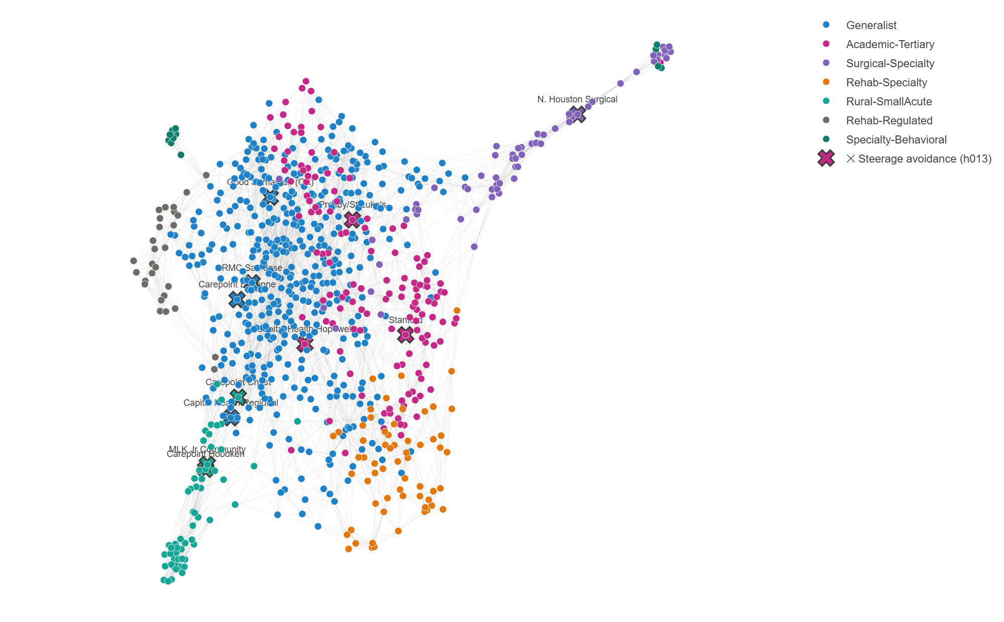
COMPARING FAIRLY
I group hospitals by the kind of care they actually do
■ I sorted all 3,236 hospitals into families by the mix of care they deliver — academic medical centers, community hospitals, surgical specialty centers, rural hospitals, and so on.
■ The groups came out of the data automatically — not hand-picked.
■ Why it matters: I compare each hospital only to its true peers, so 'our patients are just sicker' doesn't hold up.
■ In the live dashboard you can pick a hospital type and see the flagged ones.
Notes:
The network-analytics centerpiece (role fit) — linger and demo the live dropdowns. Method: cosine similarity of each hospital's service-mix vector → k-nearest-neighbour graph → Louvain community detection, 14 communities at modularity 0.70. Archetype-relative comparison is what makes the outlier list defensible (drops Cedars-Sinai as 'expensive like its academic peers', keeps Stanford).

Slide 7
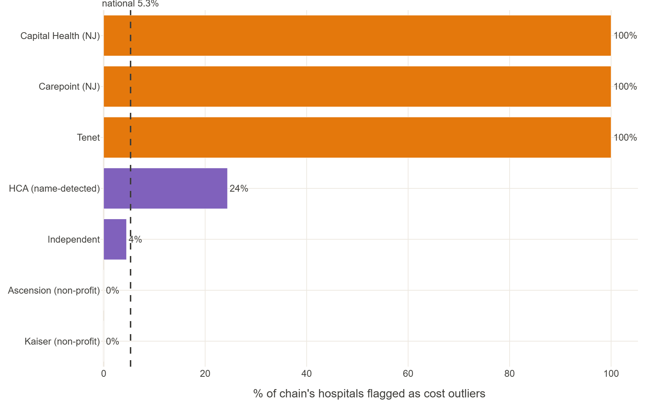
THE OVERCHARGERS
Which hospitals charge far more than their peers
■ I flagged hospitals that charge far above their true peers — in both hospital stays and outpatient care.
■ The same names show up in both: a handful of for-profit chains, plus a few high-end academic centers.
■ They cluster: a couple of for-profit chains are flagged ~100% of the time; non-profits almost never are.
■ It's a whole-hospital habit — flagged hospitals overcharge across nearly all their services, not just a few.
Notes:
Task instruction 3 (outlier detection), explicitly in BOTH settings + patterns. Inpatient = within-DRG top-charge providers (h006: Stanford, Cedars, HCA); outpatient = within-APC (h007: same names). Patterns (h008): cluster by state (CA/NJ/FL) and for-profit chain — Capital Health & Carepoint 100%, HCA 24% vs independents 4.5%. Repeat-offenders price ~95% of their service lines above the national 90th percentile.

Slide 8
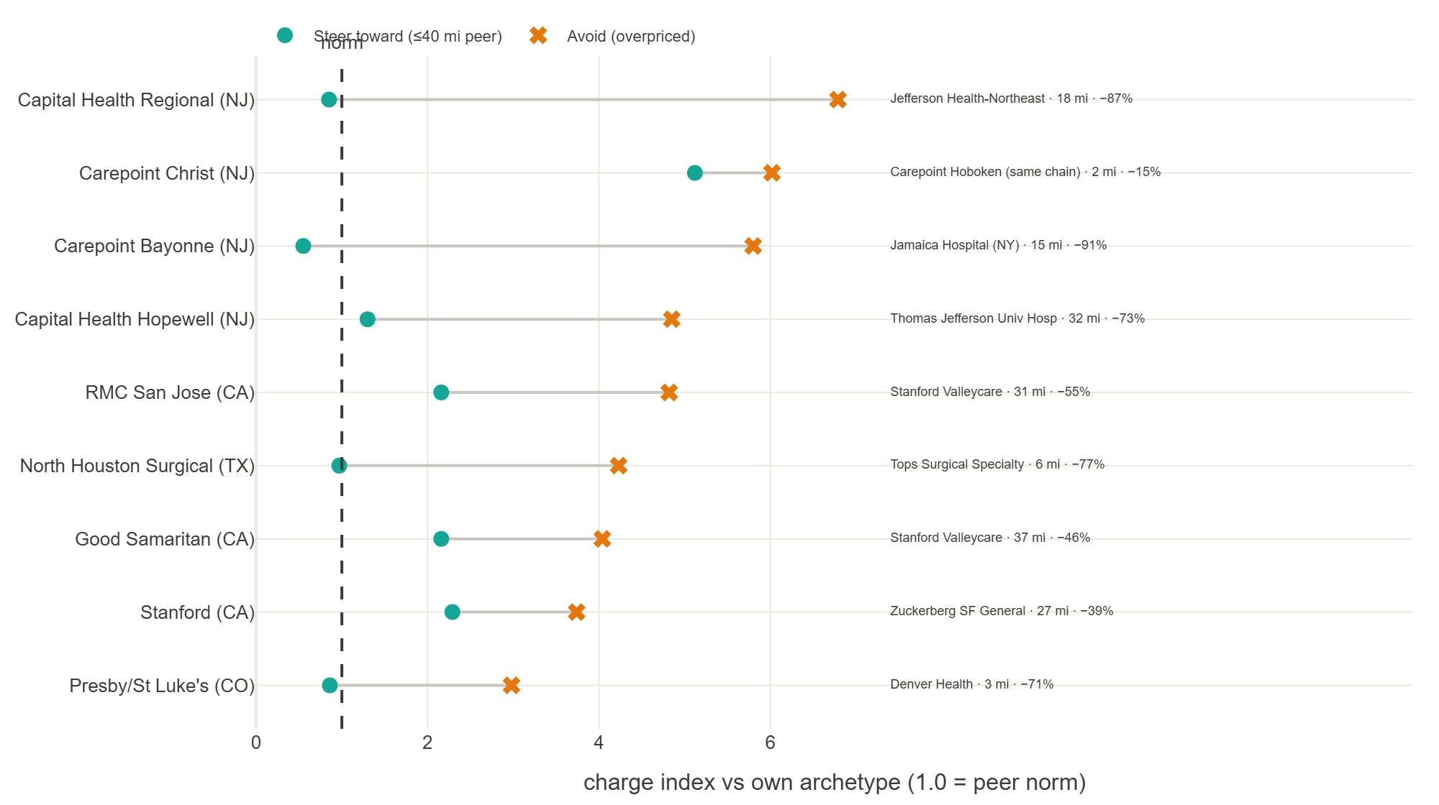
THE ACTION
Guide members to a cheaper, comparable hospital nearby
■ 'Steering' means pointing members to a cheaper, comparable hospital — and it has to be realistically close.
■ For 9 of the 11 worst offenders, there's a cheaper, comparable hospital within ~40 miles (one saves 87%).
■ For 2, there's no nearby alternative — steering can't help there; you negotiate rates instead.
Notes:
Steerage is TOWARD a lower-cost comparable peer (corrected from 'away from'), and it's inherently local (40-mi great-circle from ZIP centroids as a drive-time proxy). 9/11 locally steerable; the 2 misses are a network-adequacy gap (199–345 mi), an honest finding. Production needs true drive-time + in-network + adequacy.

Slide 9
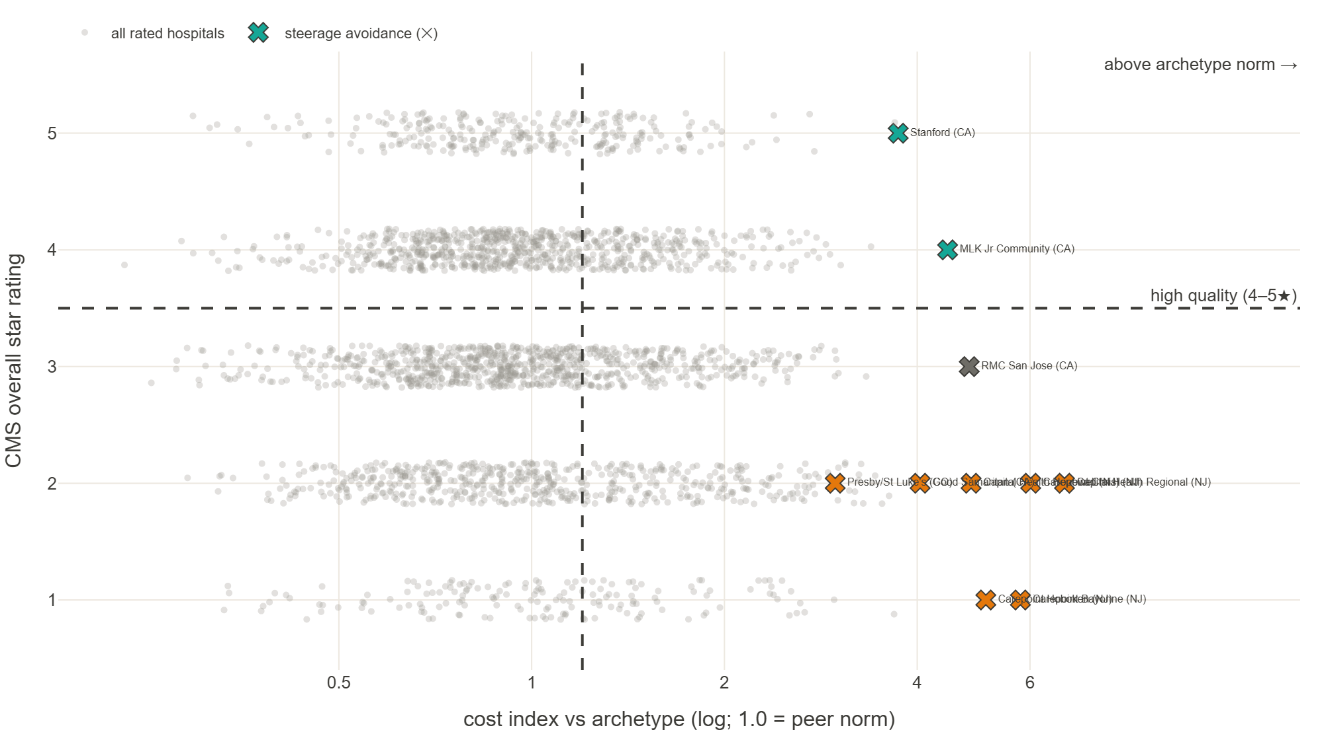
THE QUALITY CHECK
Paying more doesn't buy better care
■ I added the government's hospital quality star ratings (public data).
■ Price and quality are unrelated — and the most expensive hospitals actually rate the worst.
■ Most of our flagged hospitals are both expensive AND low-rated — steering away wins twice.
■ Two are expensive but genuinely excellent (Stanford, MLK) — the quality check keeps them off the avoid list.
Notes:
The strongest finding — and it was in-scope public CMS data (Hospital Compare). Spearman(cost, star) = −0.03; the ≥2× cost tier averages 2.74★ vs ~3.2 elsewhere. 7 of 10 rated flagged hospitals are 1–2★. The gate correctly protects the high-quality expensive ones. Cost is necessary, not sufficient — this closes the 'cost-only steerage is unsafe' objection.

Slide 10
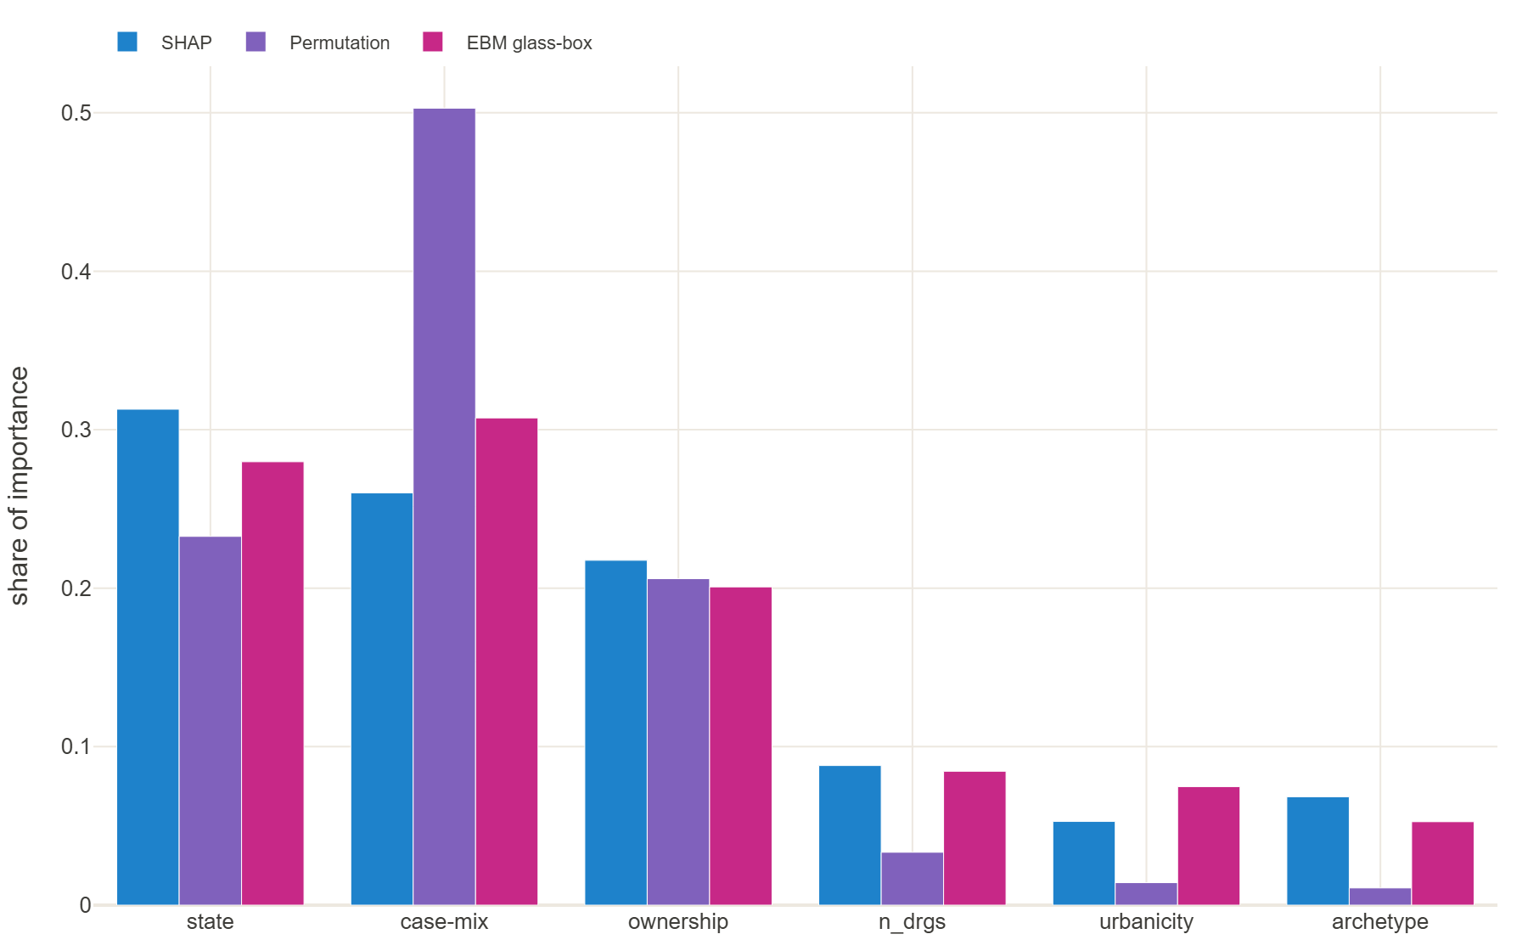
BONUS · WHAT DRIVES PRICE
Location, type of care, and ownership — not size
■ What actually predicts a hospital's price: where it is, the type and complexity of care, and who owns it.
■ Hospital size doesn't matter — bigger isn't cheaper per service.
■ Three independent methods all agree on the top drivers, so we trust the ranking.
■ The model predicts a hospital's cost to within about $11k (roughly 22%).
Notes:
Bonus question (cost predictors). Triangulated importance — interventional SHAP + permutation + glass-box EBM — perfectly seed-stable: state > case-mix > ownership; volume negligible. Reported with 5-fold CV MAE + dollar error, not R² alone (R² on a log target flatters fit). EBM vs LightGBM overlap within ~1 SD. All associational.

Slide 11
HOW IT WAS DONE
Two datasets, combined by the question — then supplemented
■ The core (the assignment): two public datasets — every hospital's inpatient (hospital-stay) and outpatient costs. I used both, throughout.
■ Explored & cleaned first: I profiled every table up front — distributions, missing values, outliers — fixed file-format/encoding issues, dropped CMS-suppressed and unreliable rows, and caught a data artifact before it could mislead.
■ Combined several ways, depending on the question: side-by-side per hospital (are hospitals pricey for stays also pricey outpatient? yes), pooled together for overall patterns, and blended into each hospital's 'care fingerprint' that defines the hospital families.
■ Then supplemented with more government data to answer the harder, more interesting questions: ownership, rural-vs-urban, location/distance, and quality ratings.
■ Assumption + check: list price as the affordability signal; and every headline finding repeats in the prior year — real patterns, not a one-year fluke.
Notes:
Task instruction 1 (data understanding & prep / INTEGRATION). The core ask was the inpatient + outpatient files — I used both, and combined them FOUR ways by analysis: (1) separately at natural grain (within-DRG inpatient + within-APC outpatient) for outlier detection; (2) stacked long (~210k rows) for pooled cost-index and markup; (3) merged per-hospital, both settings, for the pricing-culture correlation (IP vs OP charge index ρ=0.82) and the driver model; (4) a combined DRG+APC service-mix matrix for the archetype network. THEN supplemented with CMS HCRIS (ownership, rural margins → for-profit premium + rural exposure), RUCA (urbanicity), ZIP centroids (distance → in-market steerage), and Hospital Compare (quality). Cleaning: Latin-1→UTF-8, DECIMAL coercion, CCN key, RUCA=99 drop, cell-suppression noted, HCRIS margin fix. Stack: DuckDB, pandas, sklearn, statsmodels, plotly. Robustness = 2022 out-of-year holdout.

Slide 12
HOW IT WAS BUILT
AI-enabled analysis — a custom MCP server + an analyst skill
■ I built an MCP server (databench-mcp): a guard-railed tool surface the AI operates — ingest, profile, explore, model, network-analyze, visualize — with discipline built in (profile before modeling, no leakage).
■ An analyst skill defined and required the process below: nothing skipped or hand-waved; I set the hypotheses and corrected the approach when it was wrong.
■ Adversarially verified: findings stay 'suspect' until they survive a refutation check — this caught a self-prediction (data-leakage) bug and a data artifact before either reached a conclusion.
■ Evidence-tracked & self-improving: 18 of 18 conclusions trace to a logged result; the corrections become the tool's own to-do list.
The process the skill enforced, every time:
Understand
›
Get & clean data
›
Explore
›
Test each idea
›
Verify
›
Recommend
Notes:
Top line stays 'How it was built'; the differentiator is AI enablement. The step strip is plain-language but maps to CRISP-DM (Business + Data Understanding → Data Prep → Modeling → Evaluation → Deployment), enforced by the databench-analyst skill. Adversarial verification = findings default to suspect until they survive refutation (caught the charge-as-its-own-predictor leakage and the HCRIS total-margin artifact). 13-entry correction ledger; product-gap corrections become the tool's roadmap. If a technical interviewer wants the framework, CRISP-DM is the reference — happy to show the phase mapping.

Slide 13
FUTURE IMPROVEMENTS
Where this goes next — with real plan data
Analysis & data
Strengthen the AI platform
■ Care quality: do the factors that raise price also affect quality? Model both together.
■ Prove cause, not just correlation.
■ Network-aware steering: reachable, in-network, right service line, has capacity.
■ Real prices: negotiated insurer rates and member claims (we used Medicare list prices).
■ Access & equity: don't steer a community away from its only nearby hospital.
■ Automate & refresh: rebuild each year on fresher location and ownership data.
■ Expand the model set — plus a skill that picks the right method(s) for each question.
■ Prevent repeat mistakes: turn each correction into a guardrail.
■ Privacy & compliance guardrails (HIPAA / PHI, GDPR) built into the platform.
■ A shared knowledge base (wiki) so the method and evidence are reusable.
Notes:
Reorganized: Analysis & data vs the AI platform (enablement) — model-selection, prevention, and the wiki are all enablement. Technical detail: quality = drivers-of-quality + a joint multivariate price×quality model (cost–quality efficiency frontier); cause = Double-ML / causal forest (HHI + wage-index confounders); network-aware = drive-time + CMS time/distance adequacy + in-network + service-line + capacity; real prices = Transparency-in-Coverage MRFs + plan claims; access & equity = before down-tiering a community's only nearby hospital (the safety-net 'no local option' cases, e.g. MLK Jr), check the access impact; productionize = re-runnable recipe + drift monitoring, current ZIP/ZCTA + chain crosswalk + Critical Access Hospitals. AI platform: an expanded model library + a method-selection skill; a 'prevention' step that turns each correction into an automated guardrail (not just a tool fix); a knowledge-base wiki as institutional memory.

Slide 14
RECOMMENDATION
What we can do
■ Build the network on cost AND quality, not cost alone
■ Start where a cheaper, better hospital already exists nearby
■ Where there's no nearby option, negotiate rates instead
Interactive leave-behind: bitsandbeakers.github.io/databench-mcp/uhc-affordability/
Notes:
Voice track (bullets are headlines only): (1) Cost-only steering can send members to cheap-but-bad hospitals — the quality gate prevents that. (2) Start with the overpriced, low-quality hospitals that already have a cheaper, higher-quality neighbor within ~40 miles — the fast wins. (3) For the markets with no nearby alternative (the 2 'no local option' cases), steering can't help — negotiate rates or redesign the network there. Close on action, not findings; point them to the live dashboard as the interactive leave-behind.

